Slide 1
FUNDAMENTALS OF STATE REPLICATION

Slide 2
Definitions and Principles
1
First things first

Slide 3
A distributed system is one in which two or more processes work together to perform a task.

Slide 4
The total information processed by the system is known as its state.

Slide 5
Ensuring that all processes in the system have the same view of the state is known as
replication or (less precisely)
synchronization

Slide 6

Notes:
No matter what, partitions will happen. If nothing else, they happen constantly in time.

Slide 7
Notes:
Everything we’re about to cover ultimately is about which of these two cases we pick, and how we recover. If we’re always consistent, then we have to have some way to become available again later. If we’re always available, then we have to have some way to become consistent again later.

Slide 8
TWO CONFLICTING GOALS
WE CAN’T HAVE BOTH. ALL WE CAN DO IS PICK WHERE WE FALL BETWEEN THEM: C - - - - - - - - - - - - ? - - - - - - ? - - - - - - - - - - - - - - - - - - - - - - - - - - - - ? - - - - - - - - - - A
Consistency
A distributed system is consistent when all its processes agree on its state.
Availability
A distributed system is available when all its processes are allowed to modify the state.
Notes:
Whiteboard the CAP theorem
Prove that we can’t have both: two systems, sever the connection between them, make a change on one of them. Is it accepted? We’re not consistent. Is it rejected? We’re not available.
Where we fall on the line might change over time!

Slide 9
TWO COMPETING CHALLENGES
WE CAN’T AVOID BOTH. ALL WE CAN DO IS PICK WHERE WE FALL BETWEEN THEM: C - - - - - - - - - - - - ? - - - - - - ? - - - - - - - - - - - - - - - - - - - - - - - - - - - - ? - - - - - - - - - - A
Uncertainty
When a distributed system is consistent, we have eliminated its uncertainty.
Time
When a distributed system is available, it is functioning as if time were not a factor.

Slide 10
Standard Approaches
2
Don’t reinvent the wheel

Slide 11
Local Multiplayer

Slide 12
Lockstep Synchrony

Slide 13
Lockstep Synchrony

Slide 14
Lockstep Synchrony

Slide 15
Gotchas
Simulation must be completely deterministic… so be careful with the random number generator
Object references can’t use pointers
Notes:
Direct control: FPS
Indirect control: RTS, WoW

Slide 16
THIS IS GOOD ENOUGH*
Notes:
This is how Doom worked.

Slide 17
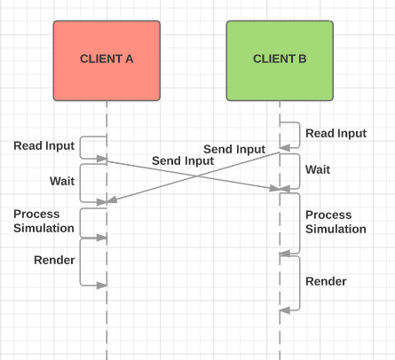
Lockstep Synchrony Sequence Diagram
Notes:
EXPLAIN SEQUENCE DIAGRAM, SLOPE OF LINES, ETC
RESPONSE TIME = HOWEVER LONG IT TAKES TO GET ALL CLIENTS

Slide 18
Lag
Direct control tasks: Noticed at 50ms, annoying at 100ms, fatal at 350ms+
Indirect control tasks: Noticed at 250ms, annoying at 1,000ms, fatal at 5,000ms+
“Ping time” is round trip; one way should generally be half that
Notes:
Direct control: FPS
Indirect control: RTS, WoW

Slide 19
Lockstep Synchrony
Lag is one-way trip time (or roughly ½ ping)
Clients are coupled; sim runs at speed of slowest client
Rejoining difficult to impossible
Consistency > Availability when operating normally
Availability > Consistency when partitioned
Notes:
Each node is always in perfect agreement with the rest, because it’s not available when it’s not.

Slide 20
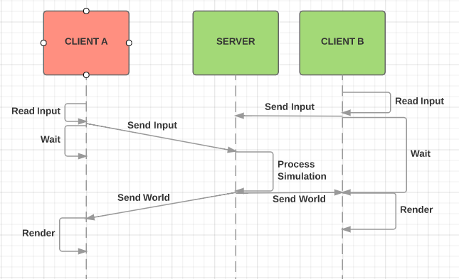
Dumb Client Synchrony Sequence Diagram
Notes:
Here’s Quake. This is also how web sites and most RTSs work. This is also how HALO’s coop play worked, prior to Reach.

Slide 21
Dumb Client Synchrony
Lag is full ping time
Clients are decoupled…
...but this is potentially unfair
Rejoining easy
Consistency > Availability when operating normally
Complete unavailable when partitioned
Notes:
TALK ABOUT DECOUPLING CAMERA FROM PLAYER, REMOVING THAT FROM STATE

Slide 22
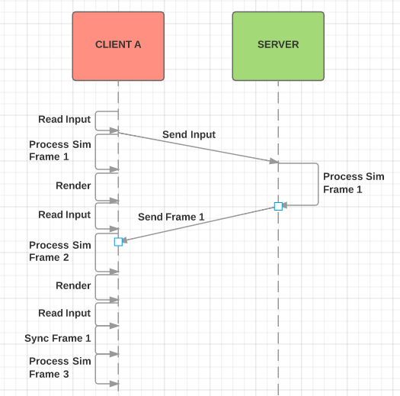
Optimistic Synchrony Sequence Diagram
Notes:
This is QuakeWorld.

Slide 23
Optimistic Synchrony
Effectively no lag on the player’s action
But the player is always acting in the future
Availability > Consistency in normal operation…
…in fact never consistent
Failure cases:
Sometimes the player’s action is rejected
The player’s always aiming behind targets

Slide 24
Optimistic Synchrony: Player Snap-Back
Remember player’s sequence of moves
Snap back to divergent frame
Replay sequence of moves from now-corrected state
Display this to the player in some suitable manner
Notes:
TALK ABOUT DECOUPLING CAMERA FROM PLAYER, REMOVING THAT FROM STATE

Slide 25
Optimistic Synchrony: Target Prediction
Track momentum for all remote entities
Project remote entities forward in time from last-known frame to current frame
When errors arise, they will be in the past. Rewind, integrate correct state, and project forward to the present again
Display this to the player in some suitable manner
For perceived fairness, server must evaluate critical actions from the known historical perspective of the player
Notes:
TALK ABOUT DECOUPLING CAMERA FROM PLAYER, REMOVING THAT FROM STATE

Slide 26
Where’s the simulation?
Just on the server:
Simpler to implement
Highly secure
Lag on every action
Very dependent on simulation frame rate
Call of Duty and World of Warcraft work this way
On both client and server:
Player’s actions are lag-free
Runs well at lower frame rates
Physics interactions between controlled objects (e.g. players) still subject to full lag
HALO, Destiny and Assassin’s Creed work this way

Slide 27
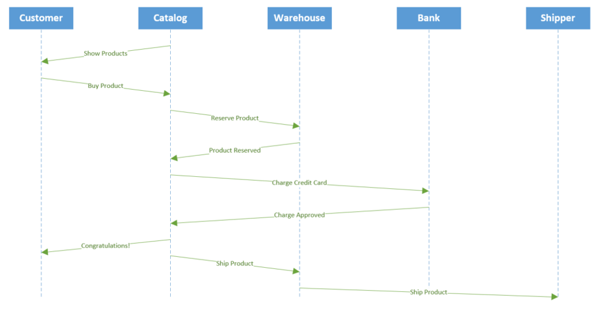
Eventual-Correctness Synchrony Sequence Diagram
Notes:
Amazon, Facebook, etc.

Slide 28
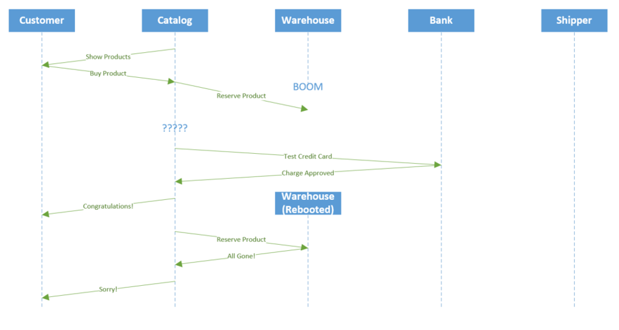
Eventual-Correctness Synchrony Sequence Diagram

Slide 29
Reality Bites
3
If this is so easy, why doesn’t everybody do it?

Slide 30
What Can Possibly Go Wrong
Lag
Jitter
Packet loss
Limited bandwidth

Slide 31
Lag
Lag interferes with the player’s sense of control.
It comes from:
Processing delay (number of hops)
Queuing delay (congestion)
Transmission delay (bandwidth)
Propagation delay (distance)
Handle using the previously-mentioned techniques.

Slide 32
Jitter
Jitter is variation in lag. It disrupts our lag-tolerance schemes and makes the simulation choppy.
It comes from:
Variation in routing (congestion and outages)
Queuing (congestion)
Packet loss
Handle by deepening lag compensation; only restore “normal” levels gradually.

Slide 33
Packet Loss
Packet loss reduces bandwidth and introduces jitter.
It comes from:
Hardware faults
Analog noise and radio interference
Congestion
TCP handles packet loss automatically (if poorly); for UDP we have to develop special schemes.

Slide 34
Limited Bandwidth
Limited bandwidth effectively introduces lag.
It comes from:
Poor infrastructure investment
Lack of competition for “last mile” service
Bad router design decisions
Handle it through compression or delaying less-important updates. A good rule of thumb is to fit within 8KB/sec.
Notes:
UO was 400 bytes down; up was irrelevant and tiny.

Slide 35
Easy Mode
4
Quick and dirty networking for GAM projects

Slide 36
Easy Mode
Use “dumb client” networking
Use TCP
Don’t run on wifi
If needed for your game, project simulation forward one frame while waiting for the next frame to arrive. Patch over errors using simple linear interpolation.
Notes:
UO was 400 bytes down; up was irrelevant and tiny.

Slide 37
Summary
5
And in conclusion...

Slide 38
Summary
A distributed system is one in which state is modified by more than one process…
...which means processes will inevitably disagree on what that state actually is.
Either halt until disagreement is resolved (consistency over availability)...
...or keep on working and cope with the disagreement (availability over consistency)

Slide 39
Networking Models
Lockstep
All clients send input to each other, then advance simulation one frame together.
Dumb Client
All clients send input to server, which advances simulation one frame itself and sends results back to clients.
Optimistic
All clients send input to server and advance the simulation locally, patching up discrepancies as they arise.

Slide 41
CREDITS
Special thanks to all the people who made and released these awesome resources for free:
Presentation template by SlidesCarnival
Photographs by Unsplash

Slide 42

PRESENTATION DESIGN
This presentation uses the following typographies and colors:
Titles: Oswald
Body copy: Source Sans Pro
You can download the fonts on this page:
https://www.google.com/fonts#UsePlace:use/Collection:Source+Sans+Pro:400,700|Oswald:400,700
Click on the “arrow button” that appears on the top right
Sky blue #00cef6 / Bright green #aff000 / Blue #3c78d8 / Dark blue #28324a
You don’t need to keep this slide in your presentation. It’s only here to serve you as a design guide if you need to create new slides or download the fonts to edit the presentation in PowerPoint®

Slide 43
SlidesCarnival icons are editable shapes.
This means that you can:
Resize them without losing quality.
Change fill color and opacity.
Change line color, width and style.
Isn’t that nice? :)
Examples:

