Slide 1
Final Review

Slide 2
FRIDAY 12/15 3:00PM MICHELANGELO

Slide 3
Final Exam
Same format as before: about equal parts vocabulary, short-answer concepts, and long-response application of ideas.
One 8.5”x11” handwritten page of notes
About 66% from post-midterm, 33% pre-
About 66% from lectures, 33% from reading assignments (entry tickets)
24% of final grade

Slide 4
Threat modeling is a process by which a system is methodically analyzed from an attacker’s perspective, to identify attack goals, evaluate the risks they pose and mitigate their vulnerabilities.

Slide 5
Zero-Days and “Hats”
Zero-days are security vulnerabilities that have not yet been revealed: Vendors have had “zero days” to mitigate them.
Hackers are just people who use systems in unintended ways. The term is neither good nor bad.
White hats disclose zero-days to vendors before making them public.
Black hats keep zero-days secret to exploit them themselves.
Gray hats make zero-days public.

Slide 6
Threat Actors
State actors have government (i.e. “infinite”) resources, but varying motives.
Organized crime have resources proportional to the economic value of the attack.
Insiders have access to more information, but may be defeated by anti-repudiation measures.
Hacktivists have diffuse resources but varying skill and motivation.
Script kiddies are plentiful but have low skill..

Slide 7
STRIDE
Spoofing: Pretending to be another user
Tampering: Modifying data outside of normal usage
Repudiation: Erasing the history of an action
Information disclosure: Reading secrets
Denial of service: Preventing normal operation
Elevation of privilege: Performing forbidden actions

Slide 8
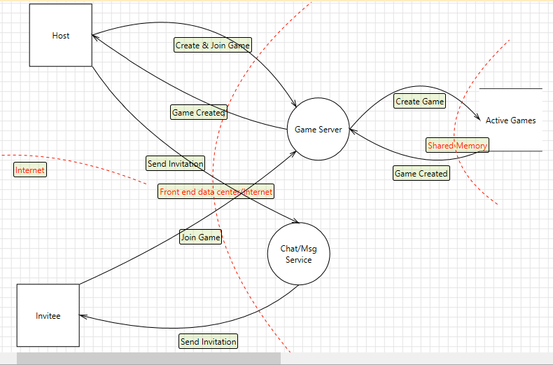
Data Flow Diagrams
Threats come from data, so to create a threat model we must document what our data is, where it comes from and goes to, and how it is handled along the way.

Slide 9
Data Flow Diagrams
Processes: Code (not an OS process)
External Interactors: A source or sink of data that’s outside your control (e.g., the client)
Data Stores: Something that holds data—memory, a file, a database
Data Flow: The transfer of data from one element to another
Trust Boundary: Border between two elements that do not trust each other

Slide 10
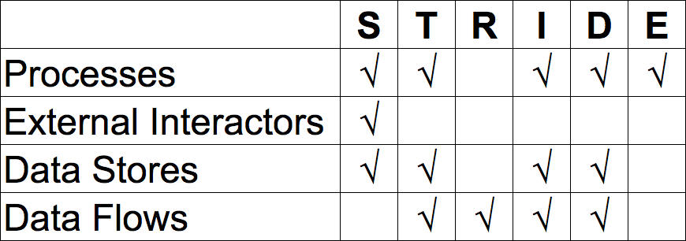
STRIDE x Elements

Slide 11
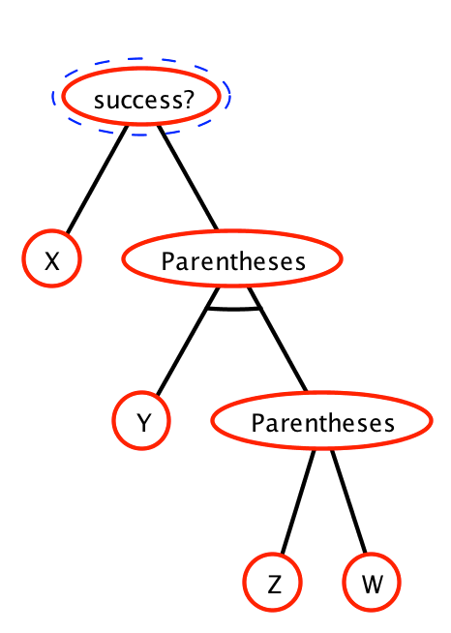
Attack Trees
Answers the question “What has to be true for an attacker to successfully perform this attack?”
Root node is the attack itself
Siblings connected with an arc must all be true (AND)
Siblings with no arc just need one to be true (OR)

Slide 12
Risk Rating
Perfect security is impossible, so we aim for “good enough”. Making that decision wisely requires balancing costs versus benefits.
Risk = Likelihood x Cost
REAL Rating:
Reward: What’s it worth to the attacker?
Effort: How little does the attacker have to work?
Audience: How many people will be affected?
Level of Skill: How many attackers have the skill required to carry out the attack.

Slide 13
Mitigations
A vulnerability is where an attacker has one or more paths from the bottom of an attack tree up to the top.
A mitigation blocks a node, preventing the attacker from making progress.
A tree is fully mitigated if there are no paths from the bottom to the top.
A tree has defense in depth if it is still fully mitigated even when one or more mitigations are removed.

Slide 14
Mitigation Toolbox
STRIDE categories imply mitigations:
Spoofing —> authentication
Tampering —> signing
Repudiation —> auditing
Information disclosure —> encryption
Denial of service —> auditing & filtering
Elevation of privilege —> defensive coding

Slide 15
Auditing
Keeping a log of all important activity, so that it can be reviewed after an incident
To be effective against repudiation, auditing requires authenticating users
To be effective against denial of service, either requires authenticating users or accepting the risk that some innocent users will be punished

Slide 16
Filtering
Rejecting invalid or malicious input as quickly as possible.
Can disclose information when done naively.
Can become a denial of service vector against legitimate users when done without authentication.

Slide 17
Authentication
An entity can be authenticated by something it is, something it has or something it knows
In information security, most often we rely on the last. In other words, the entity must demonstrate possession of a shared secret.

Slide 18
Hashes
A hash function reduces an arbitrary message to a fixed-size representation
A cryptographic hash is one that can’t* be reversed; where the message cannot* be modified without changing the hash; and where a collision cannot* be created.
“Cannot” in cryptography means “cannot in less than brute-force time”
Sometimes an algorithm gets broken, meaning that less-than-brute-force attacks against it have been discovered [for example, MD5]

Slide 19
Hash Algorithms
MD5 [broken, but still in use], SHA1 (128 bits), SHA256 (256 bits), SHA512
Take blocks of data and perform simple bit operations—shifts, rotates, XORs—on them repeatedly
Around 300,000,000 blocks a second on modern CPUs… 100 times that on GPUs.
As computing power increases, hash algorithms must become more complex
Collisions can be found in square-root time thanks to the birthday paradox
Notes:
2^128 hash space / 2^40 hashes/second = 10 billion x the lifespan of the universe

Slide 20
Signing
A signature seeks to prove that a document has not been tampered with and came from an authentic source
A cryptographic hash algorithm can prevent tampering
Including a shared secret in the hash can prove authenticity

Slide 21
Encryption
An encryption algorithm transforms a document so that it cannot* be read without the encryption key (a shared secret)
In a symmetric algorithm, one key both encrypts and decrypts
In an asymmetric algorithm, there are two keys: What one key encrypts, the other decrypts (and vice versa, usually)
“Cannot” in cryptography again means “cannot in less than brute-force time”

Slide 22
Symmetric Encryption
DES, 3DES, AES
Take blocks of data, XOR them against a key, mutate the block and key and XOR again, repeatedly
Around 200,000,000 blocks per second on modern hardware
The major challenge of symmetric encryption is key distribution—communicating the shared secret of the key between the parties of the conversation

Slide 23
Asymmetric Encryption
RSA or elliptic curve
Vastly (100,000x) slower than symmetric encryption, and only suited to small messages
Primarily used for key exchange (generate a random symmetric key and then encrypt it asymmetrically) and message authentication (calculate a hash and then encrypt it asymmetrically)

Slide 24
Creating an Authentication Scheme
Use a hash to demonstrate possession of a shared secret without revealing the secret itself
Incorporate a nonce in the hash to prevent the hash from being reused as if it were just a different shared secret
A nonce must be known to both parties, must change over time, and cannot be influenced by an attacker… but it does not need to be secret
Decouple servers by using tokens, which are effectively encrypted messages from one server to another passed through the user

Slide 25
Cryptographic Protocols
AES, RSA, SHA are cryptographic algorithms—mathematical procedures used to transform data.
A cryptographic protocol is a series of steps and message exchanges between entities to achieve a specific cryptographic result… in other words, recipes that tell us how to apply algorithms.
Protocols are effectively templates for writing programs, and so are created the same way we threat model programs: identify objectives, model data flows, look for potential attacks and mitigate them.

Slide 26
WPA2 Protocol
“Wireless Protected Access, version 2”
Goals are to verify both client and router, and encrypt traffic against external (but not internal) listeners
Router and client each generate nonces, then demonstrate knowledge of shared secret (the wifi password) by calculating hashes of the nonces
The password, nonces and hashes are all combined to generate a symmetric encryption key

Slide 27
SSL / TLS
“Secure Sockets Layer”, which was renamed to “Transport Layer Security” when legacy-breaking changes were introduced
Goals are to verify identity of the server and encrypt traffic against all listeners
Client generates a key, then submits it to server encrypted with public half of server’s asymmetric encryption key…
…but how does the client know that’s the server’s public key?

Slide 28
TLS Certificate Chain
The owner of foo.bar verifies their identity to Verisign (e.g.)
The owner of foo.bar creates an asymmetric key pair, and asks Verisign to encrypt the hash of the public key with Verisign’s private key
The client calculates the hash of foo.bar’s public key, gets Verisign’s public key, decrypts the encrypted hash and sees that they match…
…but how does the client know that’s Verisign’s public key?
The root of the chain of trust lives on each PC… and can be tampered with, maliciously or incompetently.

Slide 29
Bitcoin
Goals are to transfer value between entities without possibility of tampering or repudiation, and without requiring a central authority
The history of all transactions is called a ledger. Ultimately, Bitcoin relies on everyone agreeing which copy of the ledger is the valid one.
Each block of changes to the ledger is hashed. A block is only valid if its hash begins with a certain number of zeroes.
Discovering a valid block is like winning the lottery. Searching for valid blocks is called mining.

Slide 30
Bitcoin Repudiation
To repudiate a transaction, Alice would have to construct an alternate copy of the ledger without that transaction.
A ledger copy is only valid if all the hashes are correct, so Alice would have to mine herself.
The one accepted copy of the ledger is the one with the most hashes in it, so Alice would have to not only replace the existing one, but also replace all the work that got done to the true ledger while she was doing her mining.
Thus, Alice would need more hashing power than the rest of the world combined to keep up.

Slide 31
How Passwords Get Stolen
A minor danger of passwords is an attacker brute-force trying random passwords. Not possible with a well-implemented site.
A major danger of passwords is an attacker downloading the password database. So the developer stores hashes, not passwords…
…so the attacker generates a rainbow table of hashes…
…so the developer stores salted hashes.
A password that is strong enough to resist modern GPU cracking is probably too hard to remember… “correcthorsebatterystaple” can’t be trusted.

Slide 32
Passwords Suck
The randomness contained in a password is called entropy. More is better.
People are bad at generating entropy.
People are bad at remembering high-entropy passwords.
Failing to remember passwords requires sites to have password-reset mechanisms, which are themselves the #1 way accounts get compromised.
Use two-factor authentication wherever possible.
Use a password manager.

Slide 33
Script Injection
Do not run other people’s code in your system.
Watch out for places where user input might be interpreted as code. For example: SQL injection and script injection.
Making sure that user input does not contain injected code is called sanitizing it. This can be done through blacklists (lists of known-bad constructs), but is better done through whitelists (lists of known-good constructs).
Unsafe input can either be deleted/discarded, or can be rendered safe by escaping it.

Slide 34
Buffer Overrun
By the nature of its memory management, C/C++ is highly vulnerable to buffer overruns: reading or writing beyond the space allocated for an array or buffer.
Anytime the attacker can control the contents of your memory, they have the potential ability to put their own code there and trick you into executing it.
Use every tool available to find and prevent these errors: strict warnings, lint, etc.
If performance is less important than security—and it usually is for Internet software—use another language.

Slide 35
Error Handling
It is almost always safer to crash outright than to continue in an unexpected or misunderstood state.
When logging errors, be careful not to leak information.
Likewise, when logging errors, be careful about string processing and accessing the hard drive.

Slide 36
A distributed system is one in which two or more processes work together to achieve a computational result.

Slide 37


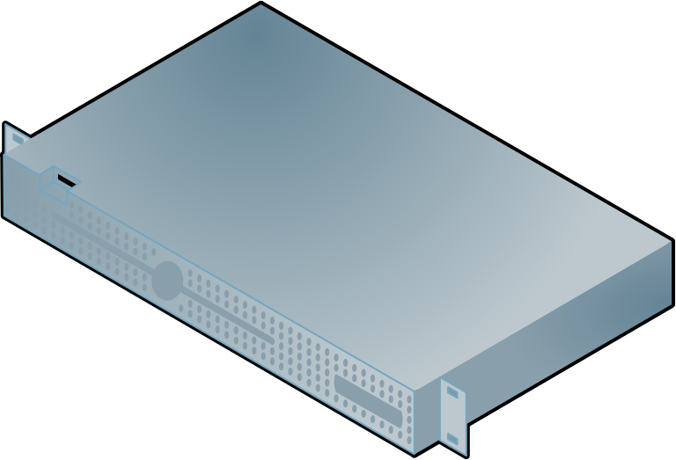
Distributed System Tasks
All distributed systems perform the same tasks, no matter what the scale. All that changes are the tools (software, languages, hardware, etc.) used
Balance load
Handle socket traffic
Interpret requests
Perform calculations
Query data
Cache data
Compose responses

Slide 38
Server Quantity
Even small numbers of inexpensive servers can handle 10s to 100s of simultaneous users
“Simultaneous users” will always be a mere fraction of total users
Facebook serves about 1.5 billion users with about 250,000 servers
Cloud computing just means “renting servers from someone else, by the day, hour or even minute”
Microsoft and Google have 1M+ servers, Amazon 2M+.
Netflix has zero.

Slide 39
CAP Theorem
The total information processed by a system is known as its state
Ensuring that all processes in a distributed system have the same view of the state is known as synchronization
The CAP Theorem tells us that when the possibility of a Partition exists (which it always does), we can either choose to be Consistent or Available, but never both at the same time.
Juggling consistency versus availability is the key challenge of synchronization

Slide 40
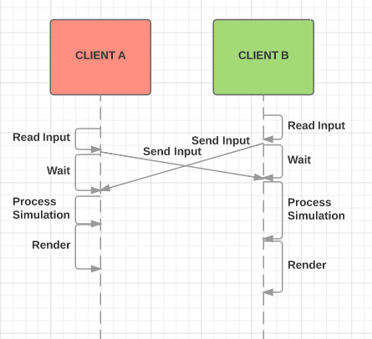
Lockstep Synchrony [Doom]
Simplest possible distributed system:
Every node has a complete copy of state
Every requested change is sent to every node
All nodes apply the changes at the same time once every node has received every change
CONSISTENT but not AVAILABLE

Slide 41
Sequence Diagram
Each line represents a process
Time runs from top to bottom
Each arrow is a function call or message
Slope of arrow represents lag (delay between request and result)

Slide 42
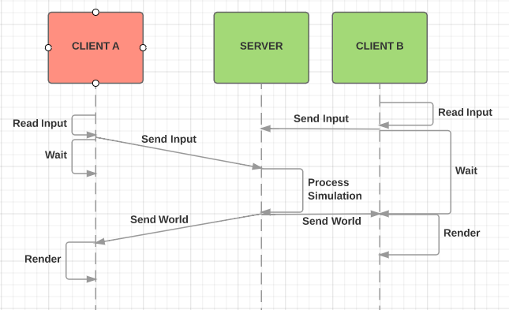
Client-Server Synchrony [Quake; HTTP]
More secure:
Only one copy of state (at host)
All nodes send change requests to host
Host sends new state to nodes
Nodes render new state
CONSISTENT but not AVAILABLE

Slide 43
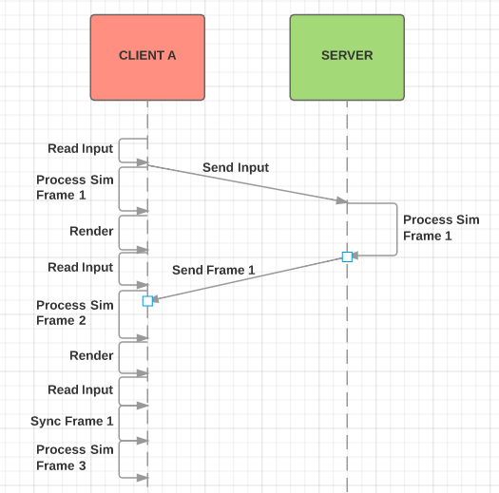
Optimistic Synchrony [all the cool kids]
More responsive:
One master copy of state, but each client has local copy
All nodes send change requests but also apply change to local copy
Local state is always out of date, so prediction is necessary
Conflicts are resolved as they are detected
AVAILABLE but not CONSISTENT

Slide 44
Networked Game “Easy Mode”
Use “client/server” (“dumb client”) networking…less burden on precise determinism, and known-good server for (re)join-in-progress
Use TCP… if packets are only very rarely dropped, TCP and UDP are basically identical
Packets shouldn’t get dropped if you only run on ethernet

Slide 45
Difficulties
Lag is caused by latency plus transmission time
Latency is increased by distance (both logical and physical), congestion and packet loss. It is usually measured by ping time, which is double the actual amount.
Transmission time is effectively packet size divided by bandwidth. Available bandwidth is always lower than claimed ISP speeds. Xbox Live requires games to run with as little as 8KB/sec.
Packet loss shouldn’t happen on wired networks, but is endemic on wireless ones
Jitter is unpredictable swings in lag

Slide 46
HTTP
HTTP was invented to fulfill the vision of the memex: a networked system that fetches documents and renders connections between them
Those inter-document connections are called hyperlinks, and documents containing them are called hypertext.
Hyperlinks consist of uniform resource locators (URLs). An URL describes where to find a document and how to retrieve it.
The description of where to find a document is a uniform resource identifier. All URLs are URIs.

Slide 47
HTTP Protocol
Fundamentally client-driven: The client opens a connection, makes one or more requests, then closes the connection.
Connection is made to an IP address, but URLs feature domain names. Thus, the HTTP protocol requires specifying the target domain name as part of the request.
Requests consist of a verb, an URL, headers and an optional body. Responses consist of a status code, headers and a body.

Slide 48
HTTP Protocol (continued)
Verbs: GET, POST, HEAD, PUT (rarely), DELETE (almost never)
Status codes: 2xx = success, 3xx = redirection, 4xx = bad request, 5xx = server error
Headers: Control various aspects of the request and response, such as target host, the content type of the body, how long to cache the response, user authentication, etc.
Cookies: A special type of header used to attach state to future client requests.

Slide 49
Web Services
The HTTP protocol has become in effect a new transport layer on top of the ATIN stack.
A basic challenge of writing web services is deciding what tasks require push from server to client, versus which can settle for the much-easier pull request from the client.
Web services generally focus on storing data objects, and providing CRUDI operations for them: create, read, update, delete and index.

Slide 50
FRIDAY 12/15 3:00PM MICHELANGELO

Slide 52
Credits
Special thanks to all the people who made and released these awesome resources for free:
Presentation template by SlidesCarnival
Photographs by Unsplash

Slide 53

Presentation design
This presentations uses the following typographies and colors:
Titles: Merriweather
Body copy: Raleway
You can download the fonts on this page:
https://www.google.com/fonts#UsePlace:use/Collection:Merriweather:400,400italic,700,700italic|Raleway:400,700
Click on the “arrow button” that appears on the top right
Dark gray #222222
Wine #a8122a
Cream #f5f1e0
You don’t need to keep this slide in your presentation. It’s only here to serve you as a design guide if you need to create new slides or download the fonts to edit the presentation in PowerPoint®

Slide 54
SlidesCarnival icons are editable shapes.
This means that you can:
Resize them without losing quality.
Change fill color and opacity.
Change line color, width and style.
Isn’t that nice? :)
Examples:

