Slide 1
Almost Done

Slide 2
Semester Review (Friday)
Security stuff
DFDs, attack trees
Encryption
Optimistic replication
State replication
SSL
Berkeley API
HTTP
Example HTTP usage

Slide 3
CS 261 Topics
Game networking
Real-time networked physics
Running servers
Optimize network code/procedures
AWS
Real-world debugging and interesting fixes
More recent examples (Overwatch)
MMO architecture
Large-scale web and database architecture
Game security

Slide 4
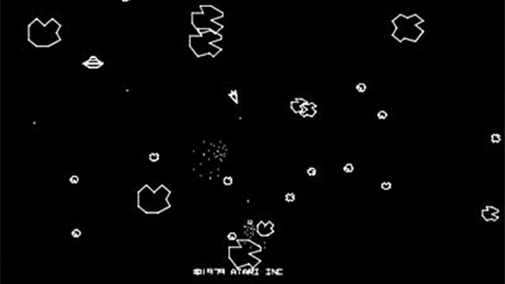
Semester Project: Massively Multiplayer Asteroids
Login system (server + database)
Inventory/catalog system (server + db)
Cloud development
State replication (dumb-client and optimistic)
Networked physics
Reliable UDP
Prioritization and selective replication

Slide 5
Quick Hits
Run a server at home
How BitTorrent works
How TOR works
How Folding@Home works
How satellite connections work

Slide 6
Network programming = PROGRAMMING + DUST MANAGEMENT

Slide 7
DUST Management: Danger
Create the simplest possible DFD
STRIDE x Elements
Can this message be spoofed?
What happens if it’s tampered with?
Do I care about repudiation?
Does this message contain secrets?
What prevents a DoS attack?
Am I guarding against elevation?
The World
Your Code

Slide 8
DUST MANAGEMENT: UNCERTAINTY
Each node of your system has an incomplete view of the total state.
When will you prioritize consistency, and when availability?
How do you know the state hasn’t changed?
How do you know other nodes are aware of your changes?
How do you know whether your state is complete?
How do you know other nodes exist and are running?

Slide 9
DUST MANAGEMENT: SCALE
Two facets of scale:
State: Your system may process too much data for a single node to handle
Users: Your system may be serving too many users for a single node to handle
How will you distribute your state among the nodes?
Issues of danger (STRIDE), uncertainty (CAP), and time (efficiency)
How will you allocate users among the nodes?
How will you handle unbounded data?
How will you handle surprise surges in usage?

Slide 10
DUST MANAGEMENT: TIME
Two facets of time:
Tasks take time to complete, and the system needs to be responsive and productive while waiting
Tasks conclude at unpredictable moments, and the system needs to receive the new data without disrupting its operation
How can you minimize waiting?
How can you give the system productive work while waiting?
What happens when the system receives an update in the middle of some other task?

Slide 11
How can I run a server at home?
Danger?
Uncertainty?
Scale?
Time?

Slide 12
How does bittorrent work?
Danger?
Uncertainty?
Scale?
Time?

Slide 13
How does Folding@Home work?
Danger?
Uncertainty?
Scale?
Time?

Slide 14
How does TOR (The onion router) work?
Danger?
Uncertainty?
Scale?
Time?

Slide 15
How DOES SATELLITE INTERNET WORK?
Danger?
Uncertainty?
Scale?
Time?
Notes:
ISS = 250, geosync = 35000, moon = 380000, 1 lightsecond = 300000

