Slide 1
TL;DR Security
If you learn nothing else, learn these…

Slide 2
Common Weakness Enumeration
http://cwe.mitre.org
Collective database of the root causes of security bugs
Hasn’t changed much in 10 years… ☹

Slide 3
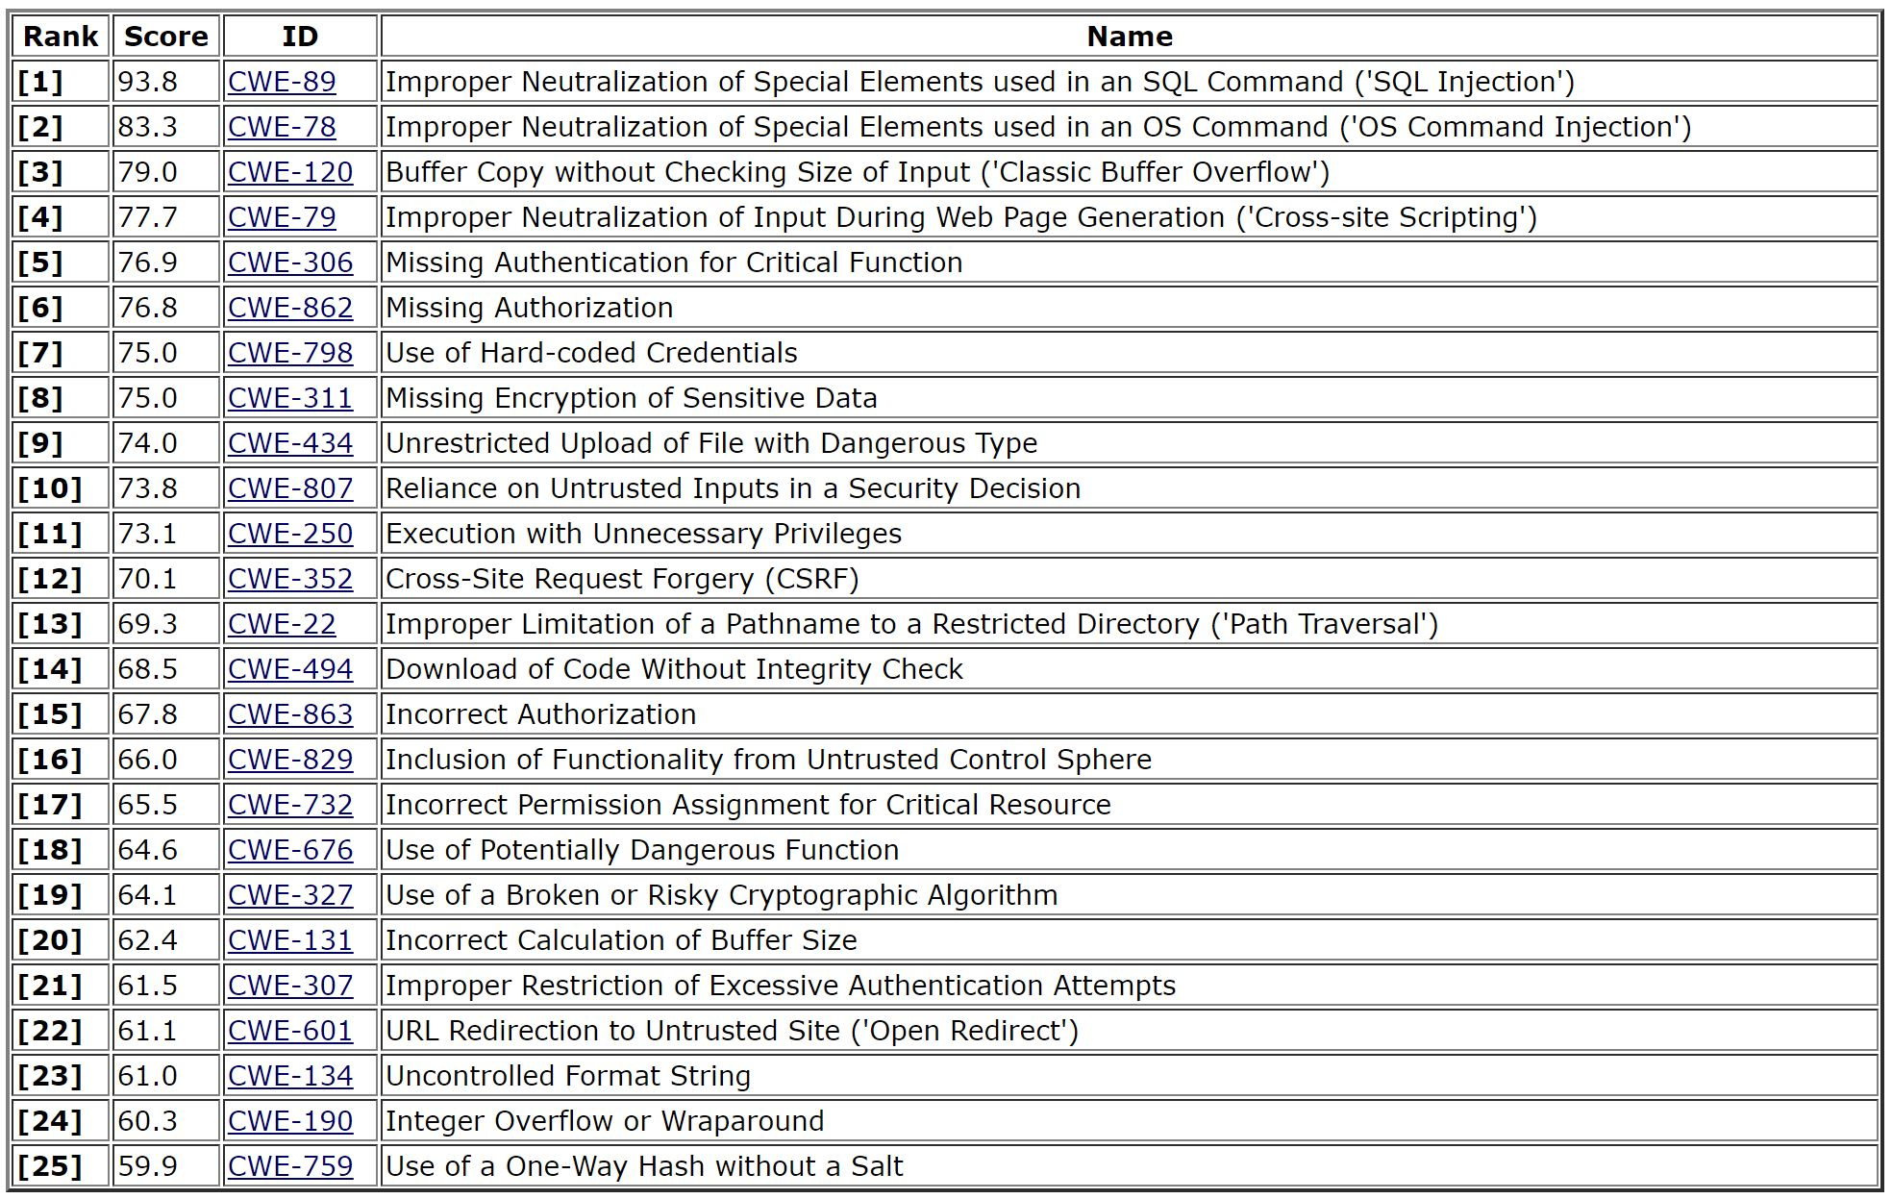
Don’t trust data if you don’t know where it’s from
Code is data
Minimize attack surface
Cryptography is hard. Leave it to experts.
Emphasis on the “s”.

Slide 4
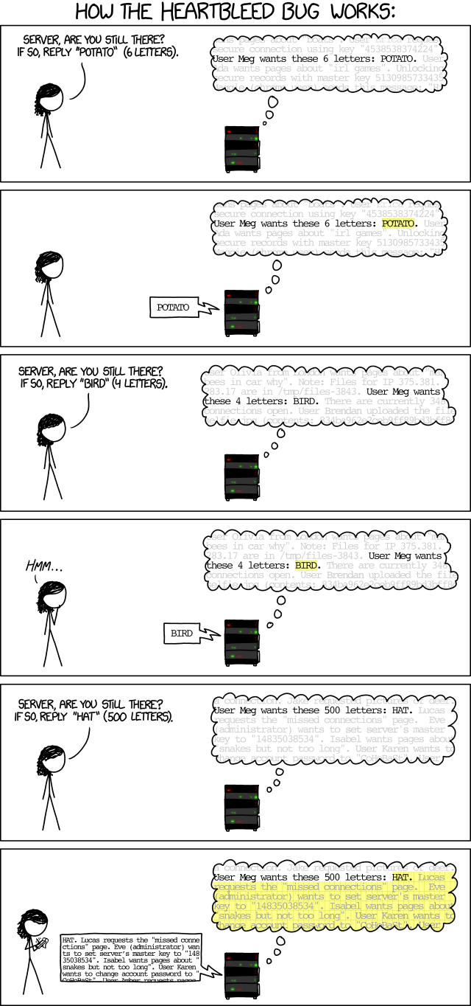
Don’t Trust Unauthenticated Data

Slide 5
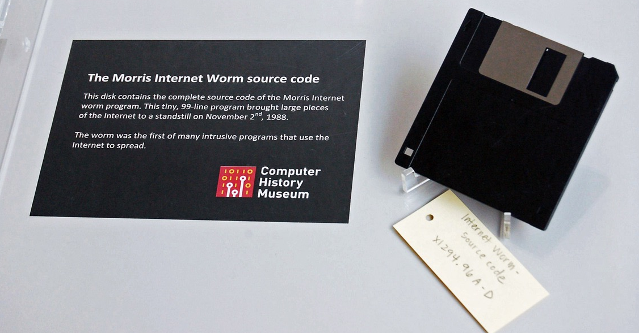
The Morris Worm
char buf[20]; gets(buf);

Slide 6
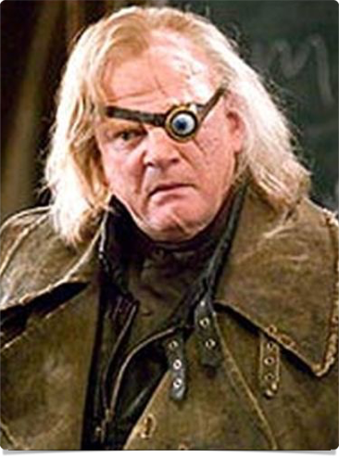
Mitigations
CONSTANT VIGILANCE
Especially when working with strings
Especially especially when working with user input

Slide 7
Mitigations
CONSTANT VIGILANCE
Especially when working with strings
Especially especially when working with user input
Strict warnings
Analysis tools
Fuzz testing
Other languages

Slide 8
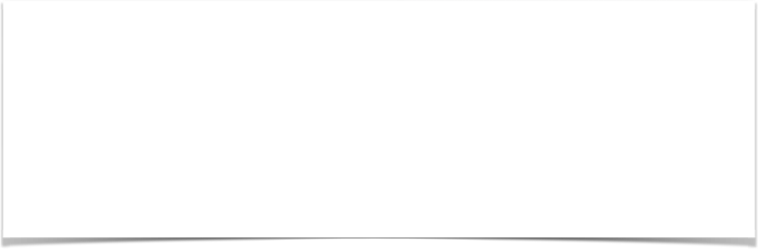

Don’t Trust Unauthenticated Data… …And Code Is Data

Slide 9
Mitigations
Blacklisting bad constructs: good
Whitelisting good constructs: better
Authenticate source and detect tampering

Slide 10
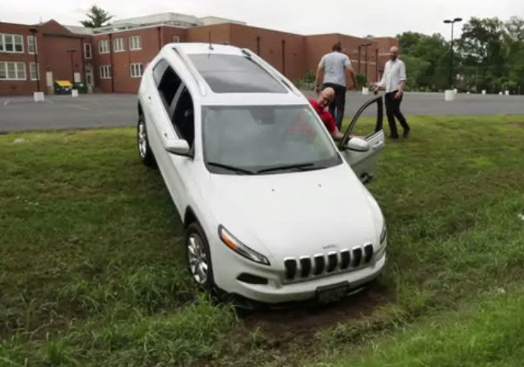
Minimize Attack Surface

Slide 11
Mitigations
Run with least privileges
Remove debugging tools in release.
Don’t try to circumvent “annoying” security features… they’re there for a reason.

Slide 12
Do Not Roll Your Own Crypto
“Any person can invent a security system so clever that she or he can't think of how to break it.”
--Bruce Schneier

Slide 13
Mitigations
Do not implement your own crypto algorithms
Do not trust closed-source crypto algorithms unless you have no alternative
Follow best practices

Slide 14
TL;DR
Don’t trust unverified data
Code is data
Minimize attack surface
Follow best practices

