Slide 1

The WinSock API
SEE WHAT I DID THERE

Slide 2

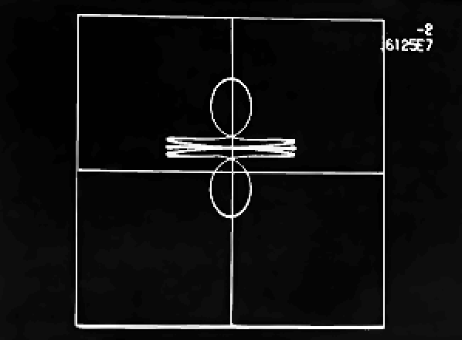
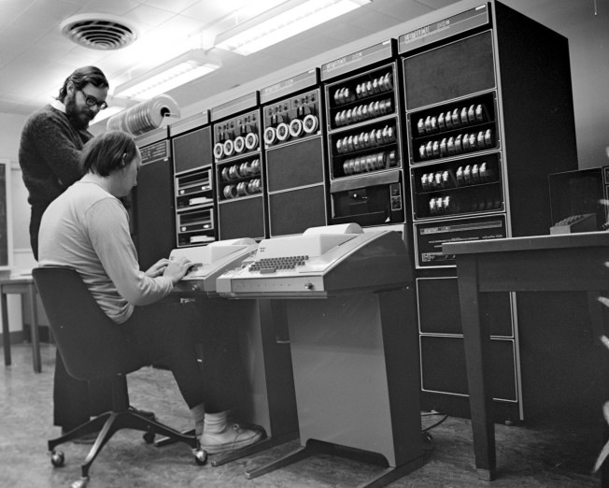
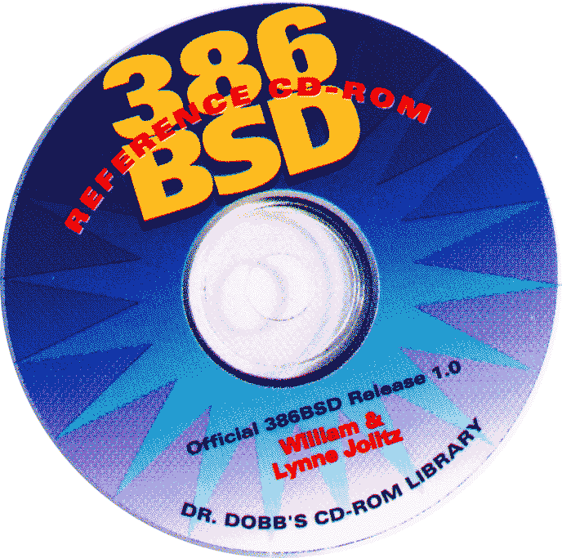





Brief History of UNIX
EXTREMELY
Notes:
This is “Space Travel”, written in 1969 by Bell Labs employee Ken Thompson for the GE-645 Multics timesharing computer system. Pretty primitive, but people liked it. Trouble was, the computer it ran on was a shared and very valuable resource, so every game session cost $75 ($400 today). [CLICK]
Desperate to keep playing, Ken sat down with his buddy Dennis Ritchie and started porting it over to an old PDP-7 computer. That machine had none of the library support that made this game possible on Multics, so Ken and Dennis had to write that stuff from scratch—effectively creating an operating system. They called that OS “Unix” (a single-user operating system) as a pun on the multi-user Multics. All this was written in assembly language; later on, Ritchie teamed up with Brian Kernighan to invent a new language, C, to support Unix development.
By its nature, Unix had lousy networking. But that changed in 1980 when DARPA contracted Berkeley University [CLICK] to implement the brand-new TCP/IP protocol on Unix. BSD’s TCP stack became the standard for Unix, which meant it was copied when the GNU Project [CLICK] created their version, and thus became the basis for Linux [CLICK]. BSD was released as an open-source OS [CLICK], which became the basis of NeXT [CLICK], which was purchased by Apple to create OS X [CLICK].
In 1992, a team at Microsoft—including J Allard, who would go on to run Xbox—created a TCP stack for Windows. [CLICK] This was deliberately as Berkeley-like as they could make it, given the constraints of supporting Windows-specific features.

Slide 3
recvfrom() = Berkeley
WSAGetLastError() = Windows
Notes:
So at this point the Internet socket programming model for pretty much every platform has its roots in that work from Berkeley. As a result, it follows the coding style of that team, which was… terse. Minimalistic even.

Slide 4
Basic sequence of calls
Initialize
Make a socket
Make an address
Bind the socket to the address
As desired:
Check for inbound packets
Send outbound packets
Cleanup and shutdown
Notes:
Initialize
Make a socket—a handle (basically a pointer to a block of system-allocated RAM that holds the data)
Make an address—a data structure that’s more than just IP address; you have to allocate it yourself
Bind the socket to the address
Then:
Check for inbound packets
And/or send outbound packets
Eventually cleanup and shutdown

Slide 5
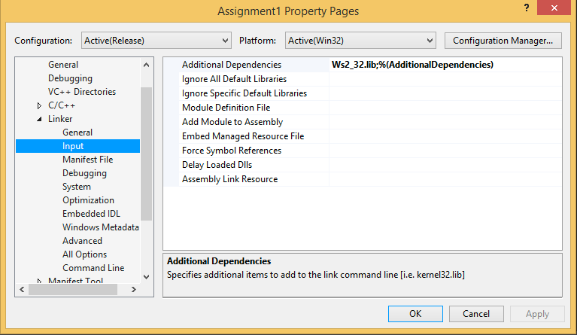
Include Library
#include <WinSock2.h>
#include <Ws2tcpip.h>
#pragma comment(lib,"ws2_32.lib")
Notes:
WinSock2.h is the header file you need, as we’re using version 2 of the WinSock API. Do not include <WinSock.h> as well—WinSock2 takes care of that, and you’ll just confuse it. Also, remember that system headers are enclosed in angle brackets instead of quotes.
The API is in a DLL, which requires linking to a lib file, Ws2_32.lib. Add that as a dependency.

Slide 6
WSAStartup
Notes:
So the MAKEWORD() macro there just creates a two-byte value with each of its bytes being a 2. That requests API version 2.2, which is the latest one. And by “latest” I mean “about 20 years old”. Remember how I keep saying that we spend increasing power on increasing abstraction; at this low level, there hasn’t been much innovation, because all the effort’s going into higher abstraction levels.
That WSADATA structure? Useless. It either contains stuff you passed in yourself, like the major and minor version, or it contains fields that actively lie to you, like “max sockets” and “max datagram size”. Throw it away.
The error result is relevant. If a Winsock call returns a thing—like a socket—then there will be an “invalid” value for that thing, which indicates an error you can then fetch with WSAGetLastError(). If a Winsock call just returns success or failure, as this one does, then 0 represents success, and any other value represents an error. The errors are all defined as constants starting with WSA. So for example if the Winsock stack isn’t ready, you’ll get back WSASYSNOTREADY. The MSDN documentation contains a list of these error messages; I won’t go into them all here, particularly since there’s not really anything useful you can do in response to them for this call.

Slide 7


WSAGetLastError
http://msdn.microsoft.com/en-us/library/windows/desktop/ms740668(v=vs.85).aspx
Notes:
All the WSA error codes are at this URL. There’s also a way to get the error strings at runtime, but I wouldn’t bother.

Slide 8
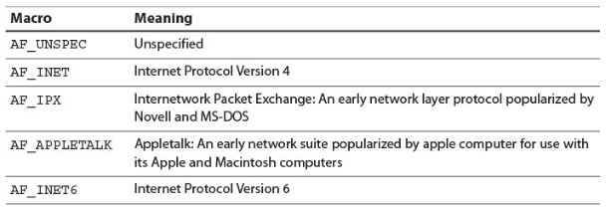
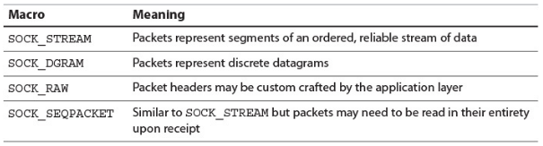
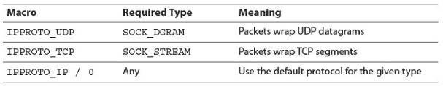
Create socket
Notes:
If we look at the underlying datatype for a socket, it’s basically a pointer. It represents a data structure that lives in the API’s memory space. Which means this is a resource that shouldn’t be leaked.
The socket call takes a parameter for the type of socket—datagram or stream—and a parameter for the protocol—UDP or TCP. Since all UDP sockets are datagrams, and all TCP sockets are streams, this is superfluous. There are other protocols and other socket types, but it’s quite likely you’ll literally never, ever use them, so I’m not going to talk about them… just be aware that when something seems redundant, it’s because you’re wading through 40 years of cruft. Reading Internet documentation is like watching an episode of Hoarders.
This’ll return INVALID_SOCKET if it fails, in which case call WSAGetLastError().

Slide 9

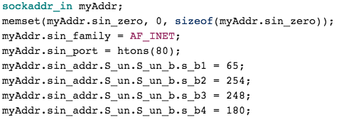
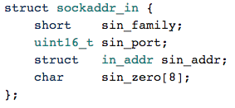
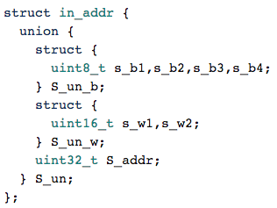
Create address
Notes:
IP only; we’ll talk about DNS later.
Allocate memory for the sockaddr_in structure. There’s also a sockaddr structure, which is generic for multiple types of sockets (think of it as a root class), but all we care about is Internet sockets.
sin_family is AF_INET, which means Internet. Then we provide the port number—remember to go from host byte order to network byte order! (More on these functions later.)
INADDR_ANY is what you use when you want to bind to all IP addresses your local machine may have. All machines have two addresses: their own, plus 127.0.0.1. This is a special address that never gets routed outside of the box, and is super-efficient because it bypasses as much of the TCP stack as possible. Very useful for interprocess communication.
inet_pton() takes a dotted-decimal string and turns it into a 32-bit IP address, in network byte order. It’ll return INADDR_NONE on failure. Note that despite taking a char string, this is not the method for resolving a hostname like “www.digipen.edu”; we’ll get to that process later.

Slide 10

Create address
Notes:
IP only; we’ll talk about DNS later.
Allocate memory for the sockaddr_in structure. There’s also a sockaddr structure, which is generic for multiple types of sockets (think of it as a root class), but all we care about is Internet sockets.
sin_family is AF_INET, which means Internet. Then we provide the port number—remember to go from host byte order to network byte order! (More on these functions later.)
INADDR_ANY is what you use when you want to bind to all IP addresses your local machine may have. All machines have two addresses: their own, plus 127.0.0.1. This is a special address that never gets routed outside of the box, and is super-efficient because it bypasses as much of the TCP stack as possible. Very useful for interprocess communication.
inet_pton() takes a dotted-decimal string and turns it into a 32-bit IP address, in network byte order. It’ll return INADDR_NONE on failure. Note that despite taking a char string, this is not the method for resolving a hostname like “www.digipen.edu”; we’ll get to that process later.

Slide 11
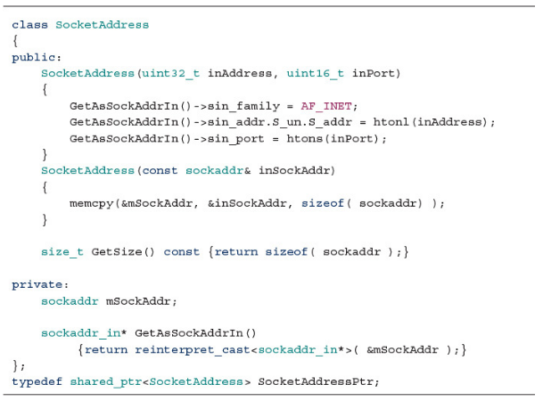
Create address
Notes:
IP only; we’ll talk about DNS later.
Allocate memory for the sockaddr_in structure. There’s also a sockaddr structure, which is generic for multiple types of sockets (think of it as a root class), but all we care about is Internet sockets.
sin_family is AF_INET, which means Internet. Then we provide the port number—remember to go from host byte order to network byte order! (More on these functions later.)
INADDR_ANY is what you use when you want to bind to all IP addresses your local machine may have. All machines have two addresses: their own, plus 127.0.0.1. This is a special address that never gets routed outside of the box, and is super-efficient because it bypasses as much of the TCP stack as possible. Very useful for interprocess communication.
inet_pton() takes a dotted-decimal string and turns it into a 32-bit IP address, in network byte order. It’ll return INADDR_NONE on failure. Note that despite taking a char string, this is not the method for resolving a hostname like “www.digipen.edu”; we’ll get to that process later.

Slide 12
Byte Ordering
htond() double ntohd()
htonf() float ntohf()
htonl() long ntohl()
htons() short ntohs()
WSAHtons(SOCKET s, u_short h, u_short* pn)
Notes:
Host to Network, Double through Short. These all work in immediate values—take an int, return an int. It’s often more convenient to be able to write the new value directly to memory, which is what the WSA versions of these do. On the other hand, the WSA versions require you to pass in a SOCKET, so that it knows whether you’re dealing with the big-endian Internet or maybe some other networking standard… so maybe easier to write your own function instead.

Slide 13
Bind
Notes:
You can use a socket without binding it. What happens then is that the TCP/IP stack arbitrarily picks an available port number and binds the socket. When the WinSock docs talk about how “clients” aren’t recommended to bind a socket, that’s what they’re saying. For the purposes of assignment 1, that’d be bad—we’re acting as both a server and a client, so we need a known port. Generally speaking, multiplayer games act as servers and clients.

Slide 14
Send To
Notes:
’Tis better to send than to receive. Sending is easy—fill a buffer, pass the address, fire and forget. You get back the number of bytes actually sent, which for a datagram will never be less than the size of the buffer—datagrams are atomic.
Okay, let’s pause here: Who can tell me how we learn how many bytes were delivered to the recipient? What function call will do that? NOTHING. YOU LOSE. GOOD DAY SIR.

Slide 15

Receive From
Notes:
Pretty straightforward: Specify the socket, provide a buffer with a maximum size. That 0 there is a flags value that you generally won’t need. Now a packet could be coming from anywhere, so we have to pass the function a pointer to memory to hold the incoming address.
What we do with that incoming address depends on our application’s needs. Here, we’re saying that we’re expecting a particular sender, and we’re going to ignore packets from everyone else. If we were a general-purpose server, we’d set up some system where we put the incoming address alongside the data in our buffer.
Note that if we pick too small a size for our buffer, we’ll get an error—WSAEMSGSIZE. If you make the buffer size equal to the Ethernet MTU of 1500, then you basically eliminate the possibility of this happening. If it does happen, then the system fills as much buffer as is available and then throws away the rest, permanently. So in the case of WSAEMSGSIZE, *buffer will actually be full of maxBytes worth of data, if you think a truncated packet is still actionable.
Okay: What happens if there’s no packets available when this function gets called?

Slide 16
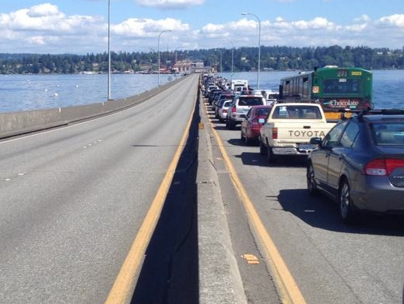
Notes:
Both receiving and sending BLOCK by default. You really don’t want that to happen. We’ll talk about that next; just remember it for now.

Slide 17
Blocking Calls (UDP Version)
Initialize
Make a socket
Make an address
Bind the socket to the address
As desired:
Check for inbound packets
Send outbound packets…sometimes
Cleanup and shutdown
Notes:
Initialize
Make a socket—a handle (basically a pointer to a block of system-allocated RAM that holds the data)
Make an address—a data structure that’s more than just IP address; you have to allocate it yourself
Bind the socket to the address
Then:
Check for inbound packets
And/or send outbound packets
Eventually cleanup and shutdown

Slide 18
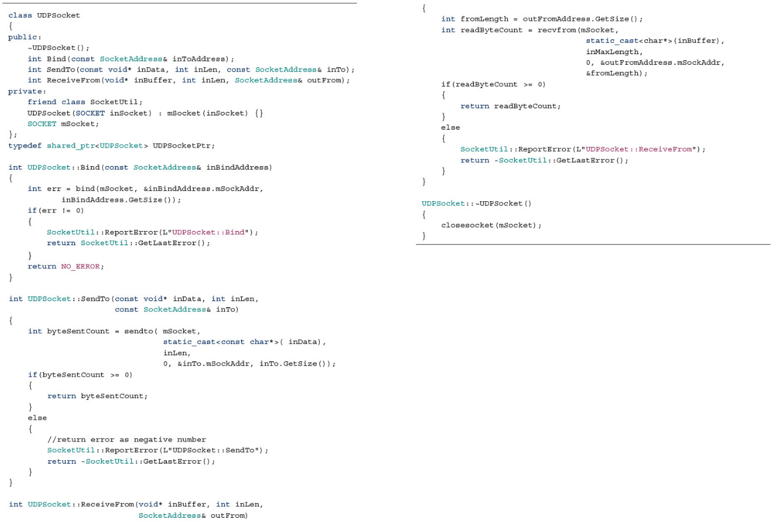
UDPSocket

Slide 19
Closure
Notes:
That was easy. Frees up everything associated with the socket. However, this is abrupt—it’s as if we just cut the cable. That’s fine for UDP, but for a TCP socket, we need to be more graceful. We’ll talk about that next week.
Sockets are system resources, and closing them frees up those resources. Remember that addresses—all that sockaddr structures you allocated—are in your memory space, so you’ll need to free those up yourself.

Slide 20
WSACleanup
Notes:
Technically, you don’t have to close sockets if you don’t want to, because WSACleanup() will do that for you. It shuts down everything, and then unloads the DLL. Once you call WSACleanup, your access to the TCP/IP stack is over.

Slide 21

Notes:
Okay, technically you now know everything you need to write a network game. You don’t know TCP, but you could create something TCP-like from first principles if you really had to. Everything from this point onward is just applying what you’ve learned.

