Slide 1

Linux
in the
Datacenter

Slide 2
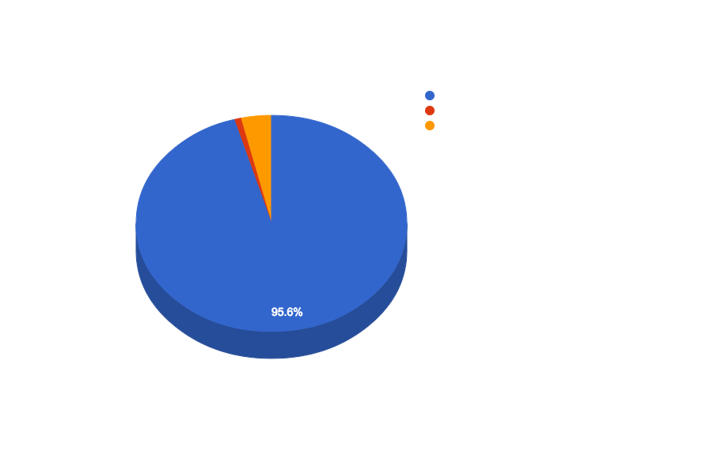
Desktop OS Market Share (NetMarketshare.com, April 2015)
Notes:
[why windows dominates desktop]
[explain Unix on desktop]

Slide 3
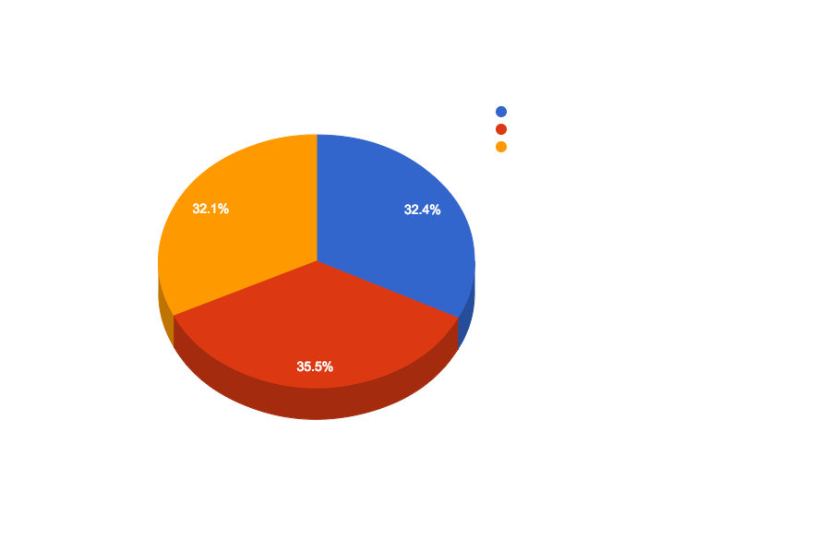
Server OS Market Share (W3Techs.com, September 2014)
Notes:
situation very different on server...

Slide 4
Definitions
POSIX
“Portable Operating System Interface”
A standard API specification for OSs
UNIX
A licensee of the Open Software Foundation
A POSIX-compliant OS
Linux
A POSIX-compliant kernel
An OS built atop the Linux kernel
*nix
Generic term for POSIX-compliant OSs
Notes:
Linux vs Unix

Slide 5
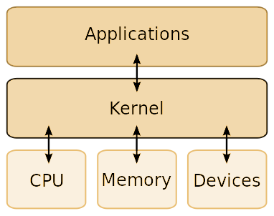
“Kernel” vs. “OS”
Kernel
The software layer that lives between applications and system resources.
Operating System
A kernel bundled with system drivers and/or a suite of standard applications. For Linux, such a bundle is usually called a “distro” (for “distribution”)
Command shell
Compiler toolchain
Text editor
Web browser
Package manager
Desktop interface
Notes:
Mint, CentOS, Red Hat, Ubuntu, Debian, etc.
[toolchain--distribution in source form]

Slide 6
2014
Server OS Market Share (W3Techs.com, September 2014)
Notes:
So now we understand the “what” of this chart, but let’s try to understand the “why”...

Slide 7
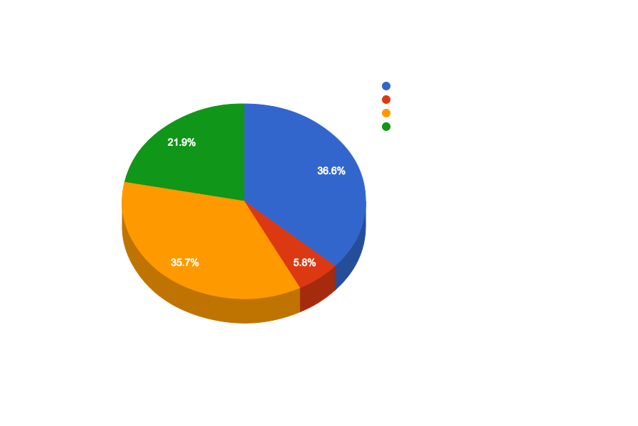
1997
Server OS Market Share in 1997 (the Microsoft “Halloween Memo”, November 1998)
Notes:
http://www.catb.org/esr/halloween/halloween1.html#_Toc427495729
...and to do that, we’re going to go back to ‘97: [linux 5 years old], [death of netware]
[explain “think week” and “halloween memo”]

Slide 8
[T]he intrinsic parallelism and free idea exchange in OSS has benefits that are not replicable with our current licensing model and therefore present a long-term developer mindshare threat.
--Vinod Valloppillil, “The Halloween Memo”, 1998

Slide 9
OSS Benefits
Customization
License Management
Interoperability
“Many Eyes”
Rapid Response

Slide 10
Customization
Open
Customizations can be created and released by any subset of the user base, down to an individual.
Closed
Customizations have to be created by the vendor and released as products, requiring marketing and testing expense.

Slide 11
License Management
Open
No license to keep track of, think about or buy.
Closed
DRM is a drag on installation and configuration time.
License types complicate deployment decisions.
$$$ x Internet scale = $$$$$$$$$$

Slide 12
Interoperability
Open
The intersection of any two user bases usually contains enough development resources to ensure interoperability.
Closed
As with customization, new features require profitable markets. They also require coordination with a separate corporation with its own agenda.
Notes:
[next up is “Many Eyes”...]

Slide 13
“Given enough eyeballs, all bugs are shallow.” I dub this “Linus [Torvald]’s Law.”
--Eric S. Raymond, “The Cathedral and the Bazaar”, 1997

Slide 14
“Many Eyes”
Open
Bug diagnosis is an easily-parallelized task.
Debugging features are a customization that can be deployed by users in the field.
Doesn’t guarantee detecting a bug.
Closed
“Black box” testers can only report symptoms; as a system becomes more complex, symptoms become more divorced from causes.
Notes:
[heartbleed]

Slide 15
Rapid Response
Open
No barrier between the user and potential fixes.
Development resources will by definition be available for as long as the product has users.
Closed
Every fix has to go through a release cycle.
Eventually, the product will be abandoned.

Slide 16
*nix vs. Windows
Customization
License Management
Interoperability
“Many Eyes”
Rapid Response

Slide 17
Customization
Security
Modular system allows disabling unneeded features to reduce attack surface.
Performance
Free to experiment with different techniques to improve performance.
Free to discard legacy support.
Operations
Open package managers make setting up and configuring a system very easy.
Command-shell focus is superior for data center operations.
Notes:
[explain attack surface]

Slide 18
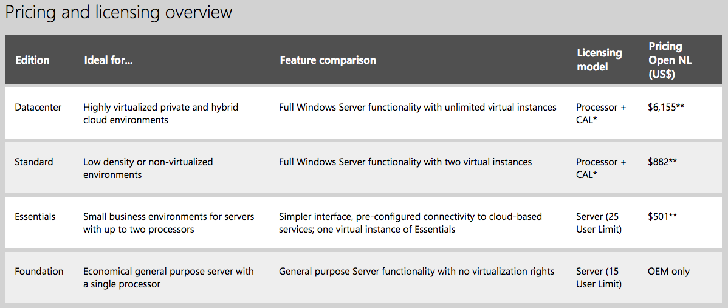
License Management
Security
Free to use best-of-breed systems… no “pro versions”.
Free to use sandboxed virtual machines.
Performance
No “pro versions”.
Free to set up parallel virtual machines.
Can spend money on hardware, not software.
Operations
No need to track keys.
Notes:
[explain attack surface]

Slide 19
Interoperability
Security
Open-source third-party components mean security bugs get fixed faster.
Eliminates possibility of “back doors”.
Performance
Vendor credibility less of an issue, so wider array of options available--can experiment to find higher-performance alternatives.
Operations
Support not dependent on often-understaffed vendors.
Notes:
[mongodb]

Slide 20
“Many Eyes”
Security
Large community of security researchers with direct source code access.
Performance
Open projects can be “forked” to experiment with improvements.
Operations
Tutorials and reference materials often written by developers themselves, or by aspiring contributors reviewing the code to learn.
Notes:
[explain attack surface]

Slide 21
Rapid Response
Security
Security bugs generally fixed within hours of “zero day” announcement.
Performance
Crashes and performance bugs fixed with same speed as security bugs.
Operations
Individual components can be upgraded separately.
OSS release cycles generally twice as fast (or more!) than closed cycles.
Notes:
22 ubuntu versions since 10/04. Six of Windows, seven of OSX.

Slide 22
Bottom Line
For the same total budget, can buy more hardware to scale
Software performs better and is more secure
Software is easier to deploy and manage

Slide 23
Why Not
Demands higher level of skill to manage
Some important software is platform-specific
SQL Server
Exchange
Office
ASP.NET (except there’s Mono…)
Sometimes the publisher decides for you...

