Slide 1
Notes:
http://map.ipviking.com

Slide 2
White Hats, Black Hats and STRIDE
An Introduction to Threat Modeling

Slide 3
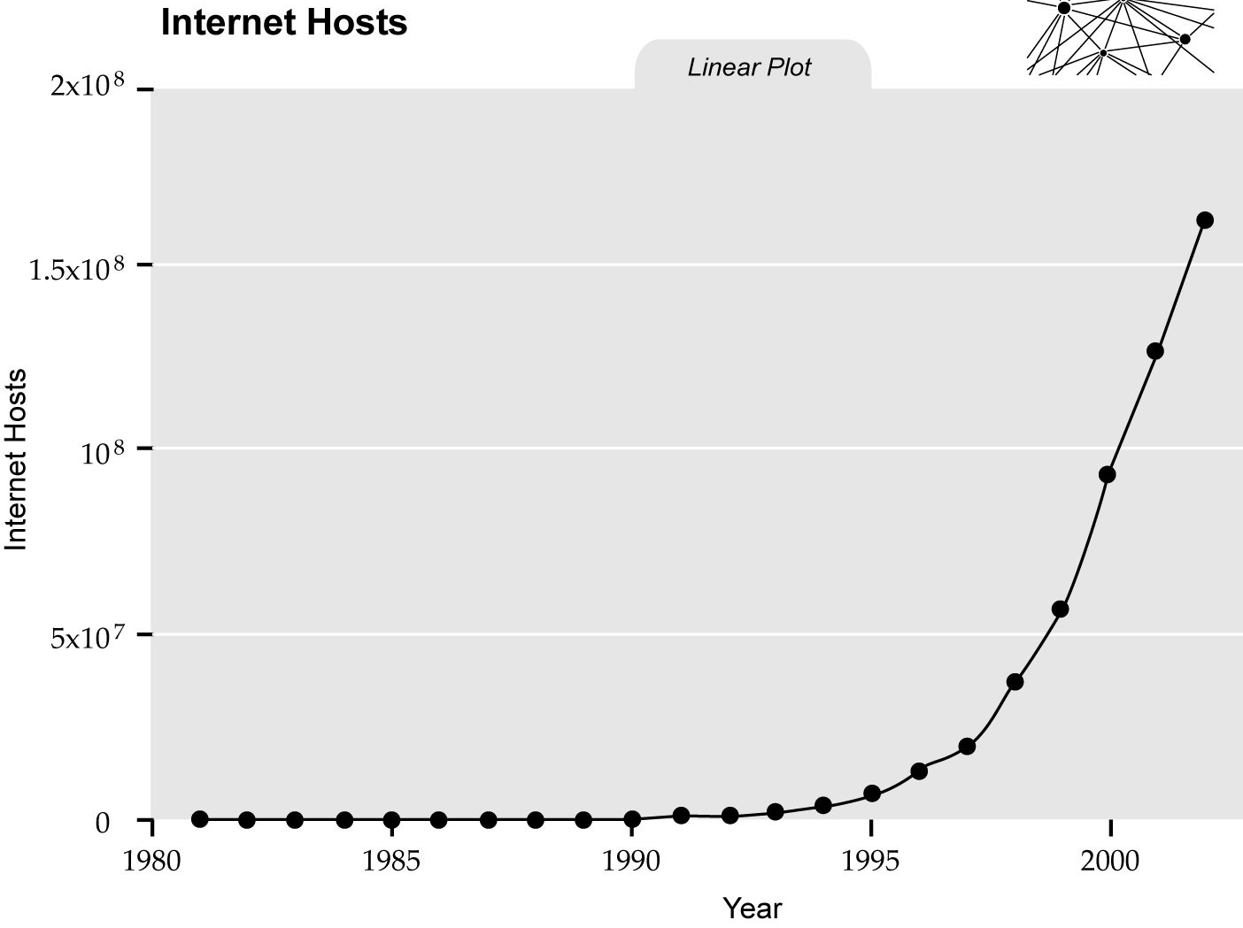

Notes:
As we’ve discussed, Internet security really wasn’t perceived as an issue when the Internet was still relatively small—most every host connected to the Internet was either on a military base or in a locked college computer lab, and virtually every action could be traced back to an authenticated account. The original Internet worm, the Morris worm of 1988, for example, was only possible because Robert Tappan Morris was a graduate CS student at Cornell. But then we can see something happened, right around 1994. [CLICK] That’s when the Internet was opened for commercial use, and the number of hosts—and by extension users—exploded. At that point, it was basically impossible to tie an attack to a specific user. As global Internet growth exploded, it became impossible to prosecute an attacker, even if you managed to track them down.

Slide 4
Threat Modeling
Risk
Vulnerability
Attack
Notes:
It was clear that the old approach, reacting to attacks as they happened and then prosecuting the offenders, wasn’t going to be sufficient. A new approach was required. [CLICK] The result, developed over the rest of the decade, has a number of different names. Varying people for varying reasons call it [CLICK] risk modeling or [CLICK] vulnerability modeling or [CLICK] attack modeling.
When Microsoft adopted this approach company-wide in 2003, they called it threat modeling, and since I was there at the time, that’s what I call it too. Like absolutely everything on the internet, this minor difference in terminology sparks huge, sprawling arguments. I like the word “threat” because it feels more precise: It’s not a “risk”, because a risk is something passive, like smoking or Ebola, whereas threats come from active aggressors; it’s not a “vulnerability”, because if I protect against it, I’m not vulnerable anymore; and it’s not necessarily an attack, because if I make it sufficiently unattractive, the attack will never materialize.
SQL Slammer is a computer worm that caused a denial of service on some Internet hosts and dramatically slowed down general Internet traffic, starting at 05:30UTC on January 25, 2003. It spread rapidly, infecting most of its 75,000 victims within ten minutes. So named by Christopher J. Rouland, the CTO of ISS, Slammer was first brought to the attention of the public by Michael Bacarella (see notes below). Although titled "SQL slammer worm", the program did not use theSQL language; it exploited a buffer overflow bug in Microsoft's flagship SQL Server and Desktop Engine database products, for which a patch had been released six months earlier in MS02-039. Other names include W32.SQLExp.Worm, DDOS.SQLP1434.A, the Sapphire Worm, SQL_HEL, W32/SQLSlammer and Helkern.^{[1]}
Contents
[hide]
1 Technical details
2 Notes
3 References
4 External links
Technical details[edit]
The worm was based on proof of concept code demonstrated at the Black Hat Briefings by David Litchfield, who had initially discovered the buffer overflow vulnerability that the worm exploited.^{[2]} It is a small piece of code that does little other than generate random IP addresses and send itself out to those addresses. If a selected address happens to belong to a host that is running an unpatched copy of Microsoft SQL Server Resolution Service listening on UDP port 1434, the host immediately becomes infected and begins spraying the Internet with more copies of the worm program.
Home PCs are generally not vulnerable to this worm unless they have MSDE installed. The worm is so small that it does not contain code to write itself to disk, so it only stays in memory, and it is easy to remove. For example, Symantec provides a free removal utility (see external link below), or it can even be removed by restarting SQL Server (although the machine would likely be reinfected immediately).
The worm was made possible by a software security vulnerability in SQL Server first reported by Microsoft on July 24, 2002. A patch had been available from Microsoft for six months prior to the worm's launch, but many installations had not been patched – including many at Microsoft.
The slowdown was caused by the collapse of numerous routers under the burden of extremely high bombardment traffic from infected servers. Normally, when traffic is too high for routers to handle, the routers are supposed to delay or temporarily stop network traffic. Instead, some routers crashed (became unusable), and the "neighbour" routers would notice that these routers had stopped and should not be contacted (aka "removed from the routing table"). Routers started sending notices to this effect to other routers they knew about. The flood of routing table update notices caused some additional routers to fail, compounding the problem. Eventually the crashed routers' maintainers restarted them, causing them to announce their status, leading to another wave of routing table updates. Soon a significant portion of Internet bandwidth was consumed by routers communicating with each other to update their routing tables, and ordinary data traffic slowed down or in some cases stopped altogether. Ironically, because the SQL Slammer worm was so small in size, sometimes it was able to get through when legitimate traffic was not.
Two key aspects contributed to SQL Slammer's rapid propagation. The worm infected new hosts over the sessionless UDP protocol, and the entire worm (only 376 bytes) fits inside a single packet.^{[3][4]} As a result, each infected host could instead simply "fire and forget" packets as rapidly as possible (generally hundreds per second).

Slide 5
Threat Modeling
Threat modeling is a process by which a system is methodically analyzed from an attacker’s perspective, to identify attack goals, evaluate the risks they pose and mitigate their vulnerabilities.
Notes:
There are many formal definitions of threat modeling; this one is mine. Each part is chosen carefully, and we’ll drill into them all tonight.

Slide 6
Threat Modeling
Threat modeling is a process by which a system is methodically analyzed from an attacker’s perspective, to identify attack goals, evaluate the risks they pose and mitigate their vulnerabilities.
Notes:
prevent that.

Slide 7
Threat Modeling
Threat modeling is a process by which a system is methodically analyzed from an attacker’s perspective, to identify attack goals, evaluate the risks they pose and mitigate their vulnerabilities.
Notes:
Process—that means it’s ongoing; you never stop doing it, just like coding is a process.
Threat modeling isn’t something you just sit down in a conference room one afternoon and crank out. It’s an ongoing activity that runs from the design of the project all the way through to live maintenance after release.

Slide 8
Threat Modeling
Threat modeling is a process by which a system is methodically analyzed from an attacker’s perspective, to identify attack goals, evaluate the risks they pose and mitigate their vulnerabilities.
Notes:
System—you can threat model anything, not just software
Notice I don’t say “an application” here. You can apply threat modeling to anything, not just a program--you could apply it to something as abstract as game mechanics to something as concrete as the physical security of a bank vault. Even if what you’re modeling is indeed a program, “the system” encompasses way more than just the code—it’s the code, the game design, the network messages back and forth, the users, the customer service people… everything. But I’m going to talk about “your application” or “your program” for convenience.
On the other hand, “system” can also be just one part of your application viewed in isolation. Threat modeling just part of your application can let you do a threat model earlier in your development cycle for especially critical systems. For example, at MSN Games we released subscription-based Messenger peer-to-peer games. We developed the threat model for the subscription verification system before we started any other part of the code.

Slide 9
Threat Modeling
Threat modeling is a process by which a system is methodically analyzed from an attacker’s perspective, to identify attack goals, evaluate the risks they pose and mitigate their vulnerabilities.
Notes:
Methodical—TM breaks attack goals into six categories and encourages you to think about how they could apply to every asset in your system, to help you spot things you hadn’t previously considered

Slide 10
Threat Modeling
Threat modeling is a process by which a system is methodically analyzed from an attacker’s perspective, to identify attack goals, evaluate the risks they pose and mitigate their vulnerabilities.
Notes:
Attacker’s perspective—attackers are people, and while that has downsides (they’re creative and determined), it has upsides (they have motivations and fears you can exploit).
The defining characteristic of threat modeling is that you look at your program the way an attacker does, and trust me on this one: Attackers are patient and thorough. The fact that you blocked ports 1 through 9999 won’t stop an attacker from probing port 10000. The fact that only one user in a million is inattentive enough to fall for that PayPal phish email doesn’t stop the attacker from sending it out again and again.

Slide 11
Threat Modeling
Threat modeling is a process by which a system is methodically analyzed from an attacker’s perspective, to identify attack goals, evaluate the risks they pose and mitigate their vulnerabilities.
Notes:
Identify attack goals—First you figure out what an attacker could be going after
To be clear, threat modeling is not some magic engine that spits out a list saying “you have a buffer overrun on line 853 of storefront.m.” What threat modeling does is help you look at your program, find the things that are valuable (to you or an attacker), determine how an attacker can interact with those things, and then determine what must be true for the attacker to get what he wants.

Slide 12
Threat Modeling
Threat modeling is a process by which a system is methodically analyzed from an attacker’s perspective, to identify attack goals, evaluate the risks they pose and mitigate their vulnerabilities.
Notes:
Evaluate the risks—then how they might get there
There is no such thing as perfect security. If you aim for perfect security, you will fail, and fail expensively. But if you throw your hands up and say, “Well, we can’t be perfectly secure so we won’t bother,” then you will be attacked, and the attacker will take something of value to you. Threat modeling lets you quantify each vulnerability so that you can focus your efforts on minimizing the risks that are most likely to cause you the most grief.

Slide 13
Threat Modeling
Threat modeling is a process by which a system is methodically analyzed from an attacker’s perspective, to identify attack goals, evaluate the risks they pose and mitigate their vulnerabilities.
Notes:
Mitigate their vulnerabilities—then how you can prevent that.
The temptation is to say “fix”; I slip up all the time. But don’t say “fix,” say “mitigate” because just as there’s no such thing as perfect security, there’s no such thing as a fixed vulnerability. The best you can do is get to where you think that there’s no current way for the attacker to carry out the attack.

Slide 14
Threat Modeling
Threat modeling is looking at your system the way an attacker does.
Notes:
Here’s an even easier definition.

Slide 15
Attackers

Slide 16



Notes:
So let’s look at our attackers. We break attackers down into three categories—white hats [CLICK], black hats [CLICK] and gray hats [CLICK], who are a little of both. This isn’t as trivial as “good guys” vs. “bad guys”—some white hats are malevolent, some black hats are on the side of the angels. Instead, it’s based on what they do with zero-day bugs they find: white hats inform the targets through approved channels, black hats don’t, and gray hats might or might not.
Also, this is a good time to dispose of “hacker” vs “cracker”. “Hacker” just means someone who’s interested in how things work, who opens them up and tinkers with them in ways they weren’t designed to support. A “cracker” is someone who is doing this for malicious purposes. But that’s not a useful term from the perspective of threat modeling, because it doesn’t really tell us anything about what they’re doing—a hacker and a cracker may be doing the exact same thing and need to be addressed the exact same way. So basically I just don’t use the word cracker, and I don’t use the word hacker pejoratively. If I mean a black hat, I’ll just say black hat.

Slide 17
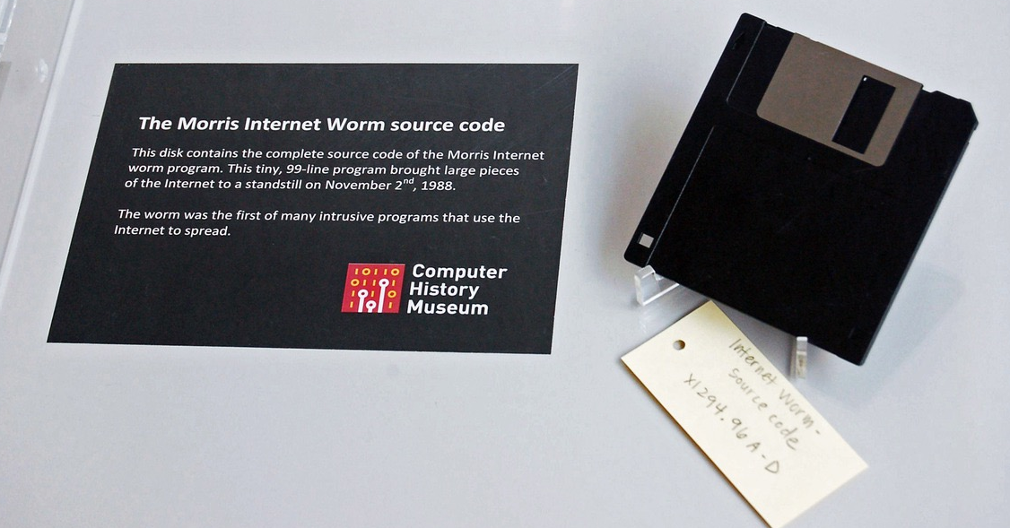
“Zero-Days”
Notes:
A zero-day, or more precisely a zero-day vulnerabilty, is a software vulnerability that’s not known to the vendor—they’ve had “zero days” to create and issue a fix. These are the lifeblood of the hacker ecosystem… every exploit starts its life as a zero-day. That’s not to say that an attack becomes useless once it’s known about—far, far from it—but the higher-value a target, the more likely they are to be fully patched. By definition, you cannot be patched or protected against zero-days.
On November 2, 1988, Robert Morris, Jr., a graduate student in Computer Science at Cornell, wrote an experimental, self-replicating, self-propagating program called a worm and injected it into the Internet. He chose to release it from MIT, to disguise the fact that the worm came from Cornell. Morris soon discovered that the program was replicating and reinfecting machines at a much faster rate than he had anticipated---there was a bug. Ultimately, many machines at locations around the country either crashed or became ``catatonic.'' When Morris realized what was happening, he contacted a friend at Harvard to discuss a solution. Eventually, they sent an anonymous message from Harvard over the network, instructing programmers how to kill the worm and prevent reinfection. However, because the network route was clogged, this message did not get through until it was too late. Computers were affected at many sites, including universities, military sites, and medical research facilities. The estimated cost of dealing with the worm at each installation ranged from $200 to more than $53,000.
The program took advantage of a hole in the debug mode of the Unix sendmail program, which runs on a system and waits for other systems to connect to it and give it email, and a hole in the finger daemon fingerd, which serves finger requests. People at the University of California at Berkeley and MIT had copies of the program and were actively disassembling it (returning the program back into its source form) to try to figure out how it worked.
Teams of programmers worked non-stop to come up with at least a temporary fix, to prevent the continued spread of the worm. After about twelve hours, the team at Berkeley came up with steps that would help retard the spread of the virus. Another method was also discovered at Purdue and widely published. The information didn't get out as quickly as it could have, however, since so many sites had completely disconnected themselves from the network.
After a few days, things slowly began to return to normalcy and everyone wanted to know who had done it all. Morris was later named in The New York Times as the author (though this hadn't yet been officially proven, there was a substantial body of evidence pointing to Morris).
Robert T. Morris was convicted of violating the computer Fraud and Abuse Act (Title 18), and sentenced to three years of probation, 400 hours of community service, a fine of $10,050, and the costs of his supervision. His appeal, filed in December, 1990, was rejected the following March.
11/2:1800 (approx.)This date and time were seen on worm files found on prep.ai.mit.edu, a VAX 11/750 at the MIT Artificial Intelligence Laboratory. The files were removed later, and the precise time was lost. System logging onprep had been broken for two weeks. The system doesn't run accounting and the disks aren't backed up to tape: a perfect target. A number of "tourist" users (individuals using public accounts) were reported to be active that evening. These users would have appeared in the session logging, but see below.
11/2:1824First known West Coast infection: rand.org at Rand Corp. in Santa Monica.
11/2:1904csgw.berkeley.edu is infected. This machine is a major network gateway at UC Berkeley. Mike Karels and Phil Lapsley discover the infection shortly afterward.
11/2:1954mimsy.umd.edu is attacked through its finger server. This machine is at the University of Maryland College Park Computer Science Department.
11/2: 2000 (approx.)Suns at the MIT AI Lab are attacked.
11/2: 2028First sendmail attack on mimsy.
11/2: 2040Berkeley staff figure out the sendmail and rsh attacks, notice telnet and finger peculiarities, and start shutting these services off.
11/2: 2049cs.utah.edu is infected. This VAX 8600 is the central Computer Science Department machine at the University of Utah. The next several entries follow documented events at Utah and are representative of other infections around the country.
11/2: 2109First sendmail attack at cs.utah.edu.
11/2: 2121The load average on cs.utah.edu reaches 5. The "load average" is a system-generated value that represents the average number of jobs in the run queue over the last minute; a load of 5 on a VAX 8600 noticeably degrades response times, while a load over 20 is a drastic degradation. At 9 PM, the load is typically between 0.5 and 2.
11/2: 2141The load average on cs.utah.edu reaches 7.
11/2: 2201The load average on cs.utah.edu reaches 16.
11/2: 2206The maximum number of distinct runnable processes (100) is reached on cs.utah.edu; the system is unusable.
11/2: 2220Jeff Forys at Utah kills off worms on cs.utah.edu. Utah Sun clusters are infected. 11/2: 2241 Re-infestation causes the load average to reach 27 on cs.utah.edu.
11/2: 2249Forys shuts down cs.utah.edu.
11/3: 2321Re-infestation causes the load average to reach 37 on cs.utah.edu, despite continuous efforts by Forys to kill worms.
11/2: 2328Peter Yee at NASA Ames Research Center posts a warning to the TCP-IP mailing list: "We are currently under attack from an Internet VIRUS. It has hit UC Berkeley, UC San Diego, Lawrence Livermore, Stanford, and NASA Ames." He suggests turning off telnet, ftp, finger, rsh and SMTP services. He does not mention rexec. Yee is actually at Berkeley working with Keith Bostic, Mike Karels and Phil Lapsley.
11/3: 0034At another's prompting, Andy Sudduth of Harvard anonymously posts a warning to the TCP-IP list: "There may be a virus loose on the internet." This is the first message that (briefly) describes how the fingerattack works, describes how to defeat the SMTP attack by rebuilding sendmail, and explicitly mentions the rexec attack. Unfortunately Sudduth's message is blocked at relay.cs.net while that gateway is shut down to combat the worm, and it does not get delivered for almost two days. Sudduth acknowledges authorship of the message in a subsequent message to TCP-IP on Nov. 5.
11/3: 0254Keith Bostic sends a fix for sendmail to the newsgroup comp.bugs.4bsd.ucb-fixes and to the TCP-IP mailing list. These fixes (and later ones) are also mailed directly to important system administrators around the country.
11/3: early morningThe wtmp session log is mysteriously removed on prep.ai.mit.edu.
11/3: 0507Edward Wang at Berkeley figures out and reports the finger attack, but his message doesn't come to Mike Karels' attention for 12 hours.
11/3: 0900The annual Berkeley Unix Workshop commences at UC Berkeley. 40 or so important system administrators and backers are in town to attend, while disaster erupts at home. Several people who had planned to fly in on Thursday morning are trapped by the crisis. Keith Bostic spends much of the day on the phone at the Computer Systems Research Group offices answering calls from panicked system administrators from around the country.
11/3 :1500 (approx.)The team at MIT Athena calls Berkeley with an example of how the finger server bug works.
11/3:1626Dave Pare arrives at Berkeley CSRG offices; disassembly and decompiling start shortly afterward using Pare's special tools.
11/3:1800 (approx.)The Berkeley group sends out for calzones. People arrive and leave; the offices are crowded, there's plenty of excitement. Parallel work is in progress at MIT Athena; the two groups swap code.
11/3:1918Keith Bostic posts a fix for the finger server.
11/4: 0600Members of the Berkeley team, with the worm almost completely disassembled and largely decompiled, finally take off for a couple hours' sleep before returning to the workshop.
11/4: 1236Theodore Ts'o of Project Athena at MIT publicly announces that MIT and Berkeley have completely disassembled the worm.
11/4:1700 (approx.)A short presentation on the worm is made at the end of the Berkeley UNIX Workshop.
11/8:National Computer Security Center meeting to discuss the worm. There are about 50 attendees.
11/11: 0038Fully decompiled and commented worm source is installed at Berkeley.

Slide 18
White Hats notify vendors before public
Security Researchers
Prestige, learning, public service
Penetration Testers
Payment
Bug-Bounty Hunters
Payment, reputation
Notes:
[CLICK] Mostly when you think of white hats you probably think of security researchers. They’re in it for prestige, education and public service. They tend to focus their efforts on consumer-facing services, or widespread systems.
[CLICK] Penetration testers are hired guns, paid by a vendor or a customer to test a system directly. They go after whatever target they’re paid to.
[CLICK] Bounty hunters race for “bug bounties”, which are rewards put out by vendors. Sort of like informal pen-testers. Often this is a way to scare zero-days out of the woodwork—the people who collect the bounty often have been sitting on the exploit for a while. Which of course makes them gray hats, not white hats.

Slide 19
Black Hats no public release
State Actors
Intelligence, sabotage, zombies
Hacktivists
Retribution, publicity, zombies
Vulnerability Brokers
Money, reputation
Notes:
[CLICK] Cyberspies! Very real situation: China hacks the US, Russia hacks Europe, Israel and Palestine hack each other, and the US hacks everybody. Bots are kind of a special case here—lots you can do with a large, widespread network of machines, from DDoS attacks, to password cracking, to wardialing.
[CLICK] You can think of hacktivists as just freelance cyberspies, really.
[CLICK] Vulnerability brokers are enablers for other attackers. They discover zero-days and then sell them. A really good zero-day, like some of the ones we’ll talk about a little later, can sell for hundreds of thousands of dollars.

Slide 20
Gray Hats notify public first
Insiders
Vengeance, whistle-blowing
Hobbyists
Self-education, thrills, prestige… …sometimes extortion
Notes:
Gray hats notify the public first. This puts everyone at risk, because vendors aren’t given time to release patches.
[CLICK] Insiders are probably the greatest threat any company has. Physical security trumps everything else—generally speaking, if an attacker has physical access to a machine, or exists inside an organization’s trust boundary, there’s nothing you can do to stop them. Some insiders actually take this a step further and become outright cybercriminals.
[CLICK] Hobbyists are people who discover an exploit and then release it. They’re not destructive, just careless. Sometimes they cross the line—“I deserve something for finding this bug, and if you don’t pay me by Tuesday I’ll release it.”

Slide 21
A$$hats use, not create, exploits
Cybercriminals
Credit cards, identity theft, extortion
Script Kiddies
Thrills, attention, vengeance
Notes:
And then you’ve got the people who don’t fall into this taxonomy, because they don’t create zero-days, they just use them. Cybercriminals use them for profit, script kiddies use them for personal reasons, but the end result is the same. It’s the existence of this aftermarket for zero-days that makes proactively preventing vulnerabilities so important.

Slide 22
Threat Actors “The Bad Guys”
Cybercriminals
Credit cards, identity theft, extortion
Script Kiddies
Thrills, attention, vengeance
Notes:
And then you’ve got the people who don’t fall into this taxonomy, because they don’t create zero-days, they just use them. Cybercriminals use them for profit, script kiddies use them for personal reasons, but the end result is the same. It’s the existence of this aftermarket for zero-days that makes proactively preventing vulnerabilities so important.

Slide 23
Attacks
Notes:
There’s a huge number of different attacks—there are more attacks than there are systems, because any system will offer multiple means of attack. But we can categorize them into a relatively small number of attack types, because different attacks can behave in similar ways.
It’s exactly like what we do in an RPG. There may be hundreds of weapons and attack moves, but there’s only so many kinds of damage—blunt, piercing, slashing, electrical, fire, ice, psychic, whatever. Attacks in an RPG are defined in terms of the way they interact with armor and the victim’s hitpoints; likewise, attacks in threat modeling are defined in the way they interact with defenses and protected assets.
Also like that RPG, any particular attack may incorporate more than one element. You might have an attack that spoofs a valid user in order to disclose hidden information. That’s okay; what we’re using this for is to figure out how attacks interact with our defenses. In such a situation, we’ll either simplify to one or the other—“yeah, this is spoofing, but the real problem is the information disclosure”—or we’ll acknowledge it as separate attacks—“the spoofing is a problem in its own right, and then if successful it opens up this information disclosure problem as well”.

Slide 24
STRIDE
Spoofing: Pretending to be another user
Tampering: Modifying data outside of normal usage
Repudiation: Erasing the history of an action
Information disclosure: Reading secrets
Denial of service: Preventing normal operation
Elevation of privilege: Performing forbidden actions
Notes:
Microsoft’s threat modeling process breaks attacks into six types, which—because Microsoft LOVES acronyms—are called STRIDE.
[CLICK] spoofing
[CLICK] tampering
[CLICK] repudiation
[CLICK] information disclosure
[CLICK] denial of service
[CLICK] elevation of privilege

Slide 25
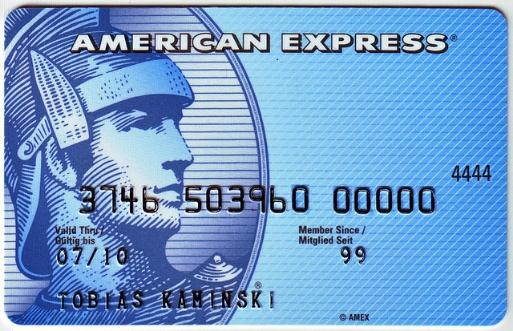
Spoofing
Notes:
This is the attack people are most familiar with. It’s why we have usernames and passwords. It’s why credit cards have CVV numbers. [explain CC carbon machines, raised numbers]

Slide 26
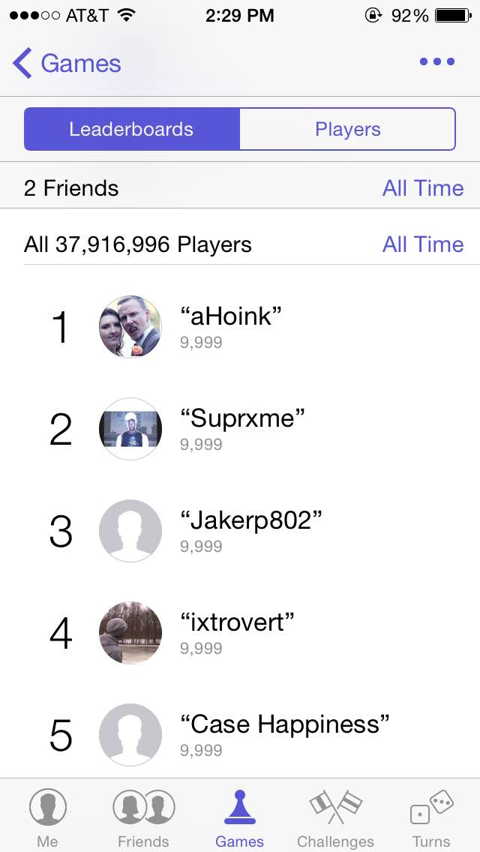
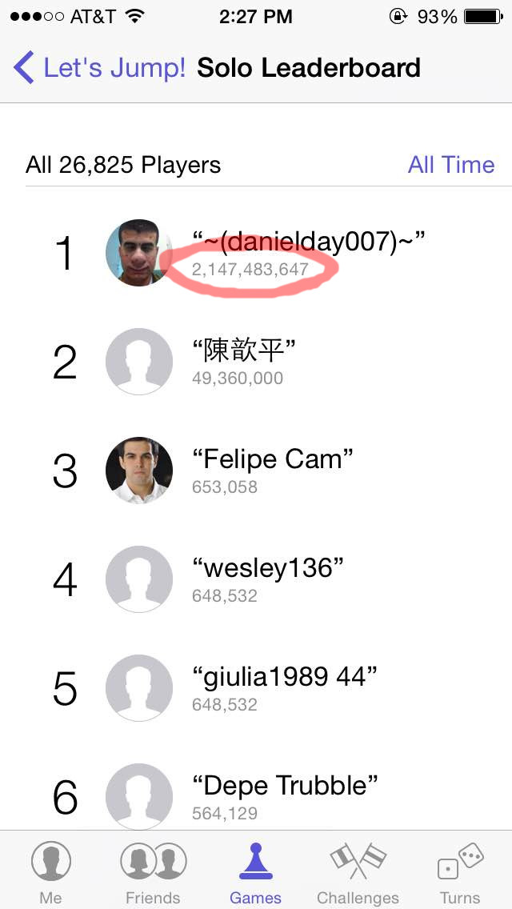
Tampering
What’s the top score on most leaderboards?
Notes:
[CLICK] 2,147,483,647, because that’s the highest value you can submit.
Actually, on iOS game center, what happens is that the game is released, the high score becomes two billion, then the developer goes into their leaderboard table definition and sets the highest possible actual score. Which is why the high score table for Flappy Bird looks like this [CLICK]

Slide 27
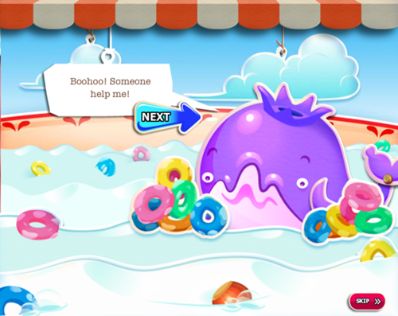
Repudiation
Notes:
So what happens when you discover you’ve spent $1,000 on Candy Crush powerups? Well, the unethical thing to do is this: Call up Apple customer support, tell them your six-year-old made the purchases, and have them reverse the charges. This is repudiation—“I didn’t do it, nobody saw me do it, you can’t prove anything”. Repudiation could also be the reverse, claiming you did do something that you didn’t.

Slide 28

Information Disclosure
Notes:
This one’s simple—you have secrets, someone else gets them. [CLICK] It’s a bad thing.

Slide 29

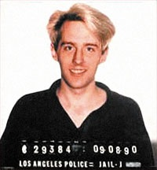

Denial of Service
Notes:
Everyone’s familiar with DoS attacks. Obviously they’re bad because they disrupt provision of services that companies rely on for income. But there’s other reasons for DOS attacks…
[CLICK] This is Kevin Poulsen, Wired magazine’s senior editor on network security. This guy really, really knows what he’s talking about, because he used to be [CLICK] this guy, Kevin Poulsen, cybercriminal. In 1990, LA radio station KIIS (FM 102) ran a contest—be the 102nd caller and win [CLICK] a shiny new Porsche 944. Kevin hacked into the phone company and shut down all the radio station’s phone lines except the one he was on… which made it easy to become the 102nd caller. He won the car, cash, seven federal indictments and 51 months in prison.

Slide 30
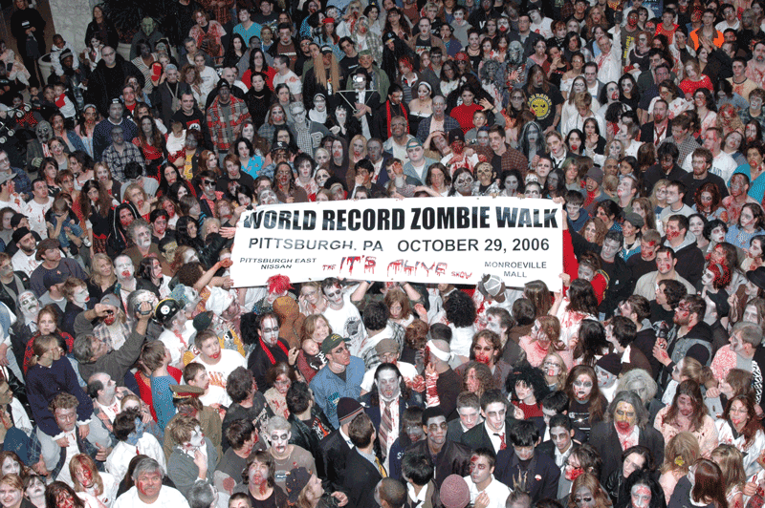
Elevation of Privilege
Notes:
The foremost example of elevation of privilege is compromising someone’s computer, taking it over. You can think of a lot of reasons to take over a server, and those attacks succeed often… but servers tend to be well-patched. What’s far, far more common is to take over individual home PCs… not to access anything on those machines, but simply to create [CLICK] a zombie army.
Black hats use zombie armies as tools to conduct other attacks. They’re key in distributed denial of service attacks—that’s what a DDoS means. They can be used to try random passwords against a service. They can be used to wardial a data center to find exposed machines. Their graphics cards can be used to hash a password database or mine for bitcoins.

Slide 31
Threat modeling looks at your system the way an attacker does.
Attackers have goals and motivations.
Classifying attacks into categories helps us maintain focus and be methodical.
Notes:
Threat modeling looks at your system the way an attacker does.
Attackers have goals and motivations.
Classifying attacks into categories helps us maintain focus and be methodical.

