Slide 1

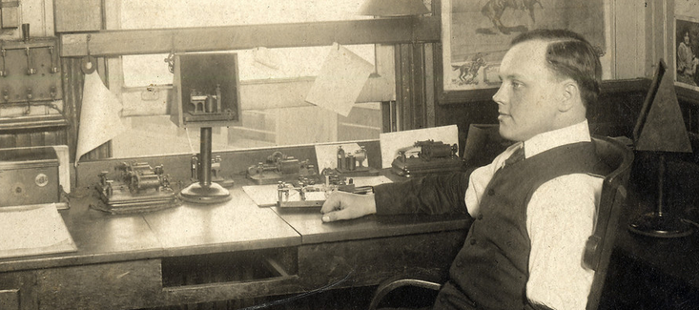
“The dot, therefore, involves time, but this time is variable, according to circumstances. The length of the dot should increase with the length of the circuit. In long submarine lines the dot has to be made longer than the dash itself on short open air lines…”
—Modern Practice of the Electric Telegraph Frank L. Pope, 1881
Notes:
PHYSICALITY
Lines can only run so far. They can have multiple stations along the line, but when they end, they end. The message has to be copied down by someone at the far end, then retransmitted on the next line. This maximum length was 250 or so miles; less in practice, because operating at the limits means less margin to cope with weather. Figure that a message from SF to DC passed through at least 30 hands along the way. So while the best operators could transmit 30 words a minute, you have to multiply that by 30.
Furthermore, imagine that one of those operators is already busy. Messages just pile up until he’s free to send them on. This is buffering, and it results in lag.
The quote here is another example of physicality. Remember that the telegraph operates by turning on electromagnets, and those don’t work instantly—the current has to build up the magnetic field. When the current is weak, it takes longer for the magnet to come on. Go too fast and the device on the far end literally doesn’t work. Telegraph wires were uninsulated (because there wasn’t a cheap solution for insulation; no plastic, and rubber had to be imported from India), so weather would “drain” current from the wire and make everyone slow down.
Here’s a good rule of thumb: You need to worry about the physicality one layer below your preferred level of abstraction. The telegrapher wants to focus on the messages, but needs to worry about the resistance of the wire. The telegraph company wants to focus on delivering telegrams, but needs to worry about the telegraphers.

Slide 2
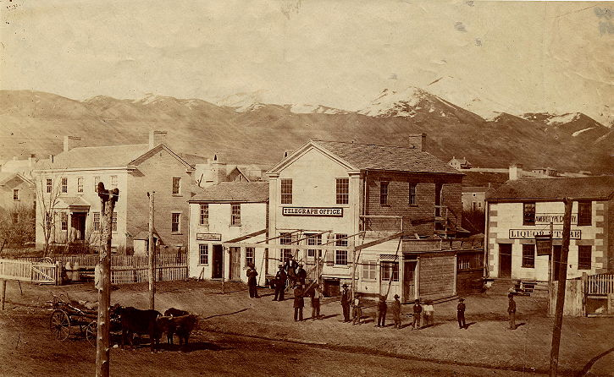

Slide 3
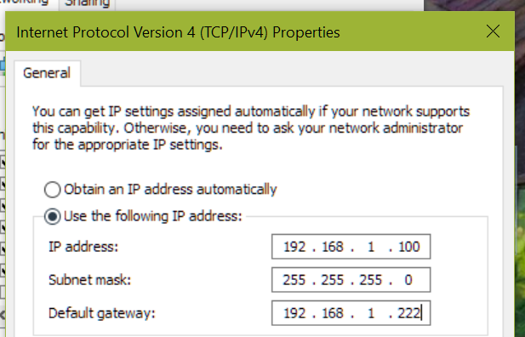
TCP/IP ADDRESSING
425-629-5076
425-629-5076
Area network
Local network
Node
IP Address Configuration Dialog (Windows NT 4.0, 1997)
Notes:
Okay, who’s seen a dialog like this one? Well congratulations, as of today you’ll be able to tell people what those boxes mean.
Let’s first think about an addressing scheme you’re more familiar with, phone numbers. My office number is 425-629-5076. The 425 says what phone network I’m on—the Eastside—the 629 specifies the subnetwork—Digipen—and the 5076 is my local address on that network. If I want to call Admissions, at 425-629-5001, I don’t have to step out to the external network, I just dial the local address, 5001. I know how the phone subnetwork is allocated, because it’s defined in the standard.
Every node on the Internet has a unique address. Originally, and generally still today, addresses were 32-bit values; there’s a push to move to IPv6, where addresses are 128 bits, but I don’t want to talk about that today. Like phone numbers, some portion of that 32 bits identifies the network, and the rest identifies a node within that network… but unlike phone numbers, the system can change from network to network.
This is identified by the subnet mask.

Slide 4
TCP/IP ADDRESSING
192.168.1.100
255.255.255.0
IP Address Configuration Dialog (Windows NT 4.0, 1997)
Notes:
Every node on the Internet has a unique address. Originally, and generally still today, addresses were 32-bit values; there’s a push to move to IPv6, where addresses are 128 bits, but I don’t want to talk about that today.
IPv4 addresses are by tradition written in “dotted-decimal” notation. This is pretty much the only place you’ll ever see this notation, and it looks weird. The big reason for this notation is literally that people back then just weren’t familiar or comfortable with hexadecimal—it’s not more complicated than that. This brings up an important point: A lot of stuff on the Internet is done a certain way simply because it’s “always” (“always” being “as much as TWENTY WHOLE YEARS AGO!”) been done that way, and was originally done that way for bad reasons that no longer apply. Don’t hesitate to question everything.
Anyway, in hex, this address would be C0A80A01, but you’ll never, ever see an IP address written that way. There’s something useful about IP addresses having a uniquely recognizable format, so it persists.
Like phone numbers, some portion of that 32 bits identifies the network, and the rest identifies a node within that network… but unlike phone numbers, the system can change from network to network. This is identified by the subnet mask. This will be easier to understand if we switch from dotted-decimal to binary…

Slide 5
TCP/IP ADDRESSING
11000000.10101000.00000001.01100100
11111111.11111111.11111111.00000000
11000000.10101000.00000000.________
01100100
IP Address Configuration Dialog (Windows NT 4.0, 1997)
Notes:
The 1s in the subnet mask identify the network; the 0s identify the node. To get the network, AND the IP address against the mask; to get the node, AND the IP address against the inverse of the mask. [You all know how to do binary arithmetic, yes? Good.]
Now, this example is trivial, because the subnet is just the bottommost 8 bits. In the first version of the TCP/IP scheme, there were only 256 networks, and the subnet was always the bottommost 24 bits. That proved unwieldy, so they moved to a scheme were there could be smaller networks, and networks within networks.
The “default gateway” down there is simply the IP address of the node that’s responsible for routing packets upward from our local subnet here. Which brings us to routing.

Slide 6



TCP/IP Routing
192.168.1.1
192.168.1.5
192.168.1.7
192.168.1.222
192.168.1.10
Local Area Network (LAN): “ping 192.168.1.7”
Notes:
Here we have a simple local network, four PCs and a router connected to one hub. The technology here is twisted-pair Ethernet. Every machine on the local network sees every packet, and just pays attention to the ones addressed to it.
Let’s say our machine, .10, wants to send a packet to .7. It knows from the net mask that .7 is on the same subnet, so it doesn’t have to talk to the router at all—it just sends the packet directly to .7. Technically, the packet gets repeated by the hub on all lines, and just ignored by the other machines, same way telegrams worked, but conceptually it’s sent “from” .10 “to” .7.

Slide 7
TCP/IP Routing
192.168.1.222
74.40.1.101
192.168.1.10
WIDE Area Network (WAN): “ping 68.142.77.176”
Notes:
Now we’re pinging something outside our network, which means we send the packet to the default gateway—our router. (In a home wifi setup, the hub and the router are the same piece of hardware, but they’re logically separate and in work environments usually physically separate.)
Our router knows nothing about the rest of the Internet—the Internet is, for all practical purposes, infinitely big. All our router knows is that it has its own default gateway, and in the absence of any other information, it just sends the packet along. Our router’s gateway is a router at our ISP.

Slide 8
TCP/IP Routing
74.40.5.126
68.142.92.253
74.40.1.101
68.142.92.249
WIDE Area Network (WAN): “ping 68.142.77.176”
Notes:
The ISP has a large network; we’re just going to look at part of it, and likewise part of our target’s network. There’s two routers at our ISP, connected to each other [CLICK]…
…two at the target network, also connected [CLICK]…
…a high-capacity connection between our ISP and theirs [CLICK]…
…and a low-capacity connection. [CLICK]
Each one of these routers maintains a routing table that tells it “traffic for network X should be sent to IP address Y”. Right now, all those routing tables are empty.

Slide 9

TCP/IP Routing
68.142.77.*=68.142.77.1 [1]
68.142.92.253
68.142.77.176
74.40.5.126
68.142.77.1
74.40.1.101
68.142.92.249
WIDE Area Network (WAN): “ping 68.142.77.176”
Notes:
The destination server is here, on subnet 68.142.77.*.
On a regular interval—or when requested to do so—each router tells its neighbors about the routes it knows. So, 68.142.77.1 says “Hey, I know how to reach 68.142.77.*—you talk to me, and the packet gets there in one hop.”

Slide 10
TCP/IP Routing
68.142.92.253
68.142.77.176
74.40.5.126
68.142.77.*=68.142.77.1 [2]
68.142.77.1
74.40.1.101
68.142.92.249
WIDE Area Network (WAN): “ping 68.142.77.176”
Notes:
68.142.92.249 says “well, that’s interesting, thanks for telling me.” Note that it increments the hop count to .77.

Slide 11
TCP/IP Routing
68.142.77.*=68.142.92.249 [2]
68.142.92.*=68.142.92.249 [1]
68.142.92.253
68.142.77.176
74.40.5.126
68.142.77.1
74.40.1.101
68.142.92.249
WIDE Area Network (WAN): “ping 68.142.77.176”
Notes:
A bit later, 68.142.92.249 does its own announcement, and talks about its own network (.92), plus the .77 network it just learned about. Note that it replaces 68.142.77.1’s address with its own—it’s saying “you wanna talk to .77, you gotta come through me first.”

Slide 12
TCP/IP Routing
68.142.92.253
68.142.77.176
74.40.5.126
68.142.77.*=68.142.92.249 [3]
68.142.92.*=68.142.92.249 [2]
68.142.77.1
74.40.1.101
68.142.92.249
WIDE Area Network (WAN): “ping 68.142.77.176”
Notes:
74.40.1.101 says “well thanks for telling me”.

Slide 13
TCP/IP Routing
68.142.77.*=68.142.92.249 [3]
68.142.92.*=68.142.92.253 [1]
68.142.92.253
68.142.77.176
74.40.5.126
68.142.77.1
74.40.1.101
68.142.92.249
WIDE Area Network (WAN): “ping 68.142.77.176”
Notes:
As does 68.142.92.253. But this router is also on the .92 network, and is just as capable of routing traffic to it as .249 is. So it doesn’t change its route for .92—it already has a one-hop route to that.

Slide 14
TCP/IP Routing
68.142.77.*=68.142.92.253 [3]
68.142.92.*=68.142.92.253 [1]
68.142.92.253
68.142.77.176
74.40.5.126
68.142.77.1
74.40.1.101
68.142.92.249
WIDE Area Network (WAN): “ping 68.142.77.176”
Notes:
68.142.92.253 makes its announcement.

Slide 15
TCP/IP Routing
68.142.77.*=68.142.92.253 [4]
68.142.92.*=68.142.92.253 [2]
68.142.92.253
68.142.77.176
74.40.5.126
68.142.77.1
74.40.1.101
68.142.92.249
WIDE Area Network (WAN): “ping 68.142.77.176”
Notes:
74.40.5.126 says “that’s interesting.”

Slide 16
TCP/IP Routing
68.142.77.*=74.40.5.126 [4]
68.142.92.*=74.40.5.126 [2]
68.142.92.253
68.142.77.176
74.40.5.126
68.142.77.1
74.40.1.101
68.142.92.249
WIDE Area Network (WAN): “ping 68.142.77.176”
Notes:
and makes its announcement. Now, just as an aside here, each router is smart enough not to announce these second-hand routes back to the router it got it from. So for example 126 here does not tell 253 that it’s able to route traffic for .77 or .92.

Slide 17
TCP/IP Routing
68.142.92.253
68.142.77.176
74.40.5.126
68.142.77.*=74.40.5.126 [5]
68.142.92.*=74.40.5.126 [3]
68.142.77.*=68.142.92.249 [3]
68.142.92.*=68.142.92.249 [2]
68.142.77.1
74.40.1.101
68.142.92.249
WIDE Area Network (WAN): “ping 68.142.77.176”
Notes:
74.40.5.101 hears 126’s announcement… but it already has a better route for those networks! It remembers the value, but it’s not going to use it.

Slide 18
TCP/IP Routing
68.142.92.253
68.142.77.176
74.40.5.126
68.142.77.*=74.40.5.126 [5]
68.142.92.*=74.40.5.126 [3]
68.142.77.*=68.142.92.249 [3]
68.142.92.*=68.142.92.249 [2]
68.142.77.1
192.168.1.222
68.142.92.249
74.40.1.101
192.168.1.10
WIDE Area Network (WAN): “ping 68.142.77.176”
Notes:
So let’s see what happens. Our PC knows to route its message to 222… [CLICK]
who knows to send all traffic to 101… [CLICK]
who’s smart enough to take the shorter of the two possible paths, through 249 [CLICK]
which goes to 77.1 [CLICK]
and to our destination server [CLICK]
But now let’s see what happens if that connection between 101 and 249 drops. It takes some amount of time for 101 to realize the connection is gone, but we’ll skip ahead to that point.

Slide 19
TCP/IP Routing
68.142.92.253
68.142.77.176
74.40.5.126
68.142.77.*=74.40.5.126 [5]
68.142.92.*=74.40.5.126 [3]
68.142.77.*=68.142.92.249 [3]
68.142.92.*=68.142.92.249 [2]
68.142.77.1
192.168.1.222
68.142.92.249
74.40.1.101
192.168.1.10
WIDE Area Network (WAN): “ping 68.142.77.176”
Notes:
With a heavy heart, 101 strikes 249 off its list. So the next packet sent from our PC goes the same rout to 101, but then takes the longer but more reliable route.
You may have heard that the Internet was designed to withstand nuclear attack. That’s not actually true, but what you’re seeing here is why people say that—because the Internet can withstand nuclear attack. These routing tables are updated every 30 seconds, all across the entire net. Nowhere is there one central server controlling everything; no one has the entire map, so there’s nobody you can nuke to bring this down. Likewise, there’s nobody you need permission from to connect to the Internet (except for getting an IP address)—once you connect, if you announce that you’re capable of carrying traffic, and you back that up by actually carrying traffic (dropping packets gets you struck from the routing tables), then congratulations, you’re now part of the Internet.

Slide 20

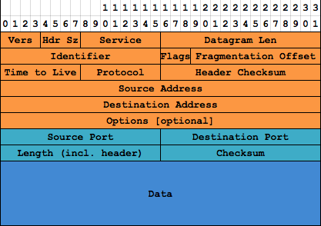
Notes:
This is what a UDP packet looks like, including its IP header info. Remember back at the TCP/IP Model slide, this is the same color coding—dark blue for our data, light blue for what UDP adds, orange for what IP adds. We’re ignoring the network layer purple stuff, because a) that only matters in one specific way, which we’ll get to later and b) it changes from network to network anyway.
Most of the orange stuff doesn’t matter—all of it is set by the operating system for us; we never actually assemble packets in memory ourselves. Couple of things worth pointing out…

Slide 21
Notes:
First, this field here holds the length of the packet, and is a 16-bit value. So packets can’t be more than 64K. In fact they have to be much, much smaller, which we’ll get to later.

Slide 22
Notes:
This field’s an interesting thing. Whenever a router forwards a packet, it decrements this field; when the field reaches zero, the packet’s discarded. This keeps undeliverable packets from cluttering up the network.

Slide 23
Notes:
This is the sender’s IP address—32 bit value. And yes, IPv6 packets have a different format; seriously don’t worry about that right now.

Slide 24
Notes:
The destination address.

Slide 25
Notes:
This is just a checksum of the header, not of your data. Corruption can and will happen—truncated packets are not at all uncommon; actual corrupted bits are completely possible on radio-backed networks like wifi and cellular; and even Ethernet can experience electrical interference.

