Slide 1
Designing a Simple Authentication Scheme

Slide 2
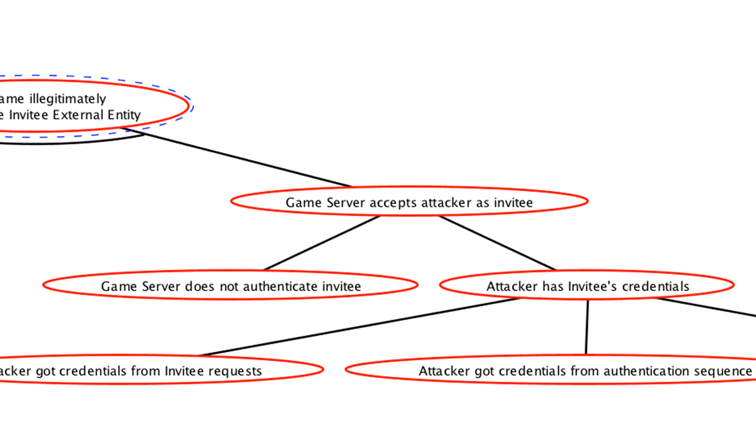

Slide 3
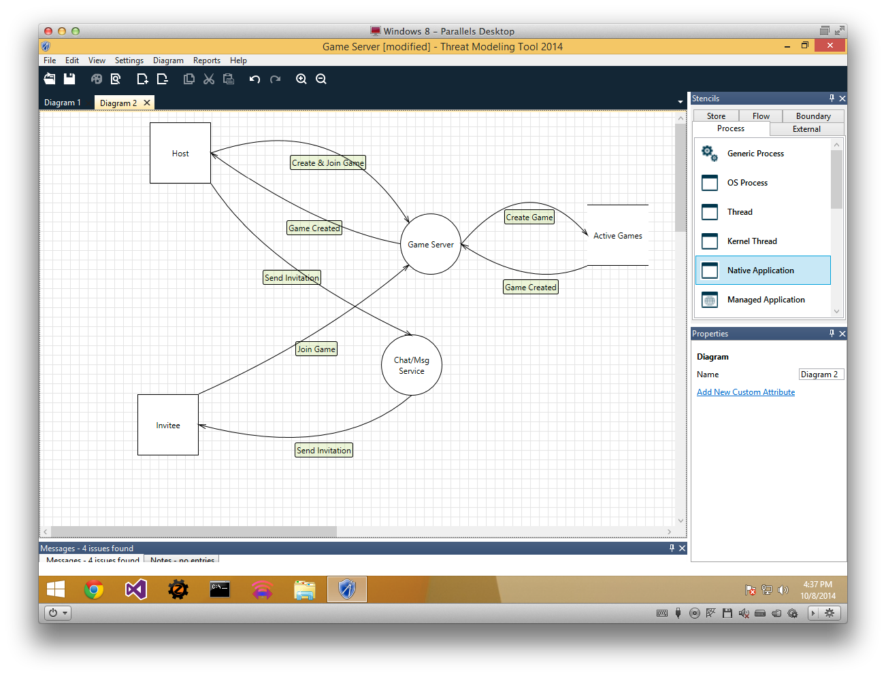
Notes:
This is our DFD from last week. To refresh our memory, our concern here is this data flow—specifically, that an attacker will pretend to be the invitee on one of these Join Game requests. So we need the Game Server to authenticate the Invitee somehow.

Slide 4
Authentication requires us to…
Demonstrate possession of a shared secret without revealing it

Slide 5
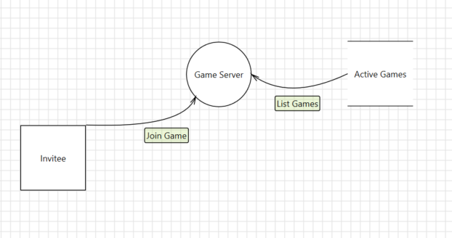
Notes:
Let’s strip away the rest of our DFD so that we just focus on the parts in question. Again, what’s happening here is that the invitee, having been given the ID of a game to join, is requesting access to that game on the game server. We need to guarantee that the entity requesting access is the one the host intended.

Slide 6
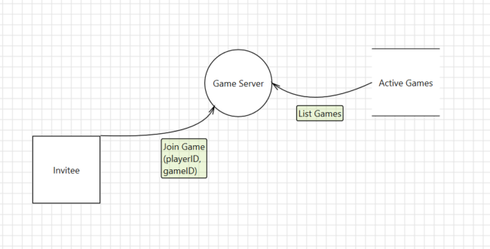
Notes:
Let’s start by putting a little more detail into our DFD. For our data flow here, we’re going to specify at a high level what the parameters are. The key parameters for joining a game are the gameID and the playerID. There might be others—what color you want to play, what character you’re using, stuff like that—but we’re leaving those out because they don’t really have any security implications. On the other hand, if we were worried about the user playing with a character they didn’t have a right to—if we were a free-to-play game, let’s say—then we’d need to track the flow of that piece of data through the system… but we might do it in a different graph than this one.

Slide 7
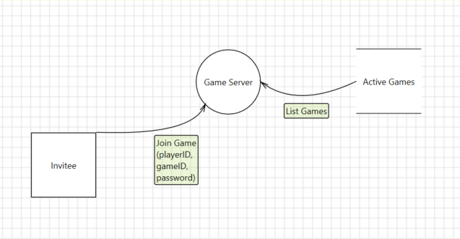
Notes:
Now let’s take the simplest possible solution. We need the invitee to prove possession of a shared secret, the password is a shared secret, so the invitee passes in the password as part of the request.

Slide 8
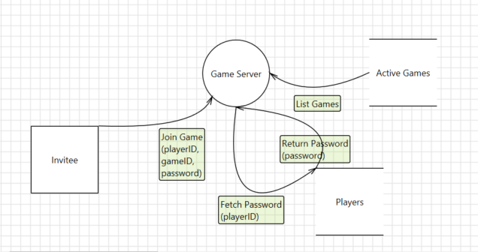
Notes:
Well, processes aren’t allowed to just magically know things—the only way the process knows the password is by fetching it from a data store. Specifically the store of player accounts. So now, in response to the join request, the game server connects to the player database, asks it for the password. If the invitee’s password matches the one in the database, great, request approved.

Slide 9
Here’s why that’s bad…
Dependent on the player database
Time-consuming
Inconvenient
Must protect request
Notes:
Spoiler alert, this is a bad solution. Why?
Well, first, the game server now has to talk directly to our player database. That takes time, which slows down our system. It also means the game server has to have a secure connection to the player database—it has to know the password for the database server, it has to have a network connection that’s not vulnerable to information disclosure, etc. Our game servers might be distributed around the world, in data centers outside our control; we’d really rather not have them routinely connecting to our accounts database.
The other problem is that we’re passing that password in on the invitee’s request, which means that data flow now has valuable information that we need to protect from disclosure. That means in turn we’re looking at encrypting that request, probably by sending it over SSL… which is expensive. Even if we have a persistent connection, where we encrypt everything that goes back and forth, symmetric encryption isn’t free.

Slide 10
Authentication requires us to…
Demonstrate possession of a shared secret without revealing it
Notes:
But let’s go back to our definition here. We don’t need the invitee to tell us the shared secret. We just need the invitee to demonstrate knowledge of the shared secret.

Slide 11
A cryptographic hash…
Reduces an arbitrary document to a fixed-size representation…
…in a way that minimizes the chance of collisions…
…and is impossible to invert in less than brute-force time.
Notes:
Let’s look at what cryptographic hashes do…
These attributes combined make them ideal for proving that we have possession of a document. Only the holder of a document can hash it, and there’s minimal risk that someone will guess the right hash randomly.

Slide 12

All About Hashes

Slide 13

H[x] = “the hash of x”
SCR[x] = “how much would x score in Scrabble”
SCR[“advance”] =
1+2+4+1+1+3+1 = 13
SCR[“advance” || “FOO”] =
19
“advance19”

Slide 14
SCR[“advance” || “BB”] = 19
SCR[“surrender” || “BB”] = 16
“surrender16”
SCR[“surrender” || “FOO”] = 16

Slide 15
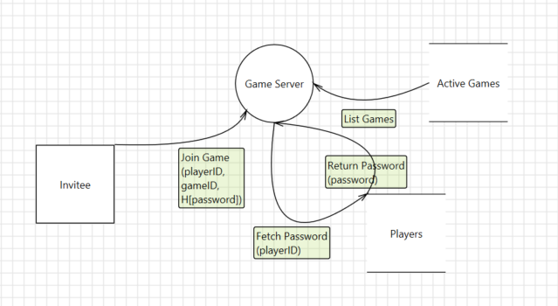
Replay attack: Resubmitting all or part of a previous request.
H[x] = “the hash of x”
H[x||y] = “the hash of x followed by y”
Notes:
So we can solve our SSL problem by just replacing the password with the hash of the password. [CLICK] H[x] just means “the hash of X”—feed the bytes of X into the hash algorithm, and send what comes out.
The invitee knows the password, hashes that, and sends it to the game server. The server fetches the password—we still haven’t solved that problem; we’ll get to that—performs the same hash, and if the values match, then the password matches.
So we’re set, right? Anyone? [CLICK] Well, no. Because think about it—all we’ve done is replace one arbitrary shared secret with another, right? Someone can just grab that hashed password and use it again. This is one example of a much broader class called “replay attacks”. [CLICK] Replay attacks simply mean grabbing part or all of a previous request and resubmitting it.
So most of the time, when we perform a hash, what we really want to do is hash a combination of two or more documents or values. We indicate that with a pipe symbol [CLICK]—so H[x||y] means the hash of X combined with Y. Most of the time, it doesn’t matter how we combine the two; sometimes it does, depending on the hash algorithm and how we’re using it. But don’t worry about that for this class; that’s an advanced subject. Bottom line is that most of the time we want to prove the authenticity of a document by hashing the document (which doesn’t change) along with something that does change.

Slide 16
Preventing replay attacks…
Known precisely to both parties
Changes over time; never reused
Cannot be influenced by attacker
Secrecy not required!
Generic term for this value is a “nonce”.
Notes:
So what are the attributes that a piece of data has to have to be a valid thing to incorporate into our hash?
First, kind of obviously, it needs to be known precisely to both parties. Remember that tiny changes in a document lead to major, unpredictable changes in hash value, so whatever the value is, both ends need to know it exactly.
Second, it needs to change over time. Now, what “time” means here varies, and depends on what we’re using this for. Ideally, the value would change on every single request. Until it changes, we’re vulnerable to replay attacks.
Third, it’s critically important that an attacker or other untrusted party can’t influence the choice of nonce.
Fourth, and this is not necessarily intuitive, the value doesn’t have to be secret! The shared secret is the document—the password in this case. Without that value, the hash cannot be correct, so there’s no need to introduce additional secrets into the process.
We can generically call a value being used this way a “nonce”, which simply means “something only used once”.

Slide 17
Nonce candidates…
Challenge value from server
Time or date
Sequence number
Notes:
Challenge values are fetched from the server prior to the request.
These other values have to be agreed upon beforehand between the server and client.
Difficulty with time or date is that the server and client may disagree. Also, fencepost problems—hashes require precision.
Difficulty with sequence number is that the server now has to remember it. If there’s a different sequence number for each client, then the server has to remember one such number per client, which gets annoying and expensive. But often there’s no choice.

Slide 18
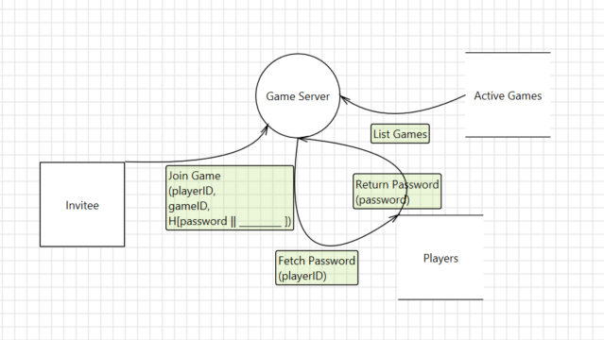
Notes:
We need to pick some value to use as our nonce.

Slide 19
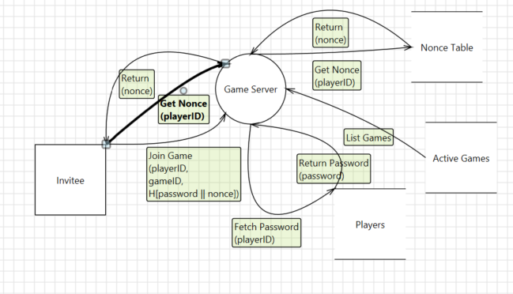
Notes:
And now that we have a nonce, we need to get it from the server to the client. That’s easy—the client just asks for it! Remember, it doesn’t have to be secret, it just has to be picked by a trusted source.
So now, on join game, the client passes playerID, gameID, and the hash of the password combined with the nonce. The game server fetches the password, the expected nonce, and repeats the hash calculation. If it comes up with the same result, the request is accepted.
None of the values that are passing in our data flow there to and from the client are secret, so no SSL is necessary. That’s one of the problems fixed. But we still have the game server talking to the players database.
The only thing password does here is serve as a shared secret. Wouldn’t it be nice if the client had some secret that we didn’t have to look up—that the game server could calculate?

Slide 20
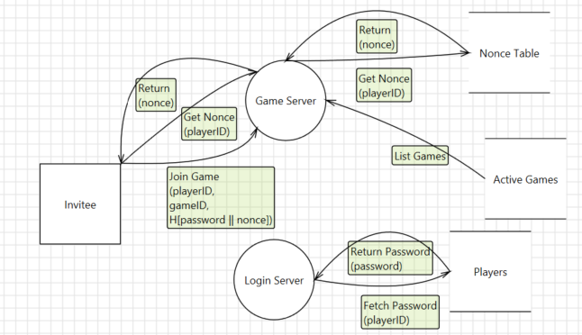
Notes:
Let’s start by moving responsibility for login to a login server. We don’t mind having a server doing this, we just don’t want it to be the game server, for the reasons we discussed—database lookups are slow (which is okay if we only do them once per session), and we might have lots of game servers but only a few login servers.
Note that the communication with the login server does need to be over SSL, both ways. But since logins are the only thing the login server handles, the expense of SSL is affordable.

Slide 21
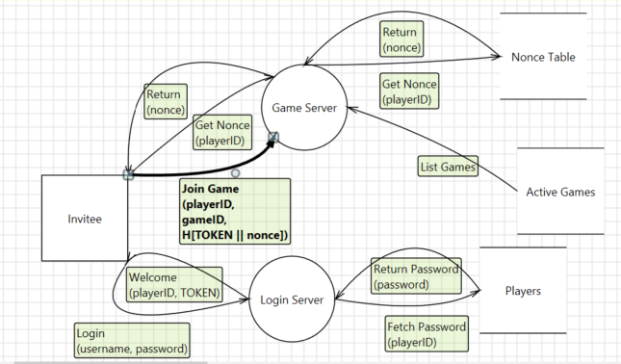
Token: Shared secret chosen by a third party.
T = H[playerID || date || key]
Notes:
So if the client isn’t going to pass a password to the game server, what’s it going to pass? It’s going to pass a “token”, which is defined as a shared secret that’s chosen by a third party. In this case, the login server generates the token and returns it to the client as part of the login process.
What’s the token? We can define it to be anything we want. Our criteria are that it can only be created by a trusted source, that it be unique per player, and (ideally) that it be somewhat ephemeral—the user can’t reset a token the way she can a password, so we need to automatically reset tokens for her.
Here, we’re going to say that the token is simply a hash of the playerID, today’s date, and a key. The key is a shared secret known only to the game server and the login server… and that’s the only direct communication between the two servers. Both the game server and the login server are equally capable of calculating this token.
So now, when the client sends the join game message, it first asks for the nonce (if it doesn’t already know it from a previous request), then sends playerID, gameID, and the hash of the token and the nonce. The game server calculates the token from playerID, date and key, then calculates the expected hash of the token and the expected nonce. If the expected hash and the actual hash match, then the request must be authentic—it must have come from an entity that knows the token, and it must be fresh because it incorporates the correct nonce.

Slide 22
No connection between Game Server and Player database/Login Server
Game Server requests contain no secret information and don’t need SSL
Invitee is authenticated

Slide 23
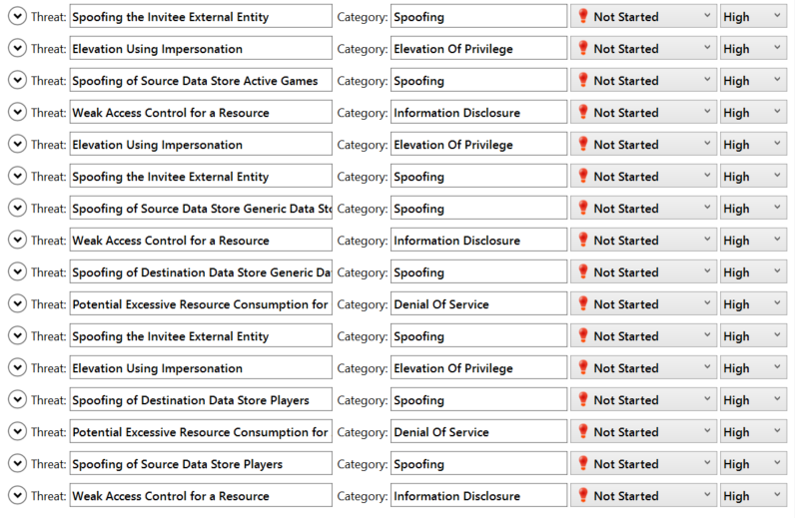
Notes:
So now we’ll switch the threat modeling tool to analysis view

Slide 24
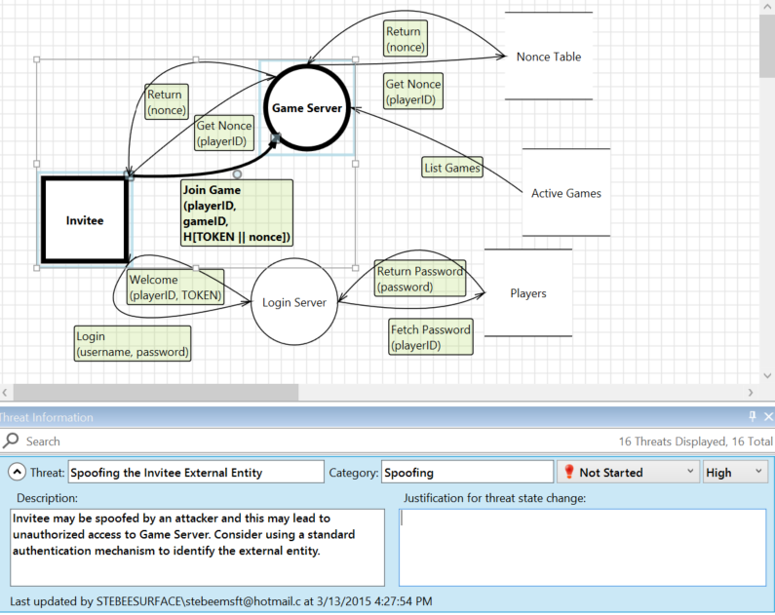
Notes:
When we click on this drop arrow, we expand the threat so that we can edit it. At the same time, it automatically highlights the elements we’re dealing with. Here, the threat is spoofing of the invitee on the Join Game data flow to the Game Server, and we can see those elements highlighted.

Slide 25
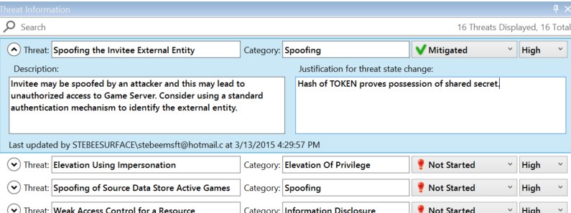
Notes:
We mark this threat as mitigated, because by proving ownership of TOKEN, the invitee demonstrates possession of a shared secret—which is how we authenticate entities.

Slide 26
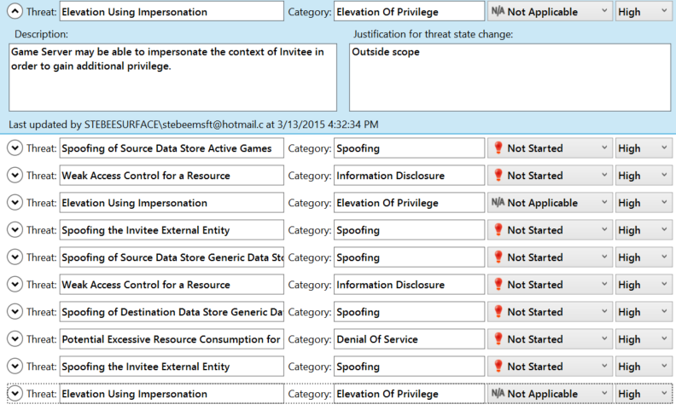
Notes:
These elevation of privilege threats we mark as Not Applicable because they’re out of scope. They’re all threats of the processes pretending to be the invitee. That’s an interesting and valid threat for many kinds of software—like for example if we were threat modeling a proxy server, we wouldn’t want the proxy server to be able to pretend to be the client. (That’s what Superfish does, right?) But in this threat model, the game server and login server are by definition trusted—they are the things we’re protecting—so these elevation threats don’t mean anything to us.

Slide 27
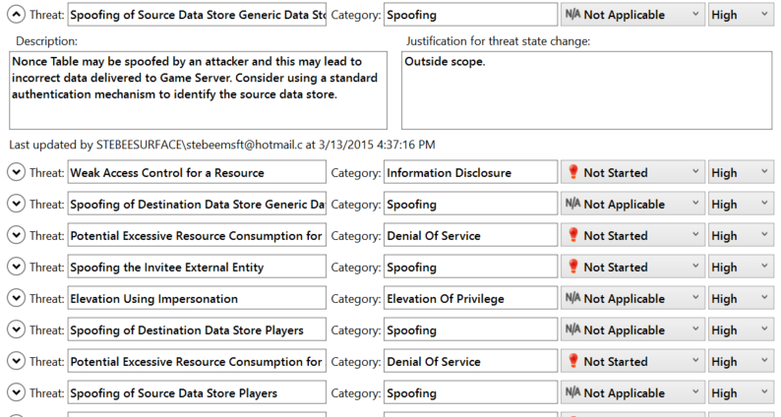
Notes:
Similarly, there’s a raft of spoofing threats where an attacker could pretend to be one of our data stores. We mark all those as NA, since those data stores are inside our data center and thus trusted.

Slide 28
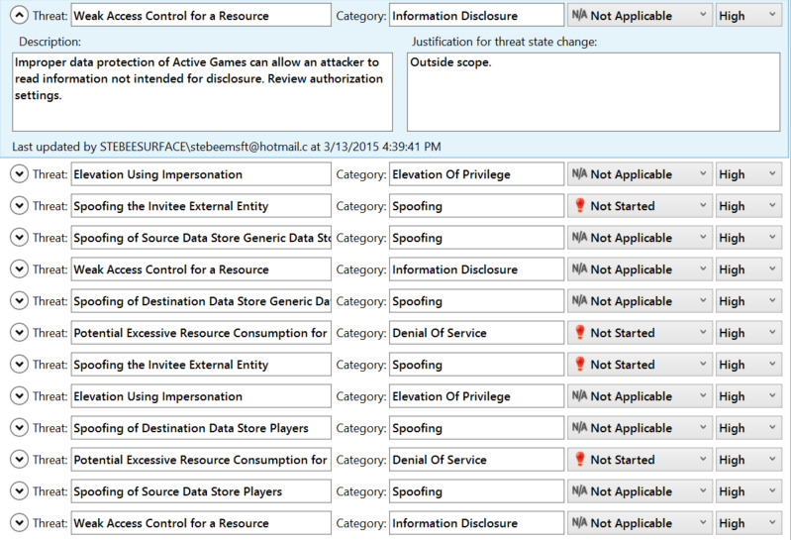
Notes:
Same deal here—the tool is warning us that the data flow from our data stores to our processes might leak info, but again, our data center is trusted. All these are outside our scope.

Slide 29
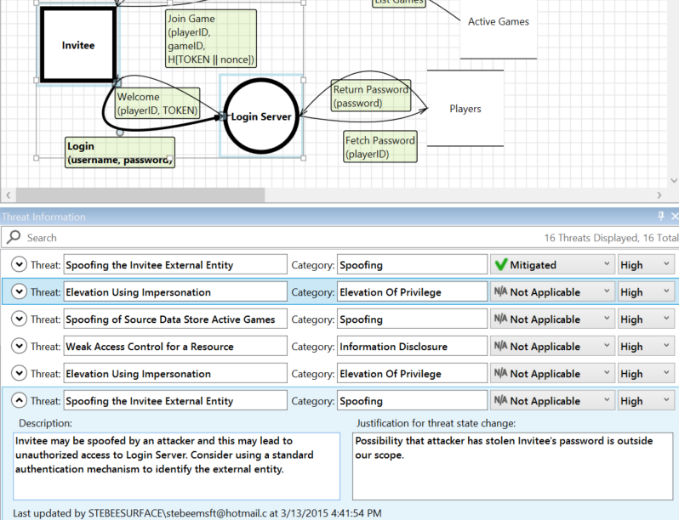
Notes:
Here’s a spoofing threat—the attacker could pretend to be the invitee on the login request. What’s that really saying? That’s right, it’s just saying “the attacker could have the invitee’s password”. We can’t defend against that, so that’s NA, outside our scope.

Slide 30
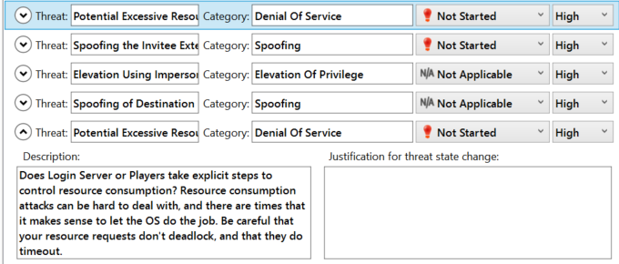
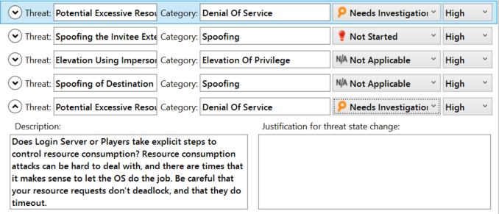
Notes:
We’re down to just three potential threats. The spoofing one here is what we were originally setting out to solve, so we’ll save that for last.
These two denial of service threats are interesting—one is against the players database, one is against the nonce table… [ELABORATE]

Slide 31
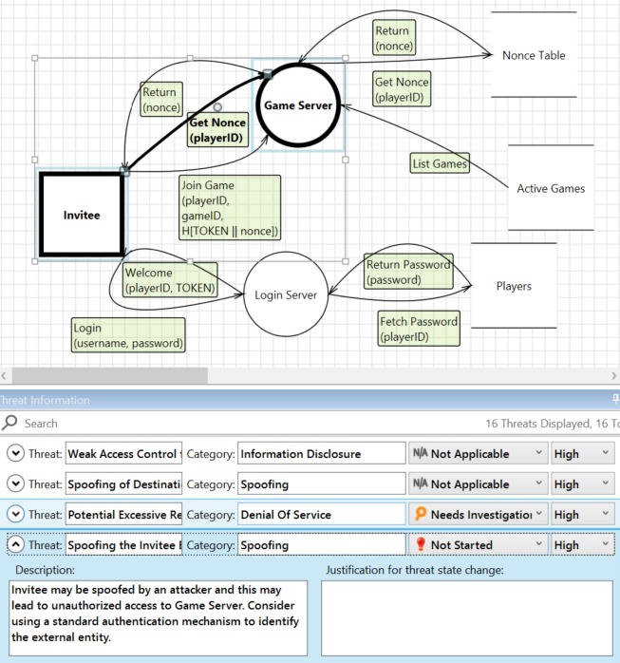
Notes:
At last we’ve got just one threat left, the spoofing attack against the invitee. Since that’s what we came here to solve, we’re going to spend some extra effort analyzing it, rather than just say “yup, mitigated!” [WHITEBOARD]

Slide 32
Questions

