Slide 1
Cryptographic Protocols

Slide 2
Algorithms vs. Protocols
Algorithm
A mathematical procedure used to transform data.
Protocol
A series of steps and message exchanges between multiple entities to achieve a specific cryptographic result.
Notes:
Algorithms are things like AES, SHA or RSA. Protocols are recipes that tell us how to apply algorithms.

Slide 3
Example Protocols
WPA2
Restricts wifi access to authorized users, and encrypts their traffic.
SSL/TLS
Verifies the identity of a web server, and encrypts traffic to and from that server.
Bitcoin
Allows the secure and decentralized transfer of value from one account to another.
Notes:
WPA2-personal is what DP’s wifi uses.
TLS is the new name for SSL, which you use on a daily basis.
You’ve heard of bitcoin.

Slide 4
Creating a Protocol
Identify your objective(s)
Understand your data
Methodically look for openings
Find ways to plug the openings

Slide 5
Creating a Protocol
Identify your objective(s)
Create data flow diagram
STRIDE x elements
Attack trees
Aim for 100% mitigation
Notes:
Sounds a lot like threat modeling, doesn’t it? Creating a protocol is basically what we’ve been doing: You figure out what you’re trying to accomplish, you document the things that take part in that process, you do STRIDE x elements to methodically catalog everything an attacker could try to exploit, then you create attack trees to figure out what an attacker has to achieve.

Slide 6
WPA2: WiFi Protected Access, v2
Block unauthorized users Protect authorized users

Slide 7
WPA2 Objectives
Verify identity of client
Verify identity of router
Encrypt against external listeners
Non-goal: Encrypt against internal listeners
Do all this on cheap hardware
Notes:
WPA2 is the latest in a long series of protocols to secure wifi. It’s the only one that’s secure, now, and even it has some flaws… but that’s outside our scope. Goal here is to learn about the process and the principles; the details of WPA2 are only interesting because they’re illustrative of that.
Allowing internal listeners to sniff our traffic is considered okay, because it meets the bar of Ethernet. (WEP = wired equivalent privacy)
This last point is really important and drives a lot of choices that seem otherwise strange. [ESP8266]

Slide 8
Possible Solutions
Encrypt packets with shared key
Strong key isn’t human-friendly
Client generates key
How to transmit securely to router?
Only solution is for client and router to collaboratively generate unique key.
Notes:
WPA2 is the latest in a long series of protocols to secure wifi. It’s the only one that’s secure, now, and even it has some flaws… but that’s outside our scope. Goal here is to learn about the process and the principles; the details of WPA2 are only interesting because they’re illustrative of that.
This last point is really important and drives a lot of choices that seem otherwise strange. [ESP8266]

Slide 9
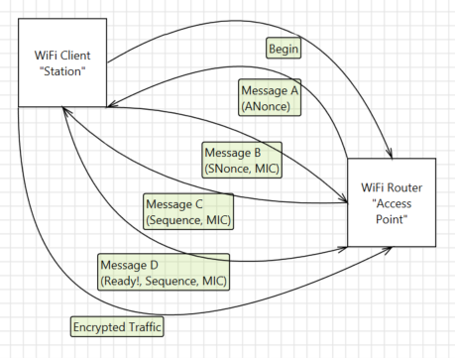
“Four-way Handshake”
Key = PRNG ( PWD + ANonce + SNonce + AMAC + SMAC )
Notes:
First, the “begin” arrow is actually hiding some two-way traffic. [TALK ABOUT ALGORITHM NEGOTIATION, ALGORITHM FUNGIBILITY, LEGACY SUPPORT]
MIC = Message Integrity Check = HMAC. Talk about difference between HMAC and normal hash (H(key || message) vs H(message || key), hash initialization vector extensibility… should probably fold that discussion into the original mitigations deck eventually

Slide 10
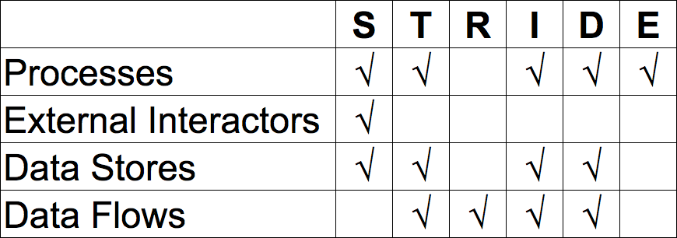
STRIDE x Elements
Just external interactors and data stores. Repudiation = not applicable Denial of service = out of scope
Notes:
First, the “begin” arrow is actually hiding some two-way traffic. [TALK ABOUT ALGORITHM NEGOTIATION, ALGORITHM FUNGIBILITY, LEGACY SUPPORT]
MIC = Message Integrity Check = HMAC. Talk about difference between HMAC and normal hash (H(key || message) vs H(message || key), hash initialization vector extensibility… should probably fold that discussion into the original mitigations deck eventually

Slide 11
STRIDE x Elements
Spoof Client
Spoof Router
Tamper Messages A-D
ID Messages A-D
Tamper Encrypted Traffic
ID Encrypted Traffic
Notes:
BTW, replay attacks are a kind of spoofing. [ADD TO ORIGINAL DECK!]
Talk about Internet Model layers, how this is far down the stack means we don’t need to know anything at all about it.
DICTIONARY ATTACK AGAINST WPA2! (PWD is the only secret…)
If you don’t look at this, and the way it can be attacked, and go “cool”... do not become a network programmer.

Slide 12
WPS = Satan
“Let’s replace the passphrase with an 8-digit PIN… ...well, 7 digits, because one is a checksum… ...and since 8 digits are hard to remember, we’ll tell you which half you got right!”
Notes:
When an enrollee attempts to gain access using a PIN, the registrar reports the validity of the first and second halves of the PIN separately. Since the first half of the pin consists of four digits (10,000 possibilities) and the second half has only three active digits (1000 possibilities), at most 11,000 guesses are needed before the PIN is recovered. This is a reduction by three orders of magnitude from the number of PINs that would be required to be tested. As a result, an attack can be completed in under four hours. The ease or difficulty of exploiting this flaw is implementation-dependent, as Wi-Fi router manufacturers could defend against such attacks by slowing or disabling the WPS feature after several failed PIN validation attempts.^{[4]} Unfortunately, some devices can also be more prone to attack; in August 2014, researchers found that several devices used weak randomization in keys used to authenticate the WPS PIN.^{[10]} An attack against these devices requires only a single guess instead of 11,000, but has to be followed by a series of offline calculations.

Slide 13
SSL/TLS: Secure Sockets Layer/ Transport Layer Security
Verify server identity
Protect HTTP traffic
Notes:
Tied to HTTP, but not really… perfectly possible to use on non-HTTP connections.
Netscape developed the original SSL protocols.^{[9]} Version 1.0 was never publicly released because of serious security flaws in the protocol; version 2.0, released in February 1995, "contained a number of security flaws which ultimately led to the design of SSL version 3.0".^{[10]} SSL version 3.0, released in 1996, represented a complete redesign of the protocol, produced by Paul Kocher working with Netscape engineers Phil Karlton and Alan Freier, with a reference implementation by Christopher Allen and Tim Dierks of Consensus Development. Newer versions of SSL/TLS are based on SSL 3.0. The 1996 draft of SSL 3.0 was published by IETF as a historical document in RFC 6101.
Dr. Taher Elgamal, chief scientist at Netscape Communications from 1995 to 1998, is recognized as the "father of SSL".^{[11][12]}

Slide 14
SSL Objectives
Verify identity of server
Non-goal: Verify identity of client
Encrypt against MITM listeners
Including MITM on client
Full resources of client and server available

Slide 15
Possible Solutions
Generate a key similar to WPA2
Every other user would know it
Server could generate key
No shared secret with client
Client generates key, then submits it to server encrypted with public half of server’s asymmetric encryption key.
Notes:
Server could publish a key that we use

Slide 16
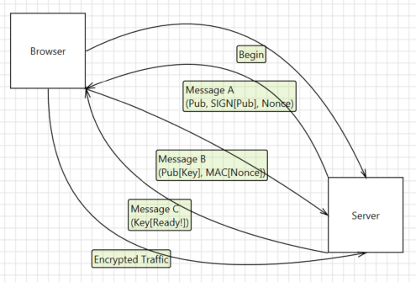
SSL/TLS Key Exchange
SIGN[X] = Priv[H[X]]
Notes:
Talk about certificate chain of trust
Talk about OPM hack, China violation of chain of trust

Slide 17
STRIDE x Elements
Spoof Server
Tamper Messages A-C
ID Messages A-C
Tamper Encrypted Traffic
ID Encrypted Traffic
Notes:
Refer to Superfish attack

Slide 18
Bitcoin
Securely transfer value from one account to another…
...without a central authority

Slide 19
Bitcoin Objectives
Alice can transfer value to Bob
Eve cannot transfer value from Alice without Alice’s permission
Alice cannot repudiate the transfer
The transfer isn’t secret… but it’s secret-ish
No central authority
Can’t fail or be compromised
Cannot create new currency (“gold standard”)
Notes:
Secret-ish means that bitcoin accounts are just numbers. You can trace transactions to accounts, but unless/until you come up with a way to tie an account to a user, you can’t tie transactions to people.

Slide 20
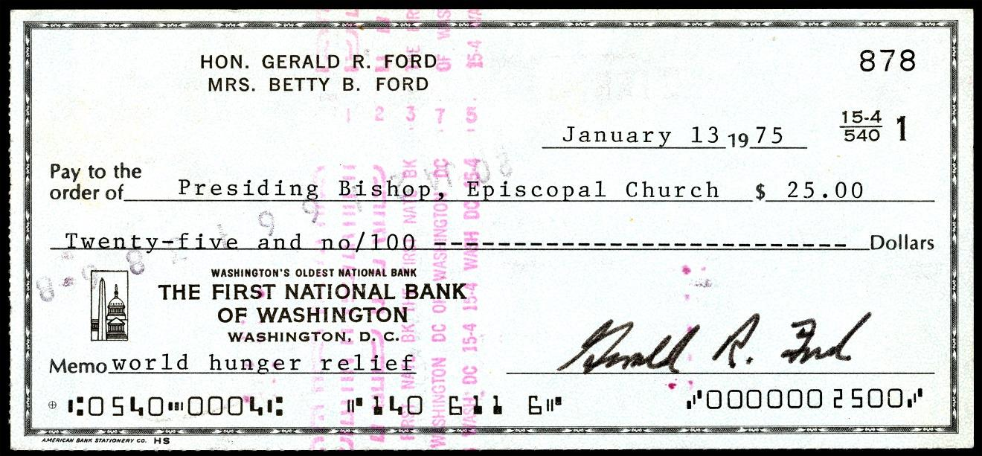
Possible Solutions
Notes:
To think about possible solutions, let’s look instead at the previous solution, and talk about why it won’t work.
Does the first thing, sure.
Eve can transfer value without Alice’s permission--check forgery happens all the time.
Forgery is fixed through reversing the transfer--through repudiation, in other words.
And there’s clearly a central authority.
But what the check represents behind the scenes is numbers moving from one row of a ledge to another. So a purely mathematical solution is possible, we just have to find it.

Slide 21
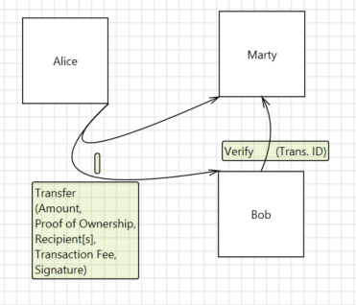
Bitcoin, Step 1: Transactions
Notes:
Proof of ownership is, essentially, the transaction IDs of all the transactions that resulted in Alice having enough money to make this transaction.
If those IDs add up to more money than is necessary, Alice adds herself to the recipients list, to “get change”.
The transaction fee is paid to somebody… don’t worry about who yet.

Slide 22
STRIDE x Elements
Spoof Alice
Spoof Bob
Tamper with transfer
Spoof Marty …
Repudiate transfer …
Notes:
Spoofing Bob doesn’t matter--he can’t refuse the transaction, which is interesting.
This is a protocol where we do care about repudiation, very much.
So we’re partway there, sure, but we’re not all the way there yet. We’ve just replaced one central authority, a bank, with another--some random guy named Marty. Let’s threat model how Alice can rip off Bob...

Slide 23
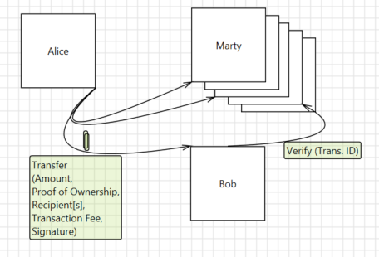
Bitcoin, Step 2: Verification
Notes:
Alice now sends her transaction to a large group of Marties. Bob picks a random one from that group. In fact Bob picks one after the other after the other. Now what has to be true for Alice to get away with this…
[still possible to collude; what if they disagree; what if they vanish; what about timing]

Slide 24
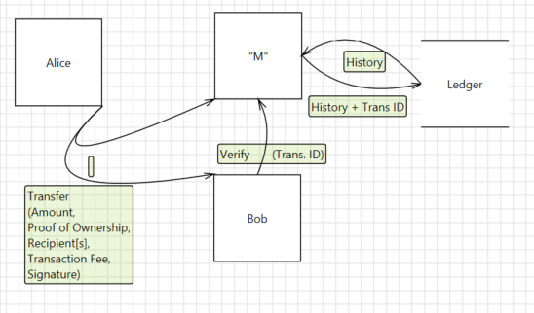
Bitcoin, Step 3: Update Ledger
Notes:
What we really want is for everybody to agree, so that it doesn’t matter who Bob talks to. And what we’re really doing is not monitoring a single transaction, but building up a huge account book of every transaction ever made; this transaction is just the newest row in that book. Just like Bob was able to solve his trust issue by picking a random Marty, we’re going to solve the ledger trust issue by only letting a random Marty write to it. But we don’t want a central authority to pick the random winner, so we need some mechanism by which a random winner will happen automatically.
proof of work: create P such that H[C + P] = 000….000xxxxxxxxxx, where first N bits (40 right now) are 0. Must be brute force, time proportional to 2^N.
Proof of work also used for anti-spam.
Note that verifying proof of work is trivial.
So to write in the ledger, a node has to discover the right P. Each node is working on a slightly different block--they may have different views of transactions (not seeing one or another), but more importantly, the node includes two special transactions to itself: there’s an automatic bounty of new value injected into the system, and there’s all the transaction fees for every transaction in the batch (or block). Those bounties are awarded to the winning node.
21 million can be generated; coinbase is limited. Reward started at 50 btc; every 210,000 blocks that gets halved (roughly every 4 years). Protocol is designed so that it takes about 10 minutes to add a block; if it takes significantly more or less than that, the system adjusts the protocol to be easier or harder. (The rules for adjustment are public, the information is public, so everyone agrees on the change as part of the protocol.)

Slide 25
STRIDE x Elements
Spoof “M”
Repudiate transfer
Notes:
Bob has to create a separate transaction block chain that leaves out the repudiated transaction, and hope that that block is accepted as the one true block
When multiple blocks compete, they’re all ignored until there’s a solution
Once there’s a solution, the accepted solution is the one that had the most work put into it--which basically means the one that incorporates the most transactions (or the transactions involving the bitcoins with the most complex and lengthy history).
has to do the proof of work himself
has to rival the existing chain that is longer… and that chain is getting longer every 10 minutes
basically Bob has to have more computing power than the honest/disinterested pool--more than half the total computing power in the system.
Forks in the chain can happen naturally.
Nodes always consider the longest chain to be the correct one and will keep working on extending it. If two nodes broadcast different versions of the next block simultaneously, some nodes may receive one or the other first. In that case, they work on the first one they received, but save the other branch in case it becomes longer. The tie will be broken when the next proof-of-work is found and one branch becomes longer; the nodes that were working on the other branch will then switch to the longer one.
The steps to run the network are as follows:
1) New transactions are broadcast to all nodes.
2) Each node collects new transactions into a block.
3) Each node works on finding a difficult proof-of-work for its block.
4) When a node finds a proof-of-work, it broadcasts the block to all nodes.
5) Nodes accept the block only if all transactions in it are valid and not already spent.
6) Nodes express their acceptance of the block by working on creating the next block in the chain, using the hash of the accepted block as the previous hash.
Nodes always consider the longest chain to be the correct one and will keep working on extending it. If two nodes broadcast different versions of the next block simultaneously, some nodes may receive one or the other first. In that case, they work on the first one they received, but save the other branch in case it becomes longer. The tie will be broken when the next proofof- work is found and one branch becomes longer; the nodes that were working on the other branch will then switch to the longer one.
Every full Bitcoin node maintains a database of which unspent outputs are left.
When verifying a transaction, all its inputs are fetched from the database. If one is missing, validation fails. Among the data retrieved is the value of those unspent outputs, and their script (od address), which define the conditions under which the output can be spent. This information is necessary to validate whether the spending transaction has the correct signatures and does not create more bitcoin than it consumes.
If all validation of all transactions in a block succeed, the consumed inputs are removed from the database, and all outputs of those transactions added as fresh unspent outputs in the database, allowing them to be spent by future blocks.
As this database only contains outputs (so no signatures, for example), and even only the unspent ones, it is much smaller than the entire blockchain (some 450 MB as of juli 2014). So, no, we don't go scan through the entire blockchain to know whether outputs are not double-spent - we keep a separate database with just the data we need from it for validation.
Sending a very small amount with insufficient fees
Coinbase pays miner fees for you on all transactions except very small transactions. But if you are sending a tiny amount you will be prompted to add a miner fee to make sure the transaction gets confirmed. If an insufficient fee is included, your transaction may never confirm.
A double spend of the same coins
Under normal conditions this should not occur with transactions generated by Coinbase (our backend systems are designed to prevent this), but in general if two transactions try to spend the same coins one of them will never be confirmed by the network.
You are trying to spend unconfirmed coins
If you are trying to spend coins that appear as pending in your account, your transaction will not be generated until these coins confirm.

Slide 26
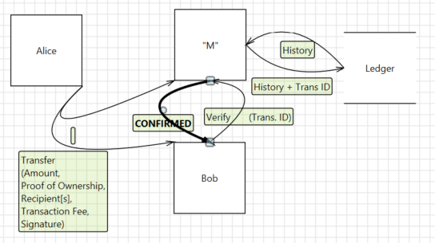
Bitcoin, Step 4: Confirmation
Confirmation takes 6 blocks (~1 hour), to minimize risk of forks.
Notes:
Awards from mining aren’t considered confirmed for 100 blocks.

Slide 27
Creating a Protocol
A protocol is effectively just a program written in a human language. To create one…
Identify your objective(s)
Understand your data
Methodically look for openings
Find ways to plug the openings
But reuse existing ones where possible!

