Slide 1
CT DevCreate BuildFest 2025
TEAM MEMBERS
K.AKHIL REDDY,CH.HEMANTH,K.SATWIK REDDY,
M.VISHNU PRABHAS,K.VISHWAHARTHAJ

Slide 2
PROBLEM STATEMENT-Smart Curriculum Activity & Attendance App
The problem is that schools still use old, manual ways to take attendance. This wastes a lot of time for teachers and students.
The Specific Problems
Wasted Class Time: Teachers spend valuable time marking attendance by hand instead of teaching.
Unproductive Free Time: When students have breaks or free periods, they often don't use the time well because they lack guidance.
No Personalized Help: Schools don't have tools to help students use their free time in a way that matches their individual interests or career goals.
In short, schools need a modern solution to save time, make attendance easier, and help students make the most of every minute of their school day.

Slide 3
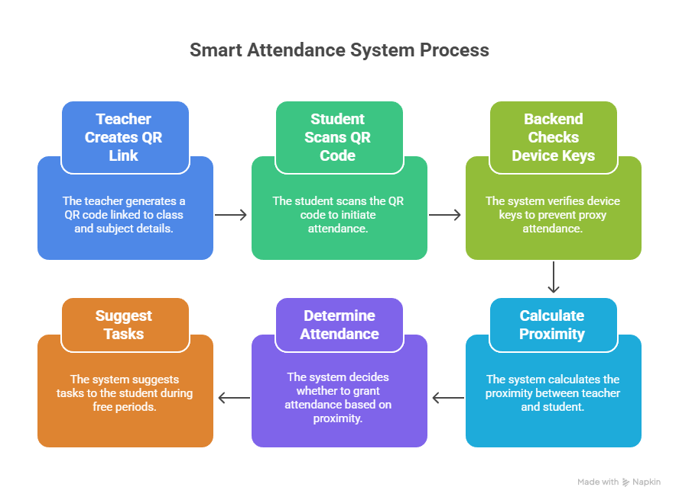
SOLUTION:-

Slide 4
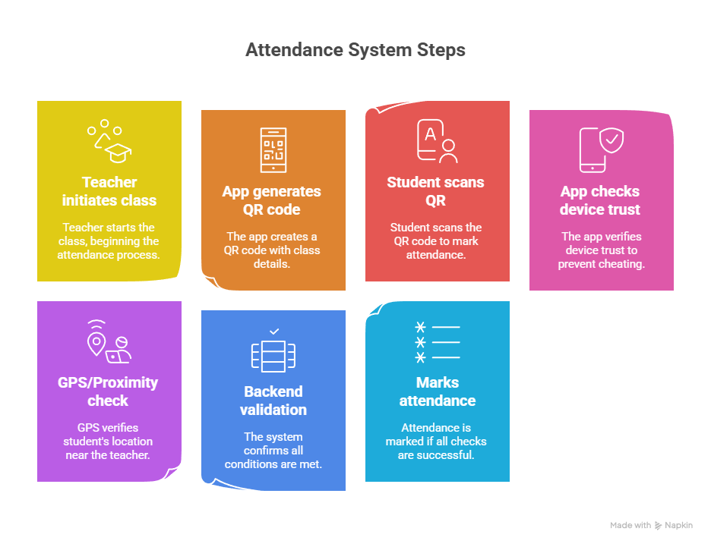
Core Flow of Attendance

Slide 5
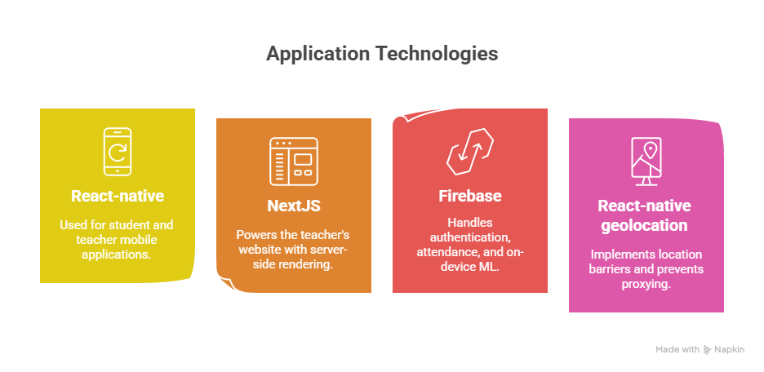
Technical Stack

Slide 6
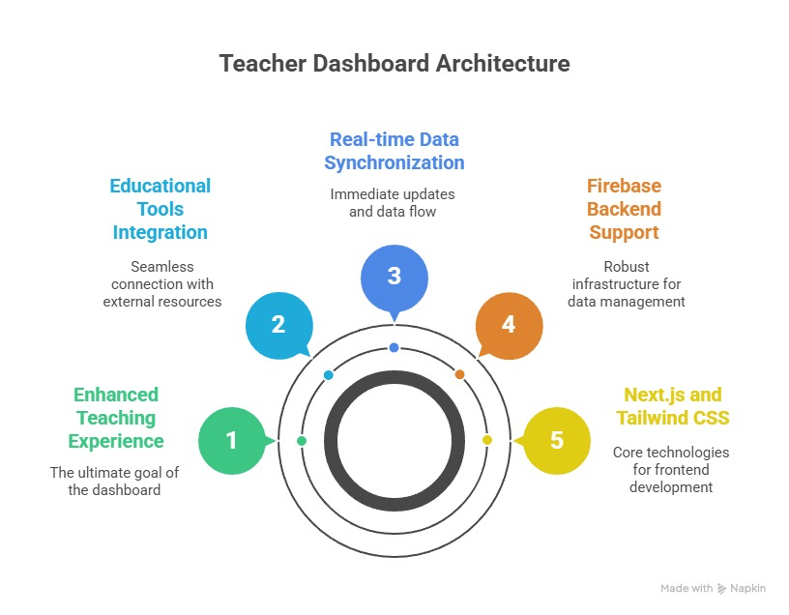
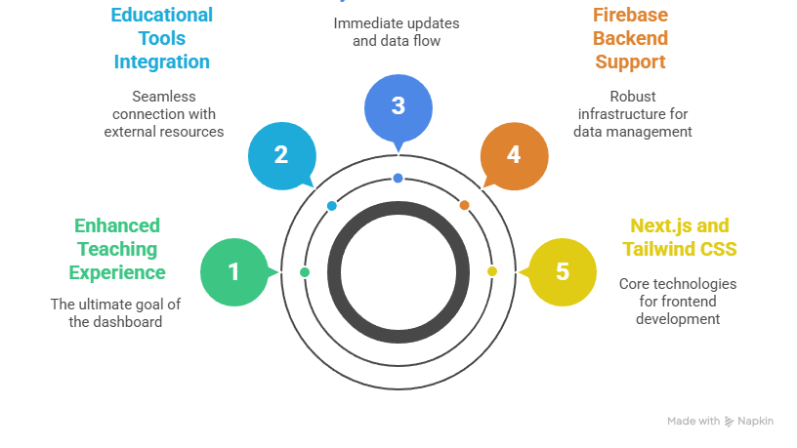
Teacher Web Portal

Slide 7
Benefits:
For Teachers:
Time-Saving: Automates the attendance process, freeing up valuable class time that can be used for teaching and student engagement.
Real-time Insights: The live dashboard provides immediate attendance metrics, allowing teachers to see who is present or absent at a glance.
For Students:
Efficiency: Students can quickly and easily mark their attendance by scanning a QR code, avoiding long queues or waiting for their name to be called.
Improved Discipline: The system encourages punctuality and honesty, as it's difficult to cheat the attendance process.

Slide 8
Impacts:
Educational Impact
More Instructional Time: By saving time on attendance, teachers can spend more time on delivering lessons, fostering discussions, and providing one-on-one help.
Improved Student Engagement: When students see how their free time can be used productively, they are more likely to stay engaged and motivated in their academic journey.
Social & Behavioral Impact
Increased Accountability: The system holds both students and teachers accountable—students for their attendance and teachers for managing the class effectively.
The multi-layered verification process (QR, device scan, proximity) reduces the temptation for students to ask a friend to mark them present.

Slide 9
Analytics Dashboard: Empowering Teachers
Average Attendance: At-a-glance view of class and student attendance trends.
Dropout & Failing Student Identification: An early warning system that uses data to flag at-risk students for timely intervention.
Proactive Insights: Move from reactive teaching to a proactive, data-informed approach.
Key Benefits:
Time-Saving: Reduces manual analysis and reporting.
Improved Student Outcomes: Enables targeted support to prevent students from failing or dropping out.
Enhanced Teacher-Student Relationship: Empowers teachers to focus on helping students who need it most.

Slide 10
A Gemini-Powered System: Productive Free Time
Personalized Recommendations: Gemini analyzes student interests, class performance, and career aspirations to suggest meaningful activities.
Multimodal Engagement: The system can recommend a variety of content formats, including video tutorials, articles, project ideas, and interactive quizzes.
Goal-Oriented Suggestions: Activities are not just random; they are aligned with a student's stated goals, helping them build a portfolio of skills during their free time.
Key Benefits:
From Passive to Productive: Transforms idle time into a valuable opportunity for learning and growth.
Increased Engagement: Students are more motivated when activities are tailored to their interests.
Future-Ready Skills: Helps students develop skills that directly support their academic success and career readiness

