Slide 1



Infobip
Mobile Messaging Specialists
www.infobip.com

Slide 2
Machine learning with neural networks Danijel Temraz

Slide 3
Agenda – part one
Quick start example
Bayes theorem
Naive Bayes classifier
Text classification
Case study SMS spam filter
Alternative solutions

Slide 4
Agenda – part two
Motivational example
Neuron model
Supervised learning
Linear separability
Perceptron
AND, OR, NAND, XOR
Delta rule
Unsupervised learning
Feed forward networks
Backpropagation

Slide 5
Animal classification
Determine if a given animal is a dog, a cat or something else if we know these features distribution:
Disclaimer: I have a cat and a dog ☺
Classify unseen animal which is grumpy, has more than 6 kg and disloyal
Feature | Dog | Cat | Other
Cheerful | 80% | 15% | 50%
Less than 6 kg | 5% | 90% | 10%
Loyal | 95% | 6% | 45%

Slide 6
Animal classification
P(Dog|cheerful, weight, loyal) =
P(Dog) *0.2 * 0.95 * 0.05 = 0,0095
P(Cat|cheerful, weight, loyal) =
P(Cat) * 0.85*0.6*0.99 = 0,5049
P(Other|cheerful, weight, loyal) = P(Other)*0.5*0.9*0.55 = 0,2475
Ignore class probabilities for now
This is the basic idea behind widely used classification algorithm known as Naive Bayes

Slide 7
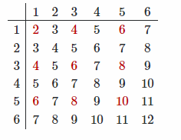
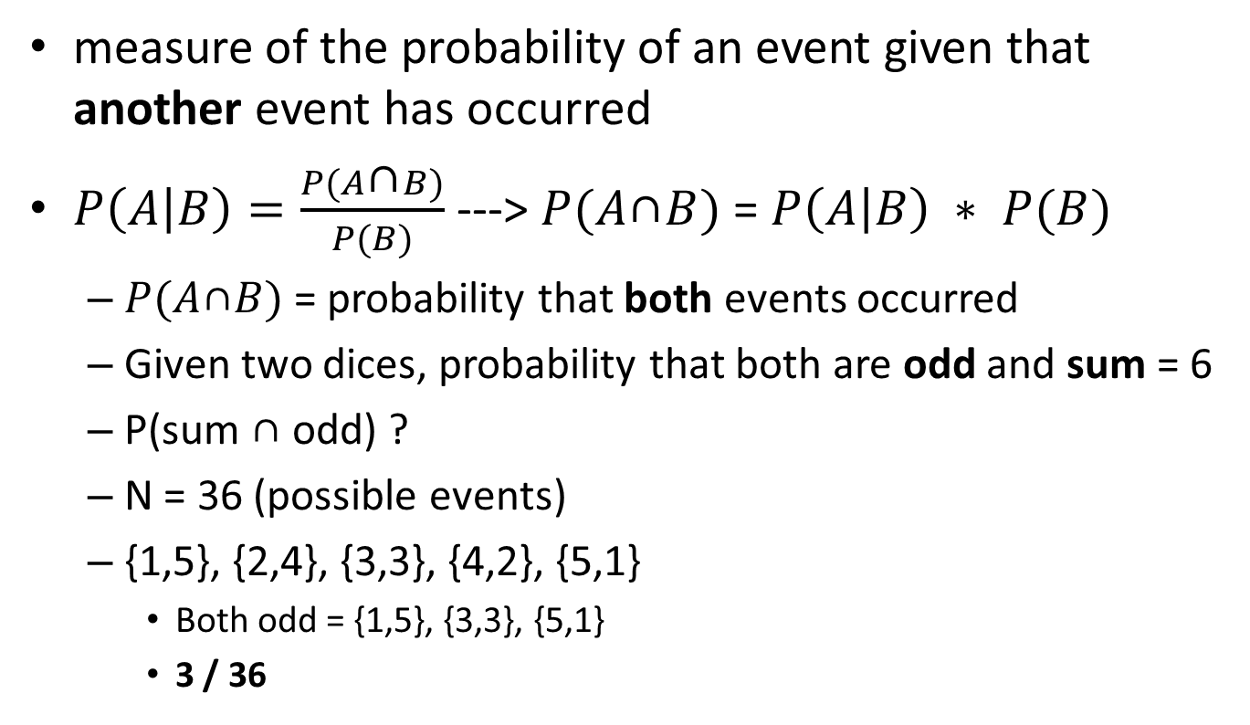
Conditional probability
measure of the probability of an event given that another event has occurred
$P\left(A | B\right)=\frac{P(A\text{∩}B)}{P(B)}$ ---> $P(A\text{∩}B)$ = $P\left(A | B\right) ∗ P(B)$
$P(A\text{∩}B)$ = probability that both events occurred
Given two dices, probability that both are odd and sum = 6
P(sum $\text{∩}$ odd) ?
N = 36 (possible events)
{1,5}, {2,4}, {3,3}, {4,2}, {5,1}
Both odd = {1,5}, {3,3}, {5,1}
3 / 36

Slide 8
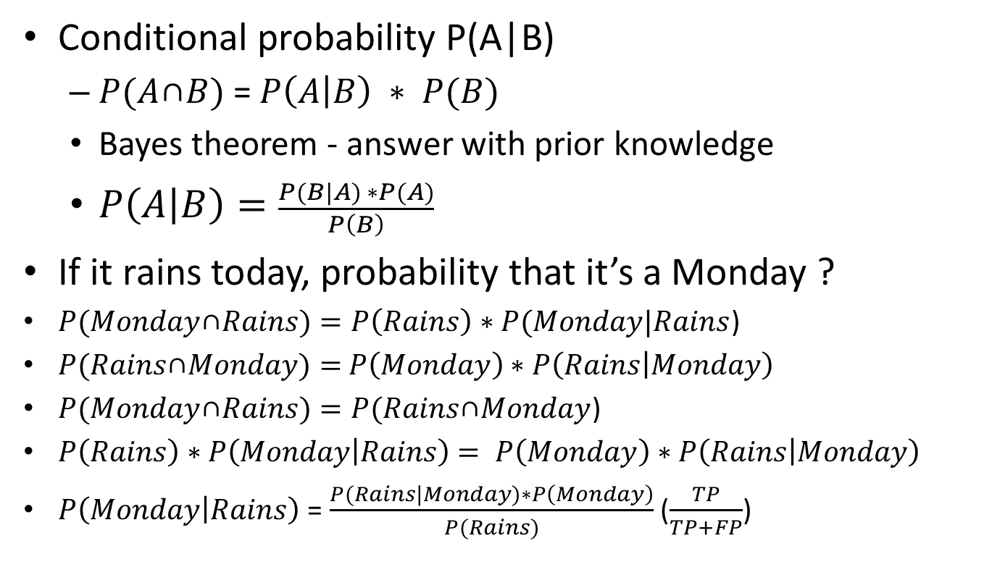
Bayes theorem
Conditional probability P(A|B)
$P(A\text{∩}B)$ = $P\left(A | B\right) ∗ P(B)$
Bayes theorem - answer with prior knowledge
$P\left(A | B\right)=\frac{P(B|A) ∗P(A)}{P\left(B\right)}$
If it rains today, probability that it’s a Monday ?
$P(Monday\text{∩}Rains)=P\left(Rains\right)∗P(Monday|Rains$)
$P(Rains\text{∩}Monday)=$ $P\left(Monday\right)∗P\left(Rains | Monday\right)$
$P(Monday\text{∩}Rains)=P(Rains\text{∩}Monday$)
$P\left(Rains\right)∗P\left(Monday | Rains\right)$ $= P\left(Monday\right)∗P\left(Rains | Monday\right)$
$P\left(Monday | Rains\right)$ = $\frac{P(Rains|Monday)∗P\left(Monday\right)}{P(Rains)}$ ($\frac{TP}{TP+FP}$)

Slide 9
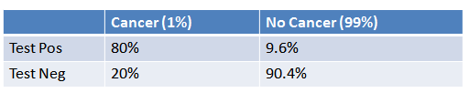
Bayes theorem
1% of women have breast cancer
80% of mammograms detect breast cancer when it is there
9.6% of mammograms detect breast cancer when it’s not there
Chances of cancer, given positive mammogram?
P(cancer|mammogram ) = 7.8 %
Bayes let’s us correct for false positives

Slide 10
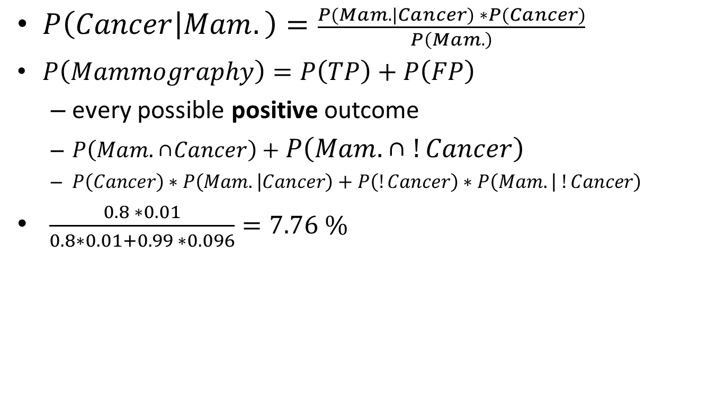
Bayes theorem
$P\left(Cancer | Mam.\right)=\frac{P(Mam.|Cancer) ∗P(Cancer)}{P\left(Mam.\right)}$
$P\left(Mammography\right)=P\left(TP\right)+P\left(FP\right)$
every possible positive outcome
$P\left(Mam.\text{∩}Cancer\right)+$ $P\left(Mam.\text{∩} !Cancer\right)$
$P\left(Cancer\right)∗P\left(Mam. | Cancer\right)+P\left(!Cancer\right)∗P\left(Mam. | !Cancer\right)$
$\frac{0.8 ∗0.01}{0.8∗0.01+0.99 ∗0.096}=7.76 \%$

Slide 11
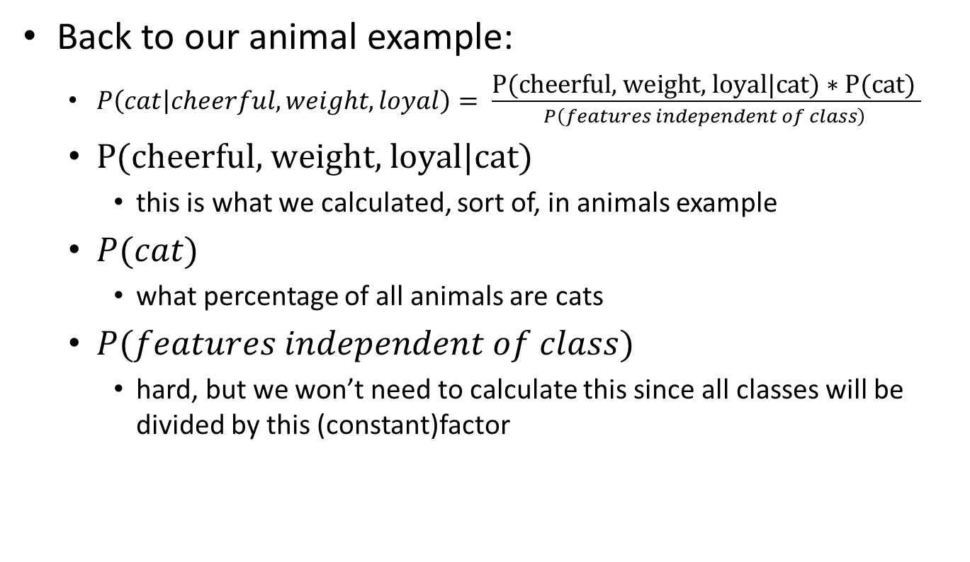
Bayes theorem
Back to our animal example:
$P\left(cat | cheerful, weight, loyal\right)= \frac{\text{P}\text{(}\text{cheerful}\text{, }\text{weight}\text{, }\text{loyal}\text{|}\text{cat}\text{) ∗ }\text{P}\text{(}\text{cat}\text{)} }{P\left(features independent of class\right) }$
$\text{P}\text{(}\text{c}\text{heerful}\text{, }\text{weight}\text{, }\text{loyal}\text{|}\text{c}\text{at}\text{) }$
this is what we calculated, sort of, in animals example
$P(cat)$
what percentage of all animals are cats
$P(features independent of class)$
hard, but we won’t need to calculate this since all classes will be divided by this (constant)factor

Slide 12
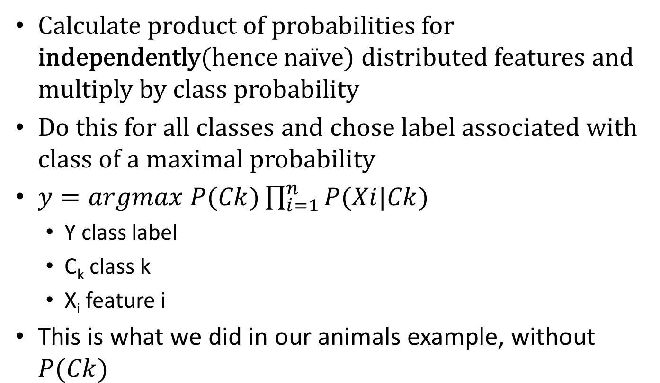
Naïve Bayes
Calculate product of probabilities for independently(hence naïve) distributed features and multiply by class probability
Do this for all classes and chose label associated with class of a maximal probability
$y=argmax P(Ck)\prod_{i=1}^{n}{P(Xi|Ck)}$
Y class label
C_{k} class k
X_{i} feature i
This is what we did in our animals example, without $P(Ck)$

Slide 13
Naïve Bayes
Multinomial
classification, feature frequency matters
Bernoulli
classification, feature presence matters over frequency
Gaussian
real numbers regression
Spam filtering
Documents classification and ranking
Medical treatment
Sentiment analysis (opinion mining)

Slide 14
Text classification
Consider these texts and their categories:
Prepare probability tables of words per class
Text | Category
cockatoo is awesome pet | Other
java is cumbersome for numerical analysis | Other
Stephen King is a great writer | Other
multivariate regression | Machine learning
feature analysis | Machine learning
linear discriminant analysis | Machine learning

Slide 15
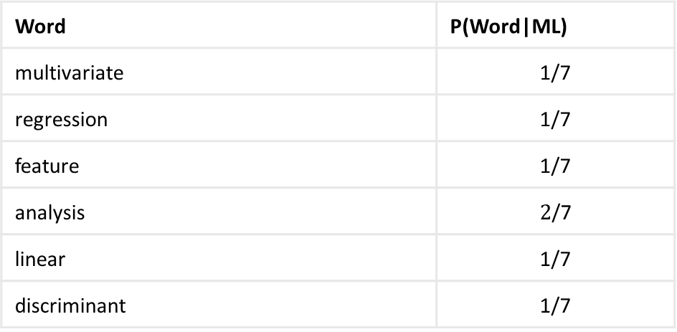
Text classification
Nominator = word(term) frequency
Denominator = words in ML class
Determine class probability from samples
Word | P(Word|ML)
multivariate | $$\text{1/7}$$
regression | $$\text{1/7}$$
feature | $$\text{1/7}$$
analysis | $$\text{2}\text{/7}$$
linear | $$\text{1/7}$$
discriminant | $$\text{1/7}$$

Slide 16
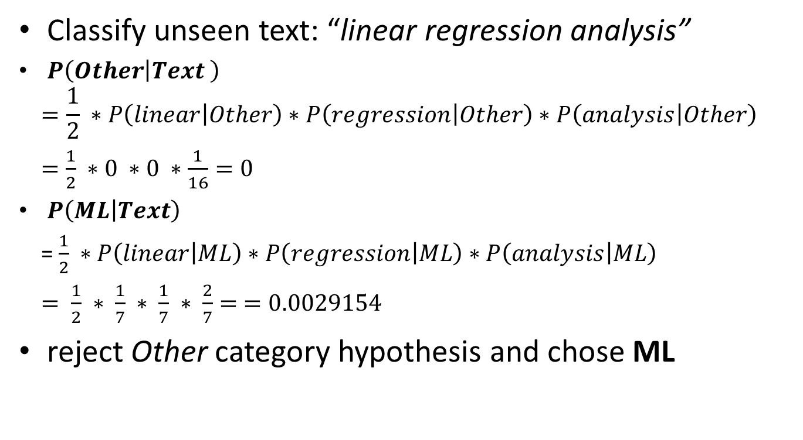
Text classification
Classify unseen text: “linear regression analysis”
$P\left(Other | Text \right)$
$$=\frac{1}{2} ∗P\left(linear | Other\right)∗P\left(regression | Other\right)∗P\left(analysis | Other\right)$$
$=\frac{1}{2} ∗0 ∗0 ∗$ $\frac{1}{16}=0$
$P\left(ML | Text\right)$
= $\frac{1}{2} ∗P\left(linear | ML\right)∗P\left(regression | ML\right)∗P\left(analysis | ML\right)$
$= \frac{1}{2} ∗ \frac{1}{7} ∗ \frac{1}{7} ∗ \frac{2}{7}= =0.0029154$
reject Other category hypothesis and chose ML

Slide 17
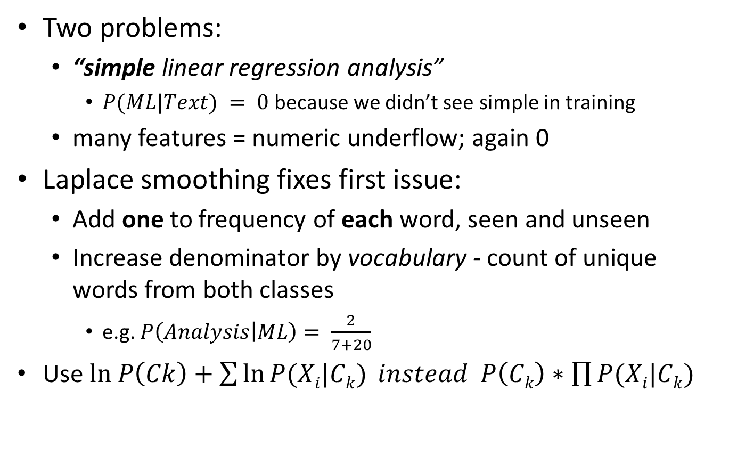
Text classification
Two problems:
“simple linear regression analysis”
$P(ML|Text) = 0$because we didn’t see simple in training
many features = numeric underflow; again 0
Laplace smoothing fixes first issue:
Add one to frequency of each word, seen and unseen
Increase denominator by vocabulary - count of unique words from both classes
e.g. $P\left(Analysis | ML\right)= \frac{2}{7+20}$
Use $ln P\left(Ck\right)+\sum{\ln{P(Xi|Ck)} instead P\left(Ck\right)∗\prod{P(Xi|Ck)}}$

Slide 18
Further considerations
Stemming
heuristic - group words such as card and cards
Lemmatization
stemming, but with a dictionary
Removal of stop(most common) words
is, a, the …
TF-IDF
penalize more frequent words
N-grams
Single word is a 1-gram

Slide 19
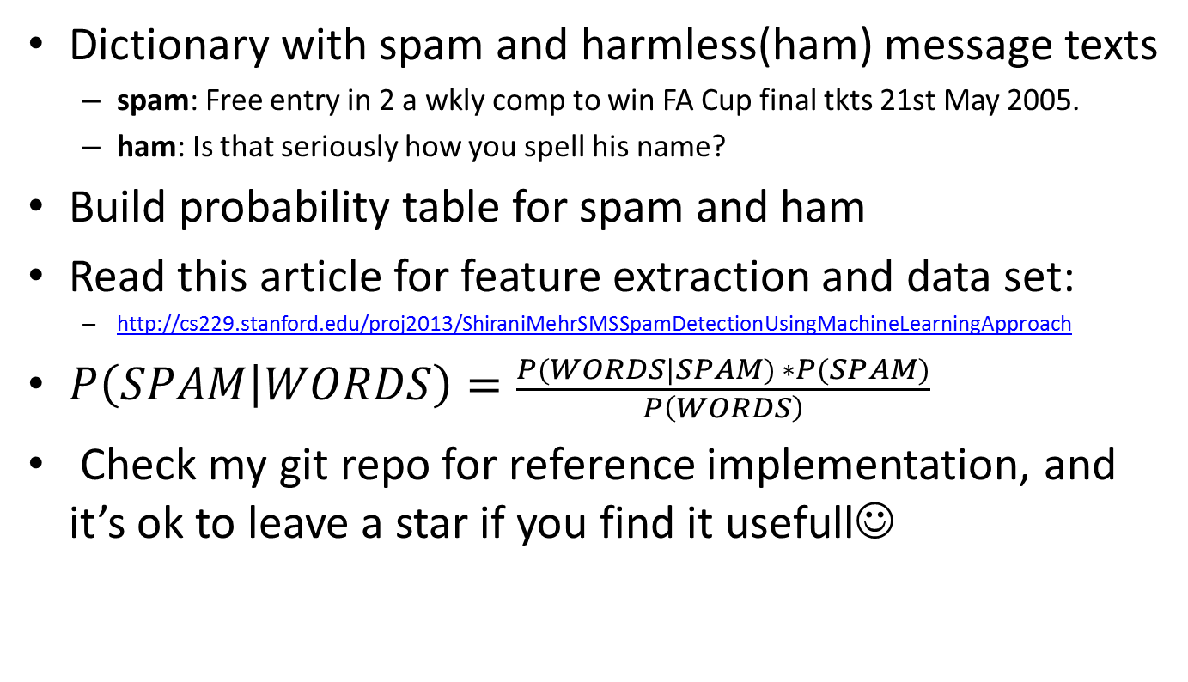
SMS spam filter
Dictionary with spam and harmless(ham) message texts
spam: Free entry in 2 a wkly comp to win FA Cup final tkts 21st May 2005.
ham: Is that seriously how you spell his name?
Build probability table for spam and ham
Read this article for feature extraction and data set:
http://cs229.stanford.edu/proj2013/ShiraniMehrSMSSpamDetectionUsingMachineLearningApproach
$P\left(SPAM | WORDS\right)=\frac{P(WORDS|SPAM) ∗P(SPAM)}{P\left(WORDS\right)}$
Check my git repo for reference implementation, and it’s ok to leave a star if you find it usefull☺

Slide 20
Alternative solutions
Naïve Bayes is a linear classifier and therefore will give poor results for non-linearly separable problems
stay tuned for linearly separable problems
text classification is largely linearly separable problem, although we cannot prove this
Fast and easy to implement, gives really good results
Generative model
For non-linearly separable problems consider Random forest, KNN, SVM and Neural networks
by the order of headache these will give you ☺

Slide 21
Introduction to neural networks

Slide 22

Motivational Example
Application that recognizes if an image contains a pet

Slide 23

Motivational example

Slide 24
Image recognition
Standard way of doing this:
build an explicit model that solves the problem
run input data against the model
verify output
It’s next to impossible to define an explicit model
How do humans solve this problem anyway?
Experience forms our neural connections
public class ImageProcessor {
public boolean hasPets (BufferedImage image) {
// we just need a couple of lines here for our model
return false;
}
}
Notes:
When we see an image of a pet, we are able to see a pattern.
We have seen fair share of pets from an early age, knowledge gained by this experience formed our neural connections and so we are able to recognize a pet pattern.

Slide 25
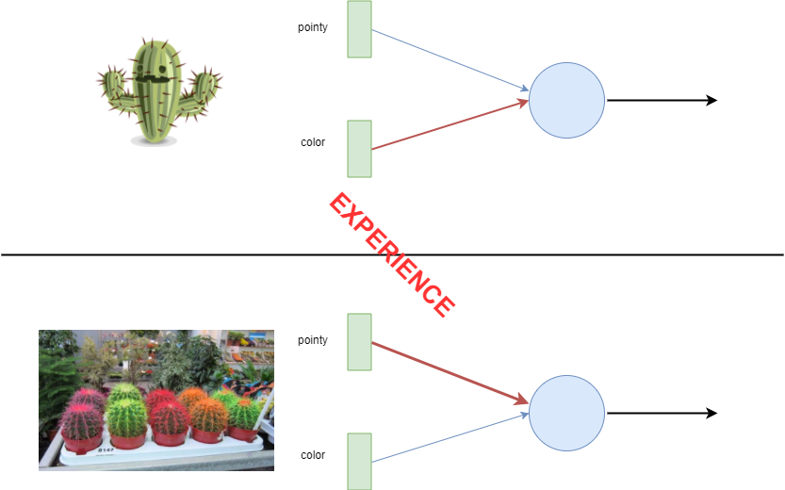
Knowledge by experience
Notes:
Initially, small child might have a bunch of green toys, of which none is ‘pointy’. When it first encounters cacti, it might decide to play with it since it green, just like other toys, ignoring the pointy property al together.
After a couple of painful experiences, the child learns that the color might not be so important for the future toys and that he should chose ones which are not pointy.

Slide 26
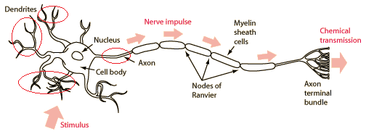
Neuron model
Dendrites, Axons and Synapse (red circle)
https://biology.stackexchange.com/questions/21082/how-does-core-conductor-model-correspond-to-an-actual-neuron
When an axon of cell A is near enough to excite a cell B and repeatedly or persistently takes part in firing it, some growth process or metabolic change takes place in one or both cells such that A's efficiency, as one of the cells firing B, is increased.
Hebb
Notes:
Neurons accumulate charge from other neurons continuously until the charge passes a threshold, this will cause neurons to activate.

Slide 27
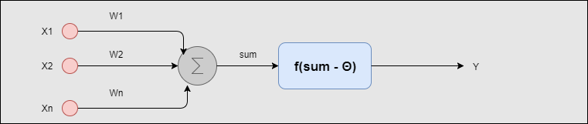
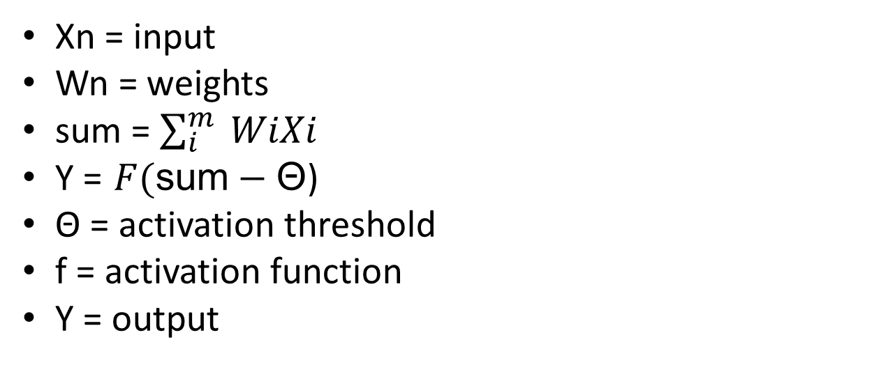
Artificial neuron
Xn = input
Wn = weights
sum = $\sum_{i}^{m}{ WiXi }$
Y = $F(\text{sum}−\text{Θ}$)
Θ = activation threshold
f = activation function
Y = output

Slide 28
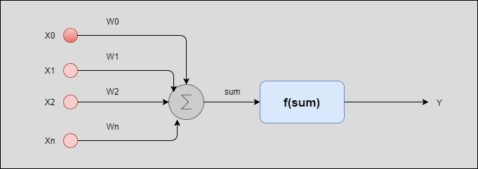
Artificial neuron
Threshold can be transformed into Bias neuron
X0 = (-)1
W0 trained together with other weights(synapse)
Gives trainable constant factor to activation function
more about biases later
Notes:
If the sum of neurons is say 5, and threshold is -2, we can simply replace threshold with always active X0 neuron with weight -2. The sum remains same, but we can dynamically adjust this weight -2.

Slide 29
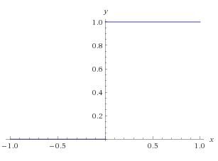
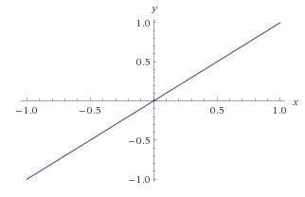
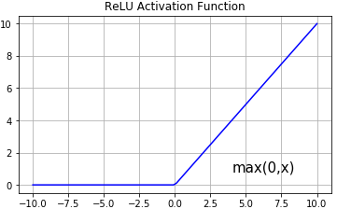
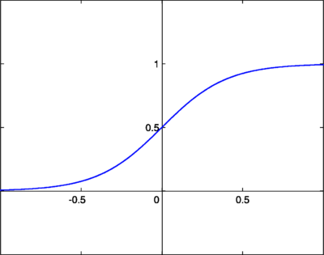
Activation functions
Heavside step
Linear
Logistic sigmoid
Notes:
Consider ELU and PRELU

Slide 30
Learning – adjusting weights
Adjust weights until some stopping criteria is met
Weight update is calculated from previous weight
Wk(n+1) = Wk(n) + Δ Wk(n)
Learning algorithms differ in calculation of Δ Wk(n)
There isn’t a single best learning algorithm
Learning paradigms:
supervised
unsupervised
reinforced

Slide 31
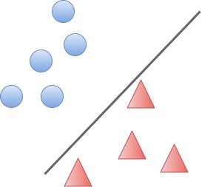
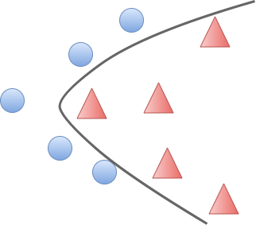
Linear separability
There exists at least one line in (2d)plane that separates two different data sets, each in it’s own half-plane
Data sets are linearly separable if their convex hulls do not overlap, this is applicable for N-dimensional space

Slide 32
Perceptron
Perceptron is a binary classifier
Receives information from input sensors (dendrites)
Amplifies or decreases each information component with respective weight(synapse)
Outputs -1 or 1 for an input, signum activation function
1 for x > 0,
-1 otherwise
Perceptron finds decision boundary to separate data sets
Data must be linearly separable to achieve correctness

Slide 33
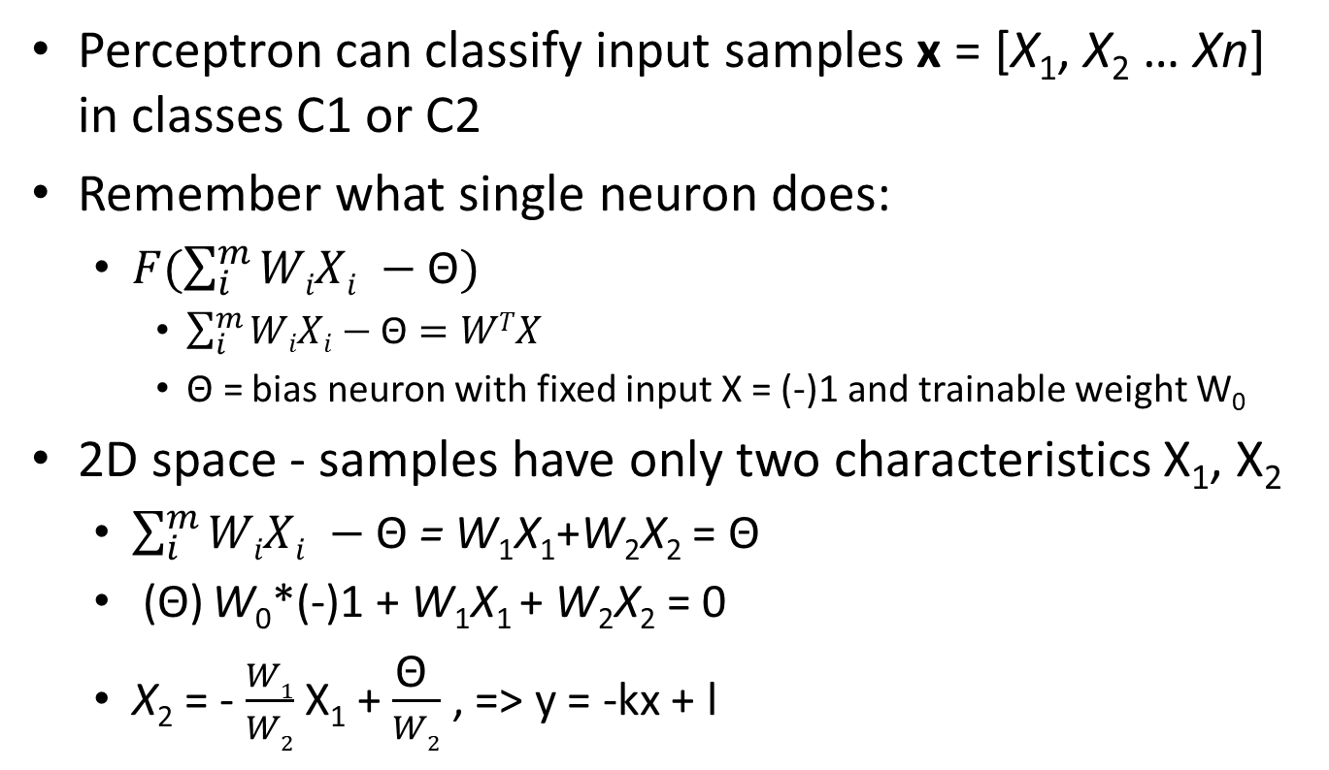
Perceptron decision boundary
Perceptron can classify input samples x = [X₁, X₂ … Xn] in classes C1 or C2
Remember what single neuron does:
$F(\sum_{i}^{m}{WiXi −\text{Θ})}$
$\sum_{i}^{m}{WiXi−\text{Θ}=WTX}$
$\text{Θ}\text{ =}$ bias neuron with fixed input X = (-)1 and trainable weight W₀
2D space - samples have only two characteristics X₁, X₂
$\sum_{i}^{m}{WiXi −\text{Θ}}$ = W₁X₁+W₂X₂ = Θ
(Θ) W₀*(-)1 + W₁X₁ + W₂X₂ = 0
X₂ = - $\frac{W1}{W2}$ X₁ + $\frac{\text{Θ} }{W2}$ , => y = -kx + l

Slide 34
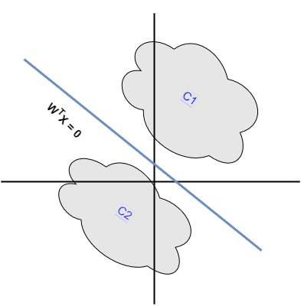

Graphical interpretation
We should find weights ($WT$) such that:
$WTX$ > 0 for all input samples $X$ from C1
$WTX$ <= 0 for all input samples $X$ from C2
W₁X₁+W₂X₂ > Θ | W₁X₁+W₂X₂ <= Θ
Weights determine slope and bias offset from origin

Slide 35
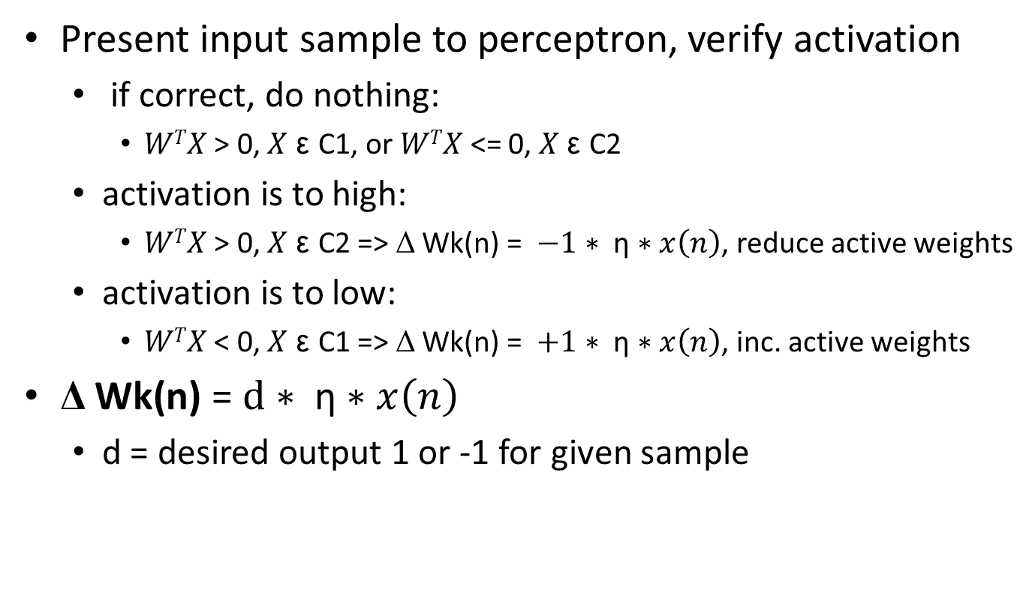
Perceptron rule learning
Present input sample to perceptron, verify activation
if correct, do nothing:
$WTX$ > 0, $X$ ε C1, or $WTX$ <= 0, $X$ ε C2
activation is to high:
$WTX$ > 0, $X$ ε C2 => Δ Wk(n) = $−1∗ \text{η}∗x\left(n\right)$, reduce active weights
activation is to low:
$WTX$ < 0, $X$ ε C1 => Δ Wk(n) = $+1∗ \text{η}∗x\left(n\right)$, inc. active weights
Δ Wk(n) = $d∗ \text{η}∗x\left(n\right)$
d = desired output 1 or -1 for given sample

Slide 36
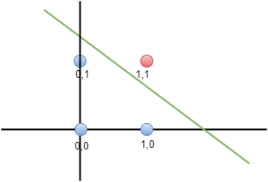
Perceptron - AND
Perceptron can be taught simple logic functions
Linearly separable
1 = C1 , W^{T}X > 0, d = 1
0 = C2 , W^{T}X <= 0, d = -1
X₁ | X₂ | Y
0 | 0 | 0
0 | 1 | 0
1 | 0 | 0
1 | 1 | 1

Slide 37
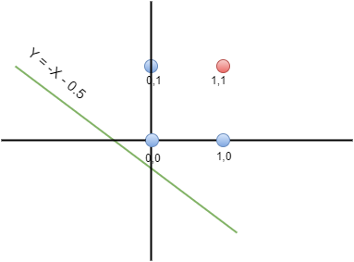

Perceptron – training AND
Random initial weights:
$\text{(}\text{Θ}$)W₀ = 0.5, X₀ = 1 | W₁ = 1, W₂ = 1
Boundary: $0.5+x+y⇒y=−x −0.5$
η = 0.2

Slide 38
Perceptron – training AND
Input sample: X₁ = 1, X₂ = 1, Y = 1
Activation: F(W^{T}X) = 1*1 + 1*1 + 0.5*1 = step(2.5)
X ε C1, W^{T}X > 0
Correct classification, do nothing

Slide 39
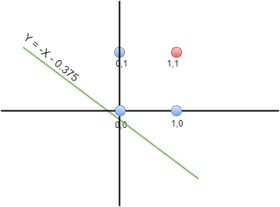
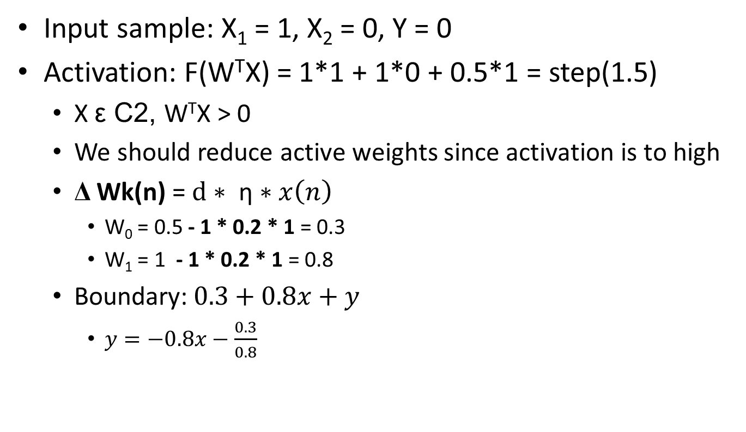
Perceptron – training AND
Input sample: X₁ = 1, X₂ = 0, Y = 0
Activation: F(W^{T}X) = 1*1 + 1*0 + 0.5*1 = step(1.5)
X ε C2, W^{T}X > 0
We should reduce active weights since activation is to high
Δ Wk(n) = $d∗ \text{η}∗x\left(n\right)$
W₀ = 0.5 - 1 * 0.2 * 1 = 0.3
W₁ = 1 - 1 * 0.2 * 1 = 0.8
Boundary:$0.3+0.8x+y$
$y=−0.8x−\frac{0.3}{0.8}$

Slide 40
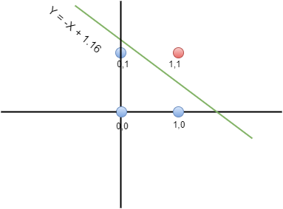
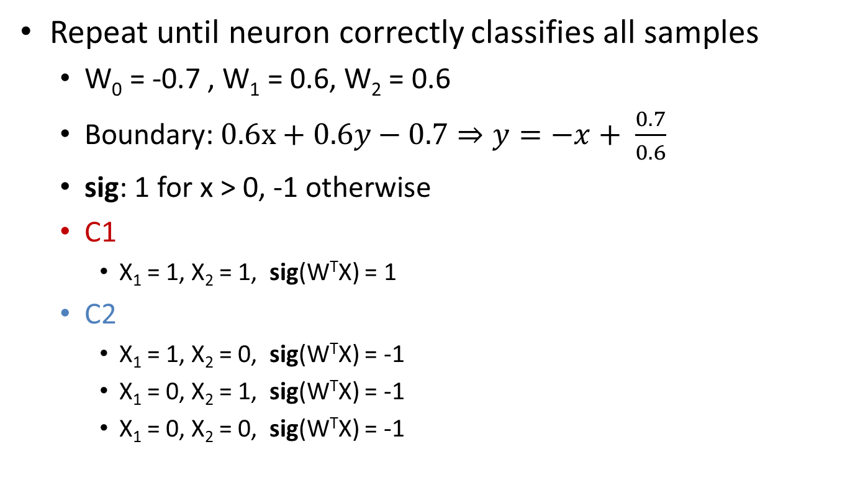
Perceptron – training AND
Repeat until neuron correctly classifies all samples
W₀ = -0.7 , W₁ = 0.6, W₂ = 0.6
Boundary:$0.6x+0.6y−0.7⇒y=−x+ \frac{0.7}{0.6}$
sig: 1 for x > 0, -1 otherwise
C1
X₁ = 1, X₂ = 1, sig(W^{T}X) = 1
C2
X₁ = 1, X₂ = 0, sig(W^{T}X) = -1
X₁ = 0, X₂ = 1, sig(W^{T}X) = -1
X₁ = 0, X₂ = 0, sig(W^{T}X) = -1

Slide 41
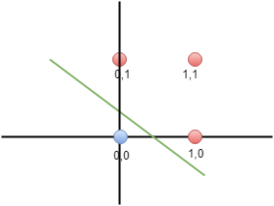
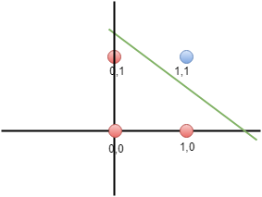
Perceptron – OR, NAND
Linearly separable just like AND
X₁ | X₂ | Y
0 | 0 | 0
0 | 1 | 1
1 | 0 | 1
1 | 1 | 1
X₁ | X₂ | Y
0 | 0 | 1
0 | 1 | 1
1 | 0 | 1
1 | 1 | 0

Slide 42
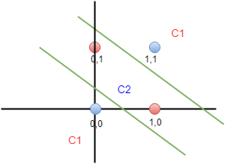
Perceptron - XOR
Linearly separable ?
Classification:
1 neuron = 1 line
2 neurons = 2 lines
3 regions
X₁ | X₂ | Y
0 | 0 | 0
0 | 1 | 1
1 | 0 | 1
1 | 1 | 0

Slide 43
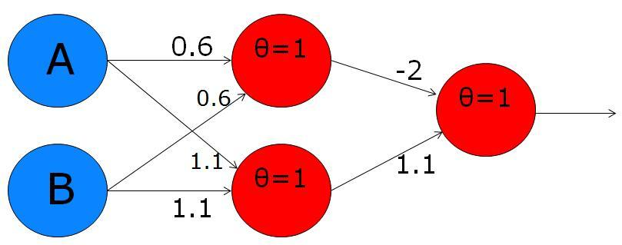
MLP - XOR
Two parallel neurons draw two decision boundaries
OR, NAND functions
Serial neuron combines their output with AND into XOR
http://toritris.weebly.com/uploads/1/4/1/3/14134854/4959601_orig.jpg
a priori knowledge
Threshold function learning ?
and

Slide 44
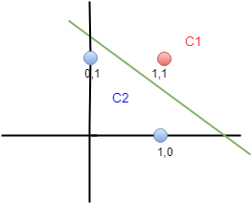
MLP - XOR
xor = (A or B) and (A nand B)
or nand
and
and
X₁ | X₂ | Y
0 | 0 | 0
0 | 1 | 1
1 | 0 | 1
1 | 1 | 1
X₁ | X₂ | Y
0 | 0 | 1
0 | 1 | 1
1 | 0 | 1
1 | 1 | 0
X₁ | X₂ | Y
0 | 1 | 0
1 | 1 | 1
1 | 1 | 1
1 | 0 | 0

Slide 45
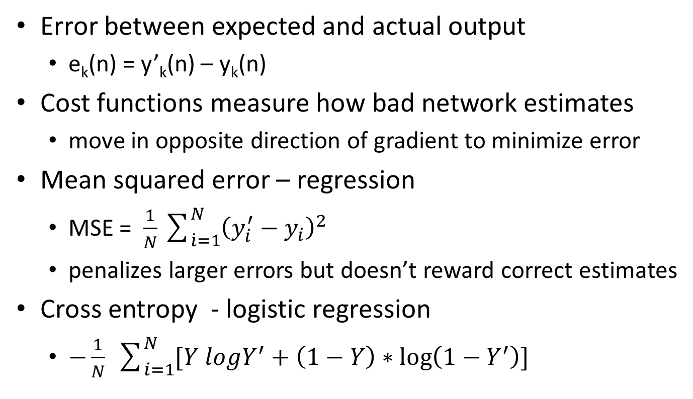
Learning - error correction
Error between expected and actual output
e_{k}(n) = y’_{k}(n) – y_{k}(n)
Cost functions measure how bad network estimates
move in opposite direction of gradient to minimize error
Mean squared error – regression
MSE = $\frac{1}{N}\sum_{\dot{i}=1}^{N}{{\left(y_{i}^{′}−y_{i}\right)}^{2}}$
penalizes larger errors but doesn’t reward correct estimates
Cross entropy - logistic regression
$−\frac{1}{N} \sum_{i=1}^{N}{[Y logY^{′}+\left(1−Y\right)∗\log\left(1−Y^{′}\right)] }$

Slide 46
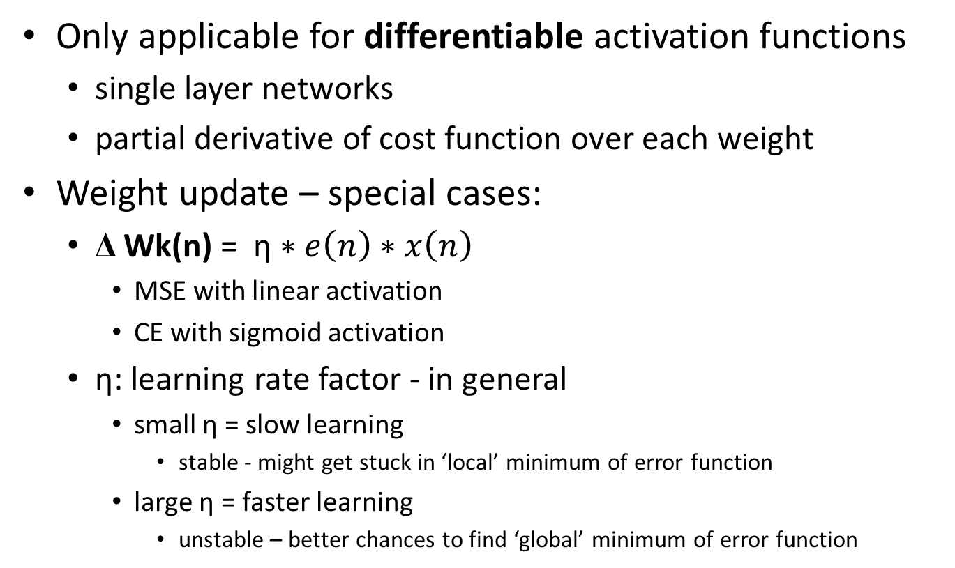
Delta rule learning
Only applicable for differentiable activation functions
single layer networks
partial derivative of cost function over each weight
Weight update – special cases:
Δ Wk(n) = $\text{η}∗e\left(n\right)∗x\left(n\right)$
MSE with linear activation
CE with sigmoid activation
$\text{η}$: learning rate factor - in general
small $\text{η}$ = slow learning
stable - might get stuck in ‘local’ minimum of error function
large $\text{η}$ = faster learning
unstable – better chances to find ‘global’ minimum of error function

Slide 47
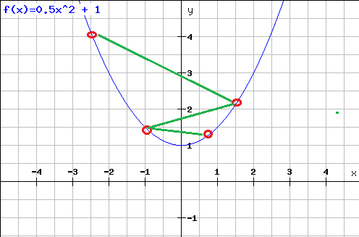
Gradient descent
Gradient is derivative of multi-variable function
Gradient descent attempts to find point in which gradient is zero – move in opposite direction of gradient
Notes:
The gradient at any location points in the direction of greatest increase of a function.

Slide 48
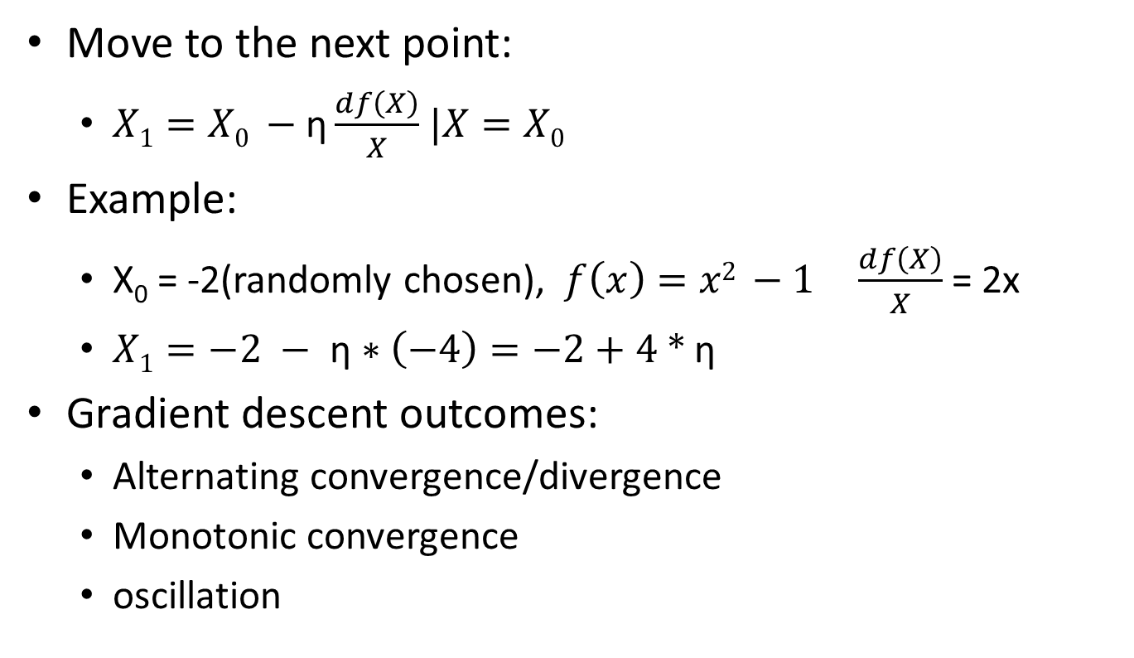
Gradient descent
Move to the next point:
$X1=X0 −\text{η}\frac{df\left(X\right)}{X}$ $|X=X0$
Example:
X₀ = -2(randomly chosen), $f\left(x\right)=x2 −1$ $\frac{df\left(X\right)}{X}$ = 2x
$X1=−\text{2} − \text{η}∗\left(−4\right)=−2+\text{4 ∗ }\text{η}$
Gradient descent outcomes:
Alternating convergence/divergence
Monotonic convergence
oscillation

Slide 49
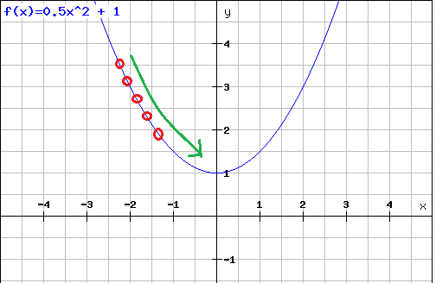
Gradient descent
Monotonic convergence
In practice, could get stuck in local optima

Slide 50
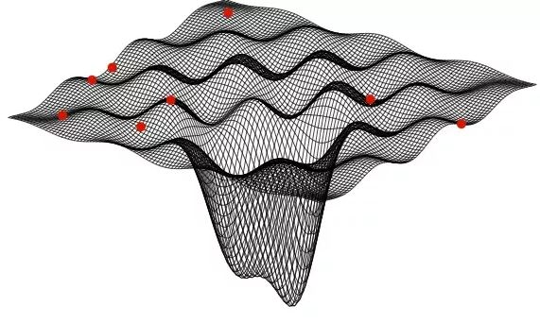

Error surface
https://qph.ec.quoracdn.net/main-qimg-abfbe698dd41306dc2691e8d0c3182a0.webp
Local vs Global minima
$\text{η}$: learning rate factor

Slide 51
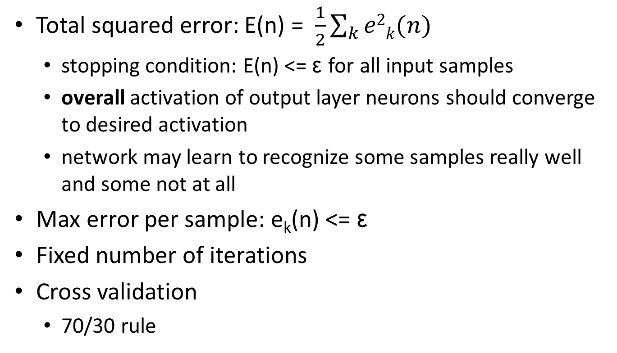
Stopping criteria
Total squared error: E(n) = $\frac{1}{2}\sum_{k}{e2k(n)}$
stopping condition: E(n) <= ε for all input samples
overall activation of output layer neurons should converge to desired activation
network may learn to recognize some samples really well and some not at all
Max error per sample: e_{k}(n) <= ε
Fixed number of iterations
Cross validation
70/30 rule

Slide 52
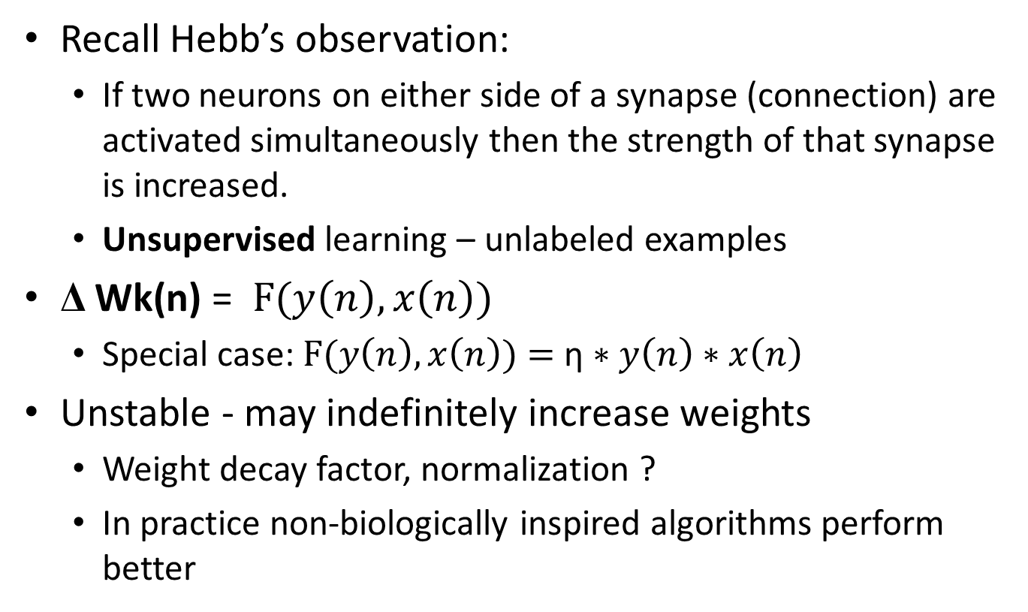
Hebb learning
Recall Hebb’s observation:
If two neurons on either side of a synapse (connection) are activated simultaneously then the strength of that synapse is increased.
Unsupervised learning – unlabeled examples
Δ Wk(n) = $\text{F}\text{(}y\left(n\right),x\left(n\right))$
Special case: $\text{F}\text{(}y\left(n\right),x\left(n\right))=$ $\text{η}∗y\left(n\right)∗x\left(n\right)$
Unstable - may indefinitely increase weights
Weight decay factor, normalization ?
In practice non-biologically inspired algorithms perform better

Slide 53
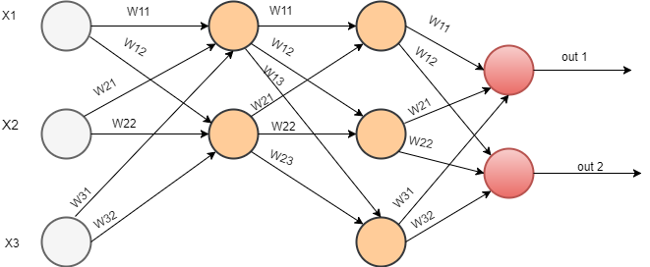
Feed forward network
Network without cycles
Network with only linear activations is equal to single layer network

Slide 54
Feed forward network
Single input layer
One neuron for each data feature
Single output layer
One neuron for binary classification
One neuron for each class in multi-class classification
Softmax activation as final output
Probability that sample belongs to each class, normalized to 1

Slide 55
Feed forward network
0 to N hidden layers
Linearly separable problems don’t require hidden layers
Non-linear activations
Complex topic, mostly based on empirical results
Cookbook:
Start with a single hidden layer
mean between input and output layer neurons
able to solve most real world problems, otherwise increase number of neurons gradually
If the network still doesn’t work properly, increase number of hidden layers by one and go back to third point

Slide 56
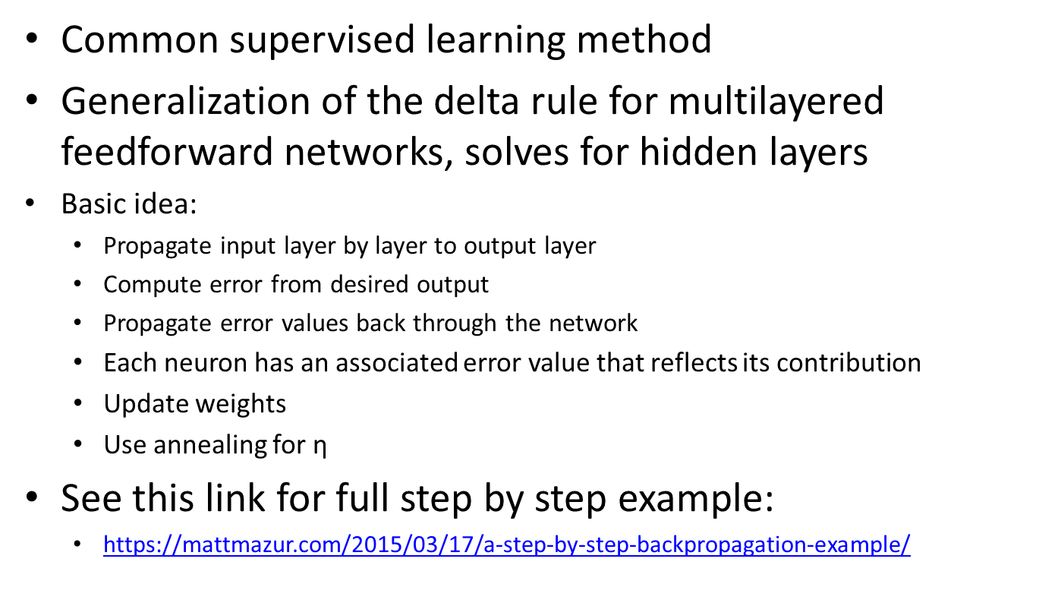
Backpropagation
Common supervised learning method
Generalization of the delta rule for multilayered feedforward networks, solves for hidden layers
Basic idea:
Propagate input layer by layer to output layer
Compute error from desired output
Propagate error values back through the network
Each neuron has an associated error value that reflects its contribution
Update weights
Use annealing for $\text{η}$
See this link for full step by step example:
https://mattmazur.com/2015/03/17/a-step-by-step-backpropagation-example/
Notes:
We don’t have a simple equation for our cost function, so computing an expression for the derivative and solving it isn’t trivial.
The function is many-dimensional (each weight gets its own dimension) — we need to find the points where all of those derivatives are zero. Also not so trivial.
There are lots of minimums and maximums throughout the function, and sorting out which one is the one you should be using can be computationally expensive.

