Slide 1
Lod in Tableau

Slide 2
LOD is also called as LOD Expressions or LOD Calculations.
It is introduced from 9.0 onwards.
It is the advance Table Calculations.
PERFORM SOME SPECIAL REQUIREMENT

Slide 3
1.FIXED LOD
2.EXCLUDE LOD
3.INCLUDE LOD

Slide 4
FIXED LOD

Slide 5
1. Fixed lod
It is used to calculate the measure at particular dimension level.
The dimension object is whether available or not in the view.
Formula:
=======
{ Fixed [dim]:aggregate[measure] }

Slide 6
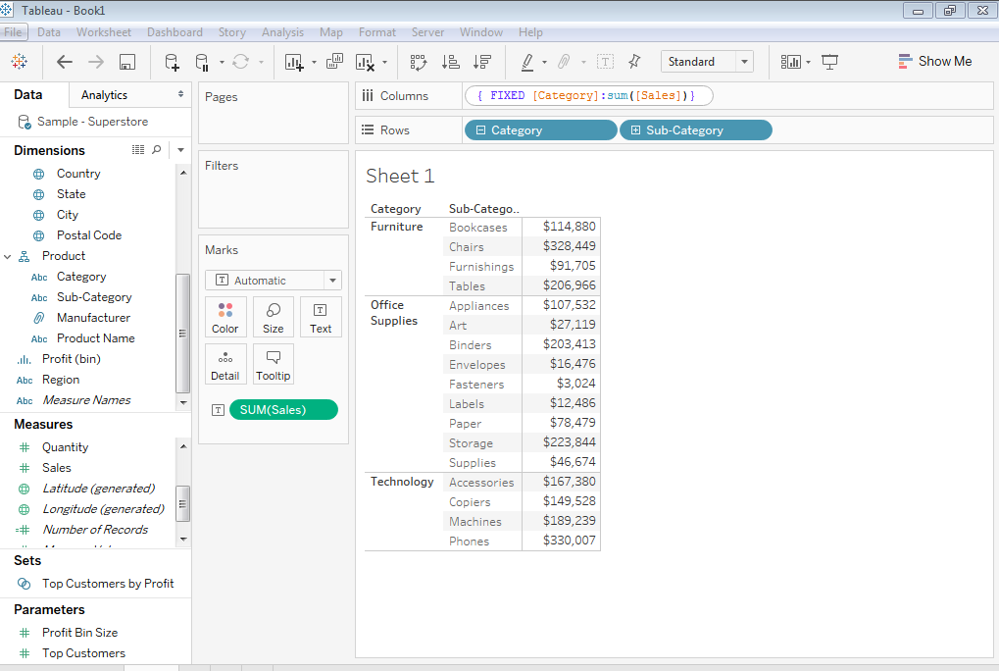
In a work sheet contains category,sub category , sales revenue.It show the subcategory wise sales revenue.when ever the data will be aggregated at lowest level only . Now I want to show the data in category wise sales revenue for that one we are writing LOD expression as fixed

Slide 7
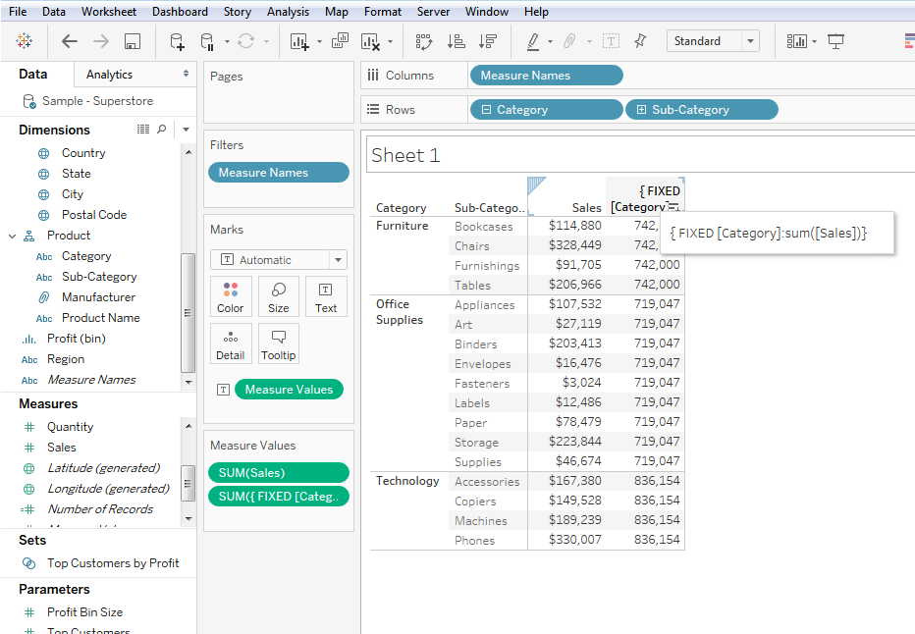
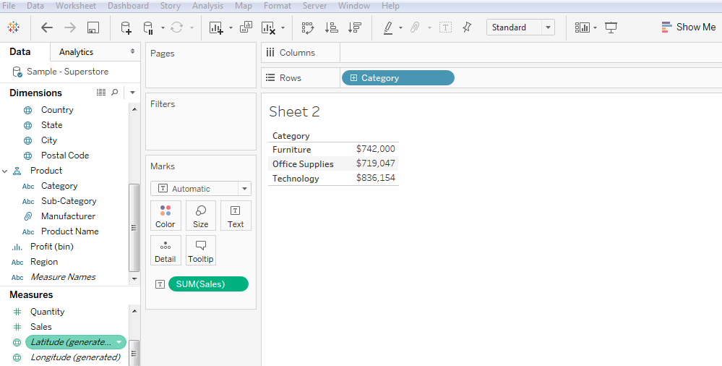
After writing lod expression fixed it shows the category wise sales revenu
{fixed [category]:sum(sales)}
Actual category wise sales revenue

Slide 8
EXCLUDE LOD

Slide 9
2.Exclude
EXCLUDE IS USED TO REMOVE THE DIMENSION OBJECTS WHILE CALCULATING THE MEASURE .
DIMENSION OBJECT IS AVAILABLE IN THE VIEW
Formula:
========
{ Exclude [dim],[dim]:aggregate(measure)}

Slide 10
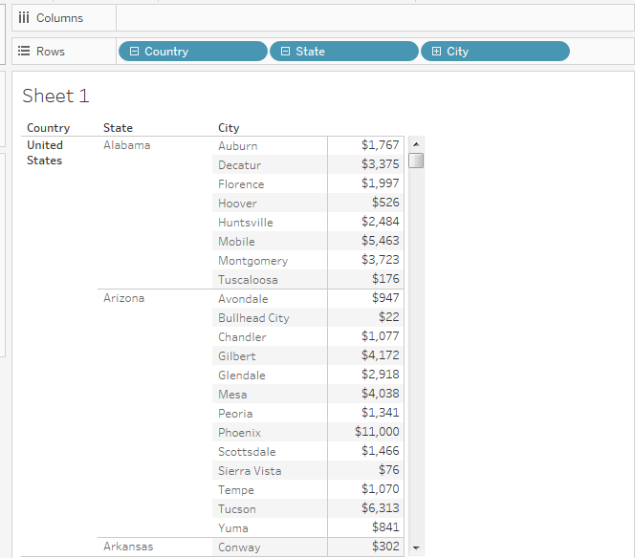
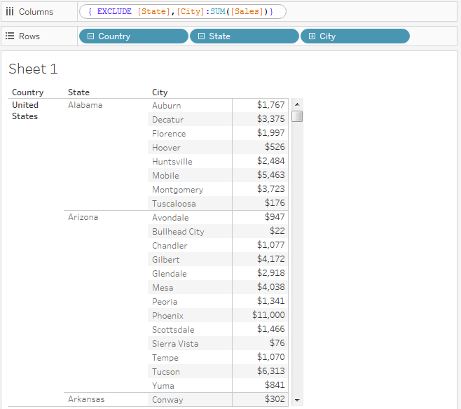
IN A REPORT CONTAINS COUNTRY,STATE,CITY,SALES REVENUE.The data will be aggregated at city level.
we want to show the data at country level for that one we are exclude state,city by using EXCLUDE LOD function

Slide 11
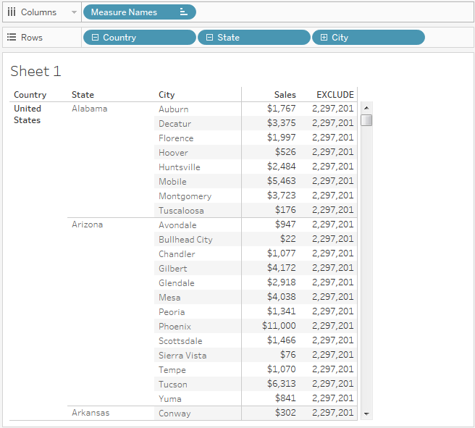
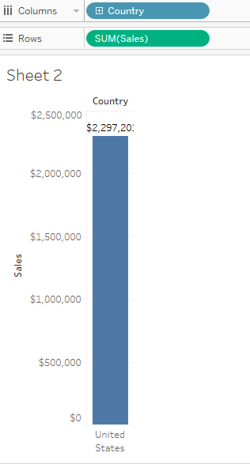
After writing LOD expression The data comes at country level
{ EXCLUDE [DIM1],[DIM2]:AGG(MESURE)}
{ EXCLUDE [State],[City]:SUM([Sales])}
Country sales revenue
COUNTRY WISE SALES REVENUE

Slide 12
INCLUDE LOD

Slide 13
3.Include
IT IS USED TO ADD THE DIMENSION OBJECT IN THE VIEW WHILE CALCULATING A MEASURE.
DIMENSION OBJECT IS NOT AVILABLE IN THE VIEW.
Formula:
=======
{ Include [dim],[dim]:aggregate(measure)}

Slide 14
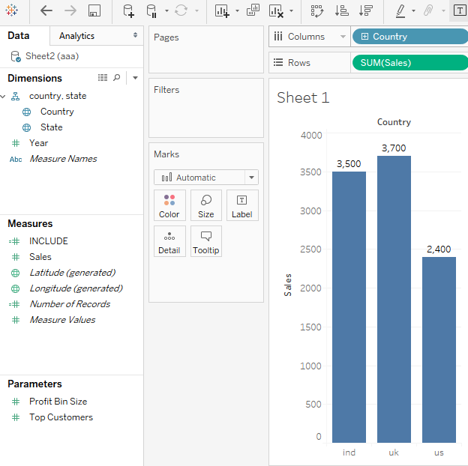
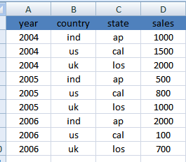

Slide 15
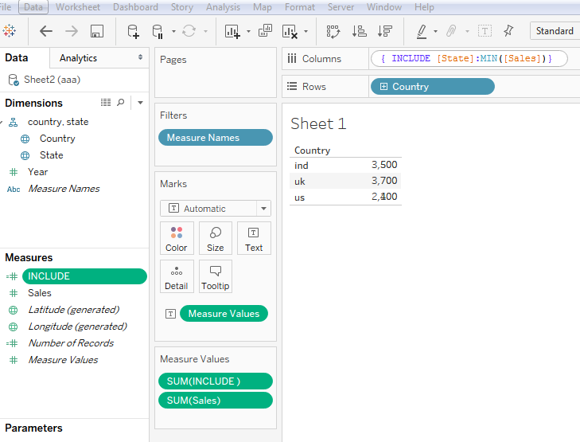
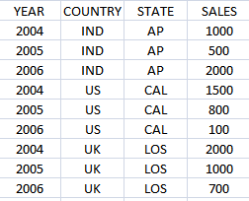
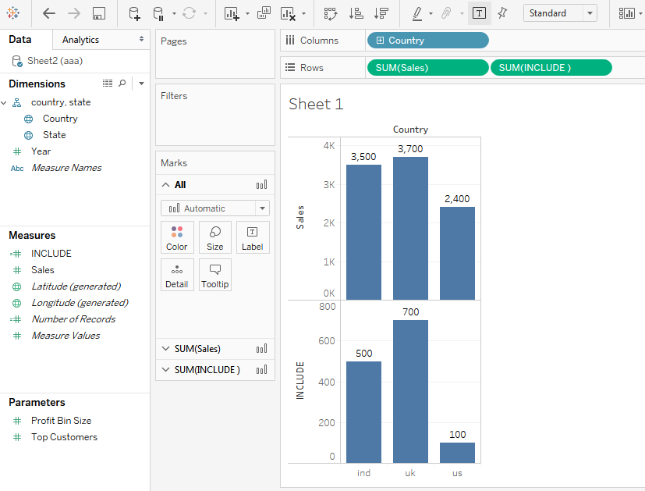
SUM=3500
MAX=2000
MIN=500
SUM=2400
MAX=1500
MIN=100
SUM=3700
MAX=2000
MIN=700
{ INCLUDE [State]:MAX([Sales])}

