Slide 1
MOAT ACADEMY
WEB APPLICATION DEVELOPMENT TRAINING
CSS Box Model2 (background properties, border, margin and padding) – Day 3

Slide 2
FONTS FROM EXTERNAL SOURCES
Making the web more beautiful through great typography

Slide 3
Mixing fonts
Your website fonts should be consistent when checked on various devices , you must be careful with the combination of font –family that you use.
Combining too many font types is not recommended
https://fontpair.co/ helps you in pairing fonts.

Slide 4
Using Custom Fonts
To be regarded as web-safe, a font must be common to most browsers. Remember, if a site visitor does not have the specified font, the browser selects an alternative.
The following fonts are considered universal:
  Arial
  Courier New
  Georgia
  Times New Roman
  Verdana
CSS allows you to specify custom fonts which may not even be available on the users’ local computer

Slide 5
GOOGLE FONTS
Google Fonts launched in 2010, quickly becoming the Internet’s largest, free, open-source selection of fonts. All Google Fonts are free for commercial and personal use. The Google Fonts website makes it easy for anyone to quickly select and utilize different fonts for their own design needs.
https://fonts.google.com/
To use Google Fonts, (See next slides)
Embed in HTML
<link href="https://fonts.googleapis.com/css?family=Lato" rel=“stylesheet" >
Specify in CSS
font-family: Lato, sans-serif;

Slide 6
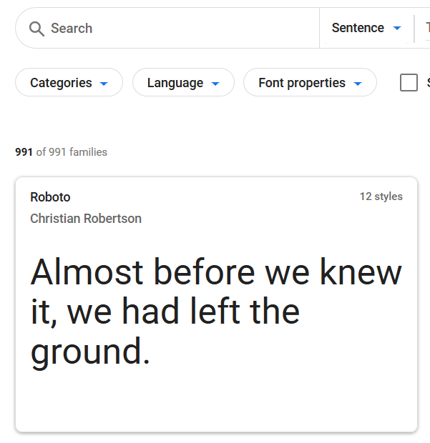
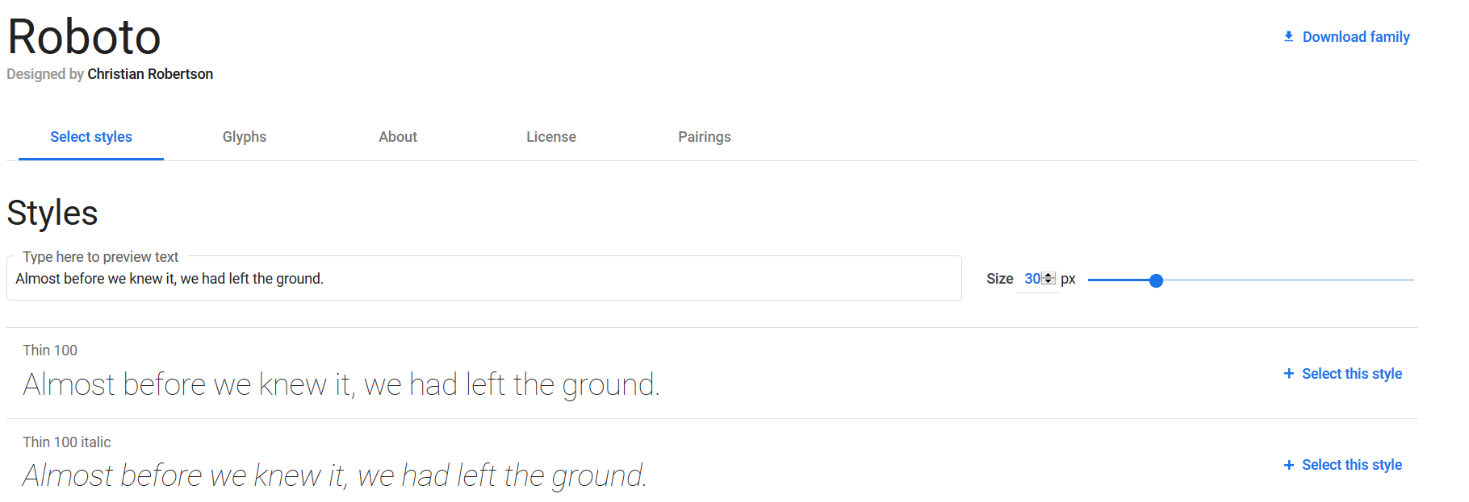
Steps in using Google Fonts
1. Search for a particular font or click on a font of interest
2. it will list all the styles under the font

Slide 7
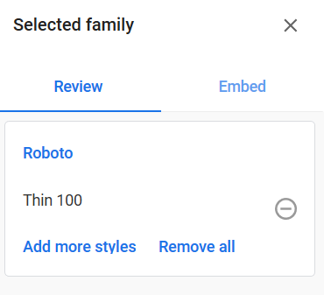

Steps in using Google Fonts
3. click on the link beside the font (Select this style)
4.Do this for as many styles you want to select. The link will turn to ‘remove this style’
5. Your selection(s) will show in the sidebar on the right
6 copy the generated code in the link option

Slide 8
CUSTOM WEB FONTS
Web fonts allow Web designers to use fonts that are not installed on the user's computer.
When you have found/bought, downloaded the font you wish to use, just include the font file on your web server, and it will be automatically downloaded to the user ‘s browser when needed.
Your "own" fonts are defined within the CSS @font-face rule.
Font Formats:
TTF (TrueType Format – Most common for Operating systems)
OTF (OpenType Format)
WOFF (Web Open Font Format – recommended for web pages)
WOFF 2.0
SVG, EOT
TTF/OTF - TrueType and OpenType font support is compatible with Chrome browser 4 to 67
You can generate web-safe fonts using the online tool: https://www.fontsquirrel.com/tools/webfont-generator

Slide 9
@font-face RULE
@font-face {
font-family: myFirstFont;
src: url(sansation_light.woff) format('woff'),
url(sansation_light.ttf) format('truetype'),
url(sansation_light.svg) format('svg’);
}
p {
font-family: myFirstFont;
}
Example 2
@font-face {
font-family: myBoldFont;
src: url(sansation_bold.woff);
}
In the @font-face rule; first define a name for the font (e.g. myCustomFont) and then point to the font file.
To use the font for an HTML element, refer to the name of the font (myCustomFont) through the font-family property:
To use a different font-style, you must add another @font-face rule containing descriptors for the font style:

Slide 10
EXERCISE
<!DOCTYPE html>
<html>
<head>
<style>
body {
font-family: sansation;
}
</style>
</head>
<body>
<h1>This is a Heading</h1>
<p>This is a paragraph.</p>
<p>This is another paragraph.</p>
</body>
</html>
Add a web font with the name "sansation" and the URL "sansation_light.woff".
Add another @font-face rule for bold characters of the "sansation" font. Use the URL "sansation_bold.woff".

Slide 11
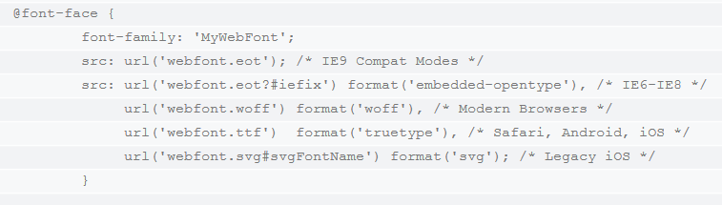
CUSTOM WEB FONTS
Webfonts are supported by all major browser platforms but not all in the same way. There are currently four different font formats that must be included in order to target all browsers. This includes TTF, WOFF, EOT and SVG.
Notes:
@font-face { font-family: 'MyWebFont'; src: url('webfont.eot'); /* IE9 Compat Modes */ src: url('webfont.eot?#iefix') format('embedded-opentype'), /* IE6-IE8 */ url('webfont.woff') format('woff'), /* Modern Browsers */ url('webfont.ttf') format('truetype'), /* Safari, Android, iOS */ url('webfont.svg#svgFontName') format('svg'); /* Legacy iOS */ }

Slide 12
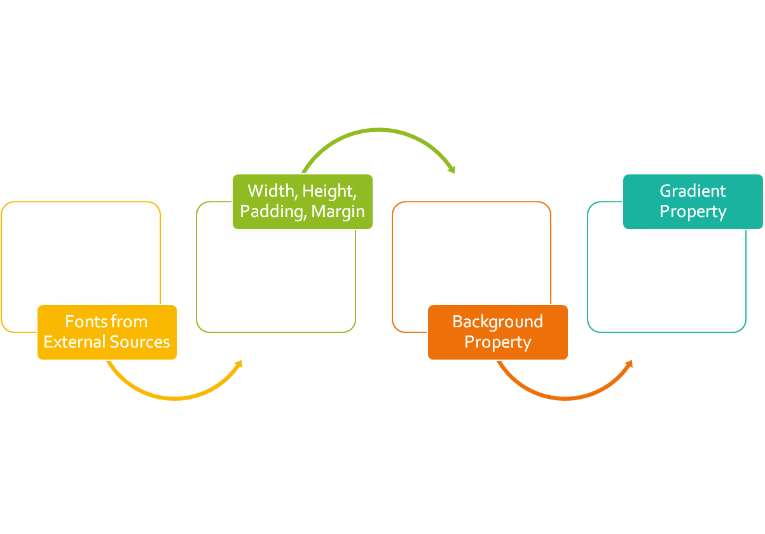
CLASS
OUTLINE

Slide 13
CSS BOX MODEL 2
The model describes the space of the content taken by an element. An element is represented by a box and each box has four edges

Slide 14
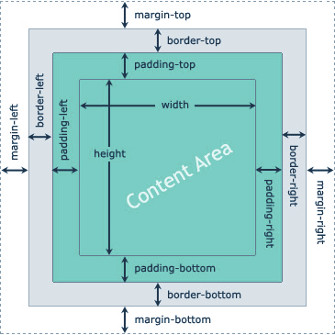
CSS BOX MODEL 2
The BOX Model describes the space of the content taken by an element. An element is represented by a box and each box has four edges
The width, height, padding, border, and margin CSS properties determines how much space an element can take on a web page
We can study all these properties using the box model.

Slide 15
BORDER PROPERTIES
The following are the properties used in affecting your border in CSS
border-style: double, dashed, solid, dotted, none type
border-width: thin, medium, thick 1px thickness
border-color: rgb or hex or name
border-radius: used in creating rounded borders. Can be specified in px or %, eg 5px . To create a complete round box, the element must have equal width and height, border-radius must be 50%
Each of the properties can have up to 4 values for the top, right, bottom and left. See below* :
  border-right-style: double OR border-top-style: dashed
Notes:
If you do not specify the side, all the four sides will take the values.
To make a circle from a box
<p style="width:100px; height:100px; border:1px solid red; border-radius:50%"></p>

Slide 16
BORDER SHORTCUT- combining all border properties in “border”
We can specify border using the CSS border property. This property needs three values to display border properly. They are: The width of the border, style (solid, dashed, dotted, double) of the border and the color of the border.
All elements have some imaginary border ; specifying the border style allows you to make the imaginary border “Real” hence the most important property is the style. If you omit it, colors , width etc wont work – you would be trying to color an invisible border!

Slide 17

EXERCISE – 7 mins
Teach a 4-year old the concept of traffic light
Objectives:
  Understand how to use the border properties especially the border-radius.
  Demonstrate the use of id and class, css external files, background color property
Achieve as close as possible. The picture shown is an image hence output may not exactly look like this

Slide 18
MARGIN & PADDING
Recall that Margin is the space around an element [tags] while padding is the space around contents
We can also apply a different amount of margin on different sides using the margin-left, margin-top, margin-right, margin-bottom properties.
The shorthand margin property combines for all sides as margin{ 100px 150px 100px 80px;} representing top, right, bottom, left
A missing value makes use of the adjacent value. Example: margin:100px 50px uses 100px for the top and bottom, while it uses 50px for the right and left.
Similar principles apply to padding

Slide 19
NEGATIVE MARGIN
#content {margin-top:-100px;}
Negative margin moves the element in the opposite direction
It does not break the flow of the page if applied to elements without floats. It means that if you use a negative margin to nudge an element upwards, all succeeding elements will be nudged as well.
Best used on elements that are not floated
Supported by major browsers.

Slide 20
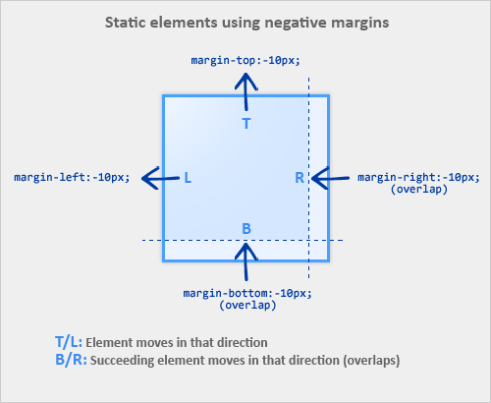
Negative Margin
Notes:
Source:https://www.smashingmagazine.com

Slide 21

See:
Sample Application of Negative Margin

Slide 22
The display property
The display property can be used to convert inline element to a block level and vice versa. **
To convert inline element like span to a block level element, use display:block
To convert block element like p to an inline element, use display:inline
Recall that inline elements can not respond to width and height, there is a 3rd value of display that allows you to specify width and height on inline element.
display:inline-block;
Inline-block makes the element behaves like a typical inline element in terms of just occupying the space it needs but will respond to width and height
We can leverage on this property to create an appropriate navigation bar
Notes:
There is also display:none which will hide the element completely

Slide 23
The display property: creating a search-engine friendly navigation bar
By convention, navigations are usually placed within a <ul>…<li> tag.
<ul>
<li> <a href=“”>Home</a></li>
<li> <a href=“”>About Us</a></li>
<li> <a href=“”>Contact Us</a></li>
</ul>
Since <li>… is a block level element, we can use the display:inline-block ; property to make each of them turn to horizontal menu bar

Slide 24
CSS BACKGROUND PROPERTIES

Slide 25
Styling Your Page Background
The background of your webpage is the part underneath the webpage contents area*
The CSS background properties are used to define the background effects.
background-color: Sets a solid color for the background.
background-image: Specifies a background image to appear in the background of the element.
Notes:
Background doesn’t sit on the margin since the margin is an area outside the content of the element *
When using a background image, use an image that does not disturb the text

Slide 26

Background-image vs img
Background Image
Image
With background-image, other elements can sit on the background
An image (img) can even sit on the background!

Slide 27
Background Properties
background-repeat: Specifies whether the background should be repeated (tiled) or not. Can be applied to repeat tiled background
background-position: Specifies the position that the background should appear inside the element background.
background-attachment: Specifies the behavior of an element's background when its content scrolls. (Scroll with content or fixed?)
background-size: Specifies the dimension of the background image within the container cover|contain | width and height
Notes:
The background image can be a static file, or a generated gradient.
The background color by default is transparent
Good to set background color as a fallback when using background-image property

Slide 28
BACKGROUND PROPERTY
The CSS background properties are used to define the background effects for elements.
The background shorthand property sets all the background properties in one declaration.
CSS background properties are:
background-color
background-image
background-repeat
background-attachment
background-position
background-size
Example:
background: violet url("img_tree.gif") no-repeat fixed center;
It does not matter if one of the property values is missing, as long as the other ones are in this order.

Slide 29
background-color
The background-color property specifies the background color of an element
In the example below, the <h1> and <p>elements have different background colors:
h1 {
background-color: tomato;
}
p {
background-color: violet;
}
Syntax:
background-color: color|transparent

Slide 30
Background-image
The background-image property specifies an image to use as the background of an element.
By default, the image is repeated so it covers the entire element.
Example:
body {
background-image: url("paper.gif");
}
Note: When using a background image, use an image that does not disturb the text.

Slide 31
Background-repeat
By default, the background-image property repeats an image both horizontally and vertically.
Some images should be repeated only horizontally or vertically, or they will look strange:
Example:
body {
background-image: url(“alumni.png");
background-repeat: repeat-x;
}
Tip: To repeat an image vertically, set background-repeat: repeat-y;
Also, background image can only be shown once.
background-image: url(“alumni.png");
background-repeat: no-repeat;
Syntax:
background-repeat: repeat|repeat-x|repeat-y|no-repeat

Slide 32
Background-position
The position of the image is specified by the background-position property:
Background-position: top | bottom | center (optionally combined with left | right)
Example:
body {
background-image: url("img_tree.png");
background-repeat: no-repeat;
background-position: right top;
}

Slide 33
Background-attachment
The background-attachment property specifies that the background image should be fixed (i.e. will not scroll with the rest of the page)
Example:
body {
background-image: url("img_tree.png");
background-repeat: no-repeat;
background-position: right top;
background-attachment: fixed;
}
Syntax:
background-attachment: scroll|fixed

Slide 34
Background-size
The background-size property specifies the size of the background image.
Example:
body {
background-image: url("img_tree.png");
background-repeat: no-repeat;
background-attachment: fixed;
background-size: 700px 500px;
}
background-size: contain;
Syntax:
Background-size: auto | cover | contain | width height

Slide 35
Background Shorthand
background-color
background-image
background-position
background-repeat
[background-attachment]
Background-size: cover | contain
body{
background: #ffffff url("tree.png") no-repeat right top;
}
Notes:
It does not matter if one of the property values is missing, as long as the other ones are in this order.

Slide 36

ASSIGNMENT
Create something similar to the following: a part of a real website:

Slide 37

Catch up with all outstanding!
Well done, we are getting there…

