Slide 1
MOAT ACADEMY
WEB APPLICATION DEVELOPMENT TRAINING
CSS Positioning and Practical Applications – Day 4

Slide 2
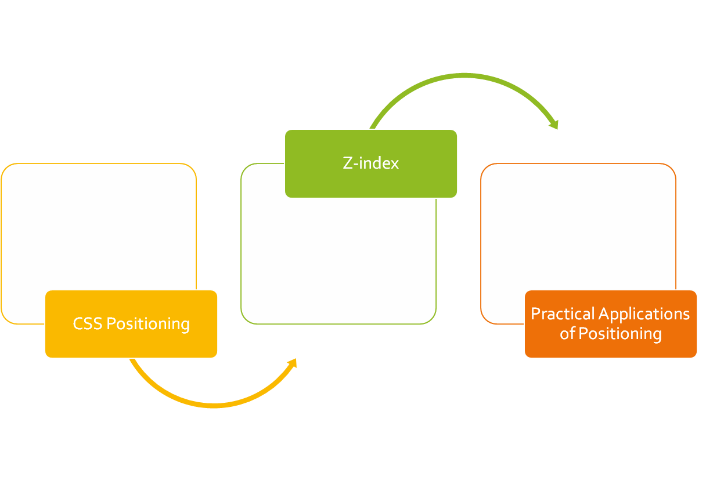
CLASS
OUTLINE

Slide 3
CSS POSITIONING

Slide 4
Positioning rules
Sometimes you just want an element to appear at a particular distance from the edges.
You can then specify to the elements where on the page they should appear. (top, bottom, left, or right)
But first, you determine the kind of positioning rule the element(s) should obey through the positioning property**
This specifies how the elements of the webpage should be placed, values may be fixed, static, relative, absolute or sticky
Notes:
Top, right, left or bottom will not work if positioning is not set. These will not have effect on statically positioned elements

Slide 5
Setting the Positioning
Static : This is the default, if an element is not positioned explicitly, then its statically positioned.
Relative: relative to its “normal” position, other contents will not take any gap left by it.
Fixed: relative to the viewport, which means it always stays in the same place even if the page is scrolled. Does not leave gap in the page where it would have been created.
Absolute: positioned relative to the nearest positioned parent, if no parent, uses the body

Slide 6

Sticky Positioning
A stickily positioned element is treated as relatively positioned until it crosses a specified threshold, at which point it is treated as fixed until it reaches the boundary of its parent.
Sticky positioning can be thought of as a hybrid of relative and fixed positioning.
You must specify a threshold* with at least one of top, right, bottom, or left for sticky positioning to behave as expected. Otherwise, it will be indistinguishable from relative positioning.
Notes:
The threshold is concerned about: as we scroll the page… and the element in question scrolls up at what distance from the top should it become fixed? Same thing applies to other edges

Slide 7
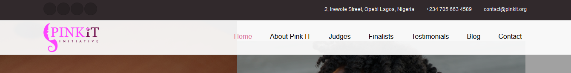
Sticky Positioning in Practice
Notice the black background before the sticky menu, it ensures that we scroll the page up to the point specified before the menu becomes fixed
Notes:
You must specify a threshold with at least one of top, right, bottom, or left for sticky positioning to behave as expected. Otherwise, it will be indistinguishable from relative positioning.

Slide 8

Sticky Positioning in Practice
Notice that the search box is at some distance from the top of the page

Slide 9
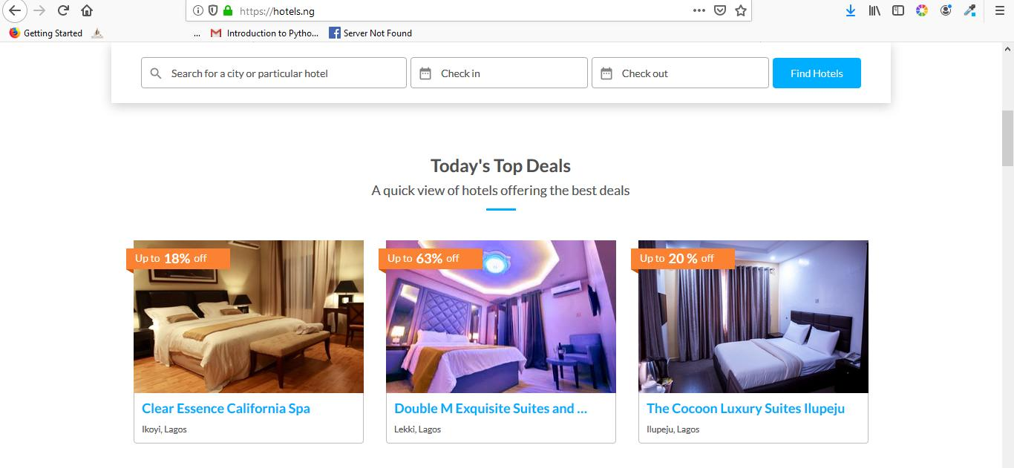
Sticky Positioning in Practice
On scrolling the page, when the search box gets to a distance of 0p from the top
From the viewport, it becomes fixed

Slide 10
Notes on Positioning
If both top and bottom are specified (technically, not auto), top wins.
If both left and right are specified, left wins when direction is ltr (English, horizontal Japanese, etc.) and right wins when direction is rtl (Persian, Arabic, Hebrew, etc.)

Slide 11
The z-index
Specifies the stack order of an element (when placed on top of each other)
! Remember that an element is placed on top of each other by positioning them so
An element can have negative or positive z-index value.
The element with a higher z-index comes on top of the others
The element must be positioned before it can respond to z-index;
Practical Application: Drop-down menu.

Slide 12
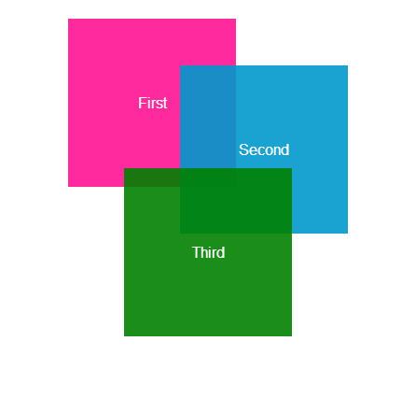
Achieve the stack shown using positioning:
Hint: z-index, positioning
Hint: Position the elements such that they almost appear in the same location. Then use z-index to arrange them, baby pink: rgb(244,194,194)

Slide 13
HANDSON

Slide 14

Search Bar with Background

Slide 15
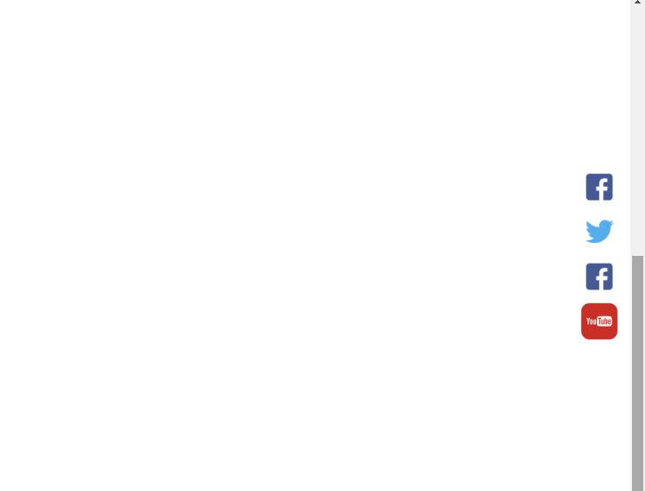
Fixed Social Media Side Bar

Slide 16
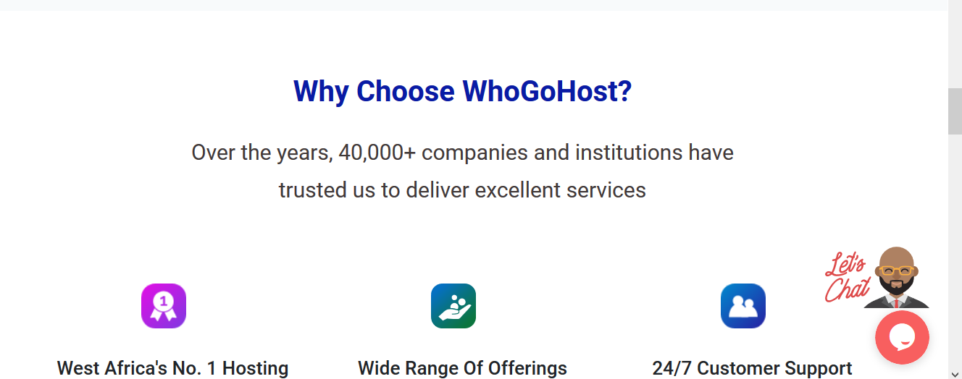
The LiveChat Icon is not moving with the page as it scrolls….

Slide 17

The social media div is not moving with the page as it scrolls….

Slide 18

Collapsible Header
Notes:
A div positioned absolutely in another div that has background image.
Step two: turn to a collapsible header by giving the background-attachment: fixed

Slide 19
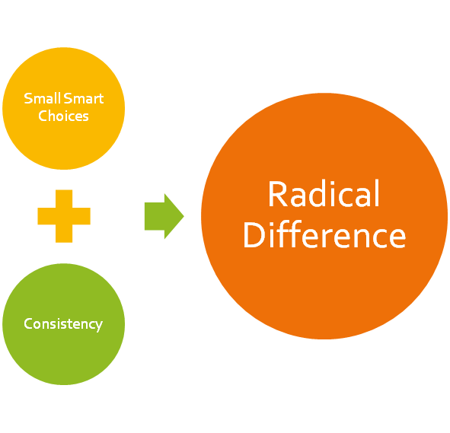
Catch up with all outstanding!
Well done, we are getting there…

