Slide 1
MOAT ACADEMY
WEB APPLICATION DEVELOPMENT TRAINING
REVISION CLASS

Slide 2
MORE ON WIDTH AND HEIGHT
Recall that when you do not set the height property of an element, its contents will determine the height.
Also remember that when you give an element a fixed height and the content is not up to the height, the element will take up the space anyway
When you set a height and the content is much than the set height, what happens? *
Min-height can be used to specify the minimum height [or starting height] of an element.
#mydiv{min-height:400px}
The above rule implies that the minimum height mydiv can be is 400px, if the contents requires more than height of 400px, mydiv will grow to accommodate the contents.
The same is applicable to min-width
Notes:
*the contents overflow

Slide 3
MORE ON WIDTH AND HEIGHT
Likewise, min-width specifies the starting width of an element, if the contents requires more width, the element will grow to accommodate the width of the contents
Max-height and max-width are used to specify the maximum height and maximum width an element can ever have.
Note :The min-height property always overrides both height and max-height, same for min-width
Notes:
*the contents overflow

Slide 4
Other CSS Pseudo classes
Pseudo classes are used to style specified parts of an element. For example, the beginning part of an element, elements when they are selected etc

Slide 5

Other CSS Properties
The text-shadow property applies shadow to each of the character in the text, Internet Explorer 9 and earlier versions, do not support the text-shadow property.
Syntax: text-shadow: horizontal amount vertical amount blurr amount color eg 2px 3px 6px red;
You can combine multiple shadow in one line by separating the h v b color with comma (see notes for example)
The box-shadow property applies shadow to elements. Syntax is like that of text-shadow. Example: box-shadow: 10px 10px 5px grey;
Notes:
h1{
box-shadow:3px 3px 5px red, 6px 6px 5px blue ;
}
h1{
text-shadow:1px 1px 2px grey;
color:white;
border:2px solid #ddd;
padding:20px;
width:35%;
}

Slide 6
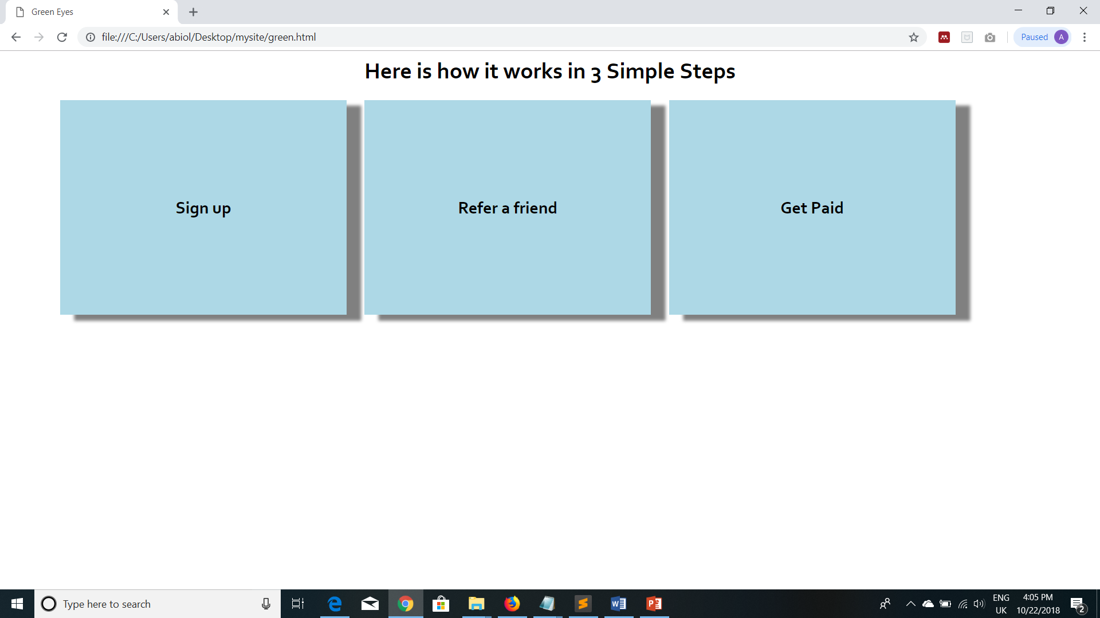
Classwork: Using box-shadow property, achieve something similar to this >

Slide 7
The hover state
General Syntax is:
selector:hover {
property: value;
}
The hover pseudo-selector is used to target an element in its hover state, that is: when the user mouses over the element.
It can be applied to any element * but it’s usually applied to the <a> tag to specify different rules based on the state of the link.
In addition to the :hover state, the <a> tag responds to other states such as :active, :link, :visited.
:hover MUST come after :link and :visited (if they are present)
Notes:
tr:hover {/* rule for when the table is moused over */}
img:hover {/* rule for when the image is moused over */}

Slide 8
Other CSS Properties
tr:hover{} and a:hover{}
line-height : can be used to specify the vertical distance between a line of text and the one coming after it.
p {
line-height:20px;
}
A common application of the line-height is to vertically centralize content that exists alone within a container. For Example: the copyright statement within a footer. The trick is to set the element’s line-height to the same as its height: see the below without and with line-height set
#demo{
height:100px;
line-height:100px;
}

Slide 9

CORRECTION
(see notes for hint)
Notes:
- Achieve overlay by creating an inner div with a transparent background. The inner div is within the div with background image . All the contents will reside on this transparent div

Slide 10

A consulting company has been having series of meeting on how they can increase their website traffic

Slide 11
Week Two Mini project
You have been approached as a web designer to help re-design their current website to be beautiful and SEO friendly so that they can attract more customers
Produce the design concept, a minimum of 3 pages is expected – home page, contact us and any other page such as about us. You can also use a single-paged website with links to different sections on the page
Useful resources:
  http://coolors.co for color mix
  http://fontpair.co to get fonts
  https://www.flaticon.com/ to get icons
  https://pixabay.com to get free HD images

Slide 12
Last Minutes Fine-tuning
Removal of outlines
www.moatacademy.com

Slide 13
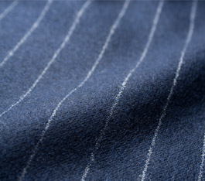
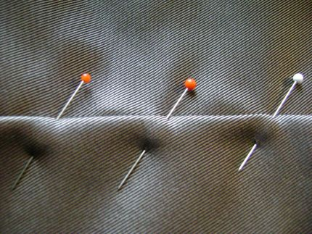
How would you feel if your tailor tells you your cloth is ready but you find chalks and pins all over?
If you would not be happy, your clients too won’t

Slide 14

Feeling like it already?
A professional website designer!
Well done, we are getting there…

