Slide 1
Responsive Websites for a better User Experience
Responsive Website Layout with Media Query, Other CSS Properties

Slide 2
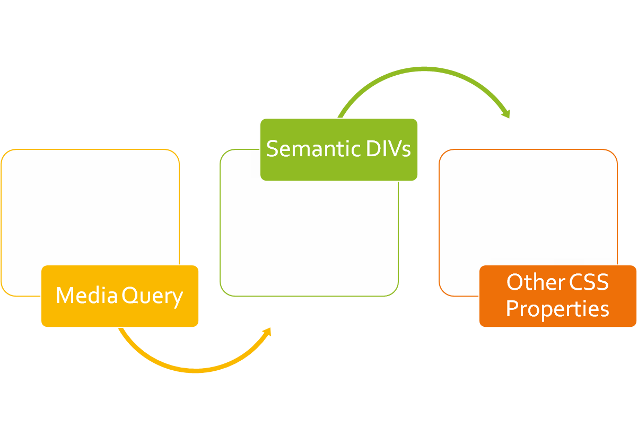
CLASS
OUTLINE

Slide 3

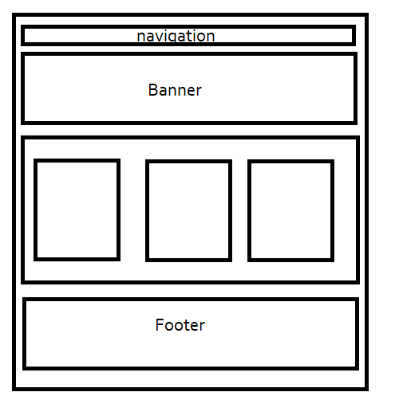
Consider PWCs website and the sketch

Slide 4
Media Queries
The @media rule, allows us to define different style rules for different media types and/or different screen sizes.

Slide 5
Simulating Mobile view in your browser
Include the meta tag for responsiveness as below:
<meta name="viewport" content="width=device-width, initial-scale=1, shrink-to-fit=no">
Mozilla Firefox: ctrl+shift+M
Chrome: Ctrl+Shift+I or right click the page and select inspect element, select the mobile phone icon
Opera: Similar step as Google Chrome above

Slide 6
Why Responsiveness?
Before mobile phones and other smart devices became common, websites were accessed through desktop computers and then Laptops.
Similar resolution across all computers hence websites had fixed widths.
Sideways scrolling is not as convenient as vertical scrolling.
To be responsive-ready, your webpage must include the meta tag for viewport

Slide 7
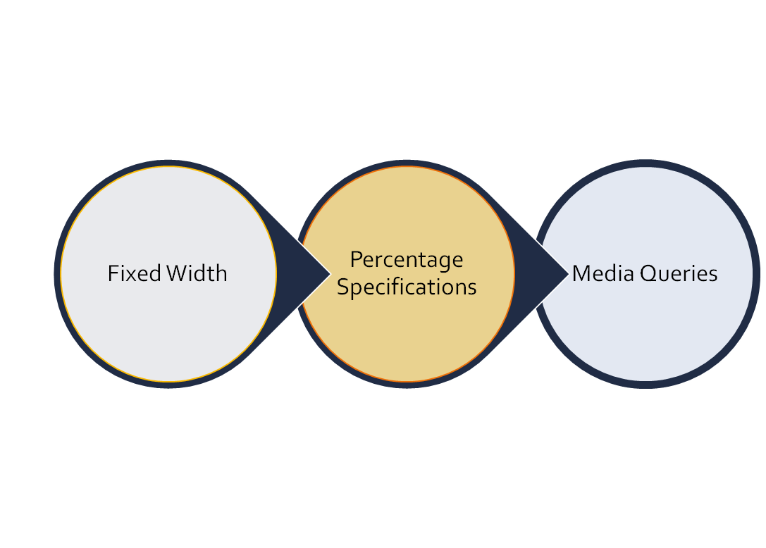
EVOLUTION OF WEBSITE
RESPONSIVENESS

Slide 8
Important Meta
<meta name="viewport" content="width=device-width, initial-scale=1, shrink-to-fit=no">

Slide 9
Media Query Syntax
@media mediatype and (expressions) {
CSS-Code;
}
mediatype may be: all, print, screen, speech
Example:
@media screen and (min-width: 480px) {
body {
background-color: lightgreen;
}
}
The mediatype is used to specify when the rule should be applied. For example, print means that the rule should only apply when the page in question is being printed; the output from the printer

Slide 10
Media Query Syntax
You can use media queries to change the font size of an element on different screen sizes:
For example, if screen size is more than 600px wide, set the font-size of <div> to 80px
You can also use the (max-width: ..) and (min-width: ..) values to set a minimum width and a maximum width as follows:
    @media screen and (max-width: 900px) and (min-width: 600px) {}
You can specify a different height when the screen size is smaller. Etc

Slide 11
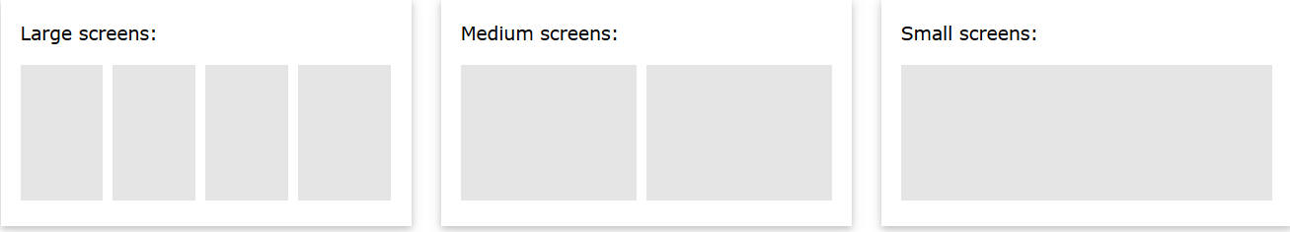
Media Query Syntax
A common use of media queries, is to create a flexible [responsive] layout when the screen size varies as shown in the image below:
.parent { display: flex; }
Child{ width: 25%;}
See Notes for more
Notes:
/* On screens that are 992px wide or less, go from four columns to two columns */
@media screen and (max-width: 992px) {
.parent{
flex-wrap:wrap;
}
.child{
width: 50%;
}
}
/* On screens that are 600px wide or less, make the columns stack on top of each other instead of next to each other */
@media screen and (max-width: 600px) {
.parent{flex-direction: column}
.child {
width: 100%;
}
}

Slide 12
Responsive Layout: Big Challenge?
Of all the device type in the world, how many device size do we want to create rules for?

Slide 13
Media Query Cheat Sheet
Devices are generally categorized into the following breakpoints: - 1280, 1024, 768, 480
1280-1024 - desktop (default grid)
1024-768 - tablet landscape
768-480 - tablet
480-less - phone landscape & smaller devices
Check https://gist.github.com/gokulkrishh/242e68d1ee94ad05f488

Slide 14
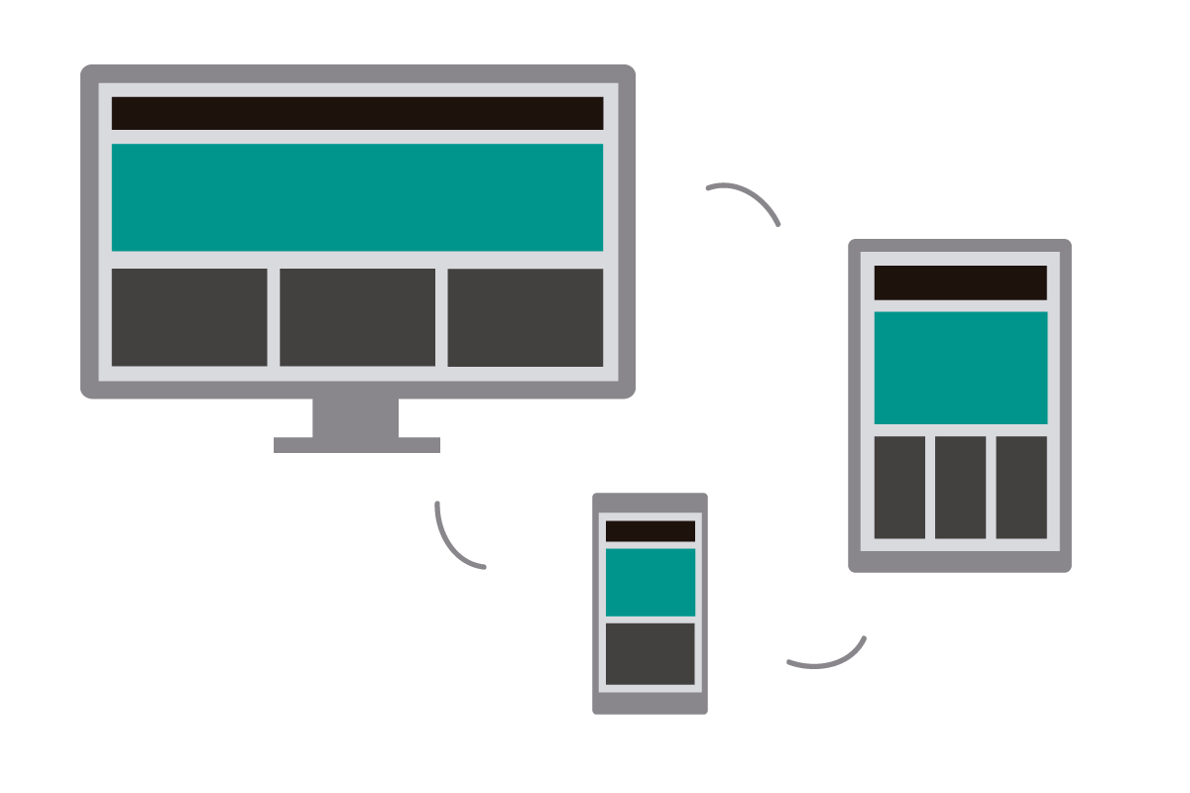
Class Hands-on: How do you achieve the following? *
Notes:
On regular device, the divs stand side by side : This can be accomplished by giving the parent the property display:flex
Using media query, we can specify that on small devices, the flex-direction be set to column and take width of 100%.

Slide 15
Media Query Cheat Sheet
Devices are generally categorized into the following breakpoints: - 1280, 1024, 768, 480
1280-1024 - desktop (default grid)
1024-768 - tablet landscape
768-480 - tablet
480-less - phone landscape & smaller devices
Check https://gist.github.com/gokulkrishh/242e68d1ee94ad05f488

Slide 16
Hands-on: How do you achieve the following? *
Notes:
On regular device, the divs stand side by side : This can be accomplished by floating each of them
Using media query, we can specify that on small devices, each of the div should stand as a block element and take width of 100% without floating.
You can use float:none;

Slide 17
CSS DIV and Other Semantic Elements
Elements whose functions are self-explanatory

Slide 18
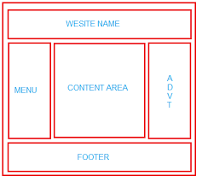
CSS DIV
Consider the layout shown:
The boxes, just like lego blocks can be put together to form a complete website.
The parents of boxes which sit side by side are flex’ed.
This layout is also known as the wireframe for your website.
It is a good idea to use meaningful names for your classes and id”s for better SEO

Slide 19
Semantic Elements
The div is a generic block-level element that can be used to group web contents
A semantic element describes its meaning to both the browser and the developer. They describe the structure of a web document in a standard way thus making browsers and assistive technologies understand the page better.

Slide 20
HTML Navigational Element (<nav>) | defines a section that contains navigation links that appear often on a site. You can have primary and secondary menus, but you never nest, or put a <nav> element inside a <nav> element.
HTML Article Element (<article>) | defines a piece of self-contained content. It does not refer to the main content alone and can be used for comments and widgets.
HTML Section Element (<section>) | defines a section of a document to indicate a related grouping of semantic meaning.
NOTE: Articles can be nested inside of sections and sections can be nested inside of articles.
HTML Aside Element (<aside>) | defines a section that, though related to the main element, but has a different placement than the main content , like an explanation box, definition or an advertisement. It has its own outline, but doesn't belong to the main one. The <aside> element is often used for sidebars containing extra, but relevant, information
HTML Header Element (<header>) | defines the part of a page which typically contains the logo, title, and navigation. The header can also be used in other semantic elements such as <article> or <section> — or section header, containing perhaps the section's heading, author name, etc. <article>, <section>, <aside>, and <nav> can have their own <header>. Despite its name, it is not necessarily positioned at the beginning of the page or section.
HTML Footer Element (<footer>) | defines a page footer which typically contains the copyright, legal notices and sometimes some links — or section footer, containing perhaps the section's publication date, license information, etc. <article>, <section>, <aside>, and <nav> can have their own <footer>. Despite its name, it is not necessarily positioned at the end of the page or section.
HTML Blockquote | Indicates that the enclosed text is an extended quotation.

Slide 21
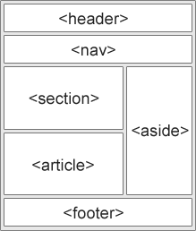
Semantic Elements

Slide 22
Designing for older browsers
Unknown elements are styled as display: inline by default, so you'll want to set them to display: block:
See example:
article, aside, footer, header, nav, section {
display: block;
}

Slide 23
CSS Pseudo Classes & Others
Pseudo classes are used to style specified parts of an element. For example, the beginning part of an element, elements when they are selected etc

Slide 24
Other CSS Properties: Pseudo Classes
General Syntax is: selector::pseudo-element {
property:value;
}
::first-line, ::first-letter
::before and ::after can be used to insert some contents before and after the content of an element.
Syntax is selector::before{content: url(‘’)}
::selection pseudo-element matches the portion of an element that is selected by a user.
The nth-child:
  tr:nth-child(odd){}
  tr:nth-child(even){}
letter-spacing: 10px;
border-collapse: collapse; (Tables)

Slide 25
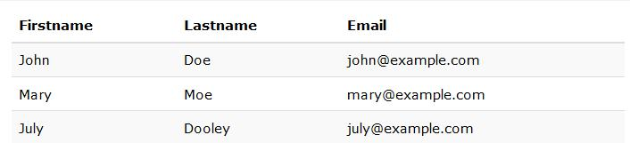
Using the tr(nth) property, reproduce the table below

Slide 26
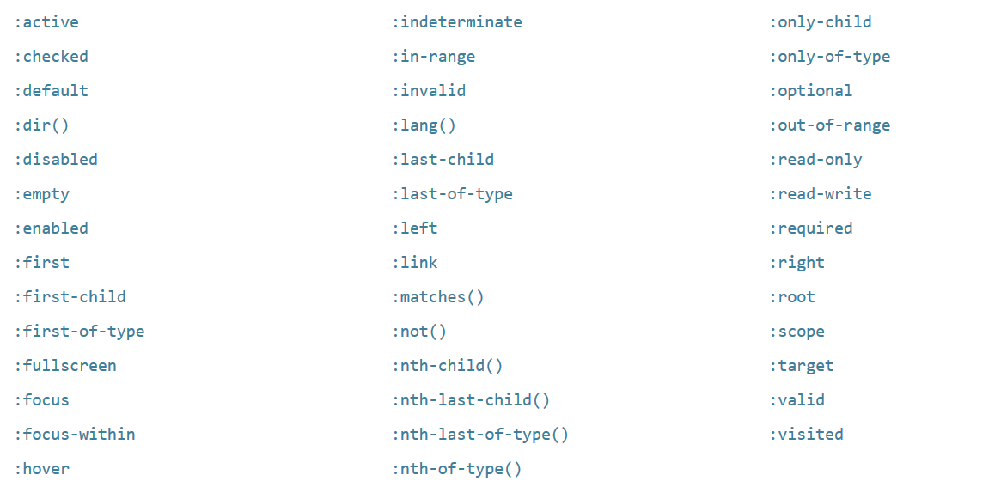
Go Further!

