Slide 1
City Hotel
Cancellation, Overbooking & Deposit Policy
Problem → Method → Findings → Recommendations
City Hotel decision analytics | 1

Slide 2
1. Problem & decision context
Three decisions must work together
• Predict cancellation risk at booking time.
• Set a profitable overbooking level using calibrated probabilities.
• Use deposits only where risk justifies conversion loss.
• Room inventory is absent from the source data.
Cleaned City Hotel
53,273 rows
Temporal test
7,932 bookings
Data span
2015–2017 arrivals
City Hotel decision analytics | 2

Slide 3
2. Method
Temporal split, calibration and policy simulation
• Train through 2016-12-12; calibrate 2016-12-13 to 2017-02-24; test from 2017-02-25.
• Exclude outcome leakage fields.
• Benchmark logistic regression against gradient boosting.
• Use sigmoid / isotonic probability calibration.
• Build a second near-arrival model as a diagnostic ceiling.
BOOKING DATA
RISK MODELS
CALIBRATED P
POLICY SIM
City Hotel decision analytics | 3

Slide 4
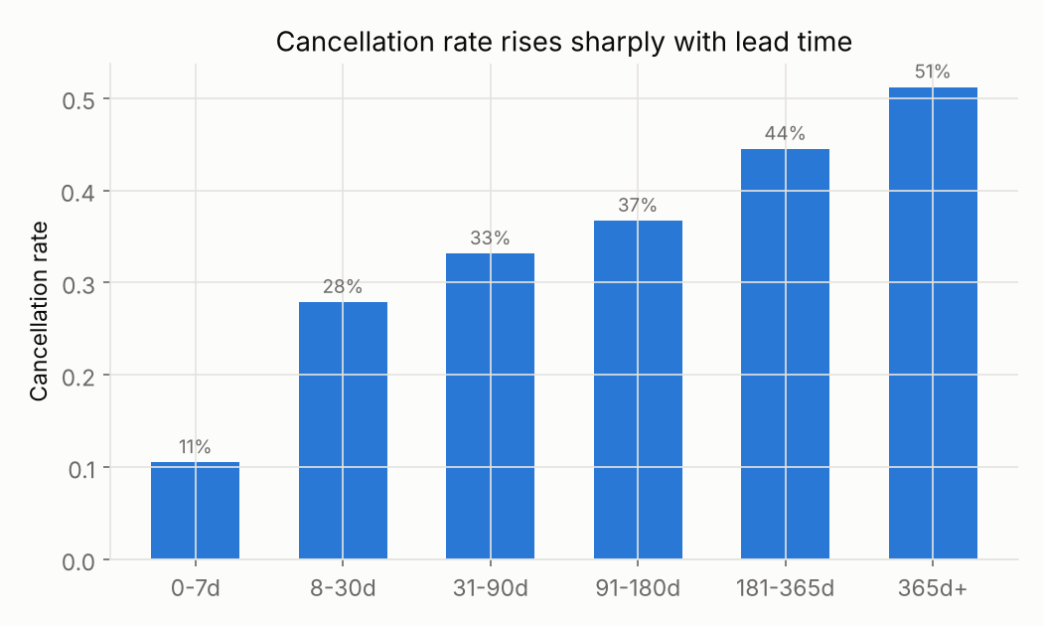
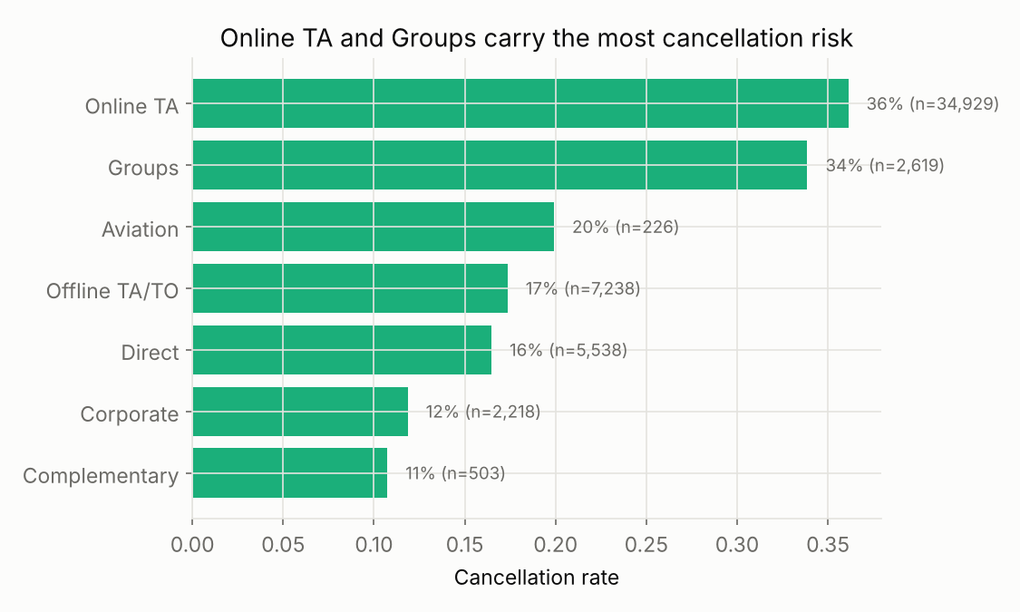
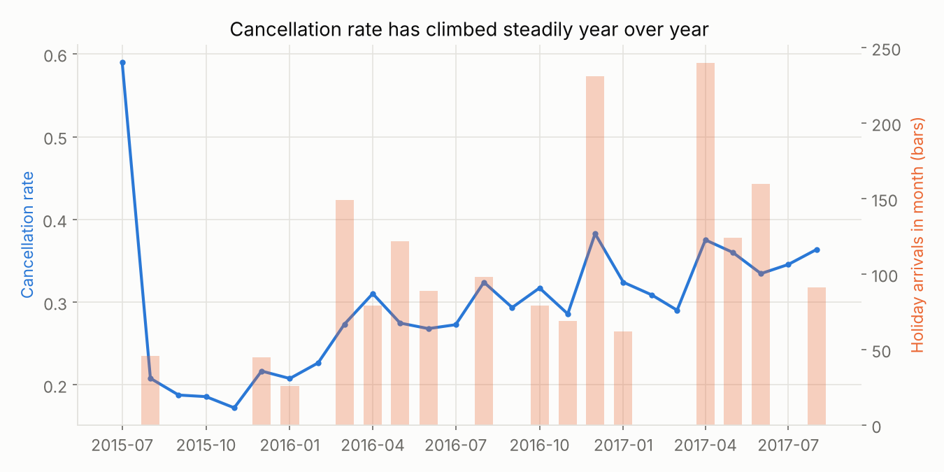
3. Findings — cancellation behaviour
Lead time is the strongest simple driver
• ≈11% cancellation at 0–7 days
• ≈51% at 365+ days
• Segment and seasonal context matters
City Hotel decision analytics | 4

Slide 5
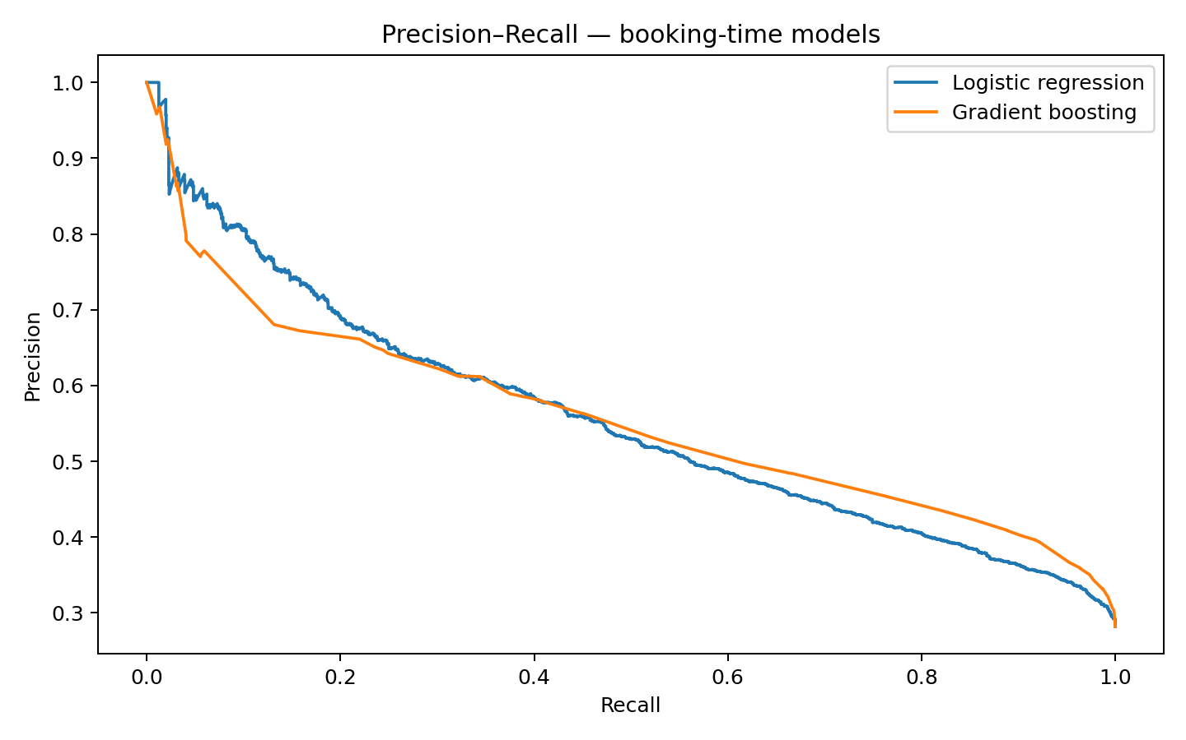
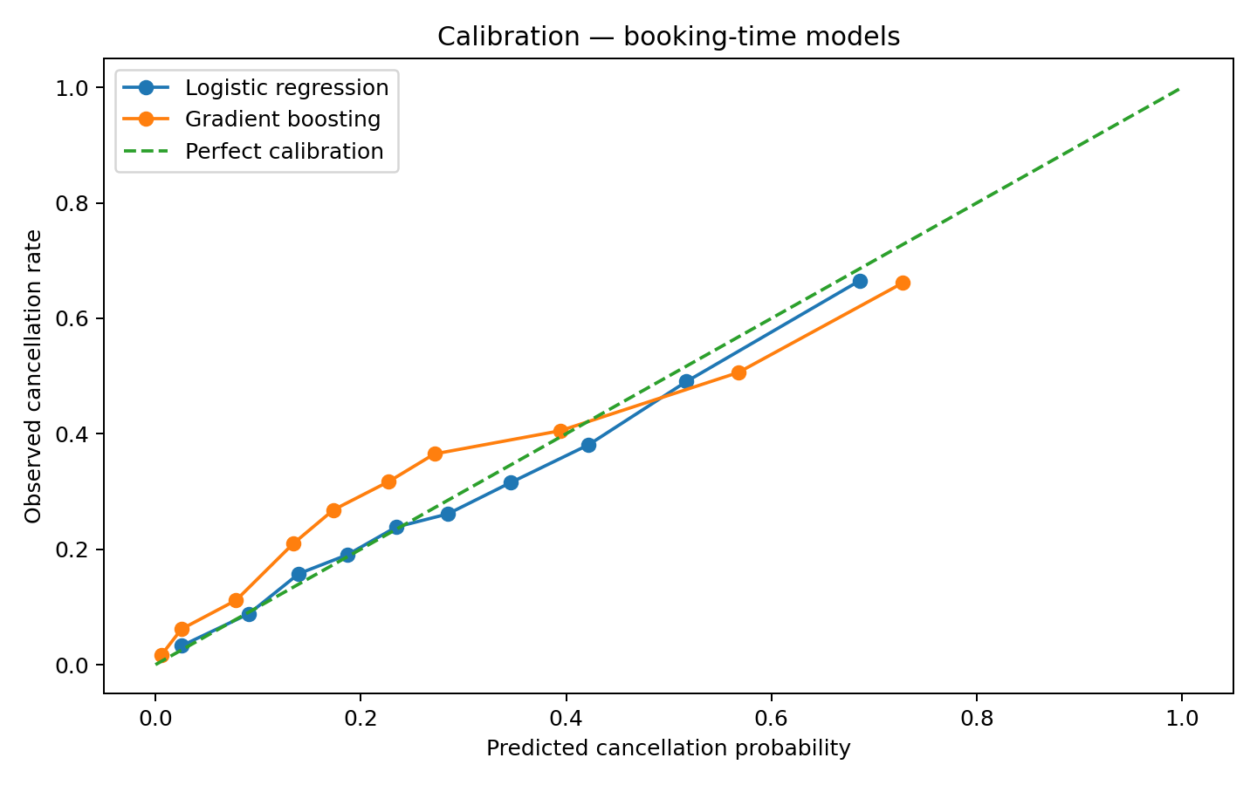
4. Model performance & SHAP
GBM improves ranking; explainability flags governance risks
0.775
Booking-time GBM AUC
0.545
Booking-time AP
0.800
Near-arrival GBM AUC
0.168
Brier
• country — 0.748
• total_of_special_requests — 0.665
• market_segment — 0.648
• lead_time — 0.378
• adr — 0.351
• required_car_parking_spaces — 0.319
City Hotel decision analytics | 5

Slide 6
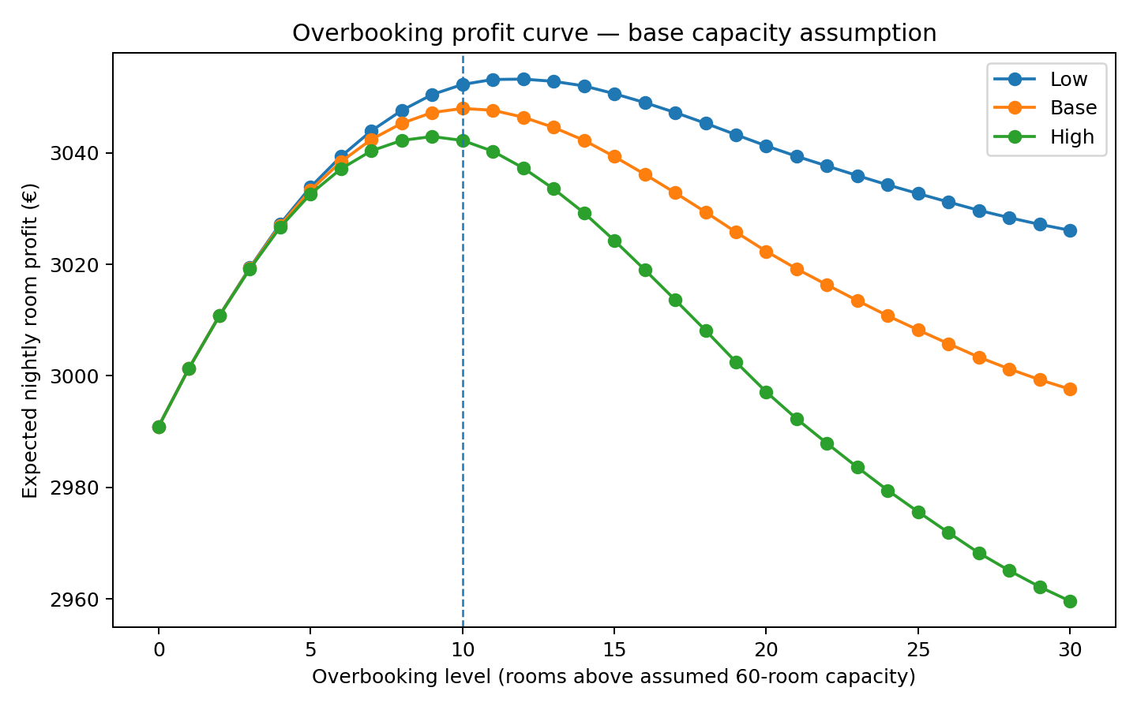
5. Findings — overbooking
Base profit curve peaks at k=10
• Assumed capacity: 60 rooms
• Base walk cost: €200
• Optimal overbooking: k=10
• Modeled uplift: ≈€57/night
• Low/base/high optimum: 12 / 10 / 9
City Hotel decision analytics | 6

Slide 7
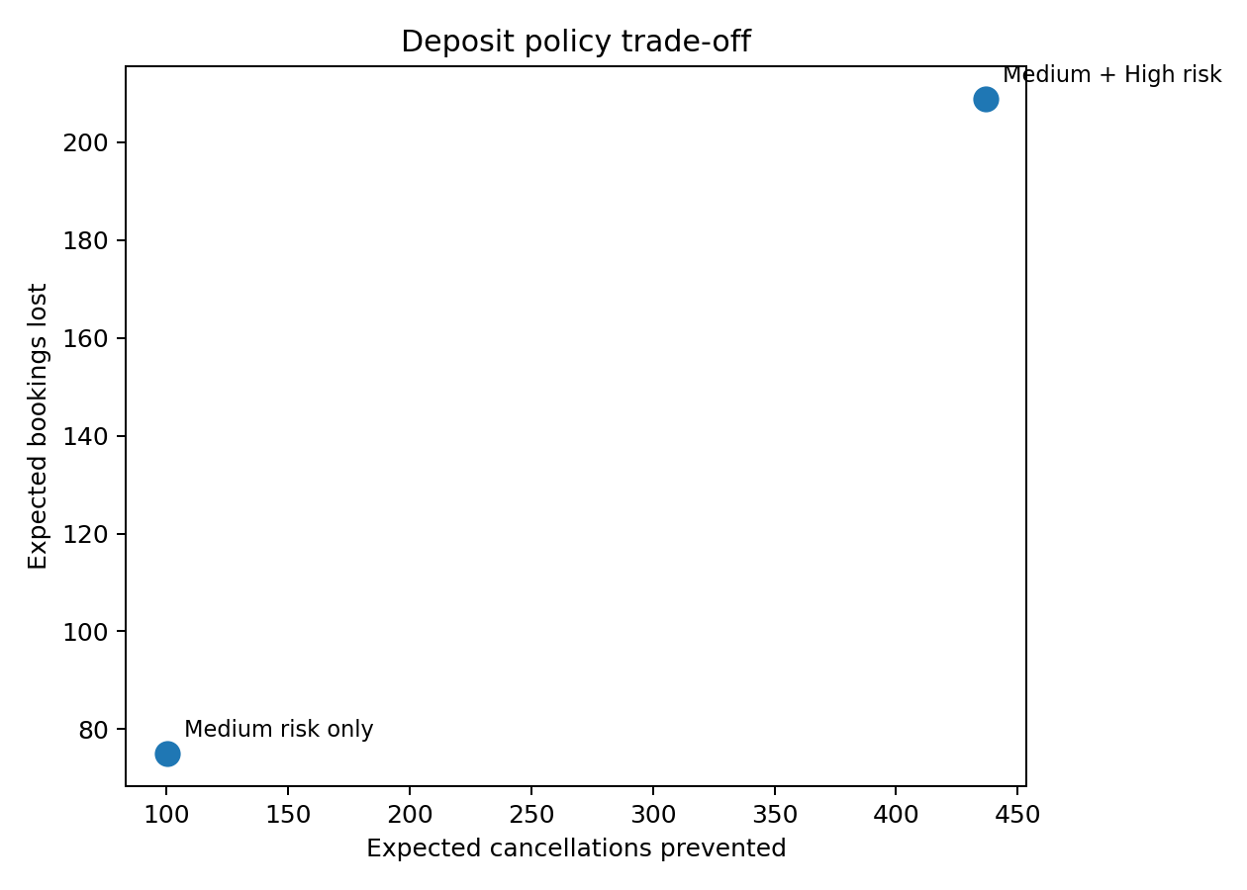
6. Findings — deposit policy
Target actionable high-risk bookings; validate through experiment
Low risk
<20% → 0%
Medium risk
20–40% → 10%
High risk
>40% → 25%
• ≈437 cancellations prevented
• ≈209 bookings lost
• ≈€168,246 modeled net uplift
City Hotel decision analytics | 7

Slide 8
7. Recommendations & implementation
Shadow → pilot → scale
• Start with booking-time calibrated GBM + k=10 under validated capacity assumptions.
• Pilot 0% / 10% / 25% deposits for actionable bookings only.
• Validate current capacity, walk cost, calibration and fairness before deployment.
• Monitor contribution margin, walk rate, booking loss and calibration monthly.
Shadow
A/B pilot
Scale
• Country = monitoring, not deposit pricing.
• Human override + rollback are mandatory.
• Refresh the historic model with current data before scale.
City Hotel decision analytics | 8

Slide 9
8. Decision
A conservative, measurable revenue-management program
Use the model to improve the decision — not to automate away judgement.
• Primary model: booking-time GBM, AUC 0.775.
• Base overbooking: k=10 under stated assumptions.
• Deposits: 0% / 10% / 25% by risk tier.
• Next step: current-data pilot with fairness, privacy and legal gates.
• Financial lift
• Calibration
• Fairness
• Customer impact
City Hotel decision analytics | 9

