Slide 1


Version Control Management
Samuel Frederickson
Alex Pena
Cade Disselkoen
Dawson Hill

Slide 2




Popular Unity Engine Games:
Cities Skyline – Windows, Xbox, Nintendo Switch, Mac, Linux
Rust – Windows (Soon to be Xbox and PS4)
Hearthstone – Android, IOS, Windows, Mac
Cuphead – PlayStation, Nintendo Switch, Xbox, Windows, Mac

Slide 3

Unity platform Types
Unity has many different build options:
  PC, Mac & Linux Standalone
  WebGL
  Universal Windows Platform
  Virtual Reality and Augmented Reality
  PlayStation
  IOS
  Xbox
  Android and more.

Slide 4
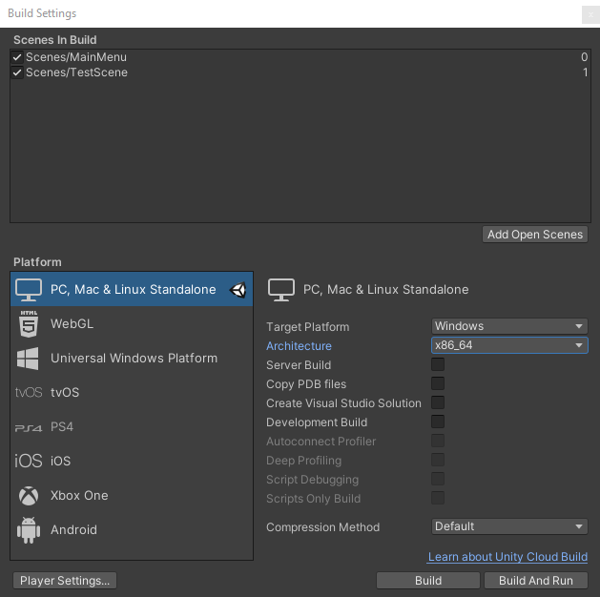
Build Settings
Scenes in build
  Put all scenes that will be in use into your build settings
Platform select
  Install platform module (if not installed)
  Switch platform
Building
  Build will build the game
  Build and Run will build and once it has finished, run the game

Slide 5
Player Settings
Player Settings will be where you can change information about the build.
  Company Name
  Product Name
  Version number
  Icon (2d Image)
  Resolution (Presentation Details)
  Splash Image (Image while game launches)
  XR Settings (VR and AR applications)

Slide 6
Quality Settings
Quality Settings allow you to change the graphical quality it attempts to render
  Add and remove presets to overall graphics settings
  Set defaults to presets
  Change overall graphics settings for the game

Slide 7
Licensing and Complications
Unity:
  Unity Personal is for individuals, hobbyists, and small organizations with less than $100K of revenue or funds raised in the last 12 months (free)
  Unity Plus is for revenue or funding less than 200k in the last 12 months ($40/month)
  Unity Pro for revenue or funding greater than $200k ($150/month)
Playstation:
  You do need to be a PlayStation Developer to test and publish. (PS4 Dev Kit is $2500)
Xbox
  If you are not listed as a registered Xbox developer, you cannot download the Xbox module of the Unity Editor. (Creator Program - $19, ID@Xbox - application)

Slide 8
Licensing and Complications Cont.
IOS
  To develop iOS apps, you must be a member of the iOS Developer Program. The cost is currently $99 per year, and allows you to build, test, and eventually release your apps in the Apple App Store.
Android (Alex)
  Free unity development module. Requires android device to test on.
VR/AR
  Must turn on developer mode for VR headset. Only available for Oculus Rift, Steam VR/Vive, PlayStation VR, Gear VR, Microsoft HoloLens, and Google's Daydream View.

Slide 9
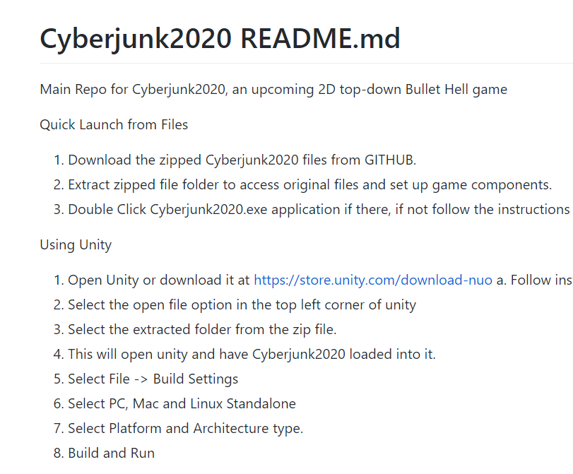
Distribution for Games
ReadMe file
  Contains info on how to download, build and run the code.

Slide 10
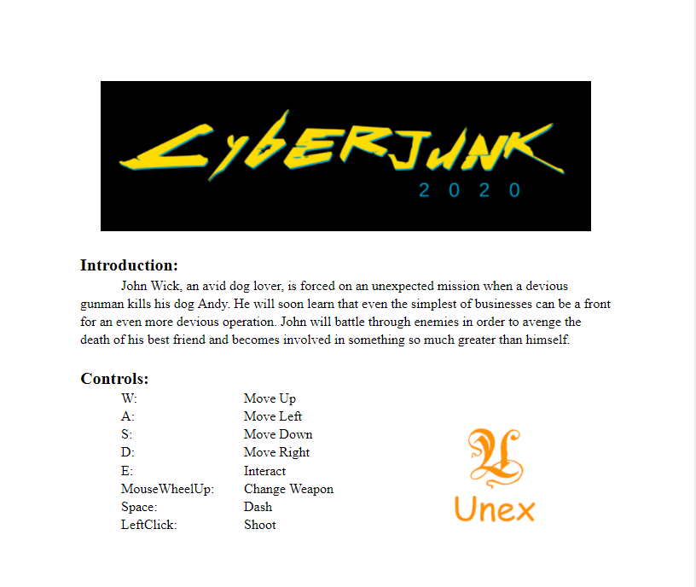
Distribution for Games Cont.
User Manual
  Brief description of the game as well as basic commands, whether they are in the game or not.

Slide 11
Any Questions?
Useful Links:
Player Settings: https://docs.unity3d.com/Manual/class-PlayerSettings.html
Quality Settings: https://docs.unity3d.com/Manual/class-QualitySettings.html

