Slide 1
Intro to GitHub
Chris, Miguel, Nathan, Nic, Tony

Slide 2

Part 1: What is GitHub, How is it Used?

Slide 3
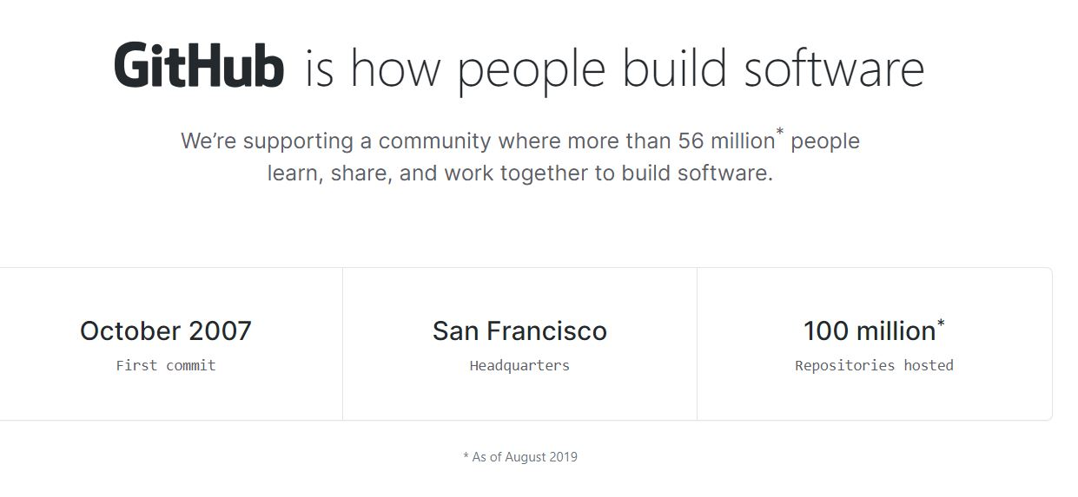
What is GitHub?

Slide 4


What is GitHub? (Cont.)
Platform for Building Software
Worldwide Development Capabilities
Graphical Interface for Version Control Management
Progress Tracker
Cloud Storage and Development

Slide 5

How is GitHub Used?
Record or Rewind Changes
Build on the Built, or Create New
Code Review with Pull Requests
Instant Developer Environments
Find and Fix Vulnerabilities or Issues

Slide 6

Octocat

Slide 7
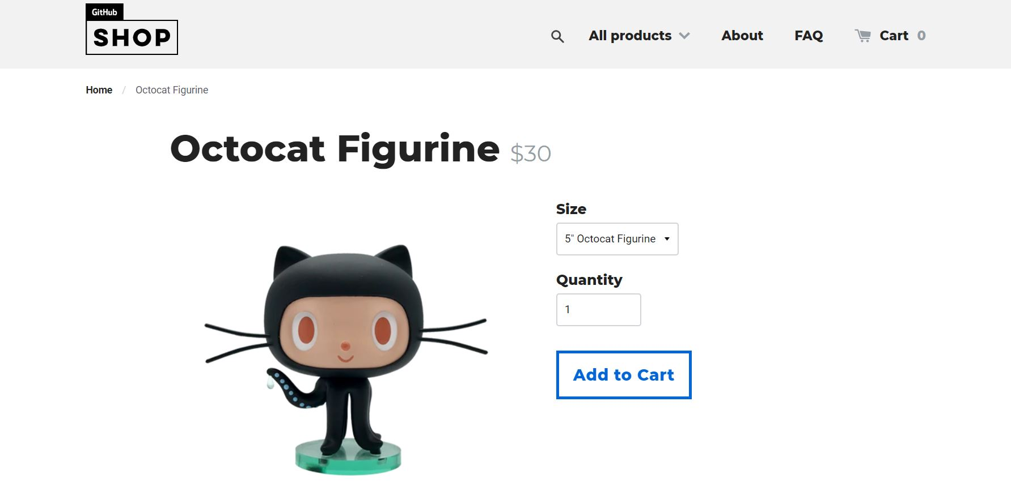




Octocat Merch

Slide 8
Part 2: Setting up GitHub Desktop

Slide 9
Creating a GitHub account
Go to https://github.com/join
Fill in the information to create your GitHub account

Slide 10
Downloading and Installing GitHub Desktop
GitHub Desktop allows you to interface with repositories from your desktop/laptop without having to use the command-line
Go to https://desktop.github.com/
Download the installer for your system (Windows (64bit), Windows (msi), macOS...)
Open the installer
Follow the instructions (if any) to install GitHub Desktop
Sign in to your GitHub account on GitHub Desktop
Using the toolbar on the top of the screen, open File -> Options -> Account
Sign in

Slide 11
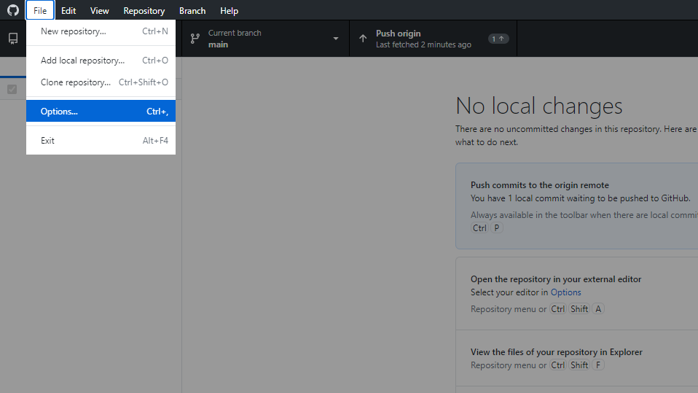
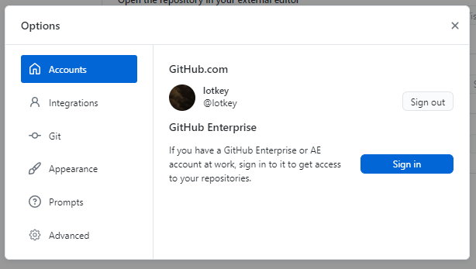

Slide 12


Part 3: Workflow with GitHub
&
GitHub Desktop

Slide 13
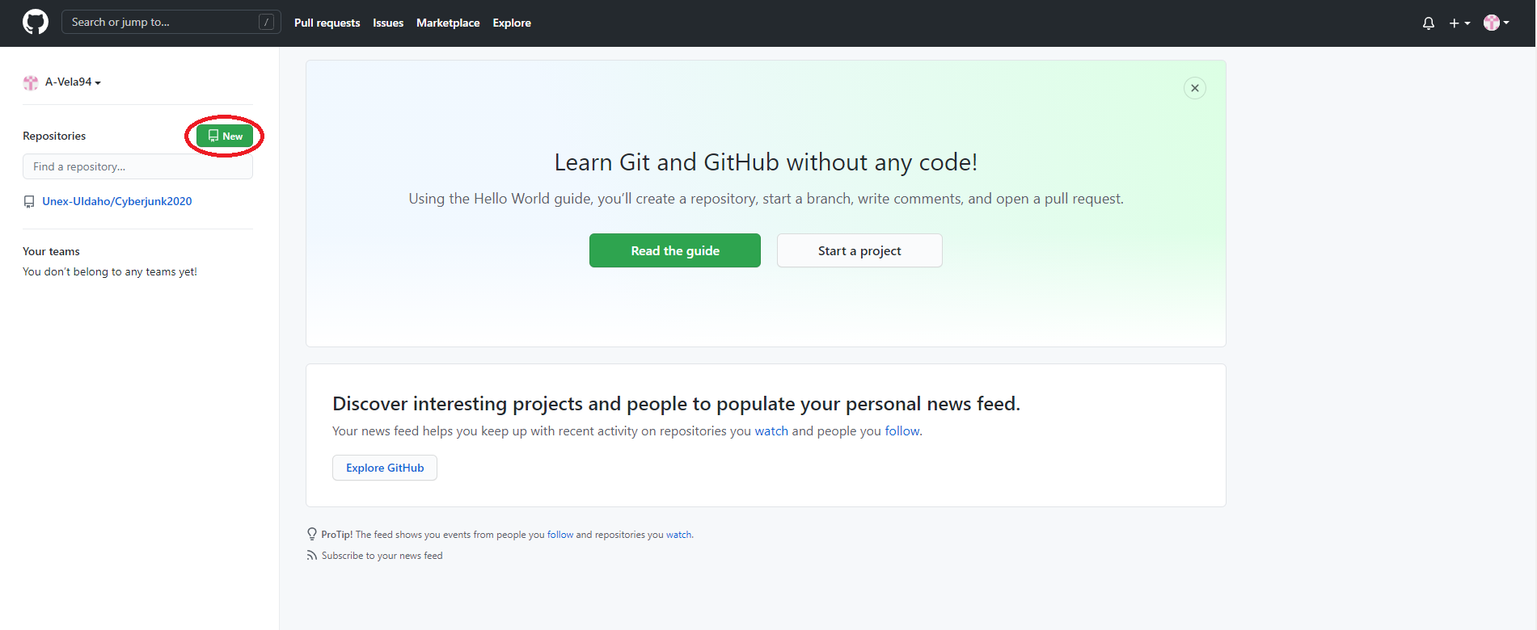
Creating Your First Repository (Repo)
From GitHub.com
After registering a new account, click on the green new icon on the top left under your username

Slide 14
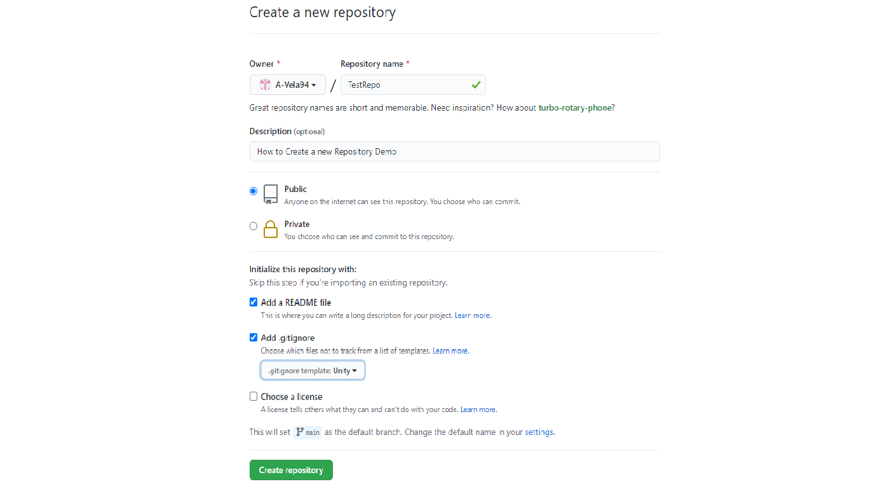
New Repository
What is a repository?
A repository, or repo, is a directory hosted by GitHub that contains all of your project files. You can choose to make your repo public or private based on the needs of your project.
After clicking on New, you’ll be presented with the following screen.
Give your repository a name fitting for your project
Give your project a short description
Choose to make your project public for all to see, or private to invite specific collaborators
You can choose to add a default README.md file as well as a .gitignore file for your type of project
The README file will be the first page displayed to users on your GitHub repository. Its purpose is to guide users/collaborators in how to use/collaborate on your application
GitHub provides templates for a .gitignore file for various types of projects. Since our project will be developed in Unity, we’ll choose that template
You can also choose a license for your project

Slide 15



A Quick Note on README.md, .gitignore, and Licensing
README.md
From the GitHub Documentation: docs.github.com/en/github/creating-cloning-and-archiving-repositories/about-readmes
‘You can add a README file to a repository to communicate important information about your project. A README, along with a repository license, contribution guidelines, and a code of conduct, communicates expectations for your project and helps you manage contributions.’
.gitignore
From GitHub Documentation docs.github.com/en/github/using-git/ignoring-files#excluding-local-files-without-creating-a-gitignore-file
‘You can create a .gitignore file in your repository's root directory to tell Git which files and directories to ignore when you make a commit. To share the ignore rules with other users who clone the repository, commit the .gitignore file in to your repository.’
Licensing
There are many different open-source Licenses available to use with your project. This article is a comprehensive guide to licensing your project. Read to learn more.
docs.github.com/en/github/creating-cloning-and-archiving-repositories/licensing-a-repository#searching-github-by-license-type

Slide 16
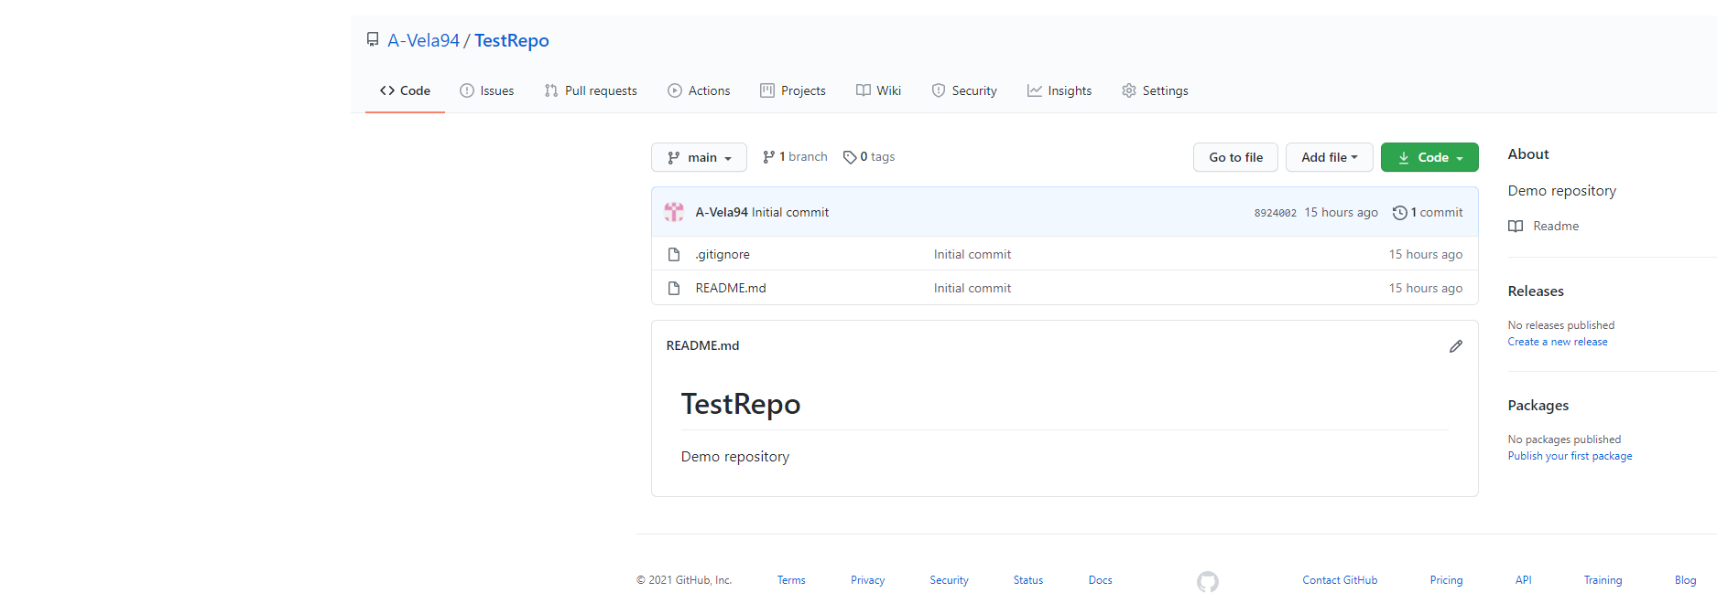
New Repo cont’d.
After creating your repository, you should see something similar to this.

Slide 17

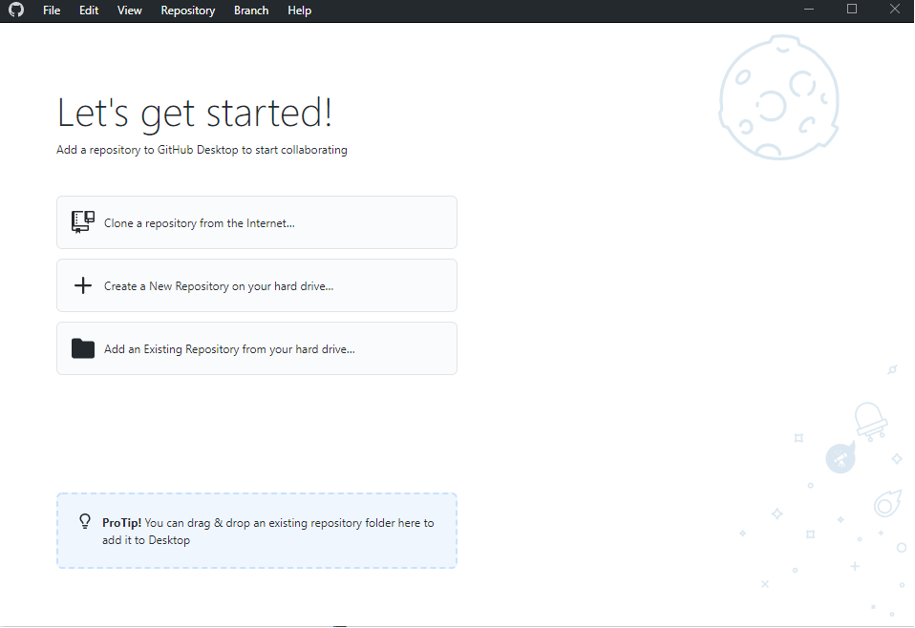
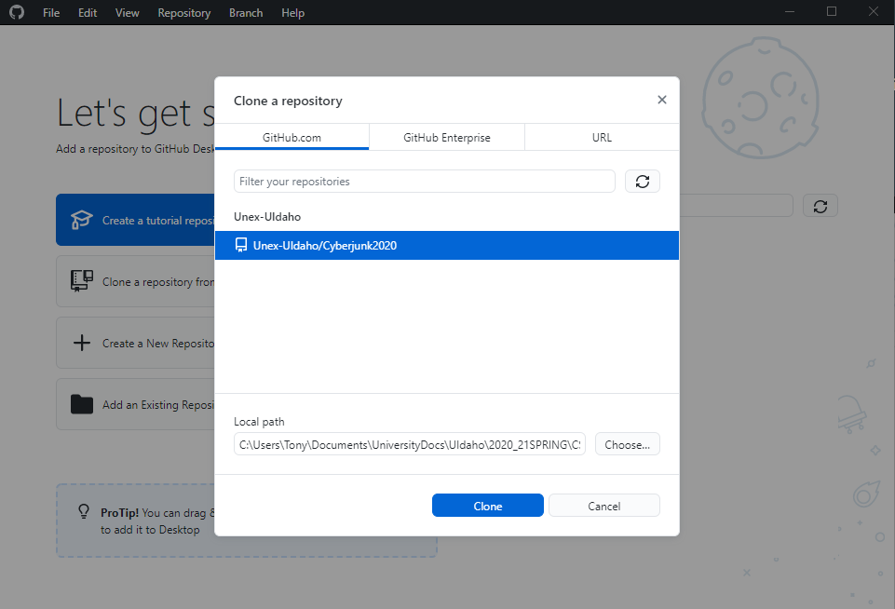
Cloning Your Repositories With GitHub Desktop
*You should have already installed and configured GitHub Desktop prior to this step. If you haven’t, return to that step in this guide. For more in-depth instructions visit docs.github.com/en/github/getting-started-with-github/github-desktop.*
After configuring GitHub Desktop and signing in via your browser you’ll see this screen.
Click on “Clone a repository from the internet...” you’ll be prompted to sign in to github.com if you’ve logged out.
Select the repository to be cloned from the list, the repo you created should be found here, and choose the directory where this repository will be stored on your local machine.

Slide 18
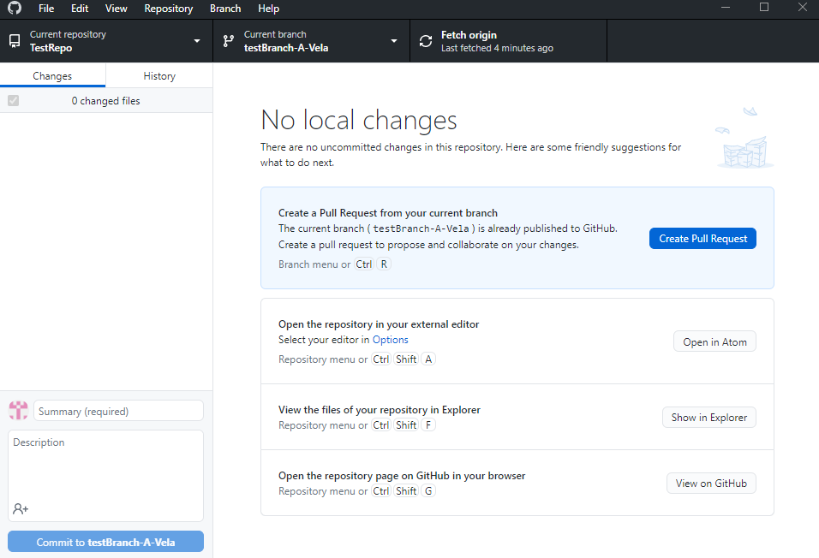
Fetching Origin GitHub Desktop
Whenever you start working on repository cloned to your local machine, remember to “Fetch” the origin of your project to resync any changes made to the repository by collaborators to your local project directory.

Slide 19
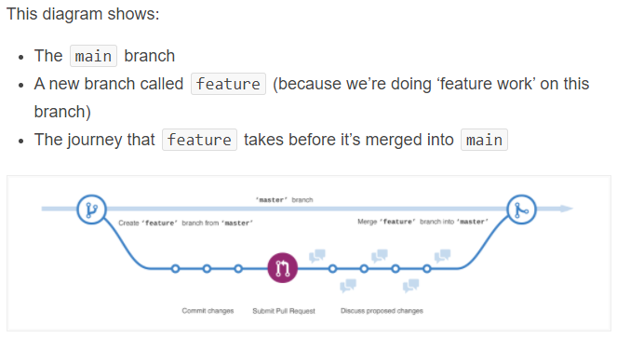
Getting Familiar with Branching
What is branching?
As stated in the introductory guide on GitHub’s web site: guides.github.com/activities/hello-world/
“Branching is the way to work on different versions of a repository at the same time”
When you create a new repository, the “main” branch gets created, this is considered the definitive branch that all other branches will get merged back into.
When a new branch is created off of the main, basically, a copy of the main branch is created and can be edited without committing those edits to the main branch.
If changes are made to the main branch while you’re working on your separate branch, GitHub makes it possible to pull those changes into your branch.
This diagram from GitHub’s guide illustrates this workflow process

Slide 20
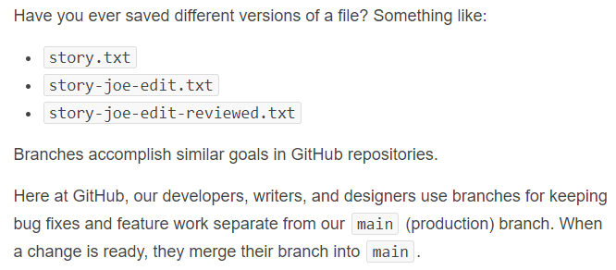
Getting Familiar with Branching cont’d.
Branching is like saving different versions of a file, with the original file being the main, and additional copies thought of as branches. As the creators of GitHub explain:
The use of branches makes collaborating on large projects easier to scale and maintain.

Slide 21
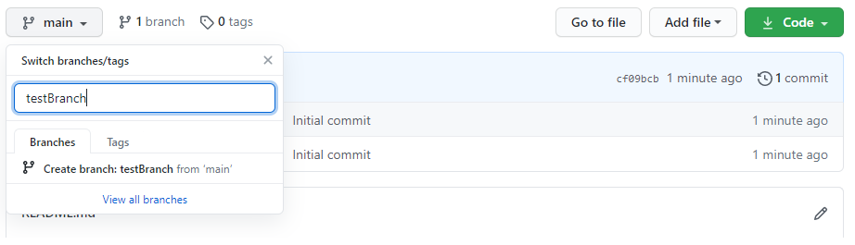
Creating a New Branch-Browser View
To create a new branch in GitHub from the Browser:
GitHub in-browser:
Navigate to your repository
Click the drop-down arrow where your main branch is
Type the desired name of your new branch and hit enter and your new branch will be created

Slide 22
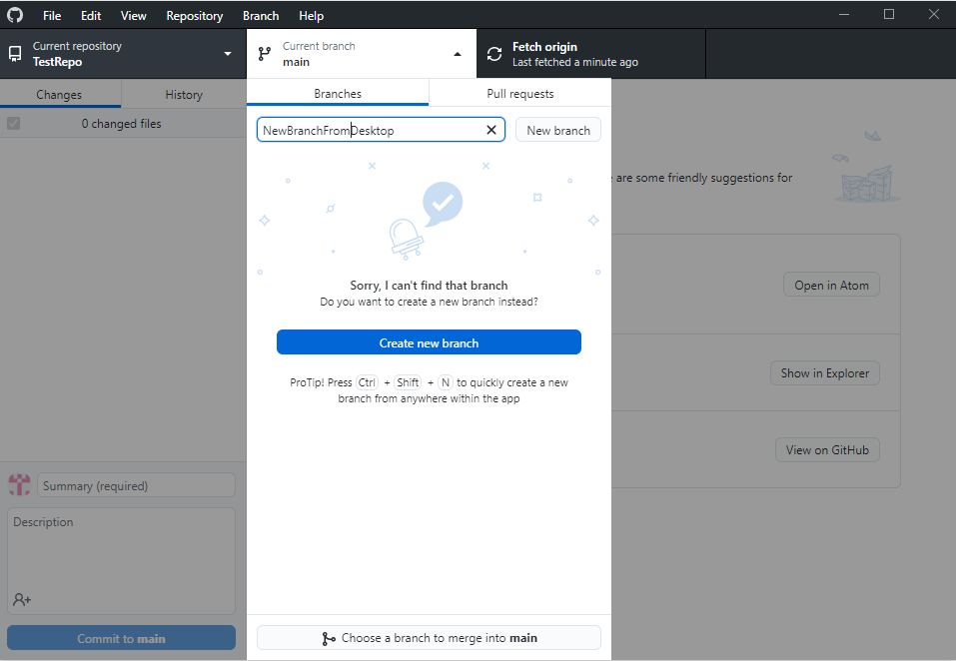
Creating a New Branch: GitHub Desktop
Creating a new branch using GitHub Desktop is very similar
Open the application, click the drop-down arrow on the main branch, enter the name and hit enter.
If the repository has a branch created off of the main branch already, choose which branch you want to base your new branch off of.

Slide 23
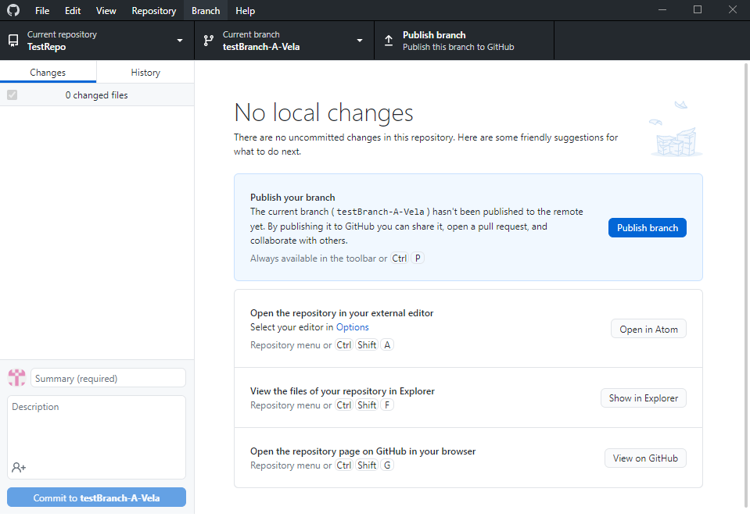
Publishing a New Branch: GitHub Desktop cont’d.
To publish your new branch created in GitHub Desktop, click Publish branch. Now your new branch should be visible on github in-browser.

Slide 24
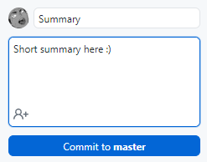
Making Edits and Commits
Now that you have a new branch to start making changes to, you can start changing things up and making some commits.
Saved changes to files stored in a repository are called commits.
Each new commit generates a message with a description of the changes for all to see.
When a developer makes a commit, they should submit a short, descriptive message detailing changes.
Edits/commits can be made via browser, or on a local machine with a cloned repository via GitHub Desktop

Slide 25
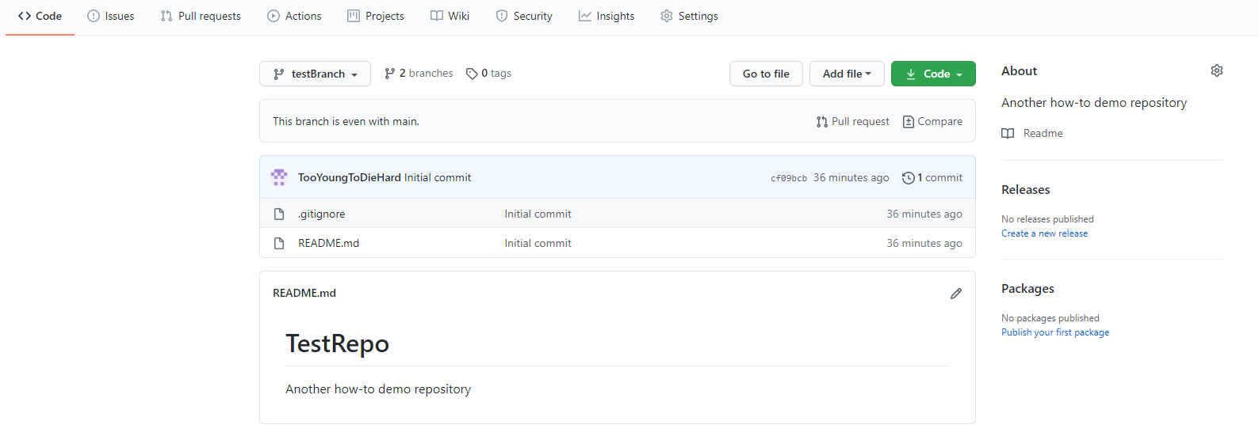
Making Edits and Commits-Browser
From your new branch: (click the drop-down on main and make sure to select the new branch)
Select the file in the new branch repository you with to edit, we’ll edit README.md below:
Confirm your branch
Double-click desired file

Slide 26
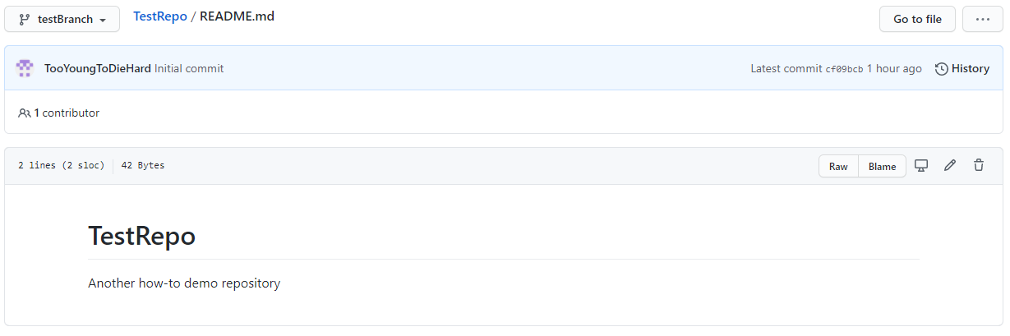
Making Edits and Commits-Browser cont’d.
Click the pencil icon on the right of the page to edit the file.

Slide 27
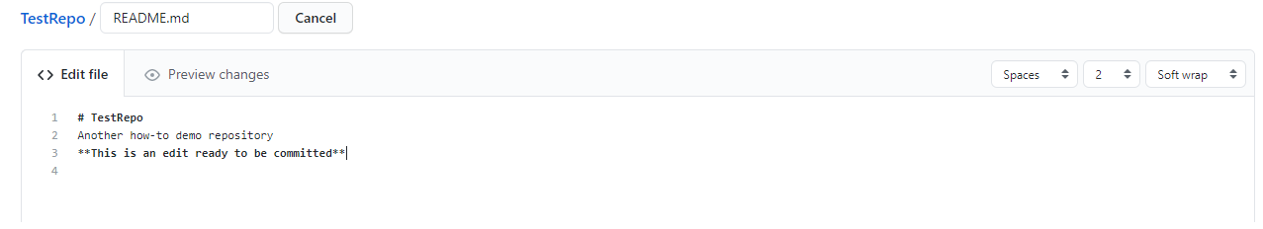
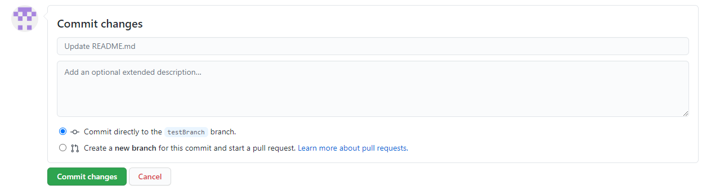
Making Edits and Commits-Browser cont’d.
Make your edits
Scroll to the bottom of the page and click Commit changes
Your changes will only be saved to the README.md file in the new branch you created.

Slide 28
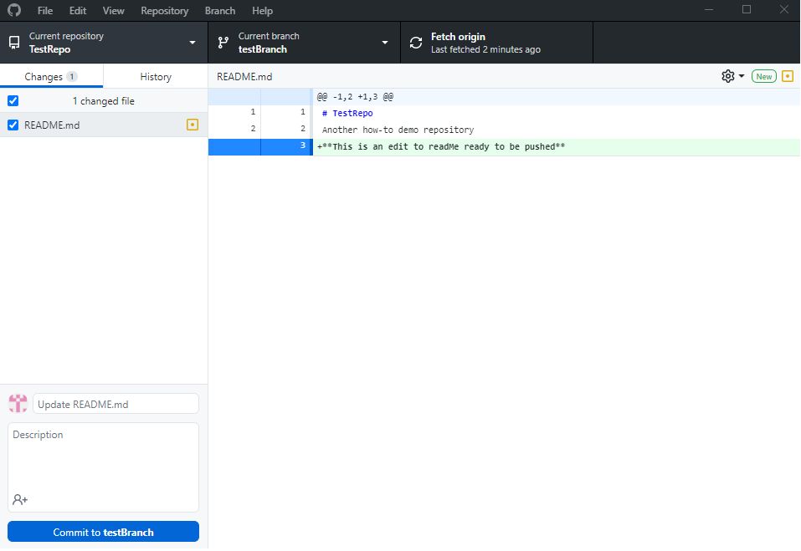
Making Edits and Commits-GitHub Desktop
Commits can also be pushed using the GitHub Desktop app with a cloned repository
You can use whatever tools your prefer to make changes to code, text files, or other assets of your project, including Unity
To do this, simply make the changes on your local machine, save the changes, return to GitHub Desktop, give your changes a description and click Commit to “yourBranchName”

Slide 29
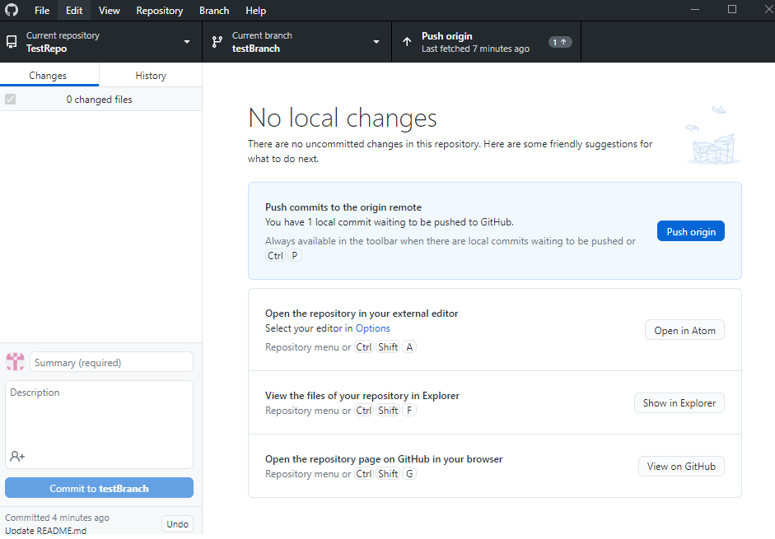
Making Edits and Commits-GitHub Desktop
After making edits and committing them, your app screen will look like this:
Click Push origin to confirm changes

Slide 30
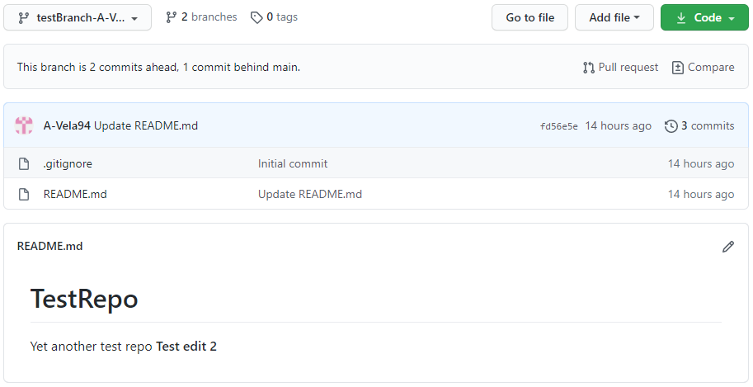
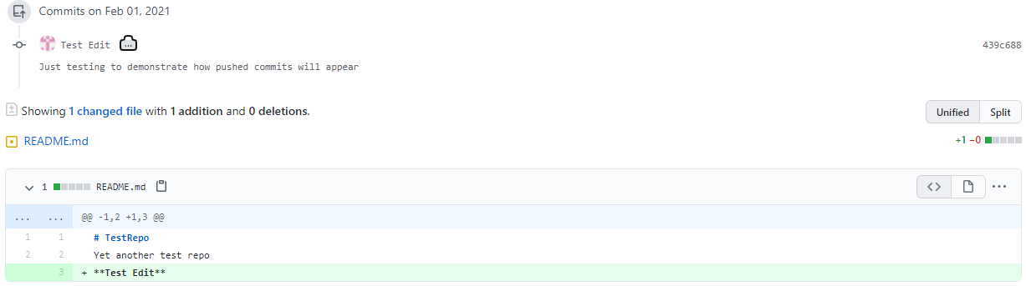
Viewing Commit History-Browser
Commits will be logged and appear on both the repository page on github.com as well as GitHub Desktop.
Commit log, github.com

Slide 31
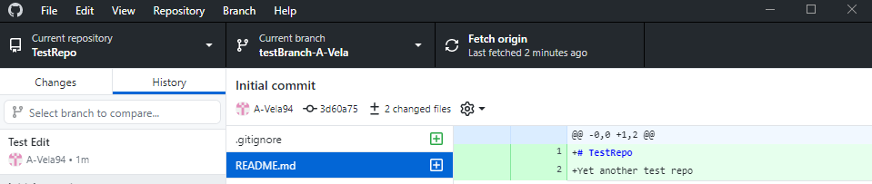
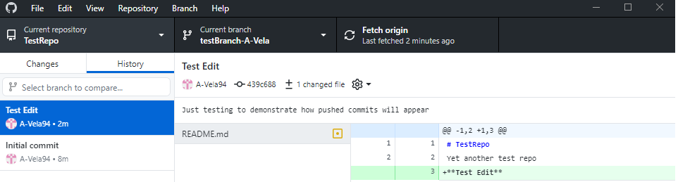
Viewing Commit History-GitHub Desktop
Commit log: GitHub Desktop - original
Commit log: GitHub Desktop - changes made

Slide 32
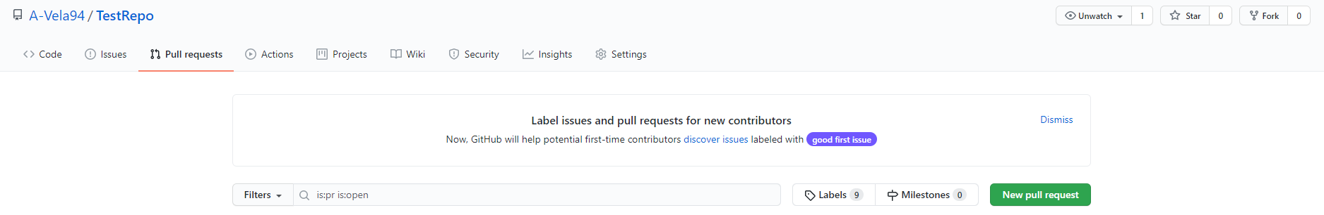
Pull Requests and Merging Branches
The changes made to the README.md file in the testBranch in the previous slide only apply to that branch, for now.
After changes are made to a branch off of main, GitHub allows developers to open what’s called a pull request
A proposal to the rest of the collaborators working on a project requesting that your contribution be reviewed and merged back into either the main branch, or another branch depending on the nature of the contribution and the project goals.
Make a pull request on github.com
Comprehensive documentation on pull requests: docs.github.com/en/github/collaborating-with-issues-and-pull-requests/about-pull-requests

Slide 33
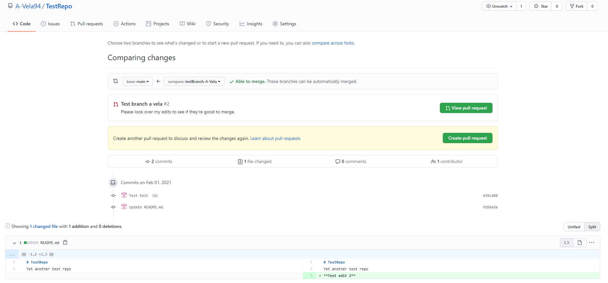
Pull Request- Browser View
Select branches to compare
If satisfied with your changes, below, create your pull request
To view differences before and after the commit, select Split.

Slide 34
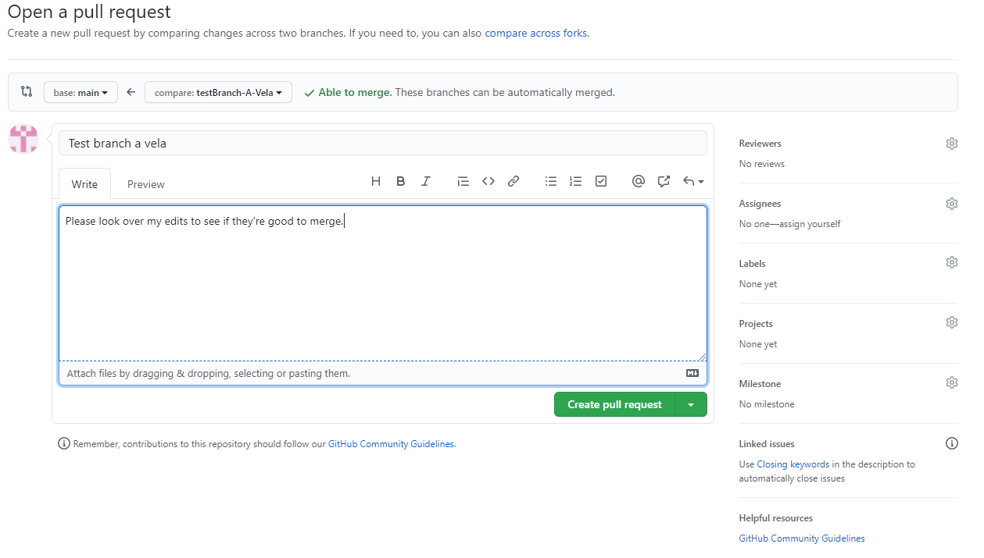
Pull Request-Browser View cont’d.
Give your pull request a title and a brief description of the proposed changes. Then create your request

Slide 35
Pull Request-GitHub Desktop View
Pull requests can also be initiated from GitHub Desktop.
This will take you to the github.com to create your pull request as previously demonstrated

Slide 36
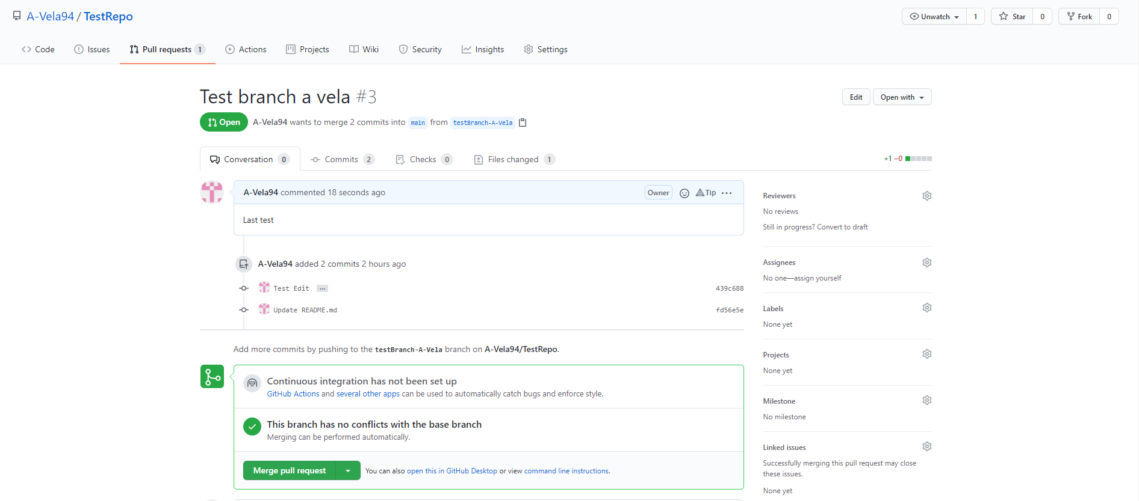
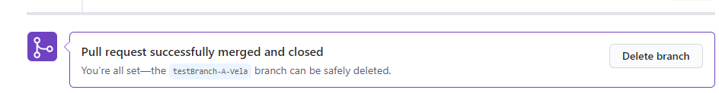
Merging Your Pull Request
After all changes have been reviewed and approved, the new branch is ready to be merged back into the main branch
The branch used to make changes can now be deleted since its changes have been merged with main
For an explanation of merge conflicts and how to resolve them visit: docs.github.com/en/github/collaborating-with-issues-and-pull-requests/resolving-a-merge-conflict-on-github

Slide 37
Git in a Unix Terminal
MacOS should have Git installed by default
If you don’t already have Git installed visit
git-scm.com/download/mac and follow the steps to install
Linux
Debian/Ubtuntu
sudo apt-get install git
Fedora
yum install git (up to Fedora 21)
dnf install git (Fedora 22)
Gentoo
emerge --ask --verbose dev-vcs/git
Arch Linux
pacman -S git
OpenSUSE
zypper install git
FreeBSD
pkg install git
Windows
git-scm.com/download/win

Slide 38
Using Git in Terminal – Initial Setup
You’ll need an active GitHub account
After downloading an installing Git open a terminal on macOS or Linux, or the Git Bash app in Windows (installed with Git) you’ll run these commands to log in to github using git on your terminal
Tell Git who you are: git config --global user.name “your username”
Supply your GitHub email: git config –global user.email “your github email”
You can setup credentials to avoid having to log in every time you want to connect to github in your terminal
Full steps to do this depending on your system can be found here: docs.github.com/en/github/using-git/caching-your-github-credentials-in-git

Slide 39
Using Git in Terminal – Initialize Repository
Now that you’ve connected with your GitHub account in terminal, you can create a new repository
Go to github.com and create a new repository by clicking the green New button under your username as previously instructed.
Name it, describe it, make it public or private, and for this tutorial don’t choose any default files.
Now you are ready to create your local repository
Navigate to the directory where you’d like your new project to be stored and create a new directory with the same name as the repo you just created
mkdir ‘yourRepoName’
Enter that directory: cd yourRepoName
Enter the command git init to initialize your repository

Slide 40
Using Git in Terminal – Making Local Changes
After you’ve initialized your repository in terminal
Go to github.com and copy the HTTPS URL on your repository home page
Back in your terminal window enter the command git remote add origin “URL you copied”
This adds a new remote origin
You can enter git status to check on the status of changes to this repository

Slide 41
Part 4: Disaster Recovery

Slide 42
Preparing for Disaster
Back up your GitHub repository constantly
Although you have access to each commit in your repository, you may accidentally override something when reverting changes
Always a good idea to keep backups!
Open your repository in a browser and download the ZIP file

Slide 43
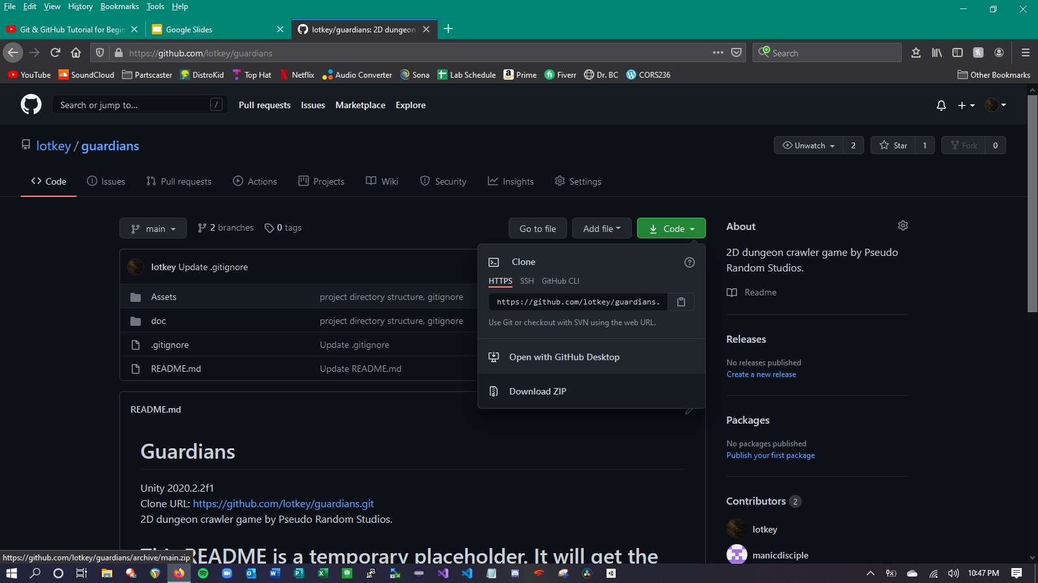

Slide 44
Treating Disaster
If you believe a specific commit is the source of your disaster, you can revert the commit
Exercise caution whenever you revert your repository
Good idea to make a separate backup before you revert
In GitHub Desktop:
Navigate to the repository you wish to revert
Select “History”
Select the specific commit you wish to revert and right-click it
Select “Revert changes in commit”

Slide 45
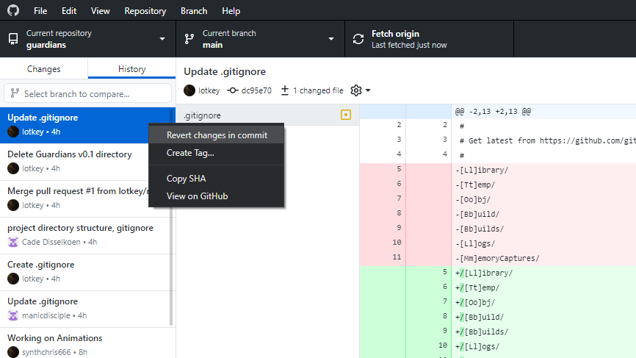

Slide 46
Part 5: Unity and Github

Slide 47

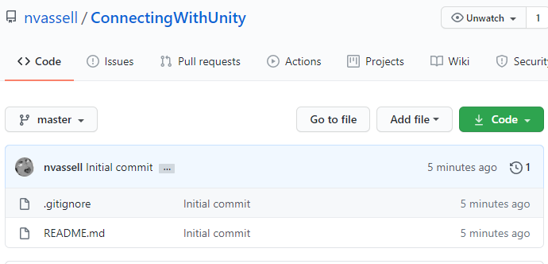
Getting a Unity project connected to GitHub
When creating your GitHub repo, make sure that the “Add .gitignore” check is active with the “.gitignore template: Unity” so our .gitignore contains the correct items.

Slide 48
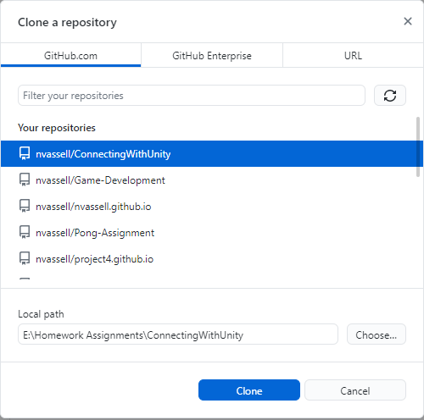
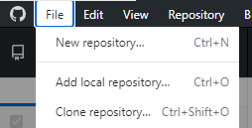

Now that we have our project repo let’s get it cloned to our GitHub Desktop:

Slide 49
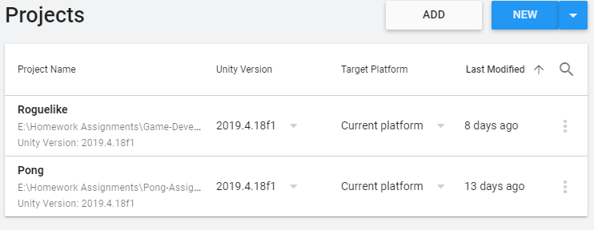

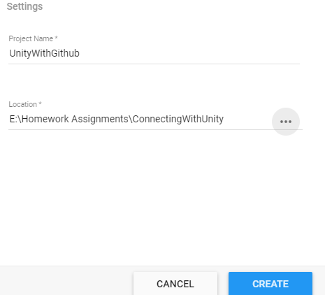
With Unity Hub: Let’s get this project created in our repo.
Click: New
And your version of Unity
When Creating our project, make sure that the location is pointing towards our newly created local repo.

Slide 50
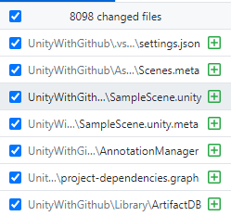
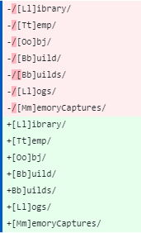
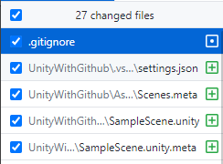
Looking at our GitHub Desktop we can see a new 8098 changed files (in our case)
If we make the following changes to .gitignore: we can down the number of changes to a more reasonable amount.

