Slide 1

Mutual Fund Analytics & Performance Evaluation System
An End-to-End Data Analytics Solution using Python, SQLite & Power BI
Presented by: Soufik Aktar
PYTHON
PANDAS
NUMPY
SQLITE
POWER BI
GIT & GITHUB

Slide 2
Project Overview
Problem Statement
Mutual fund investors and analysts lack a unified system to evaluate fund performance, assess risk, and derive actionable insights from raw NAV and transaction data.
Project Objectives
Build an end-to-end ETL pipeline for mutual fund datasets
Compute risk-adjusted performance metrics
Design an interactive Power BI dashboard for business intelligence
Why It Matters
India's mutual fund industry exceeds ₹50 trillion AUM. Data-driven analytics empowers investors, AMCs, and advisors to make smarter decisions.
Expected Outcomes
Transforms raw CSV datasets into actionable business insights through ETL, financial analytics, and interactive dashboards — enabling fund comparison, risk profiling, and investor segmentation.

Slide 3
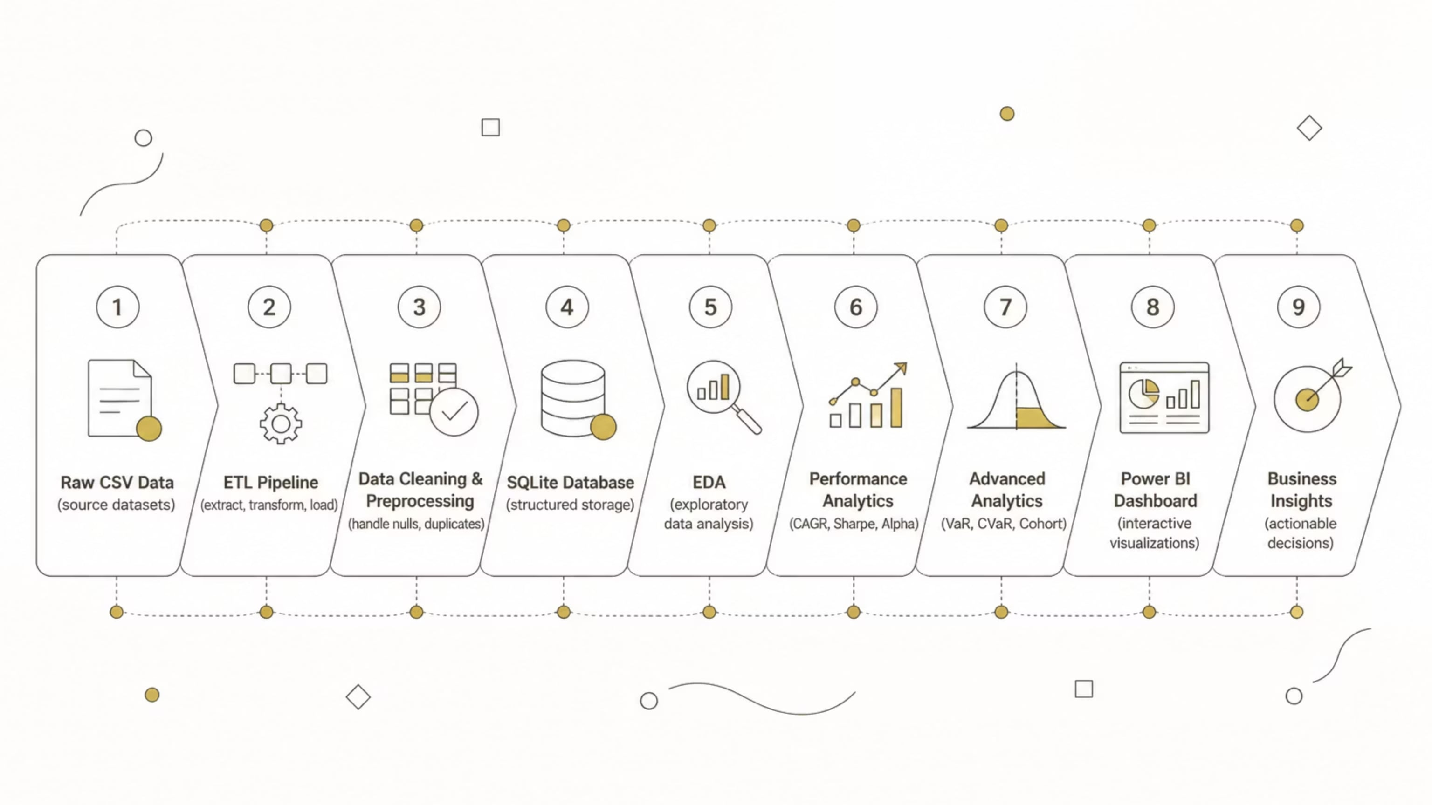
Project Workflow
A structured, nine-stage pipeline transforms raw mutual fund data into business-ready insights.
Each stage builds on the previous — ensuring data quality, analytical rigor, and clear business value at every step of the pipeline.

Slide 4






Technology Stack & Dataset
Technology Stack
Dataset Overview
Python
Fund Master
Core language for data processing and analytics
Pandas & NumPy
NAV History
Data manipulation, aggregation, and numerical computation
AUM Data
SQLite
Lightweight relational database for structured storage
SIP Inflows
Jupyter Notebook
Interactive development and documentation environment
Category Inflows
Power BI
Interactive dashboards and business intelligence reporting
Investor Transactions
Git & GitHub
Portfolio Holdings
Version control and collaborative code management
Benchmark Indices

Slide 5
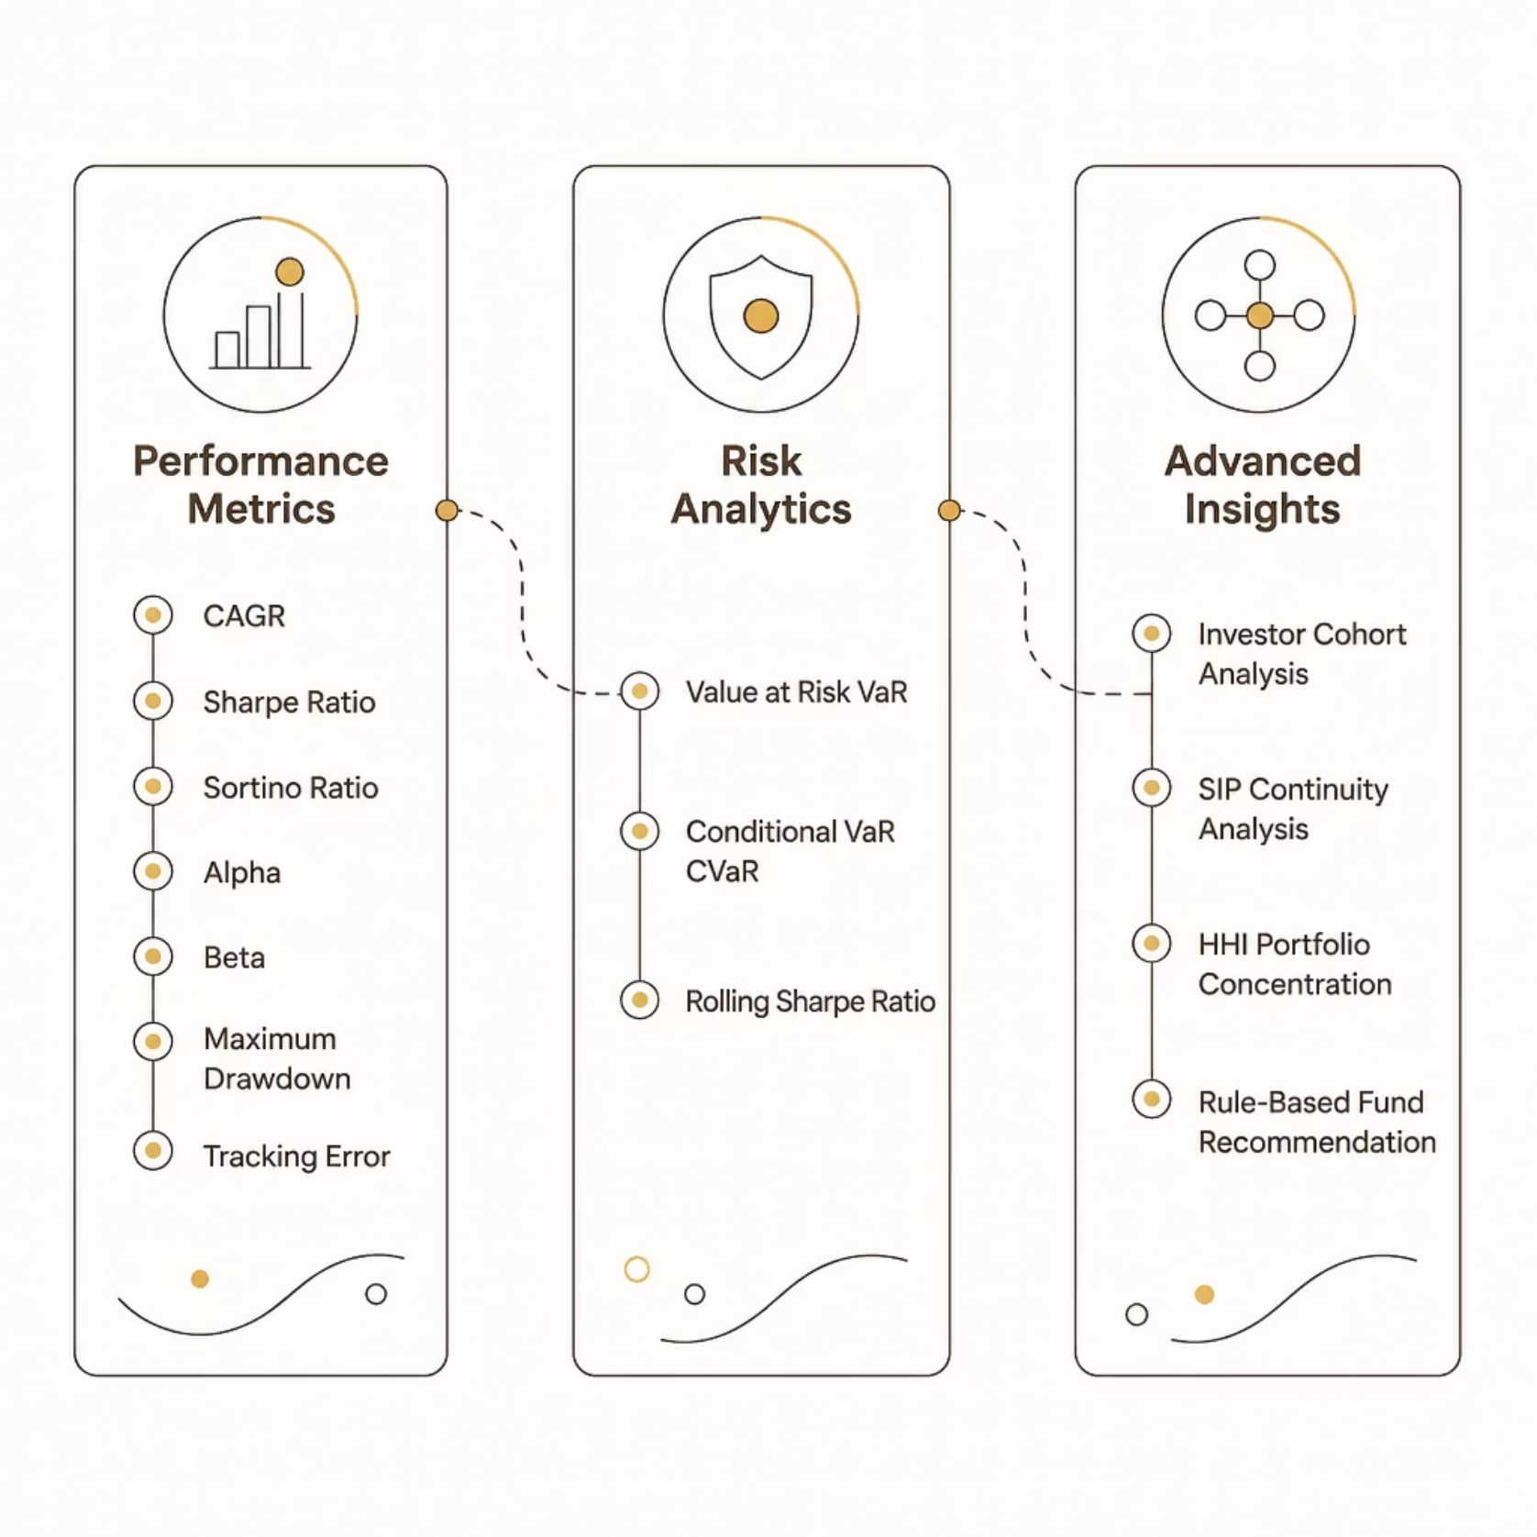

Performance & Advanced Analytics
What We Measure
The system computes a comprehensive suite of financial metrics across three analytical layers:
Performance Metrics
Risk Analytics
Advanced Insights
CAGR, Sharpe Ratio, Sortino Ratio, Alpha, Beta, Maximum Drawdown, Tracking Error
Value at Risk (VaR), Conditional VaR (CVaR), Rolling Sharpe Ratio
Investor Cohort Analysis, SIP Continuity, HHI Portfolio Concentration, Rule-Based Fund Recommendation

Slide 6
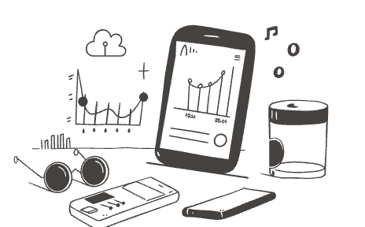

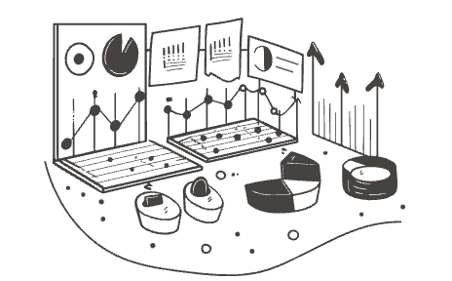
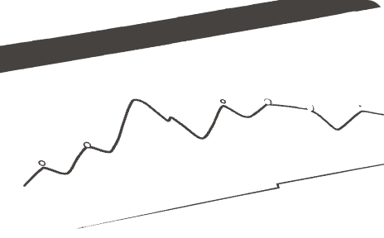
Power BI Dashboard
The interactive dashboard enables users to analyse industry performance, evaluate mutual funds, explore investor behaviour, and monitor market trends through dynamic visualisations and slicers.
Mutual Fund Industry Overview
Fund Performance Analysis
Investor Analytics
SIP & Market Trends
Demographics, transaction patterns, and cohort behaviour
SIP inflow trajectories, continuity rates, and market sentiment
AUM distribution, AMC rankings, and category-wise market share
Return metrics, risk ratios, and benchmark comparisons

Slide 7

Key Insights
Industry AUM is concentrated among leading AMCs
A small number of AMCs dominate total assets under management, highlighting market consolidation.
SIP inflows demonstrate consistent long-term growth
Systematic investment plans show steady upward trends, reflecting growing retail participation.
Risk-adjusted metrics outperform raw returns for fund comparison
Sharpe and Sortino ratios reveal true fund quality beyond headline returns.
Investor demographics reveal diverse investment behaviour
Age, income, and geography significantly influence fund selection and SIP adoption.
Portfolio concentration analysis highlights diversification opportunities
HHI metrics uncover over-concentration risks and guide rebalancing decisions.
Interactive dashboards improve financial decision-making
Dynamic visualizations and slicers enable faster, data-backed investment decisions.

Slide 8

Conclusion & Future Scope
This project successfully integrates data engineering, financial analytics, and business intelligence into a unified decision-support system for mutual fund analysis.
What's Next
01
02
03
Real-Time NAV Integration
Streamlit Web Application
ML-Based Fund Prediction
Live data feeds via APIs for up-to-the-minute fund tracking
Deploy an interactive, browser-based analytics interface
Machine learning models to forecast fund performance
04
05
Portfolio Optimisation
Automated Reporting
Markowitz Efficient Frontier for optimal asset allocation
Scheduled, auto-generated performance reports for stakeholders
Thank You

