Slide 1

Ethershield by
Cybersecurity made simple for small businesses

Slide 2



The Problem
Cyberattacks like phishing and DDoS are rising sharply
Small businesses and freelancers lack the tools and knowledge to defend themselves
Most solutions are complex, expensive, or require technical expertise

Slide 3
The Solution
The Ethershield
Threat Detection
A lightweight, real-time monitoring and protection software
Detects phishing attacks and DDoS behavior early
Alerts
User-Friendly
Provides clear alerts and automated countermeasures
Easy-to-use dashboard, no technical background needed

Slide 4



How it Works - Phishing Detection
User inputs domain/email for monitoring
System checks for spoofed or lookalike domains
Uses ML models to flag suspicious activity (Future Feature)

Slide 5



How it Works - DDoS Protection
Real-time traffic analysis
Alerts on unusual patterns, spikes, floods
Auto-blocks IPs if behavior is abusive

Slide 6
Target Market
Small and medium-sized businesses (SMBs)
E-commerce shops
Freelancers and digital creators
Educational institutions

Slide 7
Business Model SaaS subscription tiers:
Basic (Free)
Pro
Enterprise
Phishing guide, alerts only
Real-time protection, dashboard, email alerts
Enterprise: team monitoring, advanced analytics

Slide 8


Why Now?
Increase in remote work and digital business
Surge in social engineering and DDoS attacks
SMBs are underserved by existing solutions

Slide 9
Why Now?
Increase in remote work and digital business
Surge in social engineering and DDoS attacks
SMBs are underserved by existing solutions

Slide 10
Competition
Traditional antivirus & firewalls: Not phishing-aware
Enterprise cybersecurity tools: Expensive, complex
Browser extensions: Limited, client-side only
Ethershield: Focused, cloud-enabled, accessible

Slide 11
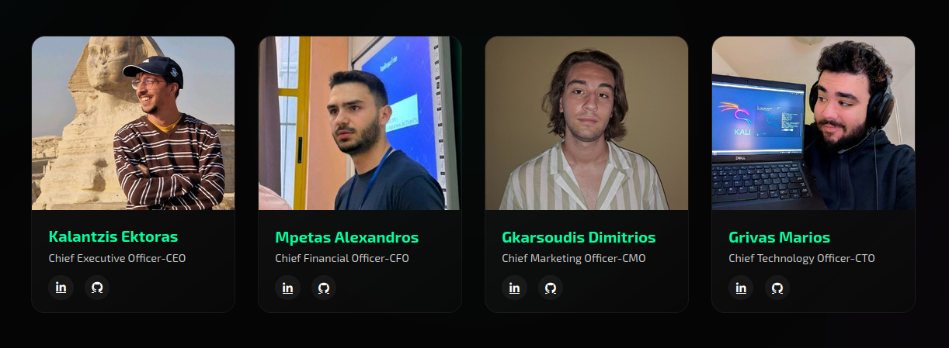
Meet Our Team
Cybersecurity & Software Development background

Slide 12
Project Timeline-Roadmap
Month 1-2: Complete phishing API & DDoS engine
Month 3: Deploy cloud backend & web dashboard
Month 4-5-6: Launch Beta with early adopters
Month 7: Secure first paying users, scale marketing

Slide 13
The Ask - 50.000€
Expand technical development and scale backend infrastructure
Launch targeted campaigns to acquire early adopters
Cover legal and compliance needs (GDPR, Trademarking)
Support pilot testing with selected business clients

Slide 14



Our Vision
Make cybersecurity proactive, not reactive
Build a trusted brand for digital self-defense
Scale to European SMB market with modular tools

Slide 15
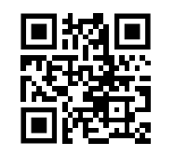
Thank you!
Do you have any questions?
info@whiteguard.org
whiteguard.org

