Slide 1
Is the stock market affected by non-financial factors?
국민대학교 비즈니스IT전문대학원
석사과정 정이태

Slide 2


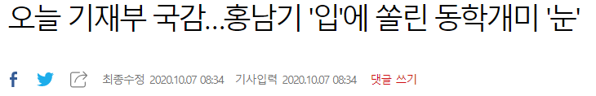
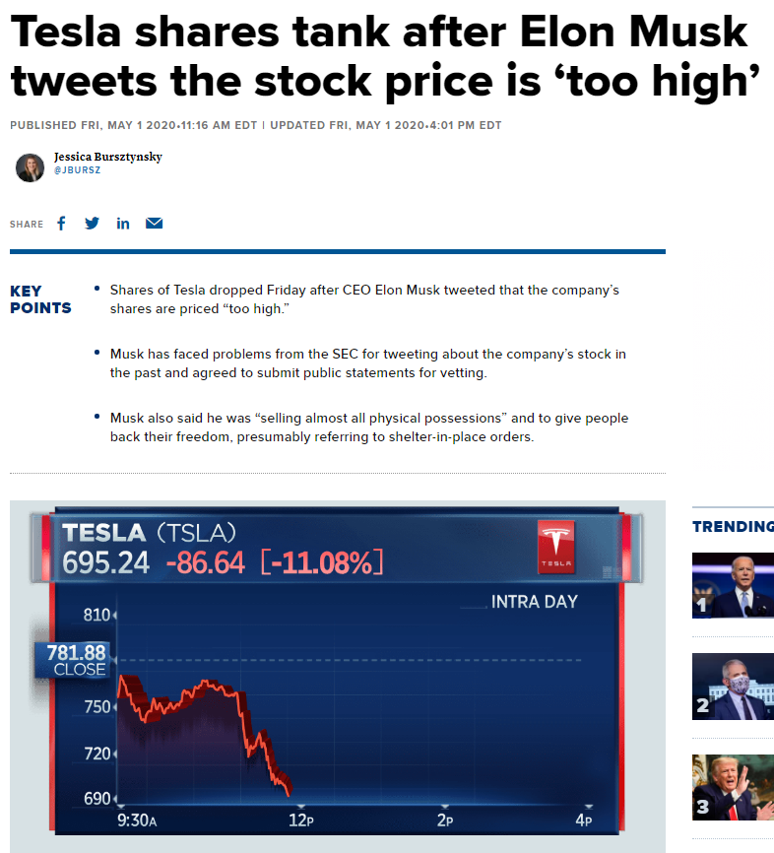
Motivation
Have Stock Market focused on the impact of non-financial announcements ?

Slide 3



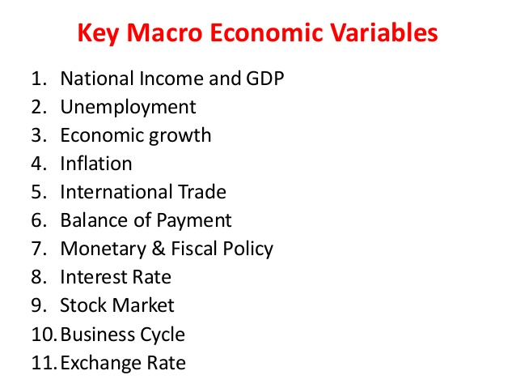
Model
Topic Modeling
Regression
Trump , Biden tweet data
2020-07-01~2020-11-30
+
Stock market

Slide 4
[Review]
The Impact of Donald Trump’s Tweets on Financial Markets

Slide 5
Table of Contents
Intro
Background
Literature Review
Data
Tweet Collection
Financial Data Collection
Sentiment Classification
Methodology
Event Studies
AAV
Google Search Activity
Hypotheses
Results ; Testing the Efficient Market Hypothesis
Results ; Testing for Attention-Based Investing

Slide 6
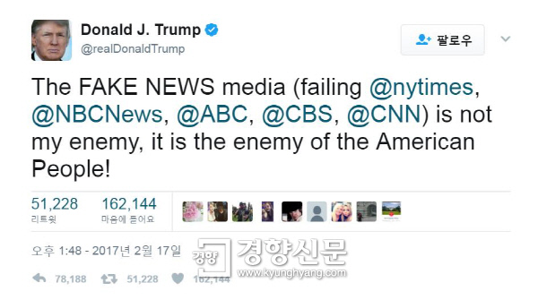
Why tweets ?
Trump is renowned for using Twitter as a strategic tool to prevent US companies from moving operations overseas and publicly berating political leaders.

Slide 7
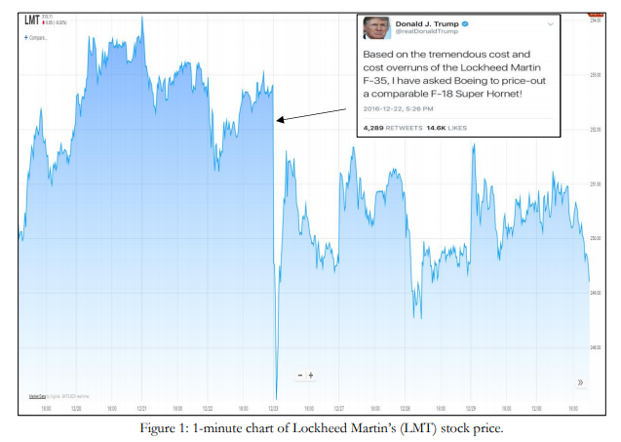
Example
This may imply markets rapidly incorporate new information and thus the efficient market hypothesis holds.

Slide 8
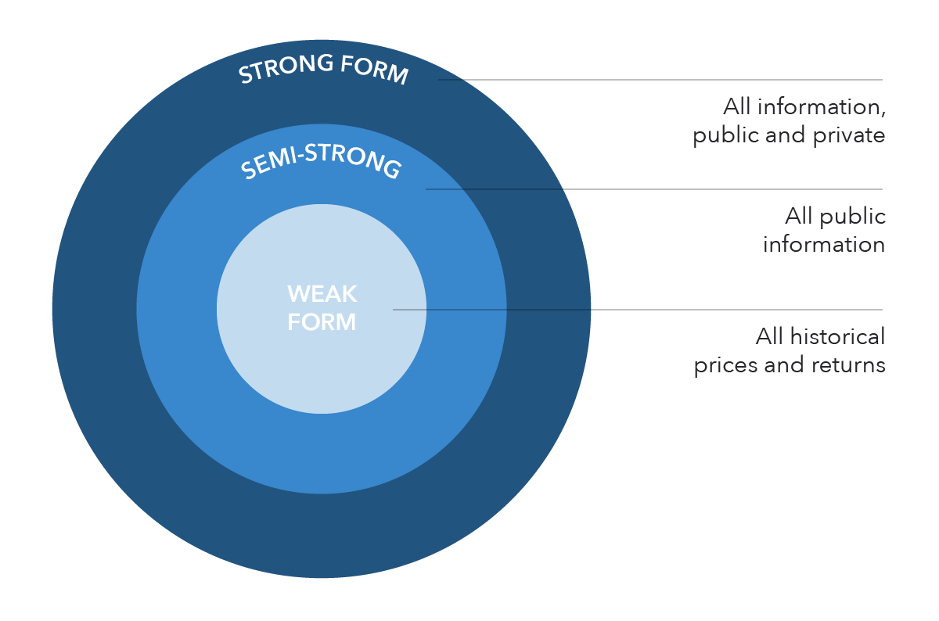
Background
Eugene Fama (1965) pioneered the EMH, which states that all available information at a certain time is fully incorporated into security prices.
The EMH appears frequently in economic literature. A common methodology used to test the EMH is event studies . This dissertation also uses event studies and therefore, the review starts by comparing key event study papers.
* 효율적 시장 가설이란 금융경제학에서 모든 시장참여자가 완벽한 정보를 가지고 있을 때 자산가격이 균형에 도달한다는 가설이다.

Slide 9
Literature Review
Lecture 1
Fama, Fisher, Jensen and Roll (1969) were the first to test the semi-strong form of EMH using event studies.
specifically, dividend payments usually change after a stock split and therefore this may affect the stock price. Once they control for dividend announcements, abnormal returns5 are insignificant for periods after the stock split announcement. This means that the market is efficient as stock prices adjust rapidly to new information.
Lecture 2
Charest (1978) analysed the impact of dividend changes on the stock prices of New York Stock Exchange (NYSE) companies over the period 1947-1967.
he finds significant abnormal returns in the months following dividend changes. This implies the market is inconsistent with the semi-strong form of EMH.
Lecture 3
Ball and Brown (1968) found evidence inconsistent with the semi-strong form of EMH.
They found that stock prices do not fully incorporate new information instantly and abnormal returns are present many days after the announcement
* Abnormal returns are the actual returns of a stock minus the expected returns of a stock ( which is calculated through the market model).

Slide 10
Literature Review
Lecture 4
Ball and Brown (1968)
they find a PEAD of 60 days. Therefore, these findings are inconsistent with the EMH. Many studies analyse the impact of financial announcements on stock markets. This dissertation contributes to the existing literature by focusing on a non-financial announcement. Specifically, it focuses on how social media posts can affect financial markets.
Etc ) earning season , foreign exchange market , CAAR(Cumulative average abnormal returns) , post-inauguration and post-inauguration period , informative / non-informative
Summary
This subsample is used to test the EMH. The key contribution of this paper to existing literature is the explanation for why markets may be inefficient. More specifically, analysis of abnormal trading volume and Google search activity provides insight on whether Trump’s tweets lead to attention-based investing, which in turn drives market inefficiency.
* They found that stock prices do not fully incorporate new information instantly and abnormal returns are present many days after the announcement. They call this the post earnings announcement drift (PEAD) and it represents the delay in stock price adjustment to equilibrium levels.

Slide 11
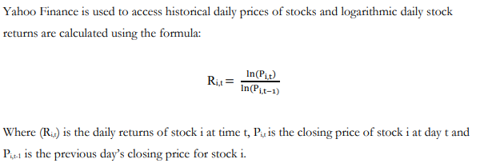
Data
Tweet Collection
Tweets posted by Donald Trump’s personal account (@realDonaldTrump) are used rather than Donald Trump’s presidential account (@POTUS) as Trump simply retweets his personal account tweets on his presidential account and hence activity on this account provides no new information.
Financial Data Collection
Sentiment Classification
Sentiment analysis is undertaken via an algorithm called valence aware dictionary and sentiment reasoner (VADER). VADER is a reliable method for calculating the polarity of tweets as it is used frequently to analyse social media. VADER has a dictionary of social media vocabulary and matches words in tweets with this dictionary. It assigns a compound value to tweets and categorises tweets as positive, negative and neutral.

Slide 12
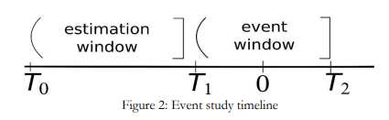
Methodology
Event Studies
1. To define the event window.
-> the time interval over which the event occurs
; one can include a certain number of days before and after the announcement.
20-day event window, which analyes average abnormal returns on day -10 and day 10, is incorporated in this study.
2. To define the estimation window.
-> the interval of time before the event window that is used to estimate the expected(or normal) returns.
; the estimation window starts from day -271 and ends on day -21. The length of the estimation window is 250 trading days. There is gap of 10 days between day -21 and day -11, in order to prevent the tweet from influencing the expected return parameters.

Slide 13
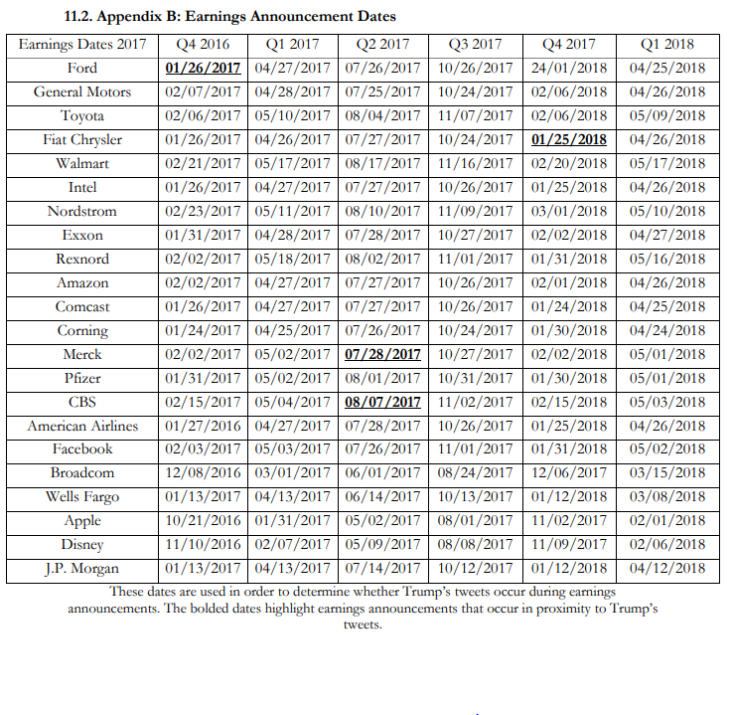
Methodology
Sample selection
Example)
@realDonaldTrump: “Thank you to @exxonmobil for your $20 billion investment that is creating more than 45,000 manufacturing & construction jobs in the USA!”
Trump’s tweets which are in a 20-day proximity to earnings announcement dates are excluded from the sample when testing the EMH.

Slide 14
Methodology
Normal & Abnormal Returns
1. Constant mean return model (CMR)
The CMR is a statistical model that postulates expected returns are simply the mean of returns in the estimation window.
2. Market model
Market model is calculates expected return by accounting for general market movements.
* This requires an OLS regression of stock return on the market return.
3. Capital asset pricing model (CAPM)
CAPM calculates the expected return by accounting for risk investors bear when buying a specific stock.

Slide 15




Methodology
Normal & Abnormal Returns
As Trump tweets about many stocks, the abnormal return of each stock can be combined into a portfolio and averaged.
N is the number of stocks.
R_i,t ; the daily return of stock i,
∂_i ; intercept
𝛽_i ; beta of the stock
R_S&P500,t ; return of the S&P index
ε_i,t ; error term
T_1 ; the first day in the event window
T_2 ; the last day in the event window

Slide 16
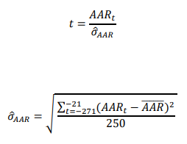

Methodology
Significance test for AAR & CAAR – Crude Dependence Adjustment (CDA)
T_2 – T_1 is the length of the event window.
The advantage of this test is that it compensates for dependence of returns across events by estimating the standard deviation of AAR using the estimation window

Slide 17


Methodology
Average Abnormal Trading Volume (AAV)
AV_it is change in abnormal trading volume for security i on day t,
V_it is the trading volume of security I on day t
E(V_i) is the average trading volume of security i
This abnormal trading volume can then be aggregated across stocks into a portfolio

Slide 18



Methodology
Significance Test for Average Abnormal Trading Volume (AAV)

Slide 19
Methodology
Google Search Activity
In order to test whether Trump’s tweets catch the attention of retail investors, a novel approach established by Born et al. (2017) is incorporated.
A limitation of this method is that Google provides relative search data rather than absolute search data.
To control for this, the search activity of the keyword ‘Amazon stock price’ is used rather than just ‘Amazon’ (see appendix D). Google Trends provides weekly data rather than daily data

Slide 20


Hypotheses
Market efficiency
If the null hypothesis is rejected, it can be argued that Trump does have an impact on financial markets.
If this null hypothesis is rejected, market efficiency can be tested by finding how many days this CAAR lasts

Slide 21

Hypotheses
attention-based hypothesis
1. If the null hypothesis is rejected this means that abnormal trading volume is seen on average across stocks when Trump tweets.
2. Google search activity confirms that it is retail investors acting upon Trump’s tweets. If Google search activity increases on the week of Trump’s tweet, this implies that Trump draws attention to specific companies and thus drives market inefficiency

Slide 22
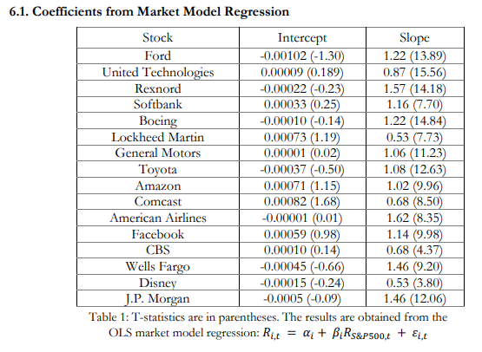
Results
Testing the Efficient Market Hypothesis (EMH)
For instance, Ford has a beta of 1.22 and therefore Ford is 1.22 times more volatile than the S&P500 index. As a result of this, the regression will show that riskier stocks with higher beta values have higher expected returns as the market compensates higher risk.

Slide 23
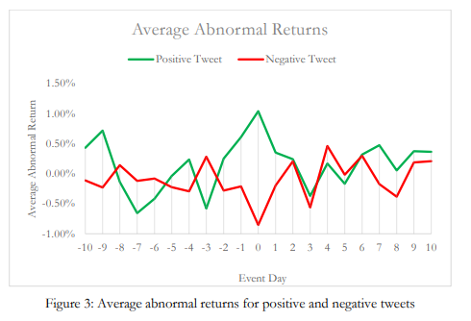
Results
Average Abnormal Returns (AAR) Results
Figure 3 shows that that for positive tweets, on event day 0, there is a spike in abnormal returns of 1%. For negative tweets there is a negative spike down to -0.85%. Interestingly, on day 2, AARs return to pre-event levels. This suggests that the markets takes 2 days to adjust to new information and therefore is inefficient. This will be analysed formally through CAAR. Overall, the AAR results show that the null hypothesis of no impact of Trump’s tweets on AAR can be rejected. As a result, the EMH can be tested by analysing the CAAR.

Slide 24
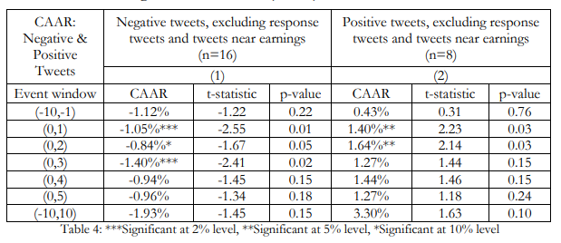
Results
Cumulative Average Abnormal Return (CAAR)
Interestingly, the (0,3) event window CAAR shows that there is a stronger negative effect of -1.40%, 3 trading days after the tweet is made and this is statistically significant at the 2% level. A possible reason for this is that Donald Trump’s tweets are released by the media a couple of days after he tweets, therefore the effect may be delayed.
Four trading days after the tweet, there is no longer an effect of Trump’s tweets as the CAARs are no longer statistically significant. This means that the market has adjusted. This is inconsistent with the semi-strong form of EMH, as new information is not incorporated rapidly into the market.

Slide 25
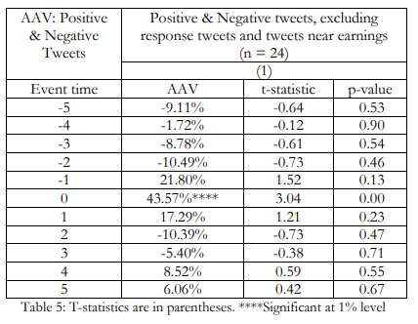
Results
Testing for Attention-Based Investing ; Average Abnormal Trading Volume (AAV) Results
there is a spike in abnormal trading volume of 43.57%. This is statistically significant at the 1% level. However, after day 0, abnormal trading volumes are statistically insignificant. This implies that Trump’s tweets do generate investor attention. Findings are consistent with the attention-based investing hypothesis if retail investors act upon the information and Google search activity confirms this.

Slide 26
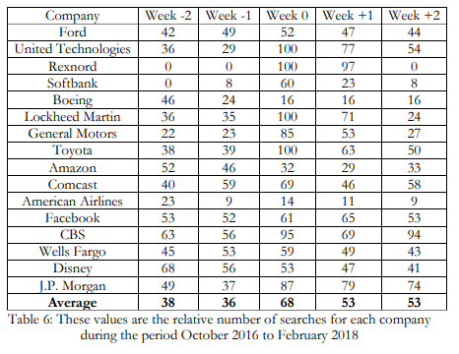
Results
Testing for Attention-Based Investing ; Google Search Activity:

Slide 27
Discussion
General Analysis , Justifications
1. A key contribution of this study is attention-based investing. Retail investors in particular tend to focus on stocks mentioned by Trump and therefore do not consider all available information.
2. A real-world implication of this study is that trading strategies can be devised so that when Trump tweets positively (negatively) an investor can short (buy) the stock and then exit their position after 2 or 3 trading days.
3. EMH states that it is impossible to beat the market if markets are efficient. This event study shows that the markets are possible to beat. However, if transaction costs are incorporated, there may be a possibility that markets are actually efficient as the abnormal returns seen are low.

Slide 28
Conclusion
General Analysis , Justifications
1. A key strength of this paper is the new insight it adds in the form of attention-based buying. Transitory increases in trading volume and Google search activity implies that Trump catches the attention of retail investors who do not consider all available information.
2. Kylie Jenner tweeted negatively about Snap Co. and this lead to a decrease in its stock market value by £1 billion. This shows that with a large follower base, celebrities and politicians can affect organisations for the better or the worse. As result, regulators may want to consider scrutinising the effect of Twitter on financial markets more critically in the future.

Slide 29
References
* https://www.nottingham.ac.uk/economics/documents/research-first/krishan-rayarel.pdf
* https://lamfo-unb.github.io/2017/08/17/Teste-de-Eventos-en/

