Slide 1
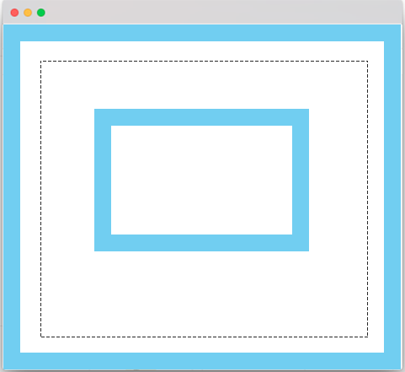
body.clientTop
div.style.top
div.scrollTop
div.clientTop
div.offsetTop
div.style.margin
div.scrollHeight
div.clientLeft
div.offsetLeft
Asdjaksfjkasfjklasfla
Asfasfasfasf
Asfasfasfasfasf
Asfasfasfasf
Asfsafasfasfaf
div.offsetHeight
body.client.left
div.style.left
div.clientHeight
div.style.padding
body.clientHeight
div.style.border
div.clientWidth
div.scrollWidth
body.clientWidth
div.offsetWidth
body.offsetWidth
body.style.padding
body.style.border

