Slide 1

Azure Functions
Leonid Petrov1, Developer

Slide 2

Experience
2018 - Azure Service Fabric workshop participant
2019 - Azure for .net developer mentoring
2020 – AZ-203 certification program at EPAM
2020 – Microsoft cloud challenges (AZ-204, AZ-303, AZ-304)

Slide 3
How to utilize Visual Studio subscription credit beneficially?

Slide 4
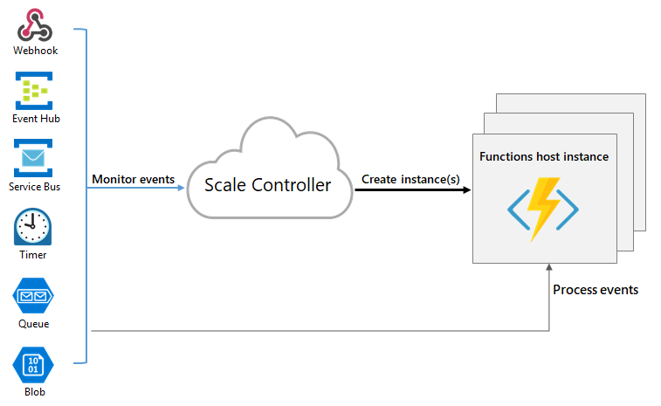
Azure functions
docs.microsoft.com/en-us/azure/azure-functions/functions-overview

Slide 5
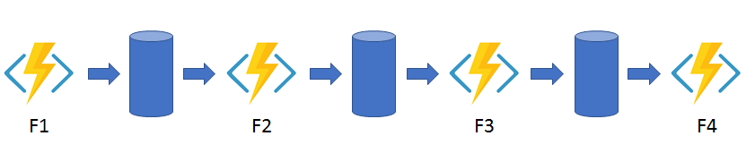
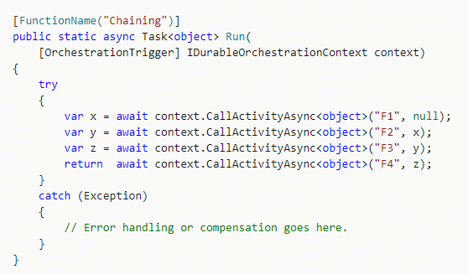
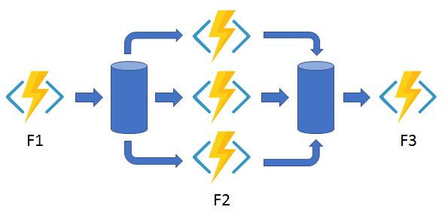
Durable functions
Function chaining
Fan out/fan in
docs.microsoft.com/en-us/azure/azure-functions/durable/durable-functions-overview

Slide 6
Use cases
Big data processing
File processing and validation
Web API
Scheduled tasks
Migrate console apps to serverless
docs.microsoft.com/en-us/dotnet/architecture/serverless/serverless-business-scenarios

Slide 7

Eric Lippert’s blog roulette
https://ericlippert.com/
programming language design and compiler construction
former member of the C# language design team at Microsoft
www.linkedin.com/in/eric-lippert-a3893485/

Slide 8
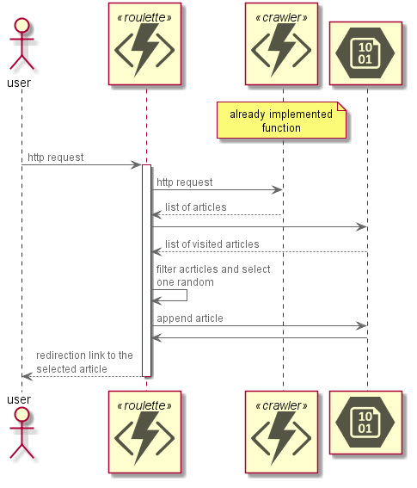

Slide 9
DEMO

Slide 10
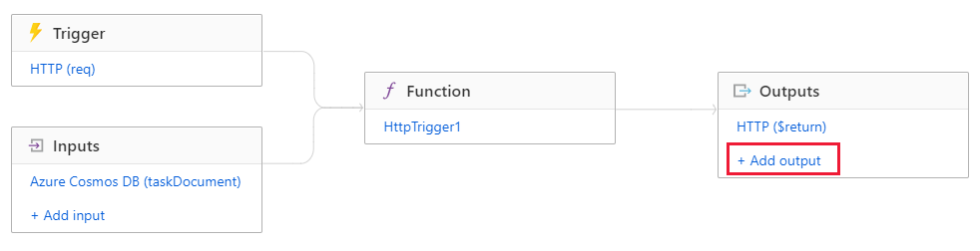
Bindings
supported-bindings

Slide 11
Bindings
BlobServiceClient blobServiceClient = new BlobServiceClient(connectionString);
BlobContainerClient containerClient = await blobServiceClient.CreateBlobContainerAsync(containerName);
BlobClient blobClient = containerClient.GetBlobClient(fileName);
BlobDownloadInfo download = await blobClient.DownloadAsync();
using (FileStream downloadFileStream = File.OpenWrite(downloadFilePath))
{
await download.Content.CopyToAsync(downloadFileStream);
downloadFileStream.Close();
}
VS
[Blob("functions-data/visited", FileAccess.Read)] TextReader inputBlob

Slide 12
DEMO

Slide 13
Authorization
API key
https://<APP_NAME>.azurewebsites.net/api/<FUNCTION_NAME>?code=<API_KEY>
App Service Authentication/Authorization (Azure AD)
Azure API Management (APIM)
Azure App Service Environment
working-with-client-identities

Slide 14
DEMO

Slide 15
Links
https://github.com/Azure/Azure-Functions
https://docs.microsoft.com/en-us/azure/azure-functions/functions-overview

Slide 16
Q&A

