Slide 1

Parsers, DSL, ANTLR
Leonid Petrov1, developer

Slide 2
Agenda
Glossary
ANTLR
Application
Q&A

Slide 3
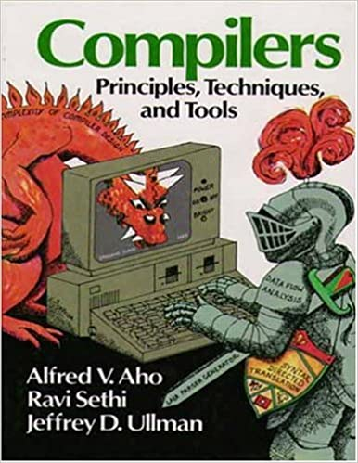

Dragon book
Chapters 1, 2, 3, 4
Lexical analysis
Syntax analysis

Slide 4
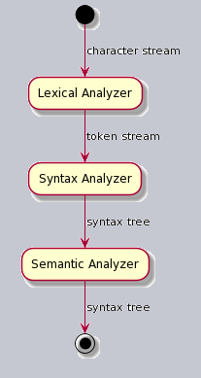
Phases

Slide 5
Lexical analysis
Groups the characters into meaningful sequences called lexemes
(token-name, attribute-value)

Slide 6
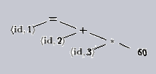
Syntax analysis
Uses the tokens produced by the lexical analyzer to create
a tree-like intermediate representation

Slide 7
DSL
Domain-specific languages are generally very high-level languages designed to make their users particularly effective in a specific domain
Data formats
Network protocols
Protein patterns
Gene sequences
Domain-specific programming languages

Slide 8
Chess notations
Portable Game Notation (PNG)
[Event "F/S Return Match"]
[Site "Belgrade, Serbia JUG"]
[Date "1992.11.04"]
[Round "29"]
[White "Fischer, Robert J."]
[Black "Spassky, Boris V."]
[Result "1/2-1/2"]
1. e4 e5 2. Nf3 Nc6 3. Bb5 a6 {This opening is called the Ruy Lopez.}
4. Ba4 Nf6 5. O-O Be7 6. Re1 b5 7. Bb3 d6 8. c3 O-O 9. h3 Nb8 10. d4 Nbd7
11. c4 c6 12. cxb5 axb5 13. Nc3 Bb7 14. Bg5 b4 15. Nb1 h6 16. Bh4 c5 17. dxe5
Nxe4 18. Bxe7 Qxe7 19. exd6 Qf6 20. Nbd2 Nxd6 21. Nc4 Nxc4 22. Bxc4 Nb6
23. Ne5 Rae8 24. Bxf7+ Rxf7 25. Nxf7 Rxe1+ 26. Qxe1 Kxf7 27. Qe3 Qg5 28. Qxg5
hxg5 29. b3 Ke6 30. a3 Kd6 31. axb4 cxb4 32. Ra5 Nd5 33. f3 Bc8 34. Kf2 Bf5
35. Ra7 g6 36. Ra6+ Kc5 37. Ke1 Nf4 38. g3 Nxh3 39. Kd2 Kb5 40. Rd6 Kc5 41. Ra6
Nf2 42. g4 Bd3 43. Re6 1/2-1/2
Forsyth–Edwards Notation (FEN)
rnbqkbnr/pppppppp/8/8/8/8/PPPPPPPP/RNBQKBNR w KQkq - 0 1

Slide 9

Grammar translator
Runtime library
Designed and developed by Terrence Parr - professor of computer science and data science at the University of San Francisco

Slide 10
Grammar DSL
grammar Hello; // Define a grammar called Hello
r : 'hello' ID ; // match keyword hello followed by an identifier
ID : [a-z]+ ; // match lower-case identifiers
WS : [ \t\r\n]+ -> skip ; // skip spaces, tabs, newlines

Slide 11
Parse tree print
grun Hello r -tree

Slide 12
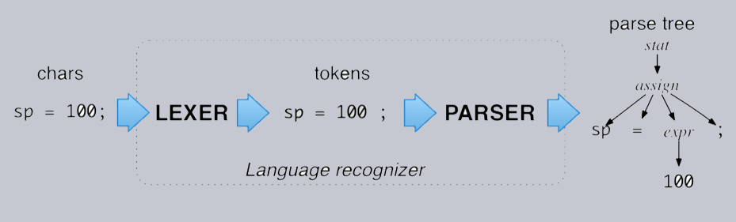
Language recognizer

Slide 13
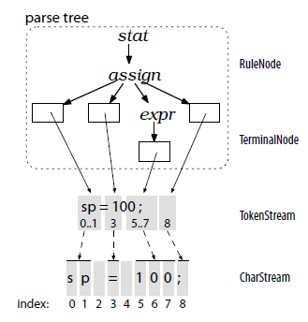
ANTLR object model

Slide 14
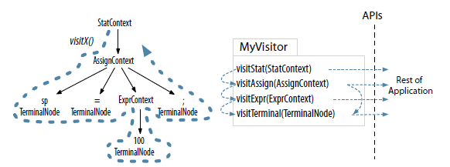
Parse tree visitor

Slide 15


Application
Problems:
Todoist in Vim (plugin)
Markdown like DSL for todoist project

Slide 16
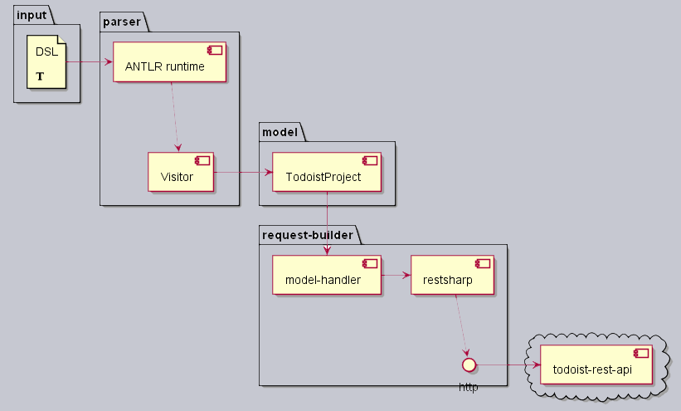
Application

Slide 17
DEMO markdown and todoist

Slide 18
Links
Introduction:
Terence Parr - ANTLR4
Reference:
https://evbyminsdbookz.minsk.epam.com/?c=&q=ANTLR
Github documentation
Tools:
https://www.antlr.org/tools.html
Examples:
https://github.com/ncalc/ncalc/blob/master/Grammar/NCalc.g
https://github.com/mar9000/antmark/tree/master/src/org/mar9000/antmark/grammar

Slide 19
Q&A

