Slide 1

Parsers, DSL, ANTLR
Leonid Petrov1, developer

Slide 2

Agenda
Glossary
ANTLR
Application
Q&A

Slide 3
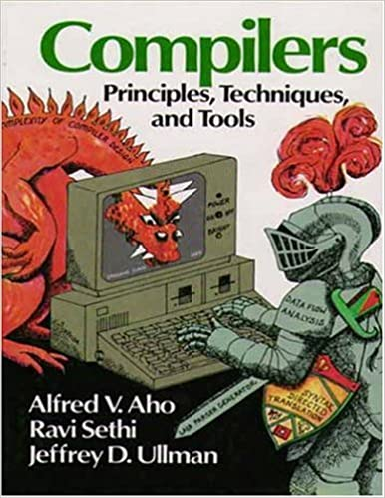
Dragon book
Chapters 1, 2, 3, 4
Parsing
Lexical analysis
Syntax analysis

Slide 4
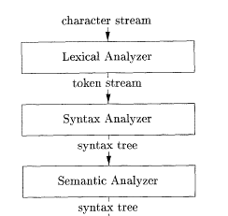
Parsing
Chapters 1, 2, 3, 4
Parsing
Lexical analysis
Syntax analysis

Slide 5
Expectations

Slide 6
Is complete Cloud Challenge enough to pass an exams?
“… Cloud Challenges by design/definition - don't cover all topics/services/features required by exam and could skip some important sections, because either Microsoft simply didn't have capacity to create such module or don't know how to build such skill. We can blame Microsoft or EPAM or anybody else - but it's reality around us…”
Igor Sychev

Slide 7
Staffing
“…Usually DMs/PMs interesting in people for positions where language is a primary filter and azure skills is important but it's second filter, not visa versa - azure primary and any programming language. So, it's why Azure - is good differentiator when you already passed first technology filter and now project should choose from limited number of candidates. If in this list of candidate, you have certificate and other candidates not- usually decision is almost done.”
Igor Sychev

Slide 8
DEMO Microsoft Learn

Slide 9
DEMO Exam artifacts

Slide 10
Links
ANTRL reference https://evbyminsdbookz.minsk.epam.com/?c=&q=ANTLR
difference-between-parse-tree-and-ast
Terence Parr - ANTLR4
Github documentation
https://github.com/ncalc/ncalc/blob/master/Grammar/NCalc.g
https://github.com/mar9000/antmark/tree/master/src/org/mar9000/antmark/grammar
https://github.com/antlr/antlr4/tree/master/runtime/CSharp/src
https://www.antlr.org/tools.html

Slide 11
Q&A

