Slide 1

Technical writing and
Azure Static Web App
Leonid Petrov1, developer

Slide 2
Agenda
Tech writing course by Google
Azure Static Web Apps
Demo
Q&A

Slide 3

Technical writing courses by Google
Two parts 3 hours total
Pre-class and in-class
developers.google.com/tech-writing

Slide 4
Requirements
Professional software engineers
Computer science students
Engineering-adjacent roles, such as product managers
B1+ writing
Background in coding

Slide 5
Objectives
Use terminology—including abbreviations and acronyms—consistently
Recognize and disambiguate pesky pronouns
Distinguish active voice from passive voice
Convert passive voice sentences to active voice
Identify three ways in which active voice is superior to passive voice
Develop at least three strategies to make sentences clearer and more engaging
Develop at least four strategies to shorten sentences
Understand the difference between bulleted lists and numbered lists
Create helpful lists

Slide 6
Objectives
Create effective lead sentences for paragraphs
Focus each paragraph on a single topic
State key points at the start of each document
Identify your target audience
Determine what your target audience already knows and what your target audience needs to learn
Understand the curse of knowledge
Identify and revise idioms
State your document's scope (goals) and audience
Break long topics into appropriate sections
Develop beginner competency in Markdown

Slide 7
Just enough grammar
Unit provides just enough grammar to understand the remainder of the course.
Exercise:
Identify the six nouns in the following passage:
C enables programmers to control pointers and memory. Great power brings great responsibility.
C enables programmers to control pointers and memory. Great power brings great responsibility.

Slide 8
Words
Define new or unfamiliar terms
Use terms consistently
Use acronyms properly
Disambiguate pronouns
Exercise:
Protocol Buffers provide their own definition language. Blah, blah, blah. And that's why protobufs have won so many county fairs.
Protocol Buffers (or protobufs for short) provide their own definition language. Blah, blah, blah. And that's why protobufs have won so many county fairs.

Slide 9
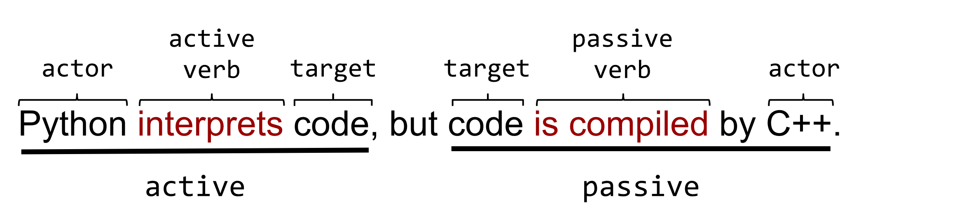
Active voice

Slide 10
Active voice
Exercise:
Rewrite the following passive voice sentences as active voice. Only part of certain sentences are in passive voice; ensure that all parts end up as active voice:
The flags were not parsed by the Mungifier.
The Mungifier did not parse the flags.

Slide 11
Clear sentences
Unit suggests a few ways to make your sentences beautifully clear.
Choose strong verbs
Reduce there is/there are
Minimize certain adjectives and adverbs (optional)

Slide 12
Clear sentences
Exercise:
Clarify the following sentences by removing There is:
There is a low-level, TensorFlow, Python interface to load a saved model.
TensorFlow provides a low-level Python interface to load a saved model.

Slide 13
Lists and tables
Good lists can transform technical chaos into something orderly.
Choose the correct type of list
Keep list items parallel
Start numbered list items with imperative verbs
Punctuate items appropriately
Create helpful tables
Introduce each list and table

Slide 14
Lists and tables
Exercise:
Is the following list parallel or nonparallel?
Broccoli inspires feelings of love or hate.
Potatoes taste delicious.
Cabbages.

Slide 15
Markdown
Markdown is a lightweight markup language that many technical professionals use to create and edit technical documents.
## bash and ksh
**bash** closely resembles an older shell named **ksh**. The key
*practical* difference between the two shells is as follows:
* More people know bash than ksh, so it is easier to get help for bash
problems than ksh problems.
markdowntutorial.com

Slide 16
Creating sample code
Good sample code is often the best documentation.
Sample code should meet the following criteria:
Build without errors.
Perform the task it claims to perform.
Be as production-ready as possible. For example, the code shouldn't contain any security vulnerabilities.
Follow language-specific conventions.

Slide 17
Creating sample code
Exercise:
What problems do you see in the comments within the following snippet?
/* Create a stream from the text file at pathname /tmp/myfile. */
mystream = br.openstream(pathname="/tmp/myfile", mode="z")
The comment elaborates on a fairly obvious part of the code
The snippet doesn't explain the non-obvious portion of the code.

Slide 18
DEMO

Slide 19
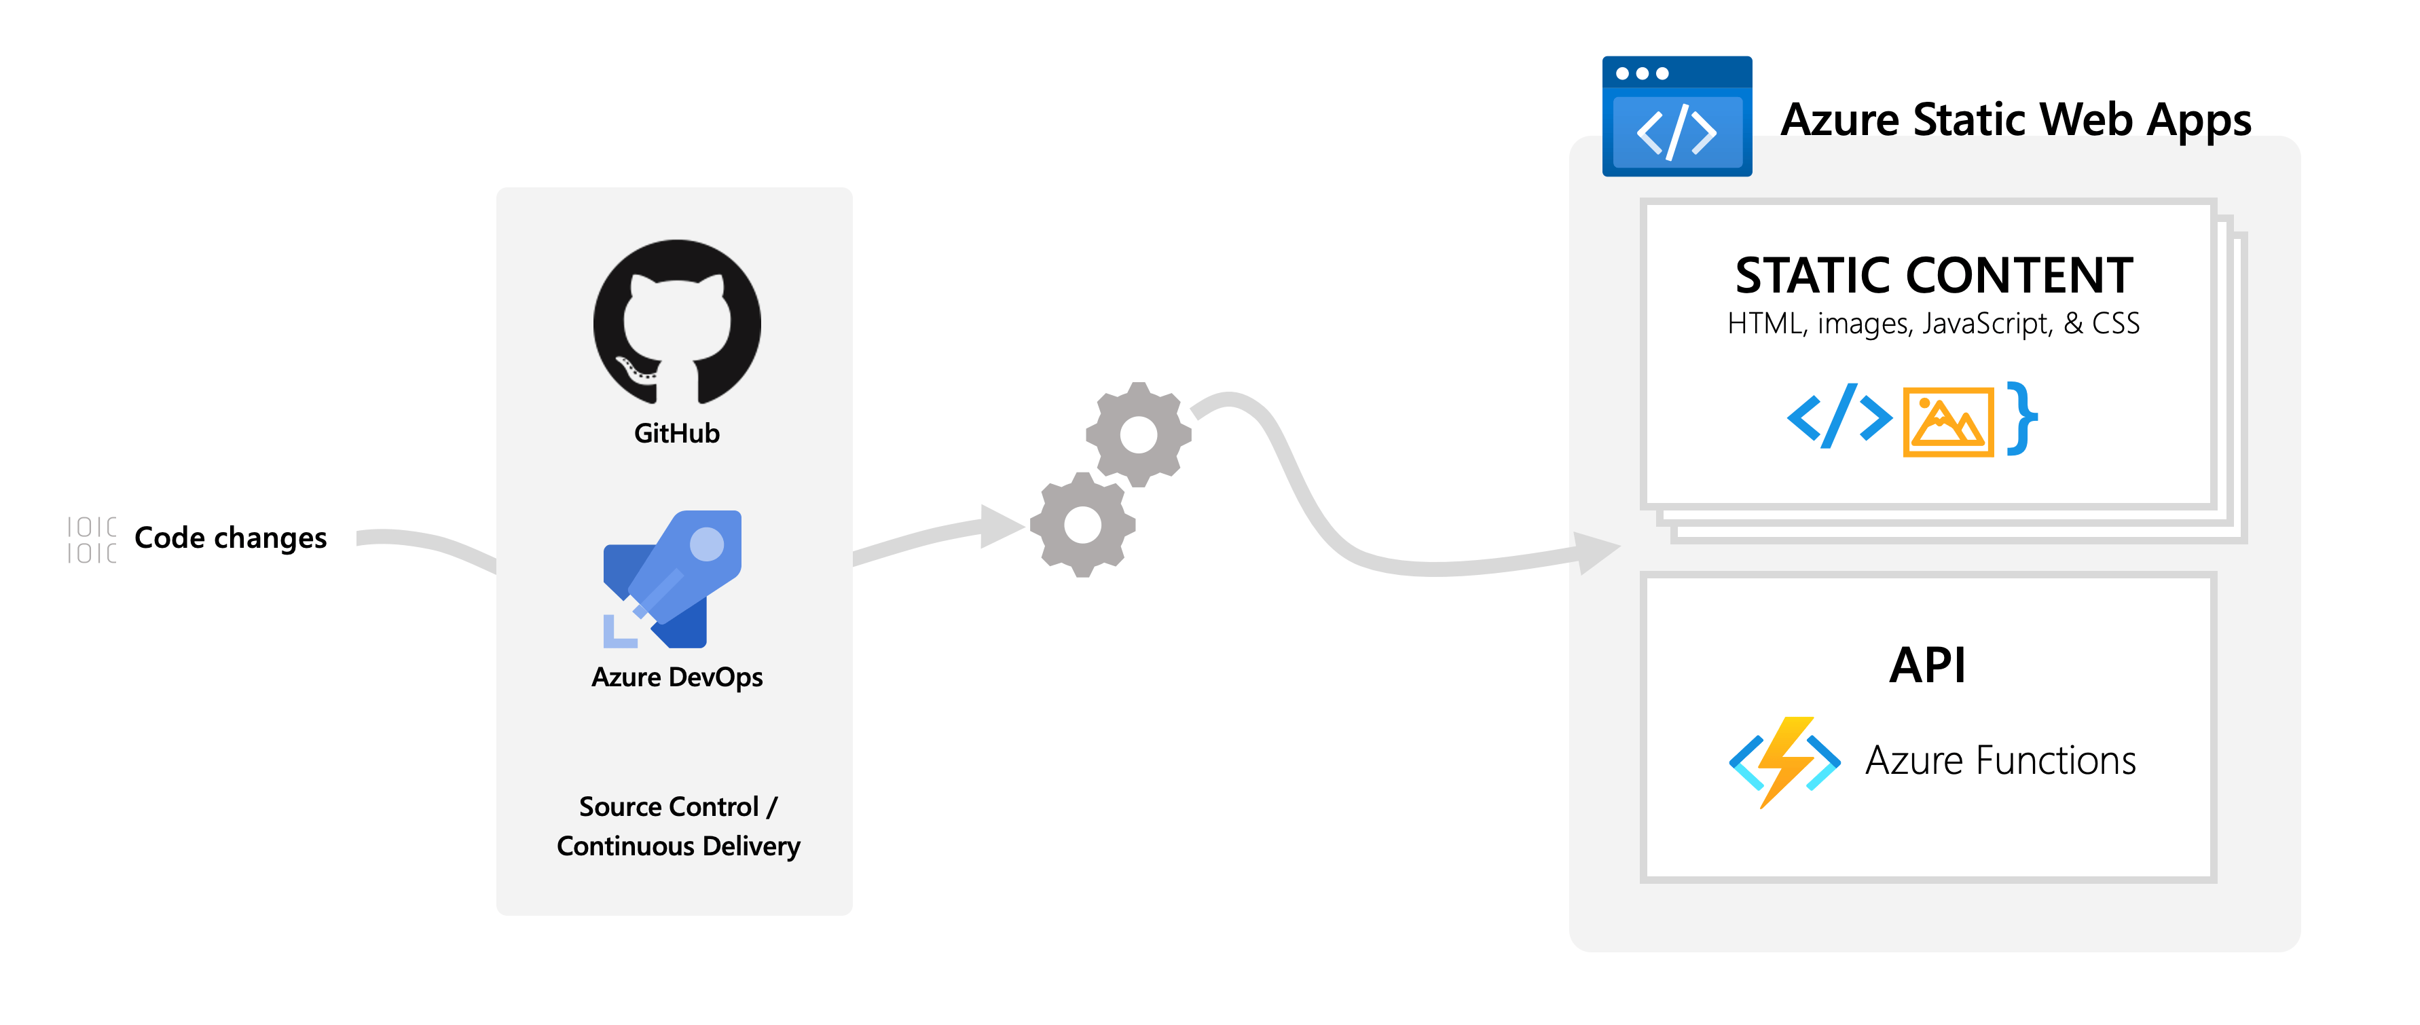
azure.microsoft.com/en-us/services/app-service/static

Slide 20

Websites for you and your projects. Hosted directly from your GitHub repository. Just edit, push, and your changes are live.
Simple – just create repository username.github.io

Slide 21
DEMO

Slide 22
Q&A

