Slide 1
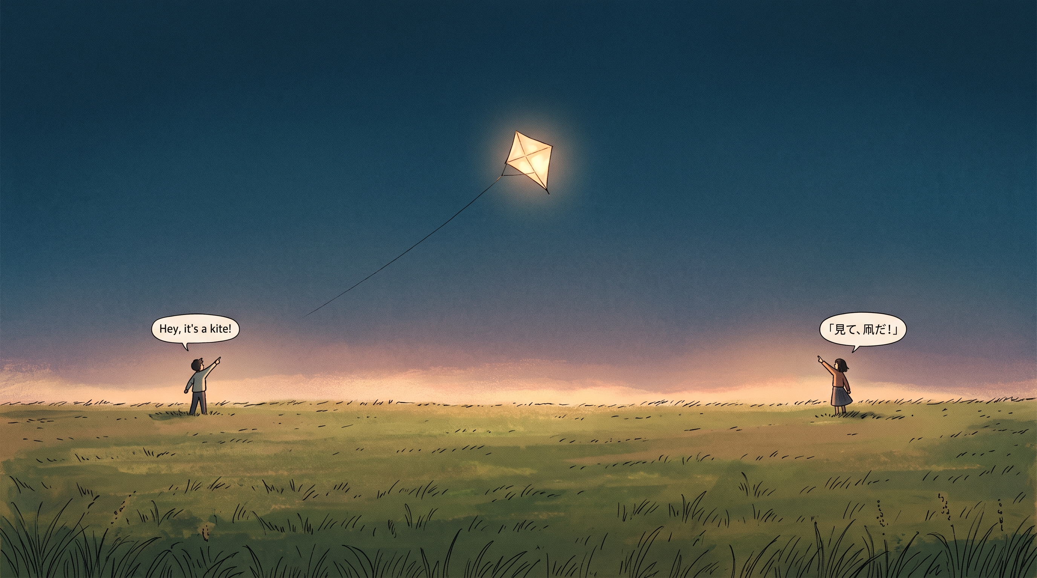
⚡ AI BUILDERS HACKATHON 2026
Kites
Spatial In-Browser Manga & Comic Translator
100% Client-Side WebGPU Neural Pipeline • Zero Python • Zero Cloud Lock-in • Authentic Comic Lettering in Real-Time
Creator: Unheat (dangtruongan)
Live Demo: https://kites-translator.pages.dev • GitHub: Unheat/Kites

Slide 2
01 · PROBLEM STATEMENT
Reading Raw Comics is Broken and Painful
Existing manga translation tools force users into trade-offs between impossible setups and expensive paywalls.
💻
Complex Python/CUDA Setups
💸
Aggressive Cloud Paywalls
Legacy tools like Cotrans require downloading gigabytes of PyTorch models, configuring CUDA environments, and terminal commands that 99% of readers cannot set up.
Commercial browser extensions charge $10/month subscriptions, impose strict daily page limits, or sell credits that run out after two manga chapters.
🔒
Severe Privacy Risks
🎨
Ugly White-Box UX
Cloud translation services upload user reading data and images to third-party servers, compromising user privacy and copyright integrity.
Crude rectangle erasers obliterate surrounding linework, screentones, and textures, replacing artwork with jarring white blocks.

Slide 3
02 · SOLUTION OVERVIEW
Kites: 100% Local-First In-Browser AI Translation
An ultra-lightweight Chrome Extension running neural computer vision, generative inpainting, and typesetting right inside your browser.
ZERO SETUP
HARDWARE ACCELERATED
100% PRIVATE
COMIC-AWARE
Instant Browser Extension
Client-Side WebGPU Engine
Zero Data Uploads
Authentic Typesetting
Install unpacked in 30 seconds. Works natively on Chromium browsers without Python, Docker, or command-line dependencies.
PaddleOCR detection and LaMa Manga inpainting execute on your device graphics card via ONNX Runtime Web with zero server compute.
Images are processed entirely in browser memory and cached in local IndexedDB. Comic panels never touch our servers.
Measures balloon shapes, balances line wrapping, auto-sizes dialogue fonts, and bakes translated text cleanly into comic panels.

Slide 4
03 · TARGET USERS
Who Needs Kites: Global Manga & Web Comic Ecosystem
Serving millions of international comic enthusiasts, social media readers, and scanlation creators.
01
02
03
Global Manga & Webtoon Fans
Social Media Comic Readers
Scanlators & Content Creators
CHALLENGE:
CHALLENGE:
CHALLENGE:
70M+ readers globally wait weeks or months for fan scanlations of Japanese raw chapters.
Millions of comic strips and indie creator illustrations are shared daily on X (Twitter), Pixiv, and Reddit in Japanese, Korean, or Chinese.
Manual scanlation requires hours of tedious Photoshop editing: cloning stamps, redrawing screentones, and retyping fonts.
HOW KITES EMPOWERS THEM:
HOW KITES EMPOWERS THEM:
HOW KITES EMPOWERS THEM:
Translate untranslated chapters instantly on raw manga sites with one click, preserving original panel art and dialogue emotion.
The subtle CSS-anchored Hover button lets users read indie artwork directly in their timeline without taking screenshots or copying text.
Kites Studio provides an interactive 8-point bounding box editor to polish translations, adjust balloon text, and export 1:1 lossless PNGs.

Slide 5
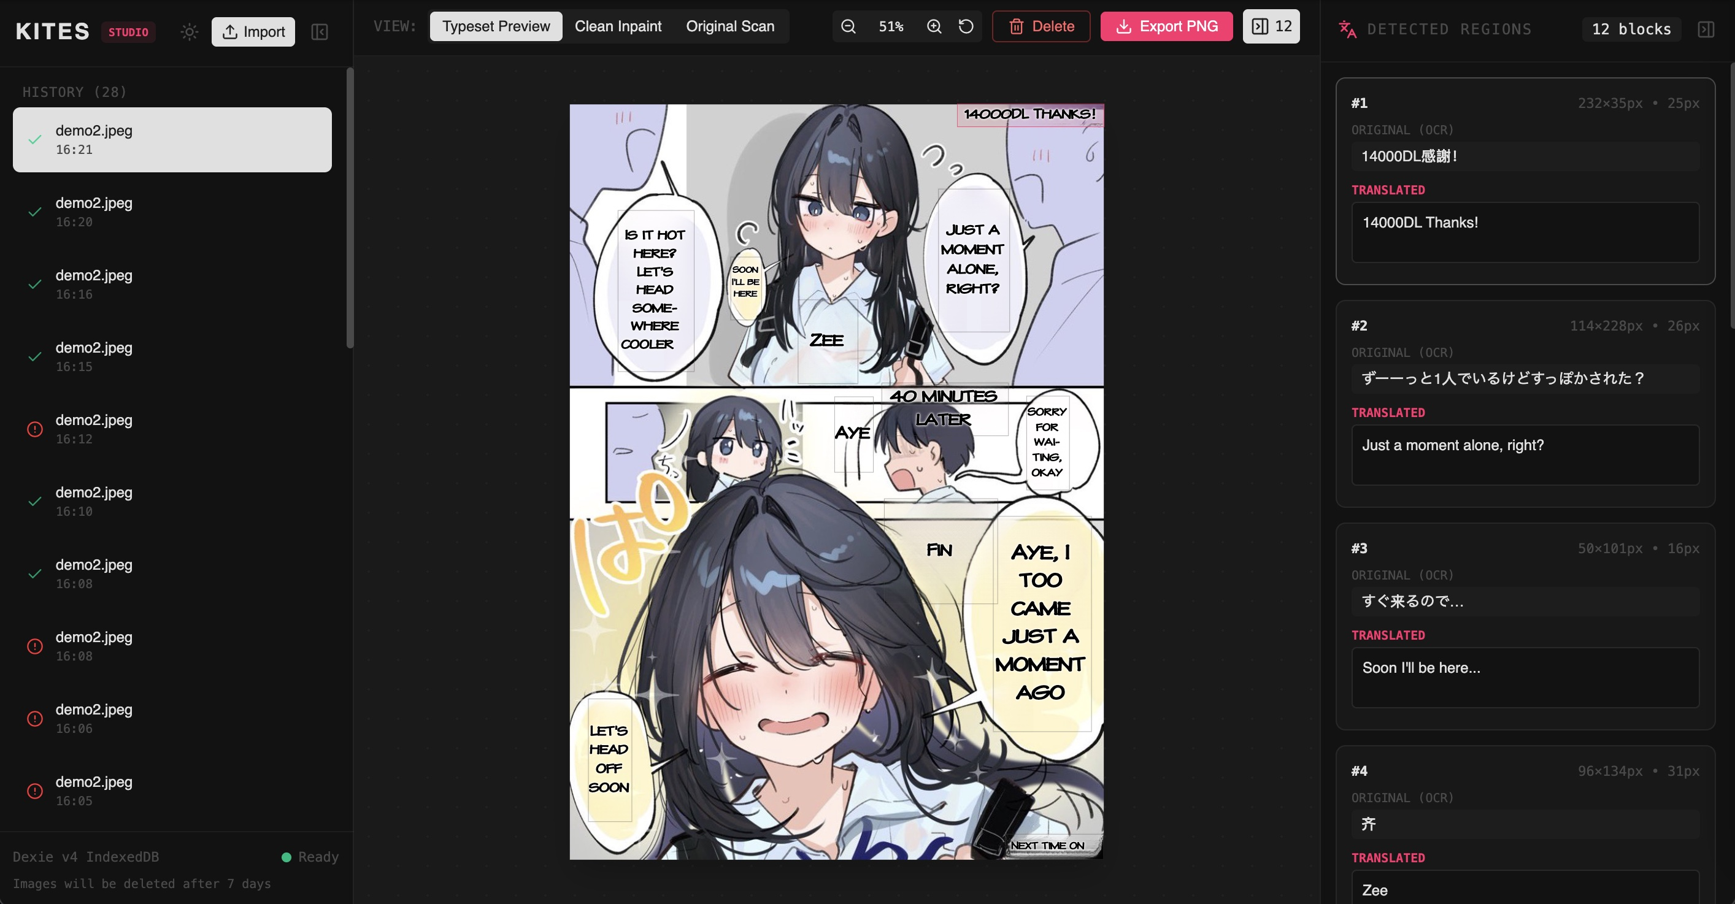
04 · PRODUCT FEATURES
Frictionless In-Page Interaction & Dedicated Studio
Four versatile browsing trigger modes paired with an interactive full-screen post-editor.
🖱️ In-Page Hover Translation
Hover over any image to reveal the floating translation badge. Translates directly over comic panels with zero DOM layout shift.
📌 Persistent Pins & 🚀 Auto-Translate
Keep action badges pinned across all comic panels, or enable Viewport Auto-Translate to queue chapters automatically as you scroll.
🛠️ Built-in Kites Studio
Triple-view inspection (Original, Clean Inpaint, Typeset), 8-point interactive bounding box resizing, and lossless 1:1 PNG export.
🛡️ SPA Reversion Shield
MutationObserver guards prevent modern React/SPA frameworks (X/Twitter, Reddit) from resetting translated images back to raw scans.

Slide 6
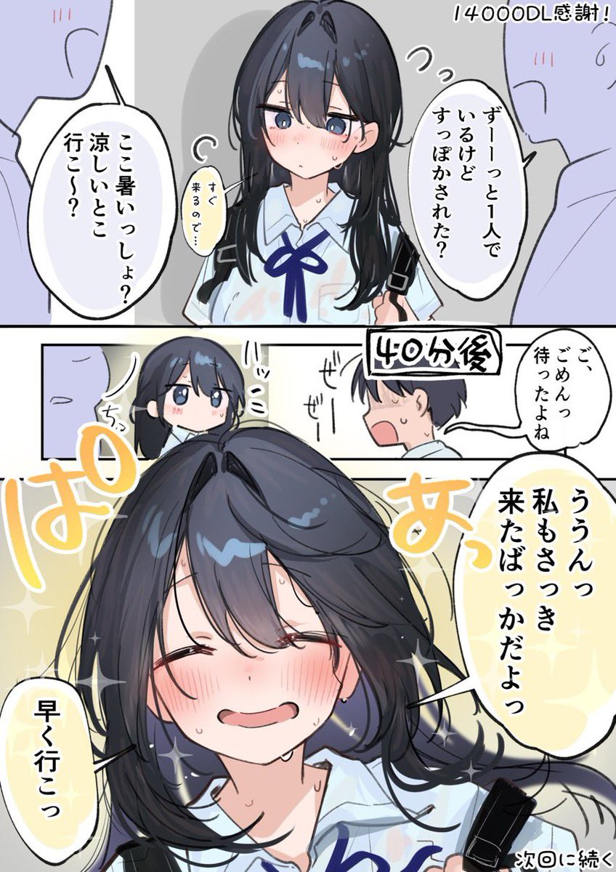
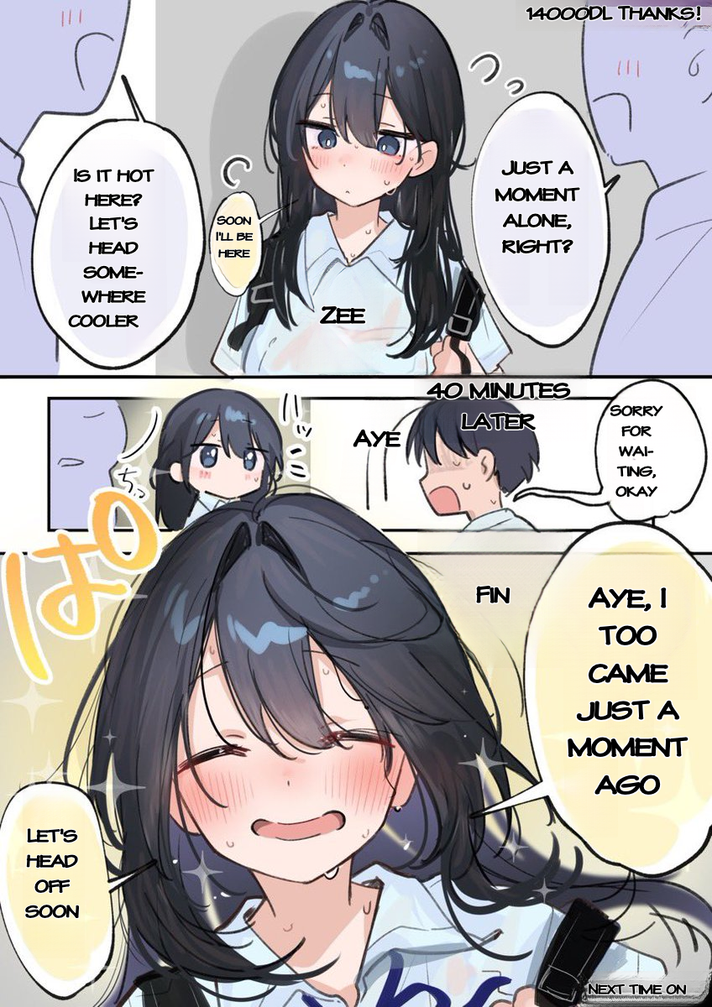
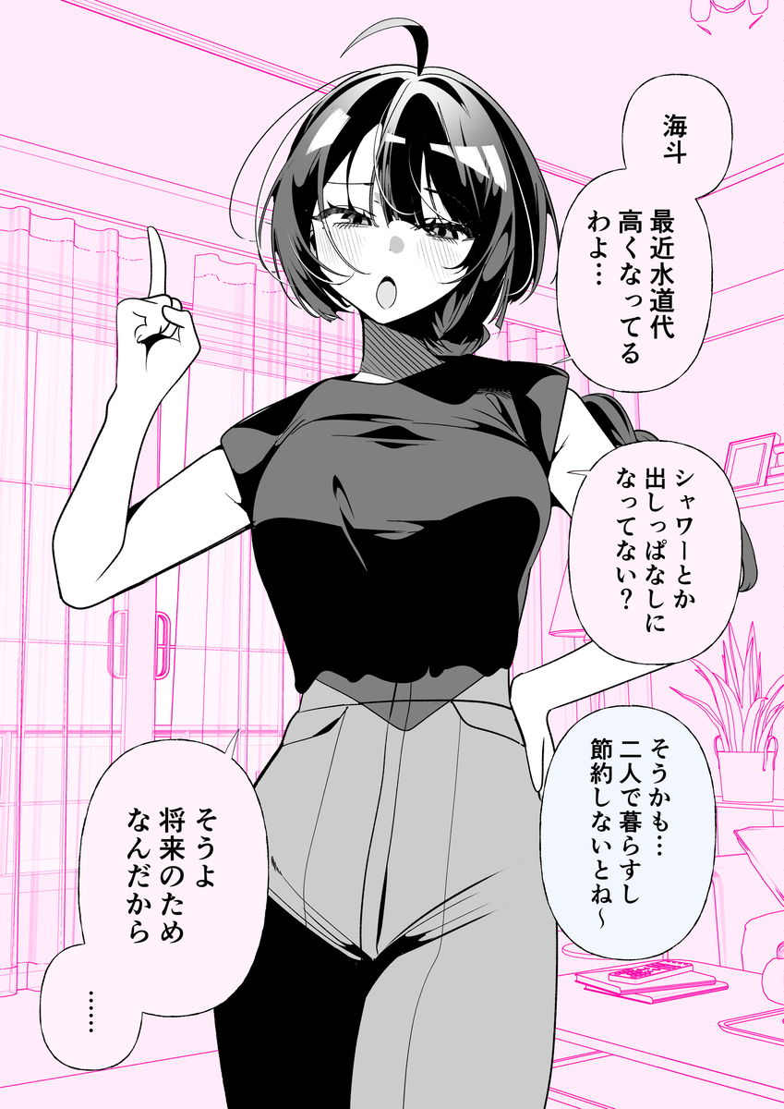
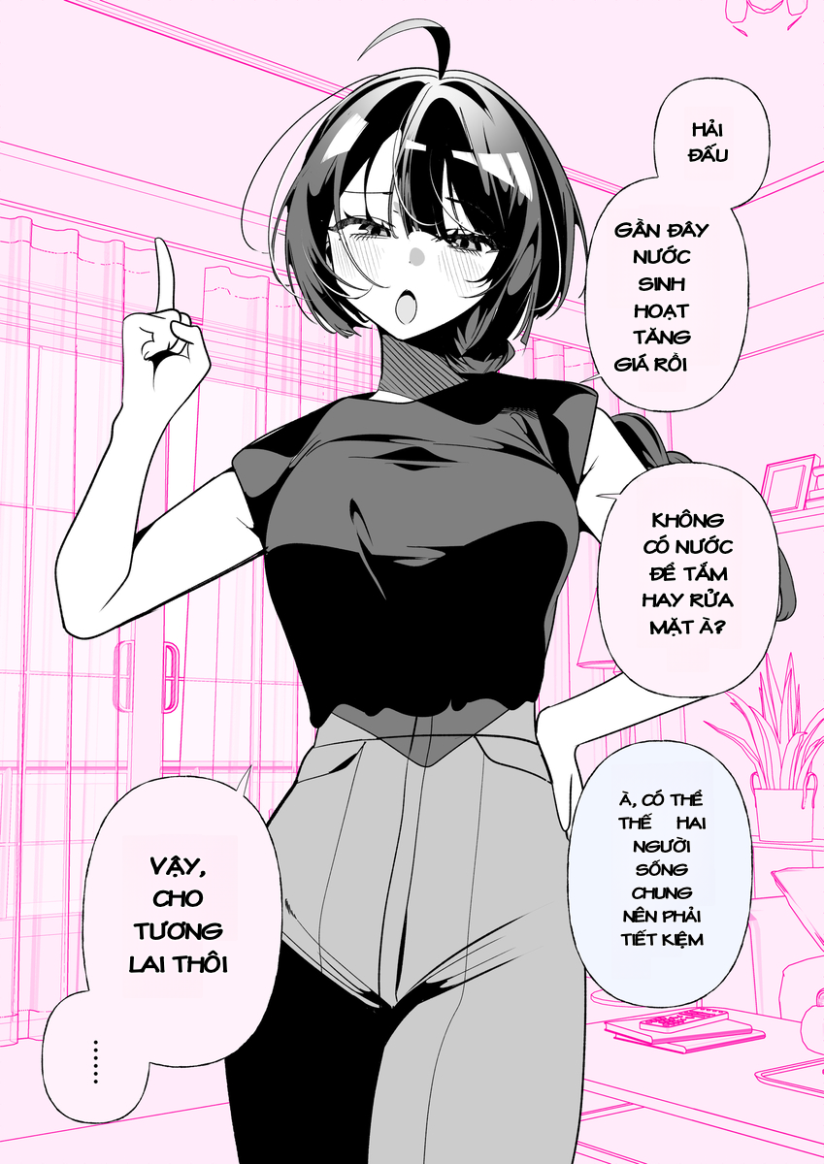
05 · VISUAL PROOF
Uncompromising Quality: Zero White Boxes
Neural background inpainting erases strictly within character contours, preserving line art and screen tones.
JAPANESE ➔ ENGLISH (Sato-san benchmark)
JAPANESE ➔ VIETNAMESE (Pixiv #145272482)

Slide 7
06 · TECHNICAL ARCHITECTURE
Manifest V3 Offscreen Document Sandboxing
Overcoming service worker lifecycle limits to run persistent WebGPU neural computation.
1. In-Page Scanner
2. Message Hub & Queue
3. WebGPU Sandbox
4. Storage & Display
Content Script
Service Worker
Offscreen Document
Dexie IndexedDB
Discovers DOM <img> elements ≥150px
Attaches CSS Anchor hover button
Wipes responsive srcset candidates
SPA Reversion Shield (MutationObserver)
Deduplicates redundant triggers
Enforces 1–5 task concurrency queue
Token-bucket rate limiter
Routes explicit target/source RPC markers
Persistent context (no SW timeouts)
PaddleOCR DBNet rotated detection
Promise.all: Inpaint + Translation
4-Pass binary-search typesetting
Stores clean plate + TextBlocks
Automatic 7-day TTL cache pruning
Converts Base64 to safe Blob URLs
Studio editor interactive re-rendering

Slide 8
07 · AI TECHNOLOGIES
The 4 Core Pillars of the Kites AI Engine
Orchestrating computer vision, graph clustering, generative diffusion, and LLM inference.
COMPUTER VISION (OCR)
SPATIAL GEOMETRY
PaddleOCR DBNet + SVTR
Kruskal Minimum Spanning Tree
Runs ONNX Runtime Web via WebGPU/WASM. Detects arbitrary rotated 4-point convex hull polygons (dt_polys) with projective perspective crop homography.
Direction detection (connected-component majority scoring) + 14-stage noise battery + Kruskal MST bubble clustering to reconstruct natural reading order.
GENERATIVE INPAINTING
LANGUAGE TRANSLATION
LaMa Manga & AOT-GAN
WebLLM & Cloudflare Shared Pool
Zero-resizing 1:1 scale dynamic 64px patch bucketing. Erases strictly along character contour polygons with UNCLIP 1.8 expansion to preserve line art.
Runs on-device WebLLM (Qwen 2.5, Llama 3.2) or zero-cost Cloudflare Worker pool with Google OAuth and multi-provider fallback (Mistral -> Gemma -> Groq).

Slide 9
08 · IMPACT & VALUE
Democratizing Visual Storytelling at Zero Server Cost
A sustainable, highly scalable consumer product engineered for privacy and accessibility.
$0
100%
< 3s
Marginal Server Cost
User Privacy Guaranteed
Average Pipeline Latency
Client-side WebGPU compute
Zero images uploaded to cloud
Parallel inpaint + translation
WITHOUT KITES (STATUS QUO)
WITH KITES (LOCAL-FIRST ERA)
• $10/month cloud subscription fees with token limits
• Painful terminal setup (Python, PyTorch, CUDA, Git)
• Crude white boxes destroying comic backgrounds
• Personal reading history uploaded to unknown servers
• 100% Free & Unlimited reading with zero subscriptions
• One-click Chrome extension install (no terminal needed)
• Clean LaMa neural inpainting preserving original art
• 100% On-device privacy with zero cloud image uploads

Slide 10
09 · ROADMAP & FUTURE VISION
Scaling Kites: Next Milestones & Community Launch
Expanding platform reach, multi-language OCR coverage, and creator tooling.
Q3 2026
COMPLETED
Q4 2026
IN PROGRESS
Q1 2027
PLANNED
Core Engine & Release v1.0.3
Store Launch & Cross-Browser
Multilingual Asian OCR Expansion
WebGPU ONNX PaddleOCR & LaMa Inpainting
Kruskal-MST spatial bubble clustering
Interactive Kites Studio 8-point editor
Pre-built zip & Chrome Web Store submission
Chrome Web Store official public release
Firefox MV3 & Microsoft Edge packaging
Dynamic WebLLM model download manager
Custom comic typography font packs
Vertical Korean Hangul dedicated dictionary
Traditional Chinese Manhua tuning
Canvas / WebGL viewport screen snipping
Community scanlation cloud sync
Try Kites Today: https://kites-translator.pages.dev • GitHub: https://github.com/Unheat/Kites • Contact: andangtruong085@gmail.com

