Slide 1
Iterative methods
Operations Research
Hungarian method for the assignment problem
Iterative solution for the transportation problem
Hill climbing algorithm
Local Search heuristic

Slide 2
Base idea of iterative solution methods
Start from an initial solution
Use a simple heuristic, like a greedy method
Find ways to improve the current solution
Repeat as many times as possible
If no improvements are found, stop
Optimality is not guaranteed for most problem classes
Optionally: Restart from a different initial solution
As the method converges to a local optimum, restarts help in finding different local optima

Slide 3
The Hungarian method for the assignment problem
The algorithm was published by Harold Kuhn, based on earlier works of two Hungarian mathematicians, Dénes Kőnig and Jenő Egerváry
Assignment problem:
Given 2 sets of size N, and a bipartite graph with edges weighted by costs
The 2 sets can be workers/machines and tasks for example
Find the bijection with minimal cost
If a bijection with maximal profit is sought, just multiply the profits by -1 to convert them to costs
The problem is equivalent to selecting elements in an NxN matrix, such that exactly 1 element is selected from each row and column, and the sum of the selected elements is minimal
Or minimize the diagonal sum through swapping rows and columns

Slide 4
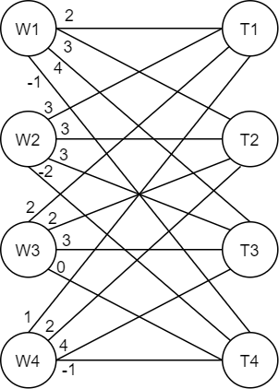
Example assignment problem
2 | 3 | 4 | -1
3 | 3 | 3 | -2
2 | 2 | 3 | 0
1 | 2 | 4 | -1

Slide 5
The Hungarian method
For each vertex in one set, decrease the weights of connected edges by the minimum of these weights, then repeat with each vertex of the other set
There will be at least one 0-weight edge connected to each vertex
Solution value must be adjusted at the end with the original values
Find a maximal matching with only 0-weight edges
If it is a perfect matching, it is the optimal assignment
Subtract the row minima from each row, then subtract the column minima from each column
There will be at least one 0 in each row/column
Select as much independent 0s as possible
If one was selected in each row, it is the optimal assignment

Slide 6
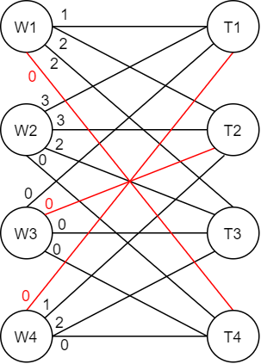
Example assignment problem
1 | 2 | 2 | 0
3 | 3 | 2 | 0
0 | 0 | 0 | 0
0 | 1 | 2 | 0

Slide 7
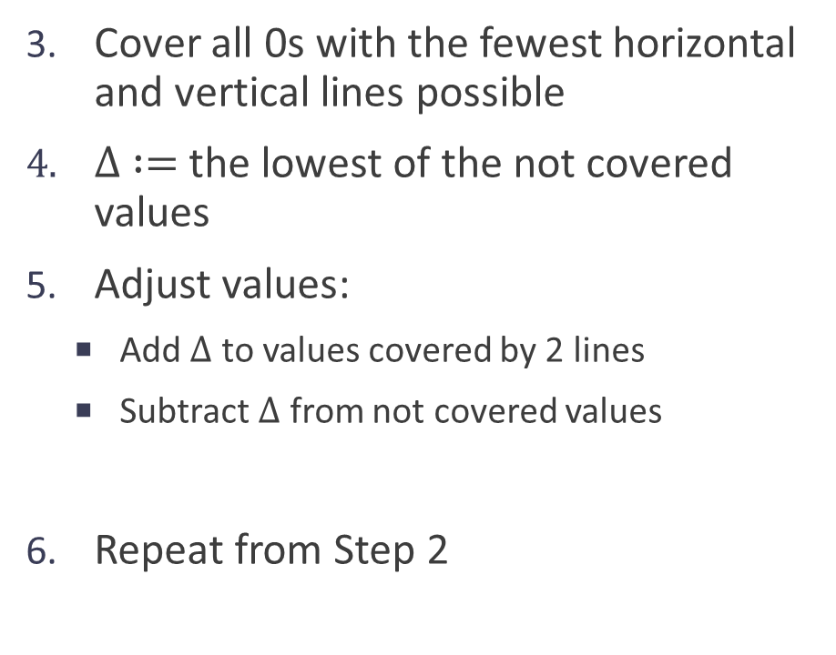
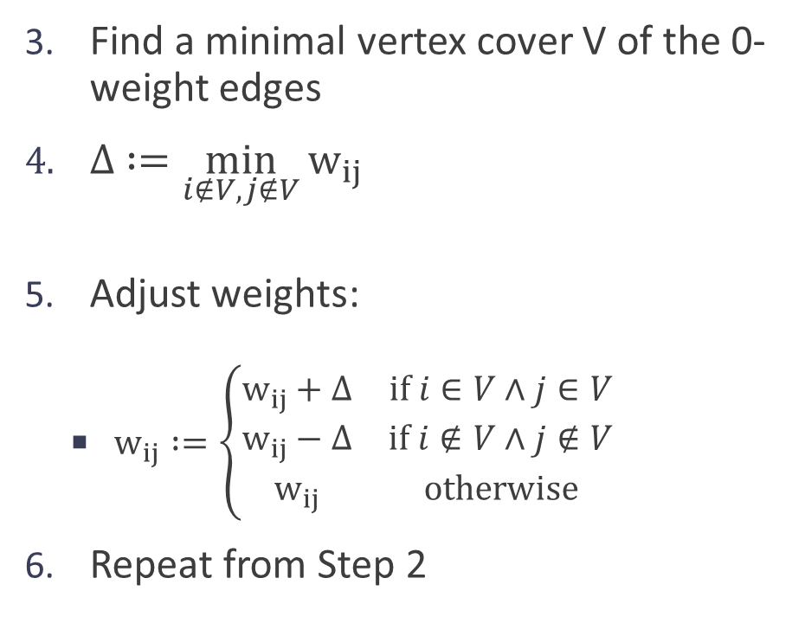
The Hungarian method
Find a minimal vertex cover V of the 0-weight edges
$∆ :=\min_{i∉V,j∉V}{w_{ij}}$
Adjust weights:
$w_{ij} :=\left\{\begin{matrix}w_{ij}+Δ & if i∈V∧j∈V \\ w_{ij}−Δ & if i∉V∧j∉V \\ w_{ij} & otherwise\end{matrix}\right.$
Repeat from Step 2
Cover all 0s with the fewest horizontal and vertical lines possible
$∆ :=$ the lowest of the not covered values
Adjust values:
Add $∆$ to values covered by 2 lines
Subtract $∆$ from not covered values
Repeat from Step 2

Slide 8
Example assignment problem
1 | 2 | 2 | 0
3 | 3 | 2 | 0
0 | 0 | 0 | 0
0 | 1 | 2 | 0
1 | 1 | 1 | 0
3 | 2 | 1 | 0
1 | 0 | 0 | 1
0 | 0 | 1 | 0
0 | 0 | 0 | 0
2 | 1 | 0 | 0
1 | 0 | 0 | 2
0 | 0 | 1 | 1
1 | 1 | 1 | 0
3 | 2 | 1 | 0
1 | 0 | 0 | 1
0 | 0 | 1 | 0
0 | 0 | 0 | 0
2 | 1 | 0 | 0
1 | 0 | 0 | 2
0 | 0 | 1 | 1
2 | 3 | 4 | -1
3 | 3 | 3 | -2
2 | 2 | 3 | 0
1 | 2 | 4 | -1

Slide 9
Transportation problem
Given:
m = number of sources (i = 1 … m)
n = number of destinations (j = 1 … n)
c[i,j] = cost of shipping 1 unit from source i to destination j
a[i] = supply at source i
b[j] = demand at destination j
Objective:
Satisfy solution demands with minimal transportation cost

Slide 10
Iterative approach for the transportation problem
If the problem is unbalanced (more supply than demand), introduce a dummy destination with 0 transport costs
Find a feasible initial solution
Northwest corner method
Least cost first
Vogel’s approximation
Find improving modifications
U-V method

Slide 11
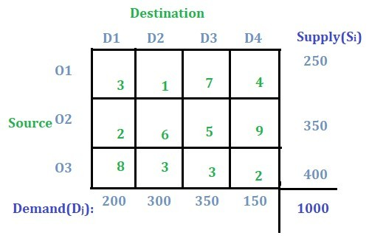
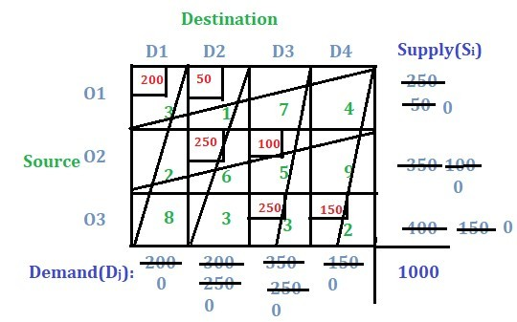
Initial solution (Northwest corner method)
Total cost: 3700

Slide 12
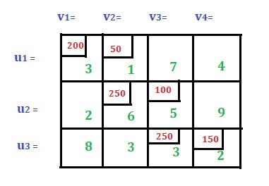
U-V method
Assign u_{i} and v_{j} values to rows and columns such that u_{i} + v_{j} = c_{ij} for every allocated (i,j) cell
There are m+n variables (u and v), and usually m+n-1 allocated cells
Choose one variable to be 0, and calculate the rest (u₁:=0 in the example)
If there are only m+n-2 allocated cells, assign 0 to one of the cells first
3 1 0 -1
0
5
3
Total cost: 3700

Slide 13
U-V method calculate penalties
Calculate penalty values for each unallocated cell: P_{ij} = u_{i} + v_{j} - c_{ij}
P₁₃ = 0 + 0 – 7 = –7
P₁₄ = 0 – 1 – 4 = –5
P₂₁ = 5 + 3 – 2 = 6
P₂₄ = 5 –1 – 9 = –5
P₃₁ = 3 + 3 – 8 = –2
P₃₂ = 3 + 1 – 3 = 1
If there is a positive penalty, improvement is possible
3 1 0 -1
0
5
3
Total cost: 3700

Slide 14
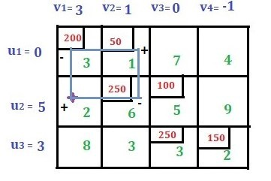
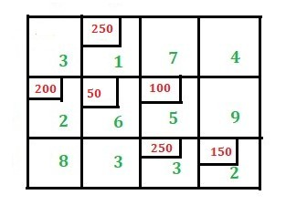
U-V method improvement step
Start from the cell with maximum penalty, and find a closed path with horizontal and vertical steps through allocated cells
Not always a rectangle, it can have more corners
Assign + and – signs alternating through the steps
Decrease the allocated values of – cells by their minimum value, and increase the values of + cells by the same amount
Total cost: 3700
Total cost: 3100

