Slide 1
Model improvements
Operations Research

Slide 2
Redundancy: Friend or Foe?
Redundant constraints ✔
Sometimes, adding constraints that don’t affect the search space, can accelerate solution by giving more insight to the solver
Redundant solutions increase computation time ❌
Variable symmetry: the values of 2 (sets of) variables are always interchangeable in a solution
Value symmetry: certain values are always interchangeable in a solution
Many other types of symmetries and redundancies
We want to decrease the search space without losing the optimal solution
Symmetry-breaking constraints (redundant but useful)

Slide 3
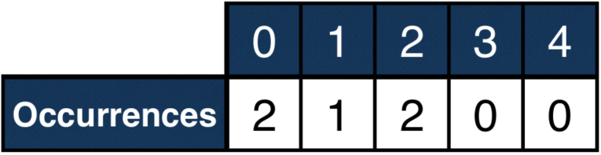
Improving the magic series model
Old model:
int: n = 5;
set of int: D = 0..n-1;
array[D] of var int: series;
constraint forall (i in D) (
series[i] = sum(j in D) (series[j] == i)
);
An aggregate function could simplify it:
constraint forall (i in D) (
series[i] = count(series, i) % or: count(series, i, series[i])
);
What other properties does a solution have?
Can we provide more information to the solver about the relationship between the variables, by adding more constraints?

Slide 4
Improving the magic series model
Since the values of the series represent occurrences, their sum must be equal to the length of the series
constraint sum(series) = n;
The value of series[i] = k means that there are k i’s in the series
But all those i’s represent occurrences too
To get all occurrences, we can sum all those i’s for i = 0,1,2,…
constraint sum(i in D) (series[i] * i) = n;
Above, the 2 types of sum functions can also be seen

Slide 5
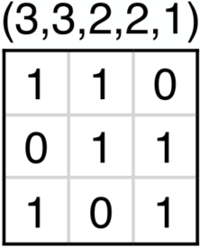
Balanced Incomplete Block Designs
BIBDs are used for designing measurement experiments
Input parameters: (v,b,r,k,l)
We need to fill a v×b Boolean matrix, such that:
Each row contains r ones
Each column contains k ones
Any 2 rows have exactly l places where they both contain a one

Slide 6
BIBD model
int: v=7; int: b=7; int: r=3; int: k=3; int: l=1;
set of int: Rows = 1..v;
set of int: Cols = 1..b;
array[Rows,Cols] of var bool: M;
constraint forall(i in Rows) (
sum(j in Cols)(M[i,j]) == r
);
constraint forall(j in Cols) (
sum(i in Rows)(M[i,j]) == k
);
constraint forall(i,j in Rows where i<j) (
sum(x in Cols)(M[i,x] /\ M[j,x]) == l % /\ is AND
);
output [
show(M[i,j]*1) ++ if j == b then "\n" else " " endif
| i in Rows, j in Cols
];

Slide 7
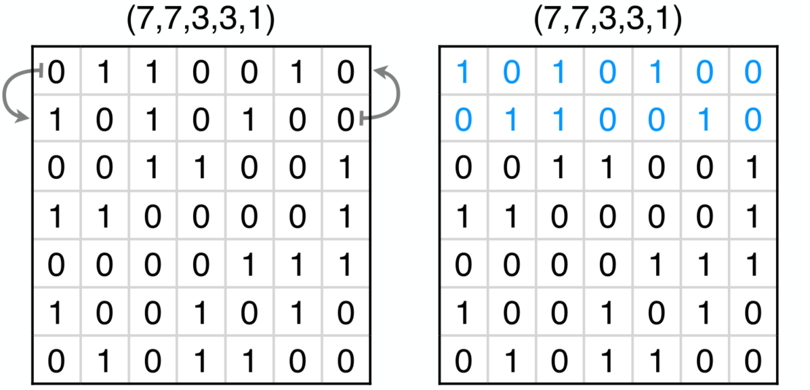
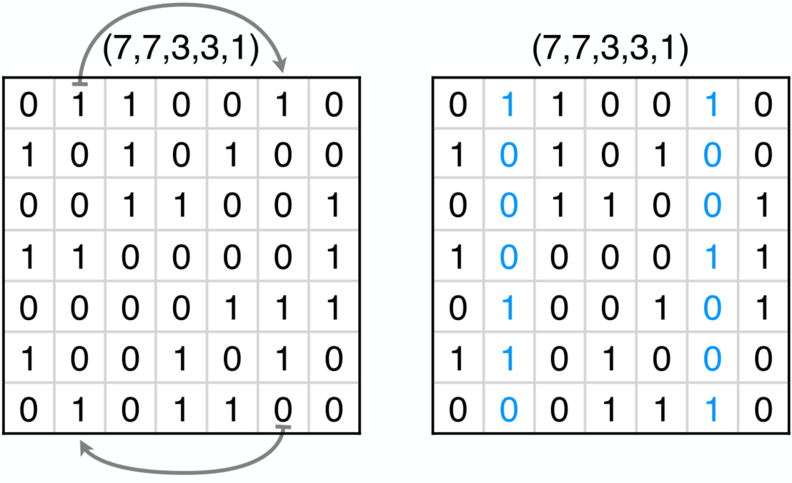
Variable symmetry

Slide 8
Improved BIBD model
Since the order of the rows and columns are arbitrary, make them sorted
There are global constraints for lexicographically ordering arrays
include "globals.mzn";
constraint forall(i,j in Rows where i<j) (
% row i is lexicographically less than or equal to row j
lex_lesseq( [M[i,c] | c in Cols], [M[j,c] | c in Cols] )
);
constraint forall(i,j in Cols where i<j) (
lex_lesseq( [M[n,i] | n in Rows], [M[n,j] | n in Rows] )
);
% global constraint equivalent to the above two
constraint lex2(M);

Slide 9
Scene allocation problem
We need to schedule movie filming scenes
Input:
Days
Actors
Fee per day (regardless of number of scenes)
Scenes
Which actors appear in them
At most 5 scenes can be filmed on each day
Minimize the total fees paid to actors

Slide 10
Scene allocation model
int: nDays;
set of int: Days = 1..nDays;
enum Scenes;
enum Actors;
array[Actors] of int: fee;
array[Actors] of set of Scenes: appears_in;
array[Scenes] of var Days: when;
solve minimize sum(a in Actors, d in Days) (
fee[a] * exists(s in appears_in[a]) (when[s] == d)
);
include "globals.mzn";
constraint forall(d in Days) (
at_most(5, when, d) % value 'd' appears at most 5 times in 'when'
);

Slide 11
Value symmetry
The days are interchangeable in a solution
Similar but different to the variable symmetry shown before
Here, those 2 sets of variables are interchangeable, where a set consists of all the variables having a certain value
The scenes of 2 days can be switched
Solution:
Assign scene 1 to day 1
Scene 2 can either be on the same day, or the next (day ≤ 2)
Scene n can either be on a same day as a scene with a smaller index, or on the next unassigned day
The last assigned day is the maximum of values assigned to previous scenes
constraint when[Scenes[1]] = 1;
constraint forall (s in Scenes where s > 1) (
when[s] <= max(k in Scenes where k < s)(when[k]) + 1
);

