Slide 1
Divide and conquer methods
Operations Research
Dynamic programming
Branch and bound

Slide 2
Dynamic programming
Divide and conquer methods

Slide 3
Dynamic programming
Break down a problem recursively into smaller subproblems
The smallest problems have trivial solutions
Use memoization to avoid computing the same function call multiple times
Store previously computed values in an array or matrix
Not suitable for all problems but very efficient

Slide 4
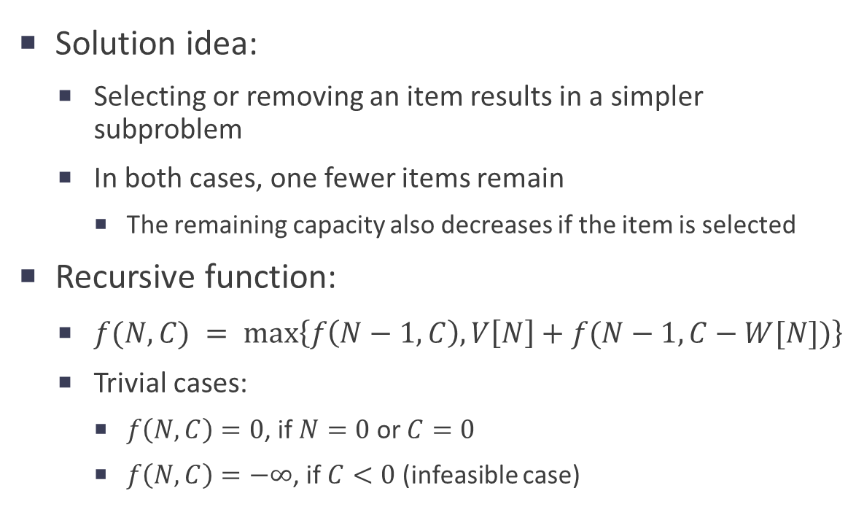
Solving the Knapsack problem with dynamic programming
Given:
N = number of items
C = knapsack capacity
V[1,…,N] = item values
W[1,…,N] = item weights
Objective:
Select items maximizing their total value
Constraint:
Total weight ≤ capacity
Solution idea:
Selecting or removing an item results in a simpler subproblem
In both cases, one fewer items remain
The remaining capacity also decreases if the item is selected
Recursive function:
$f(N,C) = max⁡\left\{f\left(N−1,C\right), V\left[N\right]+f(N−1,C−W[N])\right\}$
Trivial cases:
$f\left(N,C\right)=0$, if $N=0$ or $C=0$
$f\left(N,C\right)=−∞$, if $C<0$ (infeasible case)

Slide 5
Example
N = 4, C = 7, V = [16, 19, 23, 28], W = [2, 3, 4, 5]
 | N = 0 | N = 1 | N = 2 | N = 3 | N = 4
C = 0 | 0 | 0 | 0 | 0 | 0
C = 1 | 0
C = 2 | 0
C = 3 | 0
C = 4 | 0
C = 5 | 0
C = 6 | 0
C = 7 | 0 |  |  |  | ?

Slide 6
Example
N = 4, C = 7, V = [16, 19, 23, 28], W = [2, 3, 4, 5]
 | N = 0 | N = 1 | N = 2 | N = 3 | N = 4
C = 0 | 0 | 0 | 0 | 0 | 0
C = 1 | 0
C = 2 | 0 |  |  | ?
C = 3 | 0
C = 4 | 0
C = 5 | 0
C = 6 | 0
C = 7 | 0 |  |  | ? | max{f(3,7), 28+f(3,2)}

Slide 7
Example
N = 4, C = 7, V = [16, 19, 23, 28], W = [2, 3, 4, 5]
 | N = 0 | N = 1 | N = 2 | N = 3 | N = 4
C = 0 | 0 | 0 | 0 | 0 | 0
C = 1 | 0
C = 2 | 0 |  | ? | max{f(2,2), 23+f(2,-2)=-∞}
C = 3 | 0 |  | ?
C = 4 | 0
C = 5 | 0
C = 6 | 0
C = 7 | 0 |  | ? | max{f(2,7), 23+f(2,3)} | max{f(3,7), 28+f(3,2)}

Slide 8
Example
N = 4, C = 7, V = [16, 19, 23, 28], W = [2, 3, 4, 5]
 | N = 0 | N = 1 | N = 2 | N = 3 | N = 4
C = 0 | 0 | 0 | 0 | 0 | 0
C = 1 | 0
C = 2 | 0 | ? | max{f(1,2), 19+f(1,-1)=-∞} | max{f(2,2), 23+f(2,-2)=-∞}
C = 3 | 0 | ? | max{f(1,3), 19+f(1,0)=19}
C = 4 | 0 | ?
C = 5 | 0
C = 6 | 0
C = 7 | 0 | ? | max{f(1,7), 19+f(1,4)} | max{f(2,7), 23+f(2,3)} | max{f(3,7), 28+f(3,2)}

Slide 9
Example
N = 4, C = 7, V = [16, 19, 23, 28], W = [2, 3, 4, 5]
 | N = 0 | N = 1 | N = 2 | N = 3 | N = 4
C = 0 | 0 | 0 | 0 | 0 | 0
C = 1 | 0
C = 2 | 0 | max{f(0,2), 16+f(0,0)} | max{f(1,2), 19+f(1,-1)=-∞} | max{f(2,2), 23+f(2,-2)=-∞}
C = 3 | 0 | max{f(0,3), 16+f(0,1)} | max{f(1,3), 19+f(1,0)=19}
C = 4 | 0 | max{f(0,4), 16+f(0,2)}
C = 5 | 0
C = 6 | 0
C = 7 | 0 | max{f(0,7), 16+f(0,5)} | max{f(1,7), 19+f(1,4)} | max{f(2,7), 23+f(2,3)} | max{f(3,7), 28+f(3,2)}

Slide 10
Example
N = 4, C = 7, V = [16, 19, 23, 28], W = [2, 3, 4, 5]
 | N = 0 | N = 1 | N = 2 | N = 3 | N = 4
C = 0 | 0 | 0 | 0 | 0 | 0
C = 1 | 0
C = 2 | 0 | max{0, 16}=16 | max{f(1,2), 19+f(1,-1)=-∞} | max{f(2,2), 23+f(2,-2)=-∞}
C = 3 | 0 | max{0, 16}=16 | max{f(1,3), 19+f(1,0)=19}
C = 4 | 0 | max{0, 16}=16
C = 5 | 0
C = 6 | 0
C = 7 | 0 | max{0, 16}=16 | max{f(1,7), 19+f(1,4)} | max{f(2,7), 23+f(2,3)} | max{f(3,7), 28+f(3,2)}

Slide 11
Example
N = 4, C = 7, V = [16, 19, 23, 28], W = [2, 3, 4, 5]
 | N = 0 | N = 1 | N = 2 | N = 3 | N = 4
C = 0 | 0 | 0 | 0 | 0 | 0
C = 1 | 0
C = 2 | 0 | 16 | max{16, -∞}=16 | max{f(2,2), 23+f(2,-2)=-∞}
C = 3 | 0 | 16 | max{16, 19}=19
C = 4 | 0 | 16
C = 5 | 0
C = 6 | 0
C = 7 | 0 | 16 | max{16, 19+16}=35 | max{f(2,7), 23+f(2,3)} | max{f(3,7), 28+f(3,2)}

Slide 12
Example
N = 4, C = 7, V = [16, 19, 23, 28], W = [2, 3, 4, 5]
 | N = 0 | N = 1 | N = 2 | N = 3 | N = 4
C = 0 | 0 | 0 | 0 | 0 | 0
C = 1 | 0
C = 2 | 0 | 16 | 16 | max{16, -∞}=16
C = 3 | 0 | 16 | 19
C = 4 | 0 | 16
C = 5 | 0
C = 6 | 0
C = 7 | 0 | 16 | 35 | max{35, 23+19}=42 | max{f(3,7), 28+f(3,2)}

Slide 13
Example
N = 4, C = 7, V = [16, 19, 23, 28], W = [2, 3, 4, 5]
 | N = 0 | N = 1 | N = 2 | N = 3 | N = 4
C = 0 | 0 | 0 | 0 | 0 | 0
C = 1 | 0
C = 2 | 0 | 16 | 16 | 16
C = 3 | 0 | 16 | 19
C = 4 | 0 | 16
C = 5 | 0
C = 6 | 0
C = 7 | 0 | 16 | 35 | 42 | max{42, 28+16}=44

Slide 14
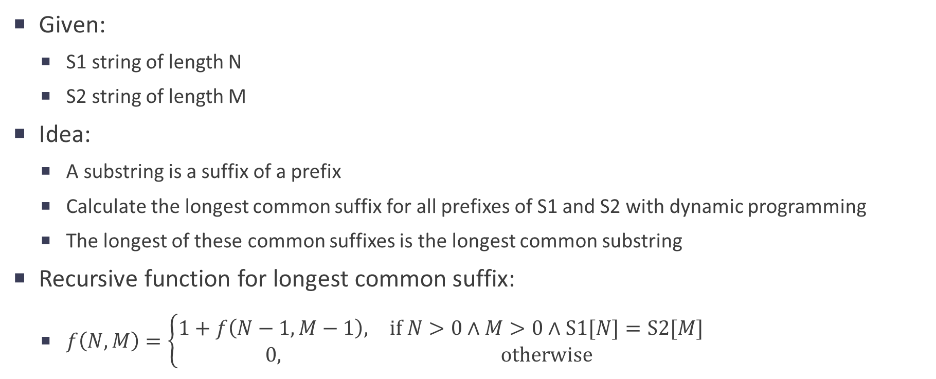
Finding the longest common substring with dynamic programming
Given:
S1 string of length N
S2 string of length M
Idea:
A substring is a suffix of a prefix
Calculate the longest common suffix for all prefixes of S1 and S2 with dynamic programming
The longest of these common suffixes is the longest common substring
Recursive function for longest common suffix:
$f\left(N,M\right)=\left\{\begin{matrix}1+f\left(N−1,M−1\right)\text{,} & \text{if} N>0∧M>\text{0}∧\text{S}1[N]=\text{S}2[M] \\ 0, & \text{otherwise}\end{matrix}\right.$

Slide 15
Example
 | S | U | B | S | T | R | I | N | G
M | 0 | 0 | 0 | 0 | 0 | 0 | 0 | 0 | 0
I | 0 | 0 | 0 | 0 | 0 | 0 | 1 | 0 | 0
N | 0 | 0 | 0 | 0 | 0 | 0 | 0 | 2 | 0
I | 0 | 0 | 0 | 0 | 0 | 0 | 1 | 0 | 0
S | 1 | 0 | 0 | 1 | 0 | 0 | 0 | 0 | 0
T | 0 | 0 | 0 | 0 | 2 | 0 | 0 | 0 | 0
R | 0 | 0 | 0 | 0 | 0 | 3 | 0 | 0 | 0
Y | 0 | 0 | 0 | 0 | 0 | 0 | 0 | 0 | 0

Slide 16
Branch and bound
Divide and conquer methods

Slide 17
Branch and bound
Use a tree to represent the search space
Each node is a subset of the solution space
Branch from a node with different decisions to partition the subset
Bound function: calculates a bound of the objective value on the solutions contained in a node

