Slide 1
Introduction to constraint programming
Operations Research
Backtracking search
Constraint propagation
MiniZinc modeling language

Slide 2
Backtracking search
Introduction to constraint programming

Slide 3
N-queens problem
♛
 |  | ♛
 |  |  |  | ♛
 | ♛
Place N queens on an NxN chessboard so no 2 queens attack each other
Backtracking search:
Go row by row from the top
Put queen in first valid space
If no valid space, backtrack

Slide 4
N-queens problem
♛
 |  | ♛
 |  |  |  | ♛
 | ♛
 |  |  | ♛
♛
 |  | ♛
 |  |  |  | ♛
 | ♛
 |  |  | X |  |  |  | ♛

Slide 5
N-queens problem
♛
 |  | ♛
 |  |  |  | ♛
 | X |  |  |  |  | ♛
 | ♛
 |  |  | ♛
 |  |  |  |  | ♛
♛
 |  | ♛
 |  |  |  | ♛
 | X |  |  |  |  | ♛
 | ♛
 |  |  | ♛
 |  |  |  |  | X |  | ♛

Slide 6
N-queens problem
♛
 |  | ♛
 |  |  |  | ♛
 | X |  |  |  |  | ♛
 | ♛
 |  |  | X
♛
 |  | ♛
 |  |  |  | ♛
 | X |  |  |  |  | ♛
 | X |  | ♛

Slide 7
N-queens problem
♛
 |  | ♛
 |  |  |  | ♛
 | X |  |  |  |  | ♛
 | X |  | X
♛
 |  | ♛
 |  |  |  | ♛
 | X |  |  |  |  | X | ♛
 | ? |  | ?
Actually, there are no solutions with the current position of the top 3 queens, but there are still many steps before the algorithm backtracks to that

Slide 8
Constraint propagation
Introduction to constraint programming

Slide 9
Improvement to backtracking search
The problem with backtracking search is that it detects infeasibility too late
Very often, a choice can be determined to be wrong without evaluating all further options
Decisions are not independent of each other
When a choice is made, it affects the possible options of other decisions
Idea: update variable domains based on past decisions
This is constraint propagation

Slide 10
N-queens problem with CP
♛
 |  | ♛
 |  |  |  | ♛
 |  |  | !
Variables: 1 for each row
Domain: { 1, …, 8 }
After each assignment, the domains of other variables are reduced by the constraints
If a domain is reduced to empty, backtrack
If reduced to 1 element, make an assignment

Slide 11
N-queens problem with CP
♛
 |  | ♛
 |  |  |  | ♛
 |  |  | ♛
 |  |  |  |  |  | !
♛
 |  | ♛
 |  |  |  | ♛
 |  |  |  |  |  |  | !
 |  |  | ♛
 | !
 |  |  |  |  |  | ♛

Slide 12
N-queens problem with CP
♛
 |  | ♛
 |  |  |  | X | ♛
♛
 |  | ♛
 |  |  |  | X | ♛
 | ♛
 |  |  |  |  |  | !
 |  |  |  |  |  |  | !!
 |  |  | !

Slide 13
Constraint propagation
Constraints:
The queens must be in different columns
A ≠ B
A ≠ C
B ≠ C
2 queens cannot be on the same diagonal
A ≠ B ± 1
A ≠ C ± 2
B ≠ C ± 1
This will result in exactly 1 queen in each column, but it’s not explicitly stated in the constraints
To deduce “!!”, constraints must be defined in a different way
See global constraints later

Slide 14
Constraint programming
Constraint Programming (CP) ≈ backtracking with propagation
Exact solution method
Propagators must be implemented for each type of constraint
They are included in CP solver kits
The programming problem becomes a modeling problem
Existing algorithms take care of the solution procedure
Search can be guided with selection strategies
Which variable to choose
Which value to assign

Slide 15
Constraint modeling with MiniZinc
Introduction to constraint programming

Slide 16
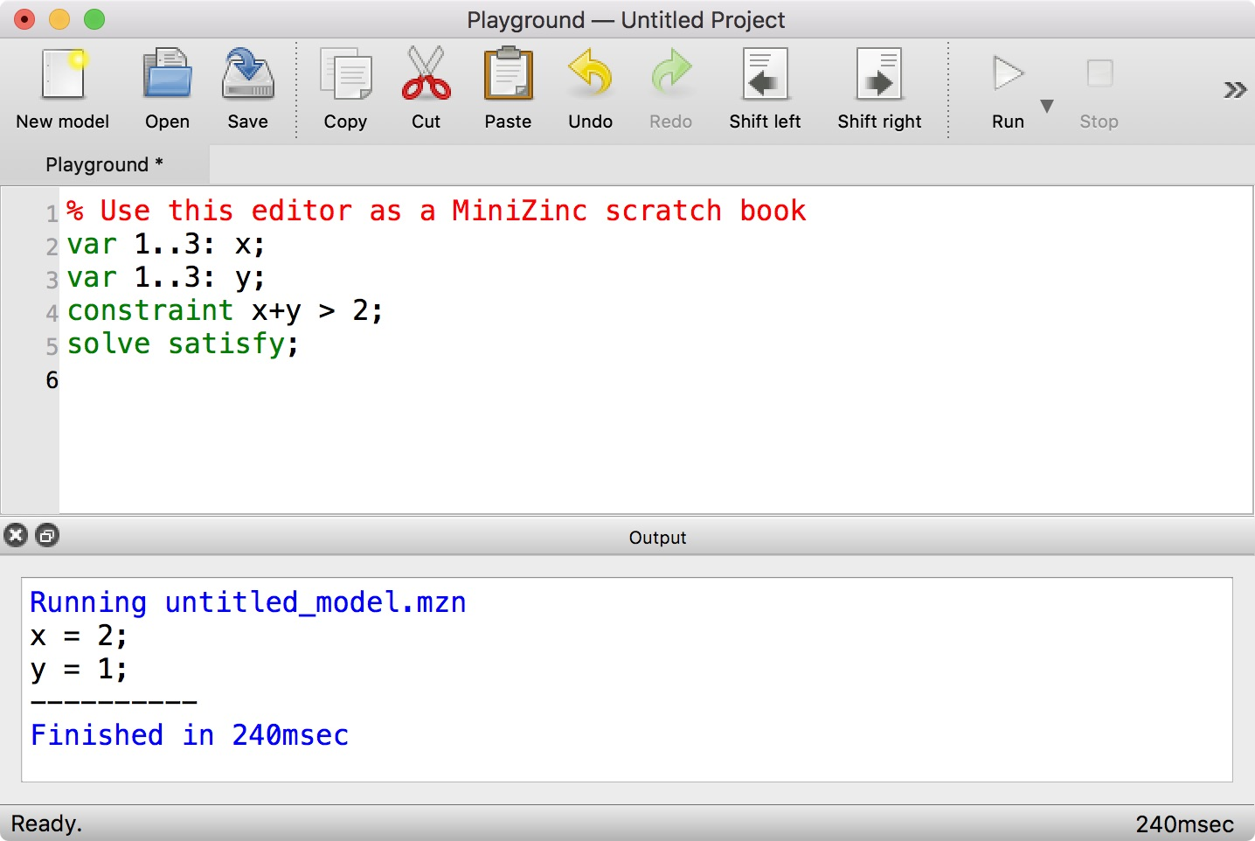

MiniZinc is…
A constraint modeling, declarative language
.mzn file extension for models
The MiniZinc Handbook
An open-source, multi-platform IDE
https://www.minizinc.org
Not a solver
The resulting model can be solved with different methods, not just CP
The IDE comes with some integrated solvers

Slide 17
Recommended resources
The MiniZinc Handbook
Introduction and Quick-start
A MiniZinc Tutorial
User Manual
Reference Manual
Free courses on Coursera
Discrete Optimization
Basic Modeling for Discrete Optimization
Advanced Modeling for Discrete Optimization
Advanced reading material
Francesca Rossi - Peter van Beek - Toby Walsh: Handbook of Constraint Programming, 2006, Elsevier
Mark Wallace: Building Decision Support Systems using MiniZinc, 2020, Springer

Slide 18
Basic model elements
Parameter variables
[par] <domain>: <var-name> [ = <value> ];
Values can also be given in a separate data file (.dzn) or as cmd-line args
Decision variables
var <domain>: <var-name>;
Domain can be:
bool or int
A finite set of values: set of int: Primes = {1, 2, 3, 5, 7, 11};
A range can be generated with the .. operator: set of int: Range = 1..10;
enum is a set with named values: enum EnumType = {first, second, third};
float (not good for solving with CP)
string (prefer enums instead)

Slide 19
Basic model elements
Constraints
constraint <logical-expr>;
All constraints must be satisfied, they are in AND relation
Objective
solve satisfy; % default, can be omitted
solve {minimize, maximize} <arithmetic-expr>;
Optimization is just a series of satisfiability problems: found a solution -> find a better one
Output statements
Displays results of the solution process, or generated parts of the model
output <array-of-strings>;
If there are no output statements, the names and values of all decision variables get displayed
Comments
% Line comment
/* Block comment */

Slide 20
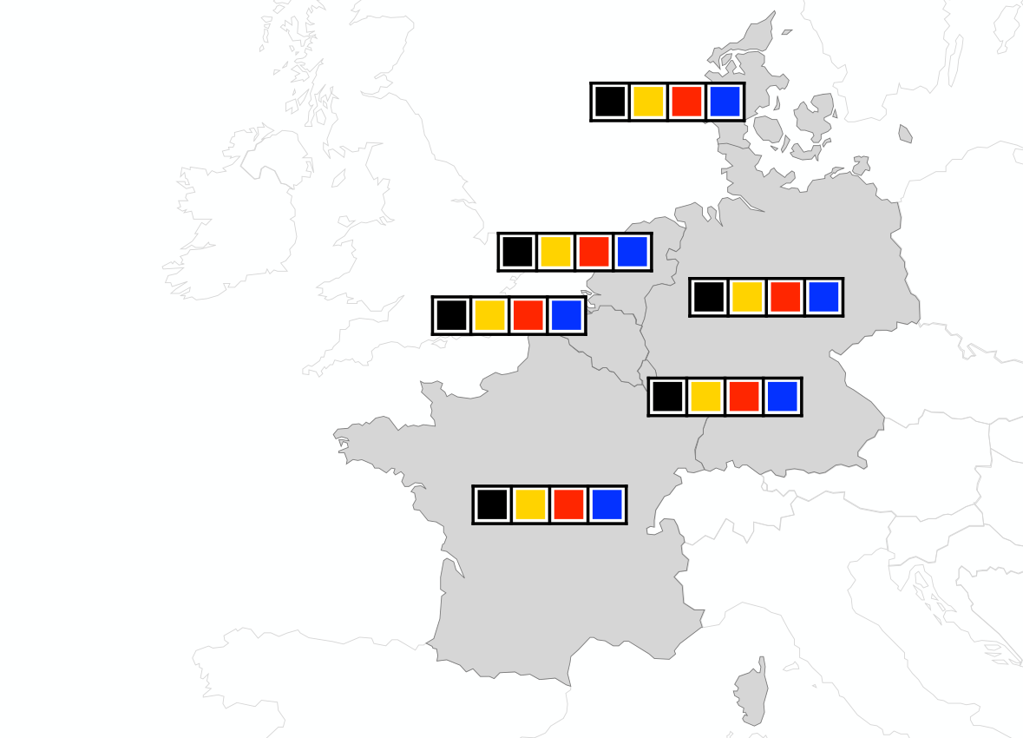
Map coloring problem
par int: nColors = 4;
var 1..nColors: Belgium;
var 1..nColors: Denmark;
var 1..nColors: France;
var 1..nColors: Germany;
var 1..nColors: Netherlands;
var 1..nColors: Luxembourg;
constraint Belgium != France;
constraint Belgium != Germany;
constraint Belgium != Netherlands;
constraint Belgium != Luxembourg;
constraint Denmark != Germany;
constraint France != Germany;
constraint France != Luxembourg;
constraint Germany != Netherlands;
constraint Germany != Luxembourg;
solve satisfy;

Slide 21
Enums, arrays, output
enum Colors = { Black, Yellow, Red, Blue };
enum Countries = { Belgium, Denmark, France, Germany, Netherlands, Luxembourg };
array[Countries] of var Colors: coloring;
constraint coloring[Belgium] != coloring[France];
constraint coloring[Belgium] != coloring[Germany];
constraint coloring[Belgium] != coloring[Netherlands];
constraint coloring[Belgium] != coloring[Luxembourg];
constraint coloring[Denmark] != coloring[Germany];
constraint coloring[France] != coloring[Germany];
constraint coloring[France] != coloring[Luxembourg];
constraint coloring[Germany] != coloring[Netherlands];
constraint coloring[Germany] != coloring[Luxembourg];
solve satisfy;
output [ show(country) ++ "\t" ++
show(coloring[country]) ++ "\n"
| country in Countries ];

Slide 22
Exercise
S E N D + M O R E M O N E Y
Find the digits marked by the letters, such that the addition of the two 4-digit numbers is valid
Different letters mark different digits, same letters mark same digits

