Slide 1
Global constraints
Operations Research

Slide 2
Basic n-Queens problem model
int: size = 8;
set of int: Board = 1..size;
array[Board] of var Board: queen;
constraint forall (i,j in Board where i != j) (
queen[i] != queen[j]
);
constraint forall (i,j in Board where i != j) (
queen[i] + i != queen[j] + j
);
constraint forall (i,j in Board where i != j) (
queen[i] - i != queen[j] - j
);
output [
if fix(queen[i]) == j then "Q " else ". " endif ++
if j == size then "\n" else "" endif
| i, j in Board
];
. . . Q . . . .
. Q . . . . . .
. . . . . . Q .
. . Q . . . . .
. . . . . Q . .
. . . . . . . Q
. . . . Q . . .
Q . . . . . . .

Slide 3
n-Queens model with alldifferent
int: size = 8;
set of int: Board = 1..size;
array[Board] of var Board: queen;
include "alldifferent.mzn"; % or include “globals.mzn”;
constraint alldifferent(queen); % queen[i] != queen[j]
constraint alldifferent([queen[i] + i | i in Board]); % q[i]+i!=q[j]+j
constraint alldifferent([queen[i] - i | i in Board]); % q[i]-i!=q[j]-j
♛
 |  | ♛
 |  |  |  | X | ♛
 | ♛
 |  |  |  |  |  | !
 |  |  |  |  |  |  | !!
 |  |  | !

Slide 4
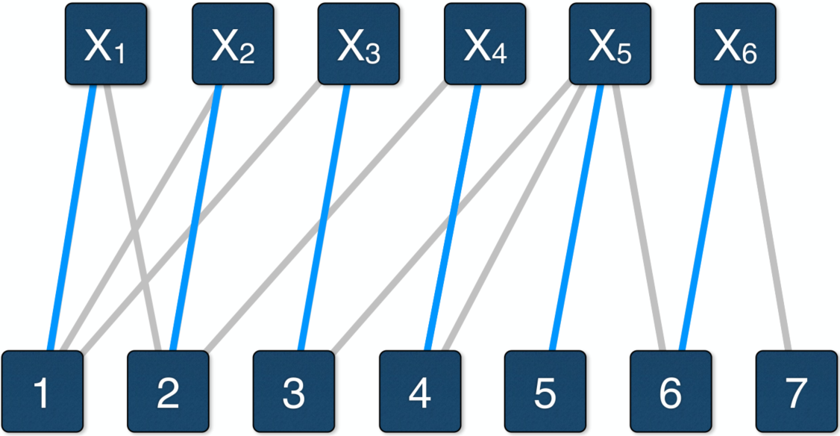
Propagator for alldifferent
Variables and their domains can be represented by a bipartite graph
If a variable’s domain contains a value, they are connected
An assignment which satisfies the alldifferent constraint, is a maximal matching that has as many edges as the number of variables
Matching: set of disjoint edges
There are efficient algorithms to find a maximal matching (alternating paths)
Edges that are not part of any maximal matchings are infeasible values of the variable
Notes:
x2 != 2 -> find a path x2-1-x1-2

Slide 5
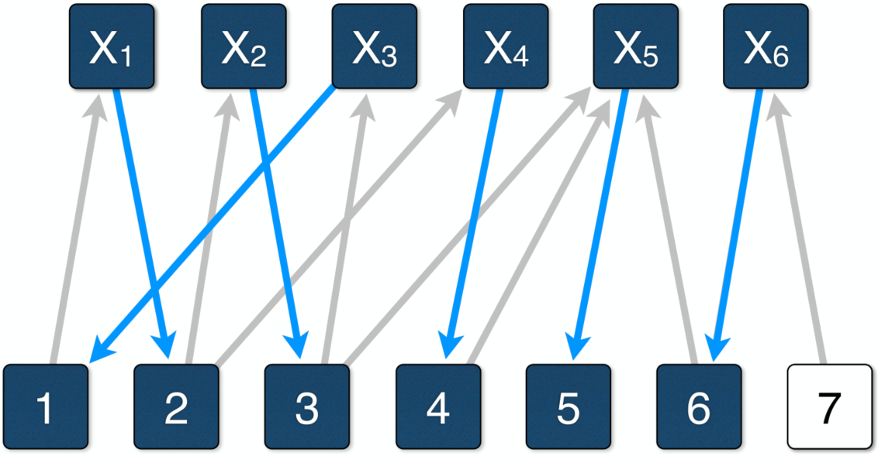
Propagator for alldifferent
Berge’s Theorem (1970): An edge belongs to some maximal matchings iff, given a maximal matching, the edge belongs to either
An even alternating path, starting at a free vertex
An even alternating cycle
X₄ ≠ 2 can be deduced
Notes:
x2 != 2 -> find a path x2-1-x1-2

Slide 6
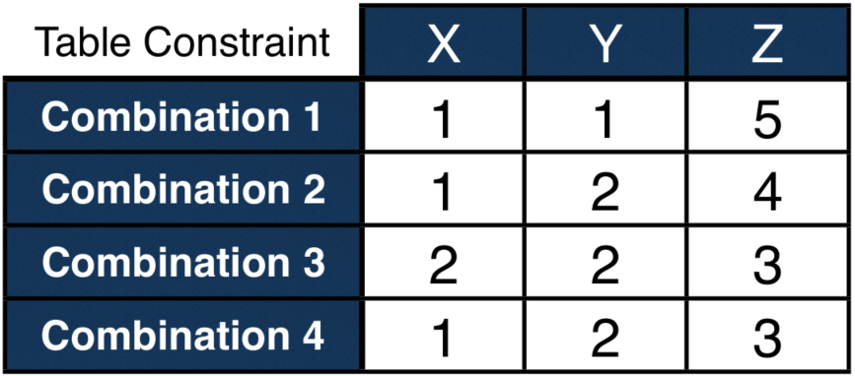
Some other global constraints
Table constraint: table(array [int] of var int: x, array [int, int] of int: t)
For an array of variables (columns), all permitted value combinations (rows) are listed
count(array [int] of var int: x, var int: y, var int: c)
There are c elements of x that are equal to y
increasing(array [int] of var int: x)
Values in x are in non-decreasing order
cumulative(array [int] of var int: s, array [int] of var int: d, array [int] of var int: r, int: b)
Given tasks with start times (s), durations (d), and resource usages (r), their total resource usage never exceeds b

