Slide 1
Force Sensitive Resistor Calibration

Slide 2
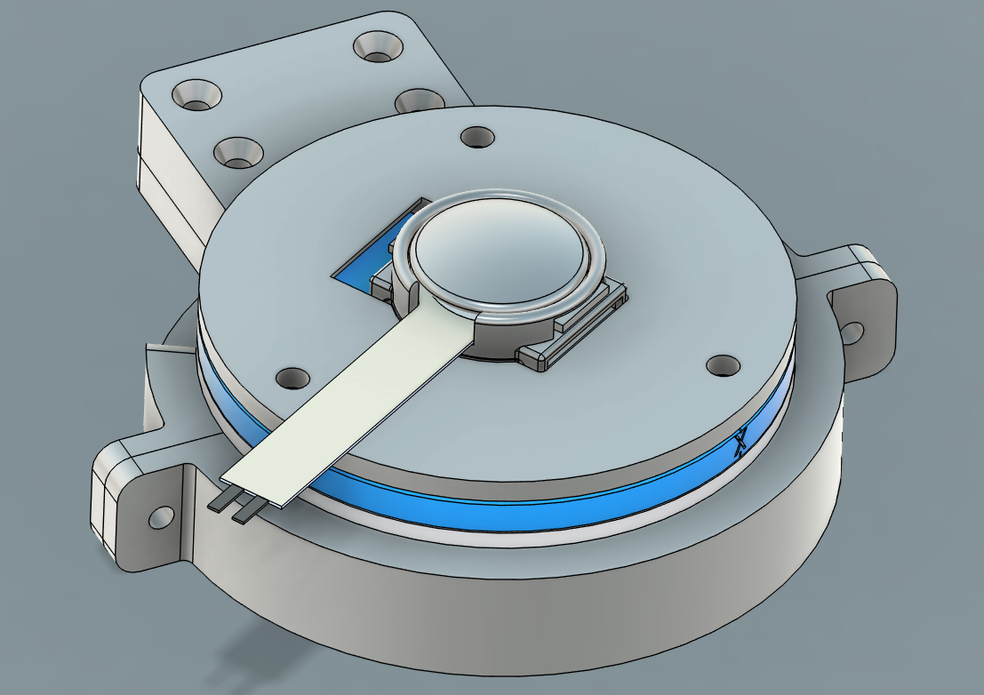
FSR Calibration Procedure
Training Data Collection
Use pressing machine to press [1,2,3,4….30] N for 2 seconds and then release for 1 second
Repeat 2 times
Testing Data Collection
Test Case 1: Use pressing machine to press [1,2,3,4….30] N for 2 seconds and then release for 1 second
Test Case 2: Use finger to press on the setup for [5,10,….30] N at random periods followed by release

Slide 3
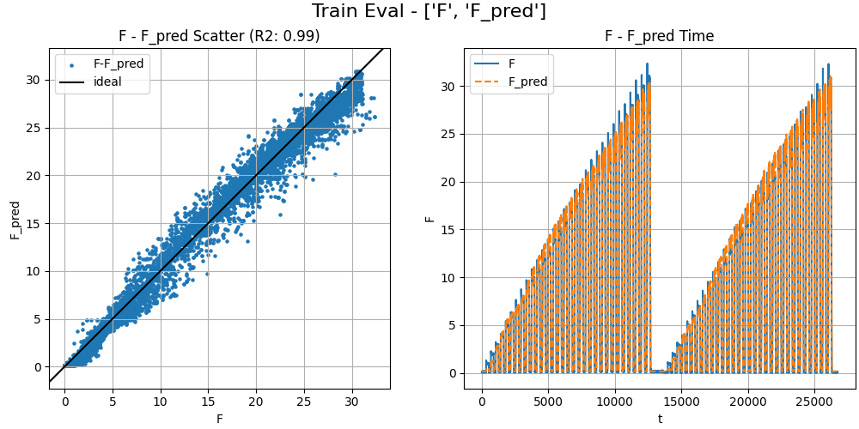
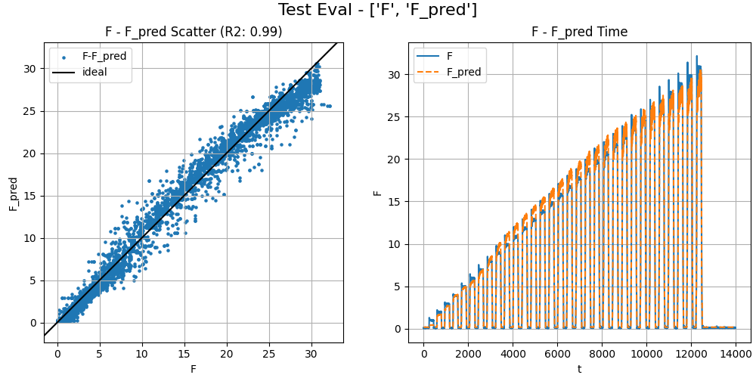
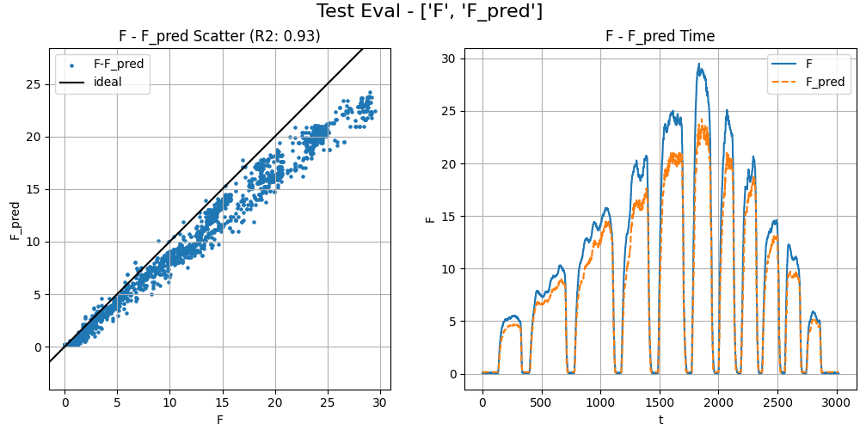
Sensor 1 Calibration Model Evaluation
Training Data
Test Case 1
Test Case 2

Slide 4
Test Case 2 Evaluation
Sensor # | R2 | Calibration Matrix (F=M(conductance)+B
F1 | 0.98 | M=9.63,b=8.40
F2 | 0.98 | M=9.62,b=8.45
F3 | 0.99 | M=9.52,b=8.09
F4 | 0.93 | M=9.54,b=8.23
F5 | 0.98 | M=9.42,b=7.83
P1 | 0.95 | M=9.80,b=8.76
P2 | 0.98 | M=9.90,b=8.76
P3 | 0.96 | M=9.79,b=8.17
P4 | 0.99 | M=9.77,b=8.49

Slide 5
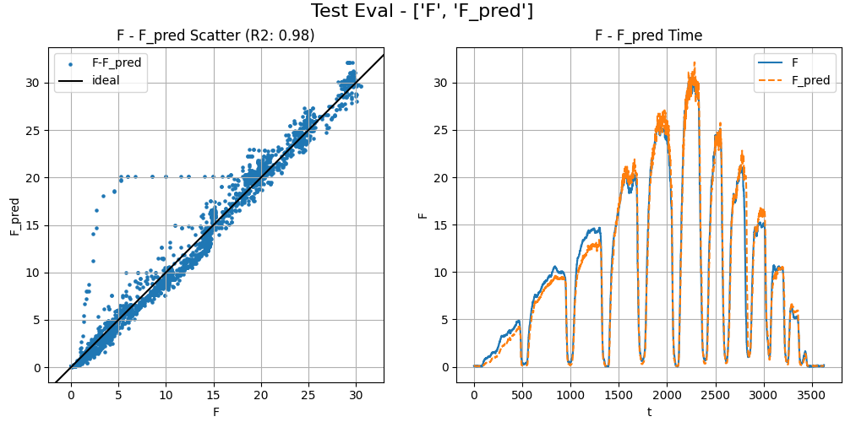
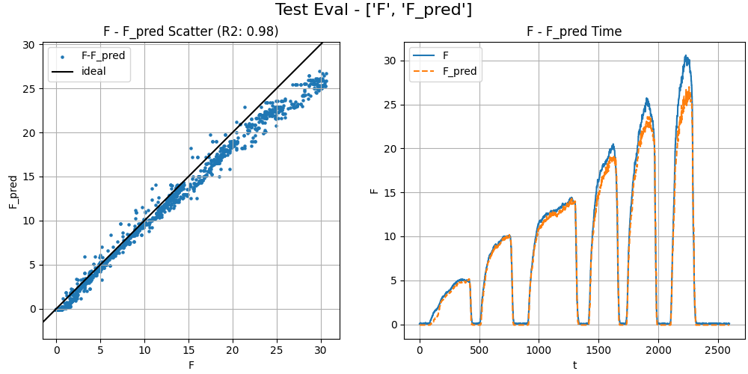
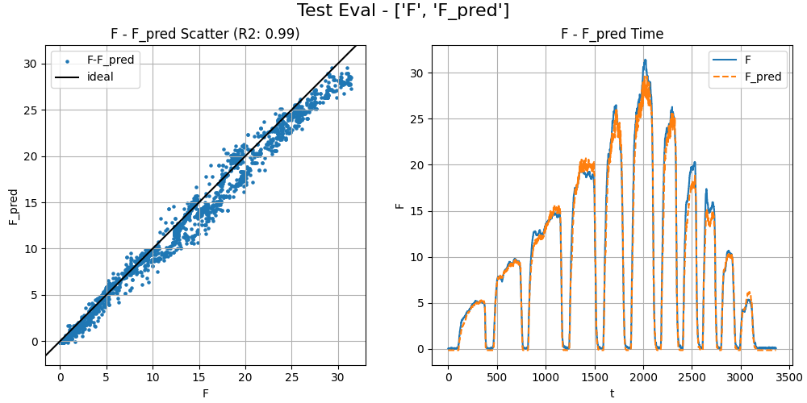
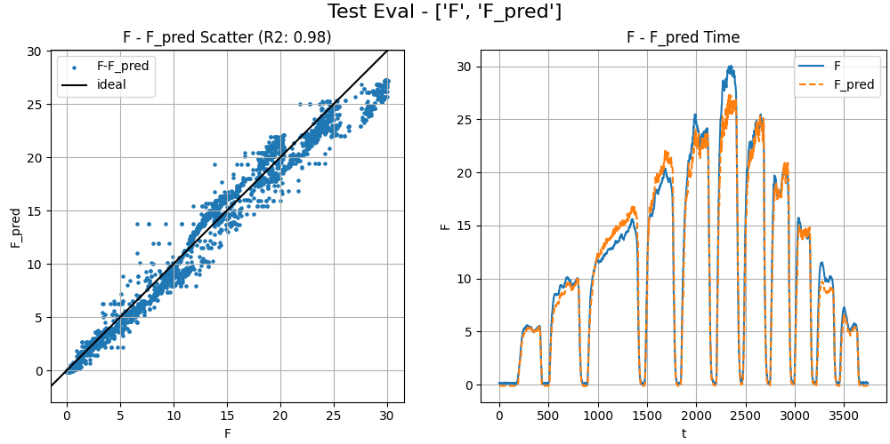
Test Case 2 Evaluation
F1
F2
F3
F4 (Worst Case)
F5

Slide 6
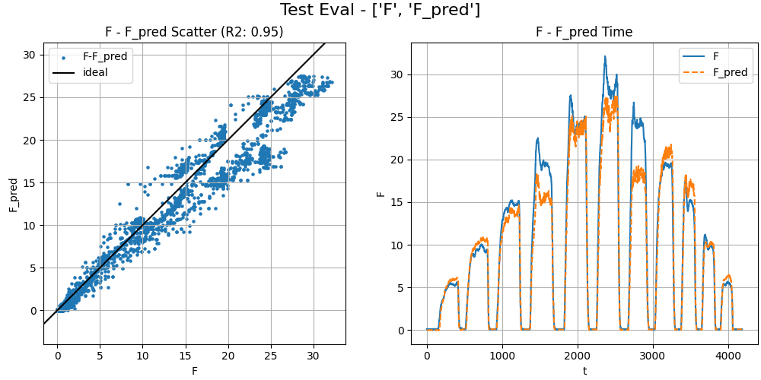
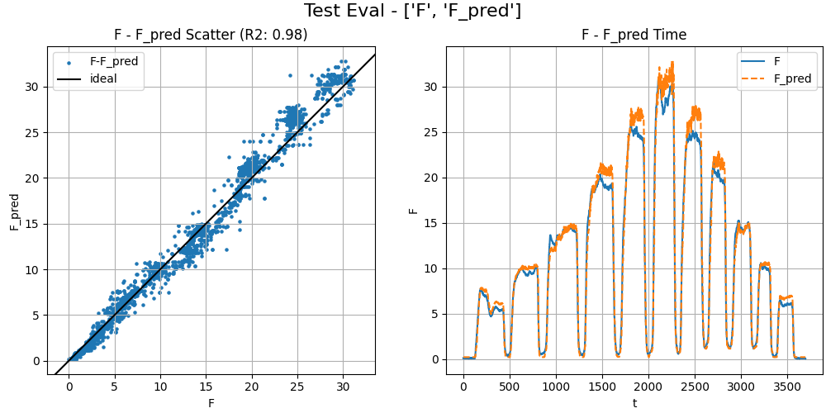
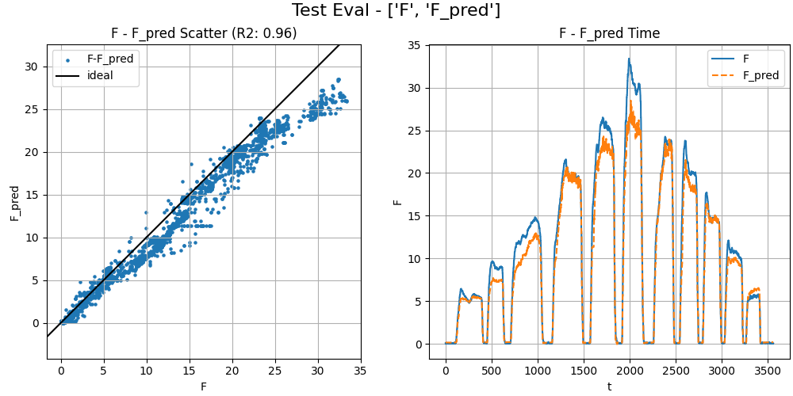
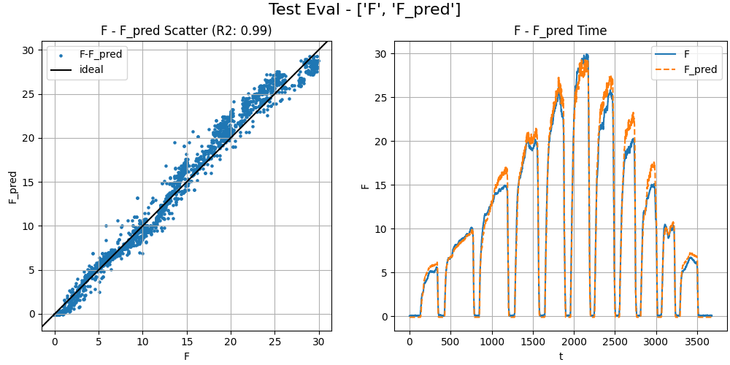
Test Case 2 Evaluation
P1
P2
P4
P3

