Slide 1
AN INTRODUCTION TO GiT
University of Leicester

Slide 2
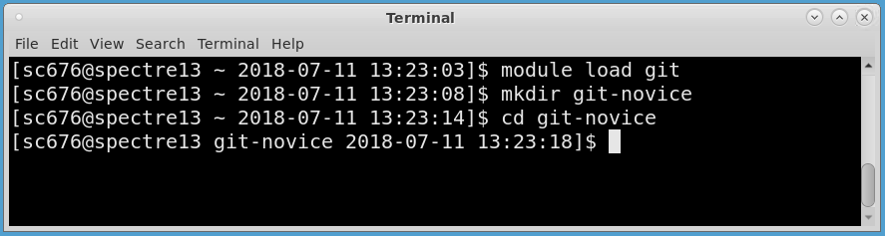
Resources and setup
https://uniofleicester.github.io/git-novice/
Log in to Spectre
Notes:
Today’s objectives:
Set up a new git repository
Commit new work to an existing repository
Explore the history of a repository
Collaborate with others via GitHub

Slide 3
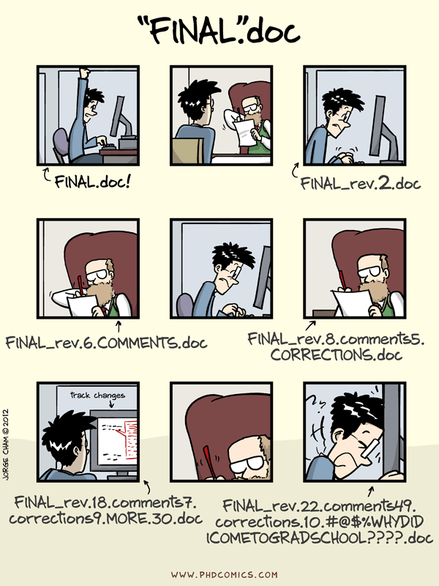
“Piled Higher and Deeper” by Jorge Cham, http://www.phdcomics.com
Notes:
Why Version control?
Who here has ended up emailing copies of scripts or paper drafts to their colleagues?
A document, or a collection of them, normally goes through several iterations before it’s ready. Sometimes our document is never ‘finished’, and is always evolving. This is true of a thesis, a single script, a collection of scripts, or a full code library.
The script starts off small, gets bits added to it, gets refined. Then a colleague asks to borrow the script. They also ask you to make some changes for their use.
In order to keep track of everything, we use versioning. We can always do that by just renaming the document ‘v2’. But that can get out of hand, and isn't very robust.
Happily, there are tools out there that have been developed to help with exactly those types of scenarios. That’s today’s topic.
(next slide): These are scenarios where it makes sense to use a version control system.

Slide 4
Why version control?
My script used to work; I changed it, and now it’s broken.
I wrote a good paragraph, decided to reword it, and now I want to go back.
I want to re-run an analysis from 6 months ago – which script version did I use?
I want to share code with my colleagues.
I don’t want to lose all my work if my laptop dies…
Notes:
We’ve probably all had one of these happen to us in the past. Version control can be used to tackle all of these problems, but it’s not a magic bullet – it has to be used correctly.
...Setting the scene for why we should use version control...

Slide 5
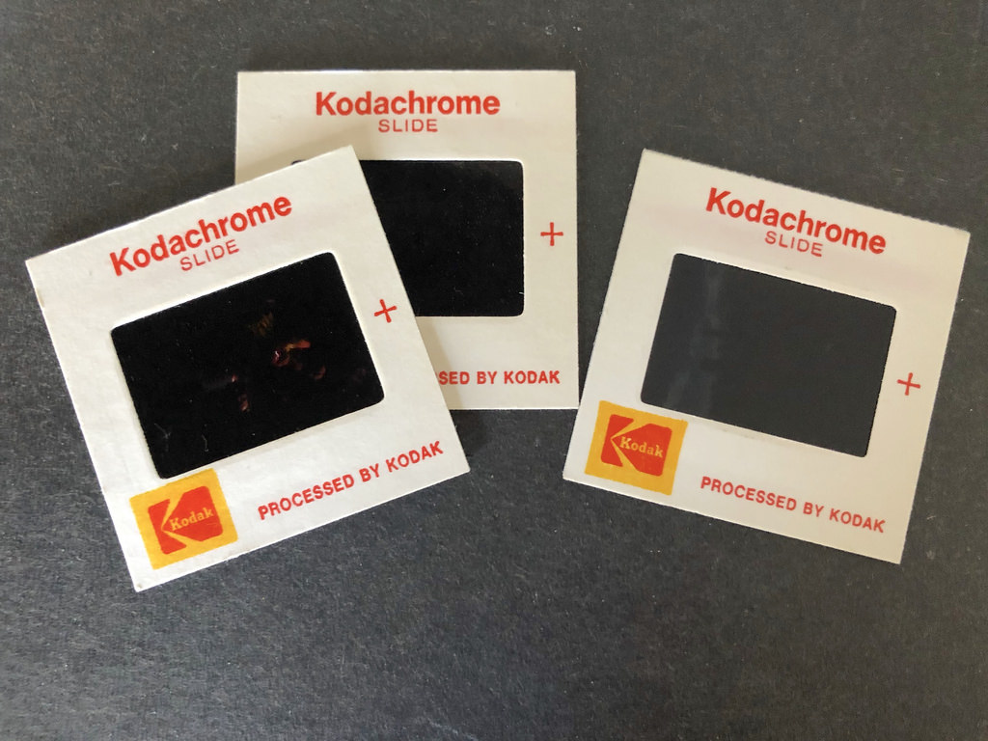
How does it work?
A B C
Notes:
So let's think about the basic ideas behind how version control works.
We can think of our work on a document as a sequence of changes. We start with some base state, and then make a series of changes to get to the final state. If you keep track of all of those changes, then you get to any point in history by playing those changes on top of the initial state.
This is *the fundamental idea of version control* - we don't need to store a copy of every version - just the changes to get from one to the next.
We can think of this as like a stack of slides, each one capturing the latest changes. So our first slide, at the bottom of the stack, contains our starting point. When we make some changes, we take a picture of those changes, and then we put that second slide on top of the first, and so on. In this way, we have a stack of slides, starting from the base, with each slides containing the changes made at that point.
If I want to get to point B in my history, I can think of that as ‘replaying’ one set of changes on top of the base state. That’s like taking the first 2 slides in my stack, aligning them, and then looking through them both together – that way I get the full picture.
If I want to get to point C, I can think of it as ‘replaying’ 2 sets of changes, first to get to B and then to C.
By adding up all the changes we made at each stage, we get to the final image of what the document looks like.
This is a very powerful way of thinking about the history of a document, and is the basis of version control systems.

Slide 6
Make Different changes
Notes:
Now we get a bit more complicated.
Imagine two people want to work on the same document. Then we can give them both a copy of the document, and allow them to make their own changes to their own copy.
Now both people have a different version of the document. The final step in version control is to merge those two sets of changes together to give us a new version. This process is called merging, and is how you share changes between users, so that everyone's changes get combined into the new version of the document.
We can also have the same user making 2 sets of changes to the same code file at the same time.
Perhaps I’m in the middle of adding a new functionality to my code, but at the same time I realise I made a typo in another place, and I want to fix that right away while I remember.
The top line is my ongoing work on new functionality. With a version control system, I can go back to before I started added the new function, just make the edit to correct my typo, and once that is fixed, I can go back to adding new functionality. I can logically separate that from the typo fix, so it’s much clearer why I changed that bit.
Finally, I need to merge the new functionality into my corrected code.
All of this would be very difficult and error-prone if we tried to keep track of all this by hand. Instead, we can use a version control system to make that easier.

Slide 7
Why git?
There are many version control systems – Git, Mercurial, Subversion, etc.
Git is just the most popular.
Almost everything we discuss today is relevant to all the other systems
It’s just a different syntax.

Slide 8
SETTING UP GIT
https://uniofleicester.github.io/git-novice/
Notes:
We've just done lesson 1 already as we talked.
_Note down the current time._
Now go to lesson 2, 'Setting Up Git’. Work through it on the screen. Ignore the ‘proxy’ bit.
Let users go through lesson 3 (skim it on screen first). Highlight the exercises to be looked at. When everybody’s done, go through lesson 3 on the screen as well.

Slide 9
Tracking changes
Notes:
_Note down the current time._
We have a file and make some changes to it.
We don’t have a single command to ‘save’ that change into the history. This is to give more control over what you want to save. We’ll come back to that in a moment.
So what do we do, and we’ll come back to why in a second?
Let's go back to the metaphor we used earlier, about how version control is like a stack of slides of all the changes you make.
Imagine you’re a photographer. You don’t just take a photo of everything without thought. Instead, you arrange the scene. You decide what you do and don't want in shot, before taking the picture.
We have a similar idea in version control. We use the ‘staging area’ to arrange what we want to be in shot, and then, when we have everything arranged as we want, we take our photo or snapshot. We call the first action ‘staging’, and the second ‘committing’.
In git language, we arrange the scene by using ‘git add’. This places the things we want into shot in the ‘staging area’.
When we are happy with the scene we’ve set up, we take our picture, with the ‘commit’ command. That generates a snapshot. We can then place that snapshot on the top of our pile of previous snapshots.
These snapshots are then referred to as 'commits' - so we use the 'git commit' command to create one 'commit'. And we end up with a stack of 'commits', starting from the 'base commit', and building up from there.

Slide 10
Tracking changes
Notes:
We don’t need to restrict a change to a single file. We can take all the changes we've made from multiple files, and bundle them up all at once into a commit (go through image).
In fact, version control is best used when we base the snapshots on logical atomic changes, that is, a collection of edits that logically fit together to make a single change.
These should be atomic, e.g. small, indivisible. If you have a change that can be split logically into two changes, it’s often better to do that.
But that doesn’t mean you have to go down to the single file level.
For example, imagine I’m writing a novel, each file contains a chapter, and I’ve just changed the name of my main character. I do a find and replace on all the files, and then add all of those individual edits onto the stage at the same time. Otherwise, if I did it on a file-by-file basis, my history would look odd – my main character would be called Steve throughout at first, then there’d be a snapshot where he’s called Dave in chapter 1, but Steve from chapter 2 onwards. Then in the next snapshot he’d be called Dave in chapters 1 and 2, and Steve from chapter 3 onwards. etc etc.
So in summary, we can put multiple edits in multiple files together on the stage at once. And we should try to bundle up changes across files, if necessary, so each snapshot is consistent. But we shouldn't put unrelated changes into the same commit too often - git works best when we use atomic logical changes.

Slide 11
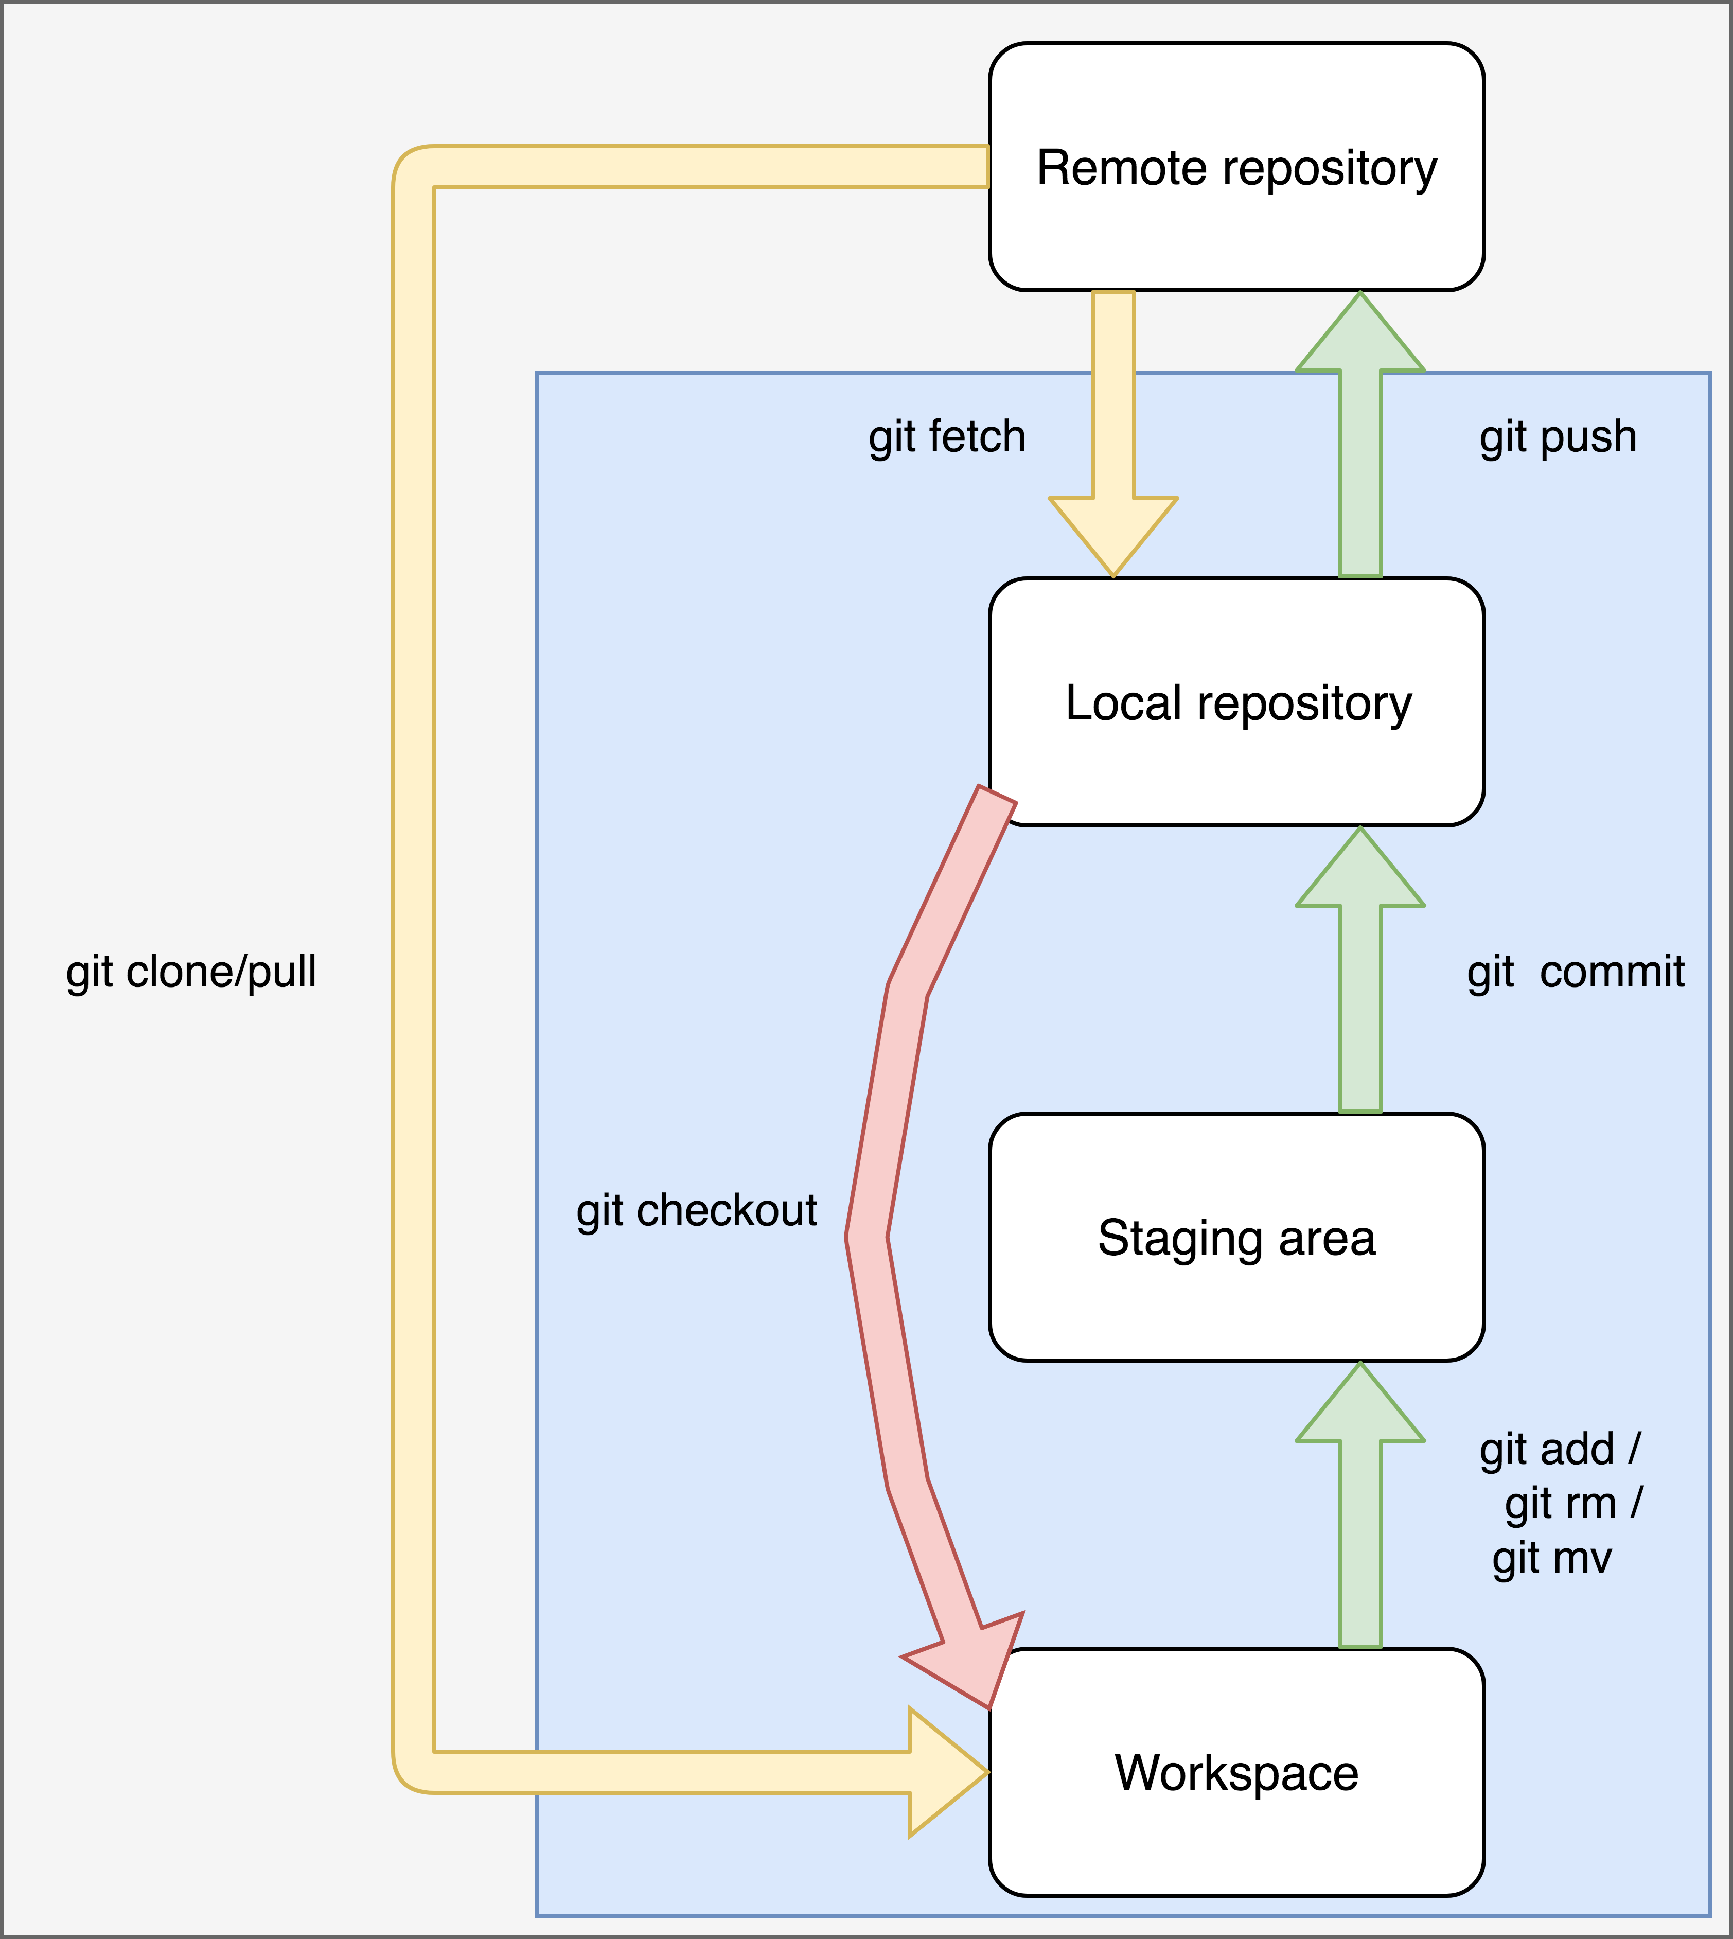
Notes:
Look at how what we’ve seen so far fits into the full git workflow.
Git add moves changes we’ve made onto the staging area, and when we’re happy, we take a snapshot with ‘git commit’. That then becomes a new snapshot on our stack of snapshots that give us our full history in our local repository.

Slide 12
Your turn!
https://uniofleicester.github.io/git-novice/04-changes/
Notes:
Use newly-created repository to make your first commits (changes), learn how to investigate the current status with ‘git status’, and see the stack of commits with ‘git log’. Also introduces git diff.

Slide 13
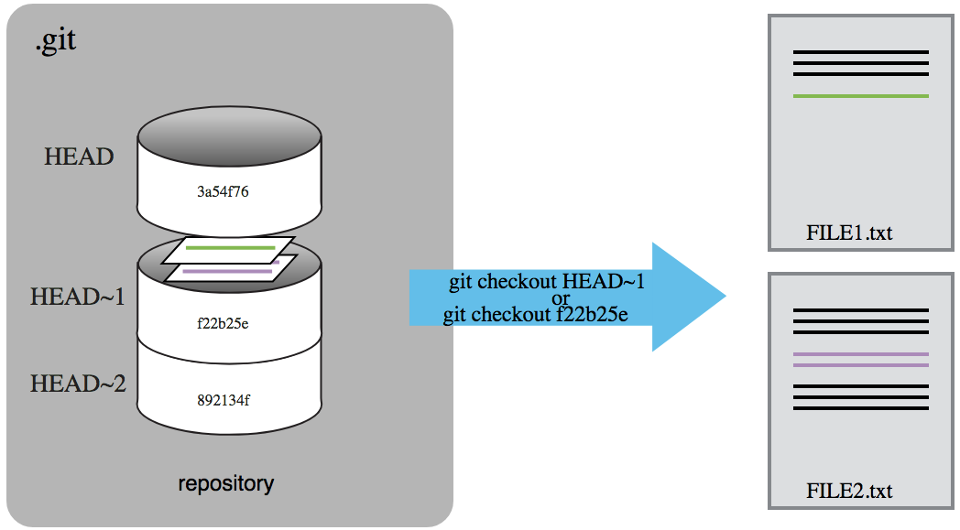

Exploring History
Notes:
Suppose we have staged and committed several times. We now have a full history of our repository, that we can think of as a stack of commits (snapshots): the bottom snapshot is the original, and then we build up to the most recent commit on the top.
We want to be able to talk about our commits, and there are two ways to do this: (1) Each commit has a unique name (hash), which is a string of letters and numbers. You saw this with the ‘git diff’ command in the latest lesson (4).
(2) We have a pointer called HEAD. This points to where we currently are in the history. We can then refer to all the earlier commits by how far back they are from HEAD. So the previous commit is HEAD minus 1, the one before that is HEAD minus 2 etc.
We write that as HEAD~1, HEAD~2 (with a tilde).
So now we have two ways to refer to commits – either by their hash, or by how far back in history they are from HEAD.

Slide 14
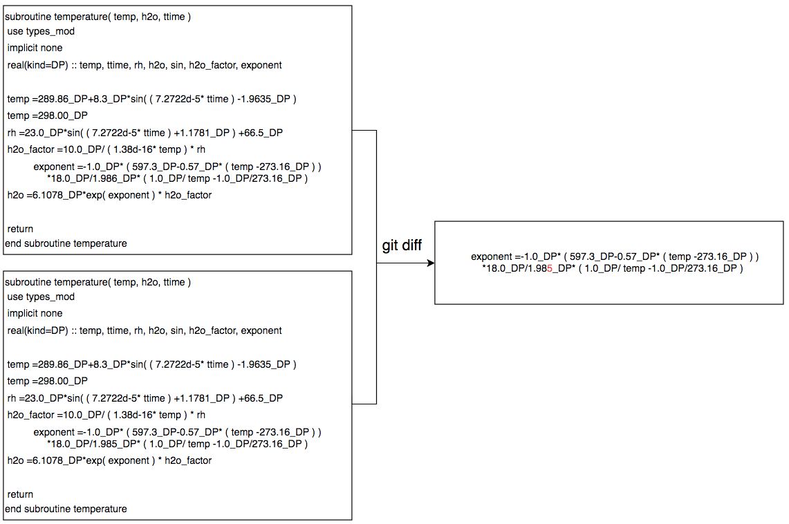
Comparing across history
Notes:
In the previous lesson, we saw the git diff command. This shows us what’s changed over history. Often this is very useful, as we’re only interested in the changes rather than the bits that stay the same. For example, say I have a long piece of code, and I made some changes to it in the previous change. I can spend all day looking at the before-and-after snapshots, but it might be quite difficult to see what that change did manually. If I instead compare what happened before and after by asking “what’s changed?”, it’s much clearer what’s happened.
What we’d like is something like we have here:
We achieve this by using the git diff command. This is very much like the Unix diff command. It just shows us what has changed. Let’s look at a couple of examples to make sure we all understand what the diffs mean when we look at them.

Slide 15
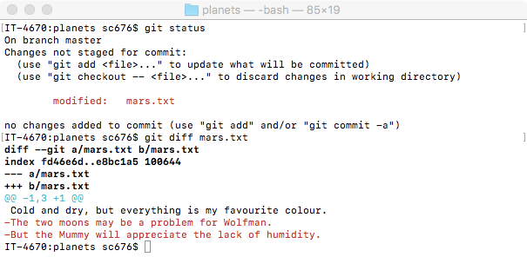
Comparing across history
Notes:
First part is just checking what I have in my repository – I’ve made some changes to mars.txt.
So I run the command git diff mars.txt.
This says ‘show me the differences between what’s currently in mars.txt against what’s most recently committed in mars.txt.’
The first line shows the command being run, and the next is some extra information that we can really ignore, but the system uses to make it look like Unix diff. That’s useful if we want to build automation or anything else on top.
Finally, we get to what we’re interested in. The line in blue tells us the location of the change, and then we see the actual change being made.
The black line is unchanged, but is shown here to provide some context - . The two lines below have a minus sign at the begin, indicating they’re removals. So we interpret this as saying that at HEAD, the file mars.txt contained all 3 lines, but currently, after editing but before staging, the file has had the last two lines removed.
Sometimes the output will be colorized, as here – red indicates removal, green indicates addition – but that depends on your system settings. Instead, the information is really contained in that first column – minus is removal, plus is addition.

Slide 16
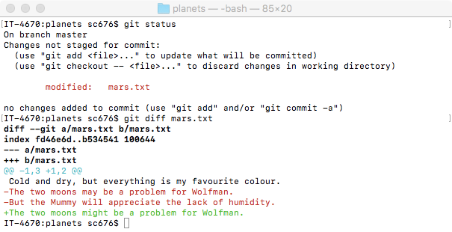
Comparing across history
Notes:
Here’s a very similar example, to show how alterations are shown.
Git is line-based. That is, when it’s looking to see whether there are differences in a file, it splits it up into lines and compares those. So if there is a single change within a line, it treats that whole line as being changed.
In this example, I started off with the top 3 lines. I removed the line about the Mummy entirely, but I’ve kept the line about Wolfman, but only modified it slightly – ‘may’ becomes ‘might’. Note that git treats this as though I removed the line entirely and then added a new one, because it’s noticed a difference.
We have a plus on the left to denote an addition. So git is treating a small change to the line as the removal of the old one and then addition of a new one.
Note that I could have just called ‘git diff’ – if you don’t supply a file to compare, git will do the comparison for all the files that have changed in this directory.

Slide 17
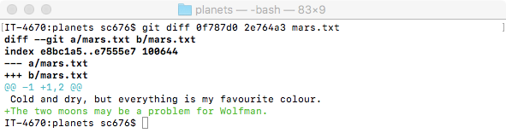
Comparing across history
Notes:
We was in the previous lesson how to compare what we have currently with the last commit – but we can do better. We can compare between any two points in history! To do that, we have to tell git which two points in history to compare – either by hashes or by using HEAD~1 etc.
In this example, I’m comparing between my first and second commit in history, using the hashes of those commits. I can see that I added the second line. I could do this between any pair of commits, they don’t need to sequential – I could compare between the first and last commits, and see the combination of all the changes I’ve made.

Slide 18
YOUR TURN!
https://uniofleicester.github.io/git-novice/05-history/
Notes:
This covers git diff, git show, and git checkout. And git revert.
_Check time_
Go through exercises at end to check understanding.
_ Check time_
Next slide is for git checkout (of commit and of one file) – can be used if further explanation required.

Slide 19
Navigating through history
Notes:
In addition to seeing how things have changed between commits with the diff command, we can also go back in time and view what the repository was like at a certain point in history. This is done with the checkout command.
So for example, suppose I have just staged committed a change. That latest change is called HEAD. I want to see what the repository looked like before that commit. I do
git checkout HEAD~1
This will change the state of all the files in my repository so that they are just like that point in history. I can now read those files, and they will contain exactly the contents they had at that point in history.
Now that I've done that git checkout, note that my HEAD has changed - HEAD points to where I am currently, and, as I've now moved, HEAD moves to point to where I am now. So I can go further back in history by saying
git checkout HEAD~1
for example. This will take me one commit further back. Note that I could have also referred to each of those by their hash, rather than HEAD~1, HEAD~2: I’d have used
git checkout f22b25e or git checkout 892134f
instead. Either way is identical, but one may be easier in some circumstances.
Once I’m done looking at history, and I want to start editing again, I first need to move forwards in history to the latest commit.
git checkout master
I’m now ready to make changes and new commits as normal.
Finally, git checkout can also be used on a file-by-file basis. E.g. git checkout HEAD~1 FILE1.txt
Here, I stay at HEAD in general, but I’ve checked out an old copy of the single file FILE1.txt. I can explore FILE1.txt as it was before, and if I want to I can stage and commit this version of FILE1.txt – then my new version of FILE1.txt is as it was back then. To bring my FILE1.txt back to its latest version again, I do
git checkout master FILE1.txt

Slide 20
YOUR TURN!
https://uniofleicester.github.io/git-novice/06-ignore/
Notes:
Explain difference between gitkeep (not special file, but convention) vs .gitignore (special file – git reads it and follows the rules inside).
Cut off fairly fast (don’t allow all exercises to be done). Get users to create a GitHub account (with @le.ac.uk if poss), and go for a break.

Slide 21
Register for github
https://github.com/
Sign up for GitHub
Verify account via email
Notes:
If you already have a GitHub account, make sure you know the password, and that it’s linked to an email address that you also know the password for!
Go through lesson 7 at https://uniofleicester.github.io/git-novice/07-github/

Slide 22
Notes:
Look at how what we’ve seen so far fits into the full git workflow.

Slide 23
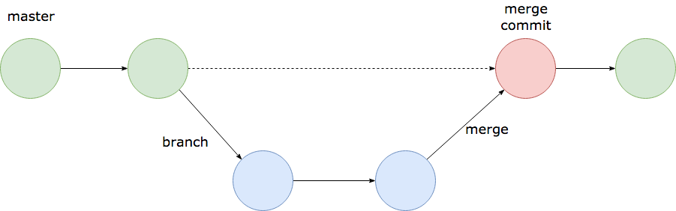
Branching
Notes:
Work on a branch is not in master – keeps things clean!
Other users can just use master as normal.
Merge at the end _into master_. We refer to this as ”merging branch into master”.

Slide 24
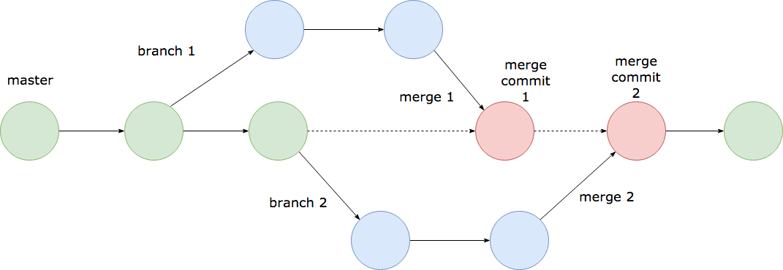
Branching
Notes:
Why do we want to do this? Because now we can do more complicated things!
Both branch 1 and branch 2 can be worked on separately.
Conflicts need to only be managed at the merge point.
We can do all of this with commands from the command line – ‘git merge’ being the principal one.
But we can also use the GitHub interface to help us. The way we do this is through Pull Requests.
Do lesson 10. Branching to see how we make a branch, then use GitHub to handle the merging part.

Slide 25
FEEDBACK
https://leicester.onlinesurveys.ac.uk/sdcct101ivc2018v01
or
https://tinyurl.com/ycrtjzes

