Slide 1
SLURPY!
KDI project by Agrusti Enrico, Buffa Mattia, Gallo Denis

Slide 2

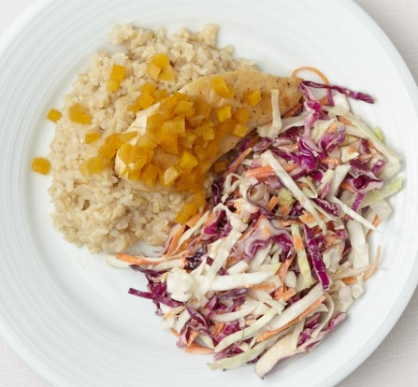


Scenarios and Personas
Mango-Cango Chicken
Paola

Slide 3

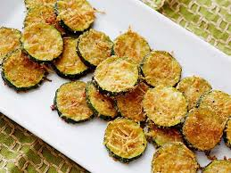


Scenarios and Personas
Zucchini gratin
Giovanni

Slide 4



Scenario and Personas
Cinzia

Slide 5



Scenarios and Personas
Giulio

Slide 6




Inputs

Slide 7


Tools

Slide 8

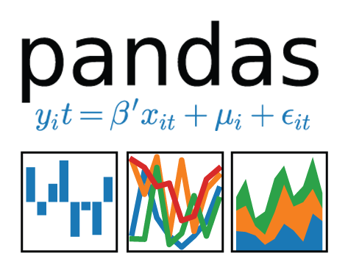


Modeling
Notes:
AIOHTTP & ASYNCIO

Slide 9

Data extraction
Recipe 1
Features 1
Recipe 2
Features 2
Index webpage
Recipe 3
Features 3
JSON file
Recipe N
Features N

Slide 10
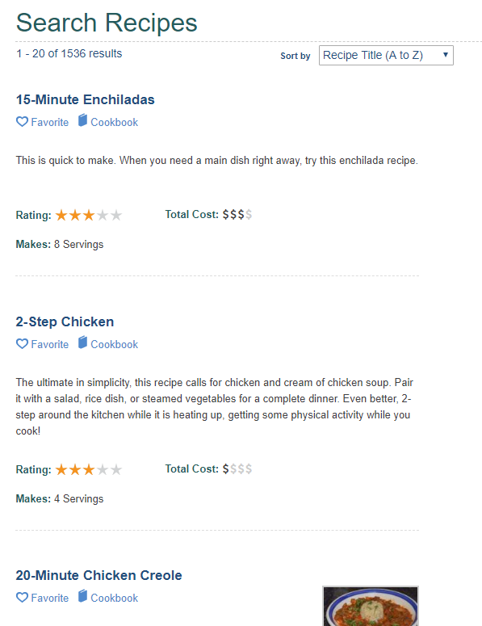
Data scraping
[
“/food-distribution-fdd/15-minutes-enchiladas”,
“/supplemental-nutrition-assistance-program-snap/2-step-chicken”,
...
]
[
[
"15-Minute Enchiladas",
"This is quick to make. When you need a main dish right away, try this enchilada recipe. ",
...
],
...
]

Slide 11

Importing in Rapidminer
JSON file

Slide 12
Cleaning, merging
[
[
"4 cups low-sodium vegetable or chicken stock",
"1 cup dried brown lentils",
"1/2 cup dried French green lentils",
"2 stalks celery, chopped",
"1 large carrot, peeled and chopped",
"1 sprig fresh thyme",
...
],
...
]
[
[
["ep1", "4", "cups", "vegetable or chicken stock"],
["ep1", "1", "cup", "dried brown lentils"],
["ep1", "1/2", "cup", "dried French green lentils"],
["ep1", "2", "", "stalks celery"],
["ep1", "1", "", "large carrot"],
["ep1", "1", "", "sprig fresh thyme"],
...
],
...
]

Slide 13
Ontology schema.org
Thing
name | Mom's World Famous Banana Bread
description | This classic banana bread recipe
hasCreativeWork
HowTo
estimatedCost | 20 USD
step | Mix in the ingredients.
supply | sugar
tool | oven
yield | 1 loaf
hasRecipe
hasPerformTime
hasPrepTime
hasTotalTime
Recipe
cookingMethod | Frying
recipeCategory | appetizer
recipeCuisine | Italian
recipeIngredient | 3/4 cup of sugar
recipeInstruction | Preheat the oven to 350 degrees.
recipeYield | 1 loaf
hasNutrition
isSuitableForDiet
hasCookingTime
Nutrition
hasCalories
hasFatContent
...
Calories
energy | 240 calories
CreativeWork
hasHowTo
hasAuthor
Fat
fatContent | 9 grams
Author
author | John Smith
CookTime
cookTime | PT1H

Slide 14
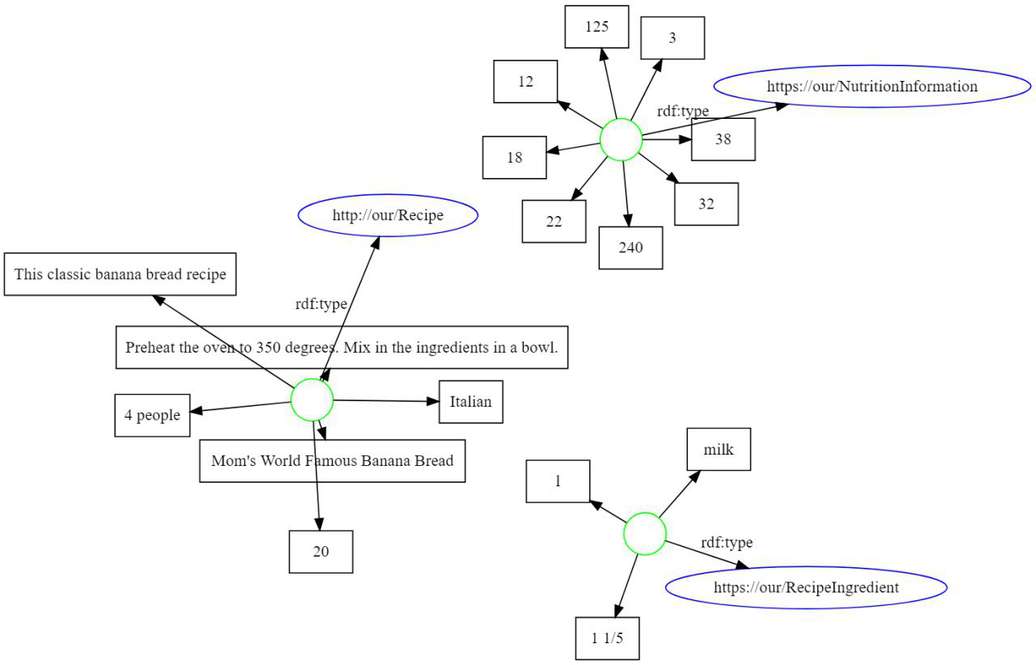
Proposed ontologies
Sugar
Fat
Calories
Description
Instructions
Serving
Cuisine
Title
Name
Unit
Cost
Quantity

Slide 15
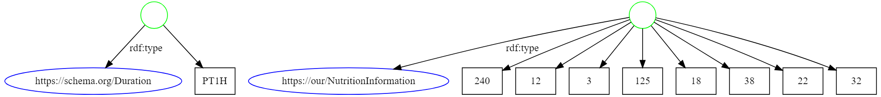
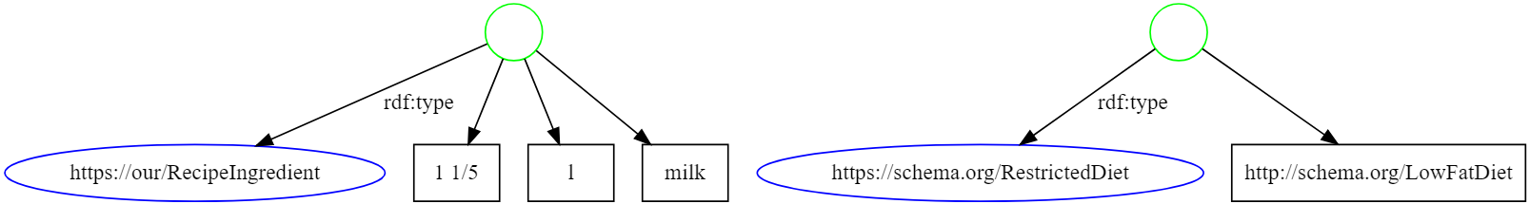
Proposed ontologies
CookTime
Category
CookingMethod
SuitableForDiet

Slide 16


Data Integration - Problem
I want to eat mexican!
I don’t provide cuisine types!

Slide 17
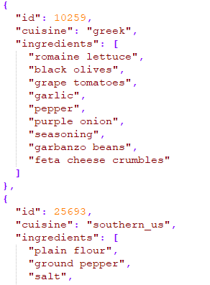
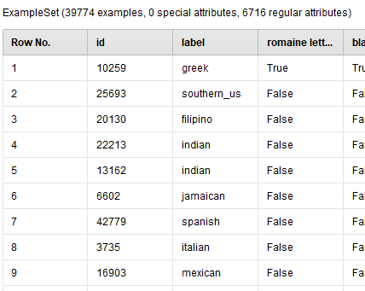
Data Integration - Setting up the ML

Slide 18
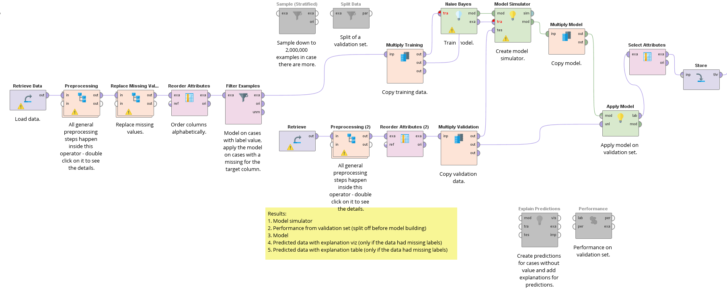
Data Integration - Pipeline

Slide 19
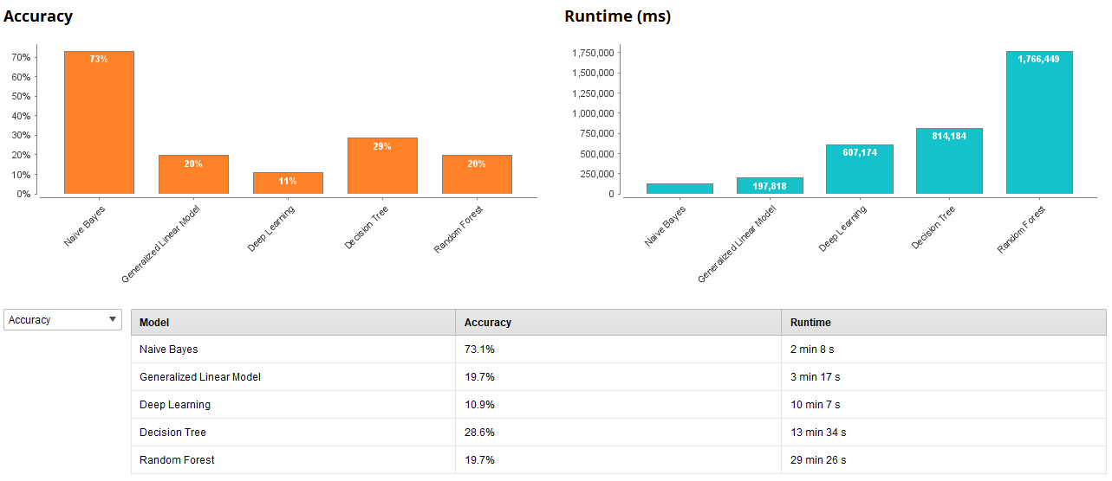
Data Integration - Accuracy

Slide 20
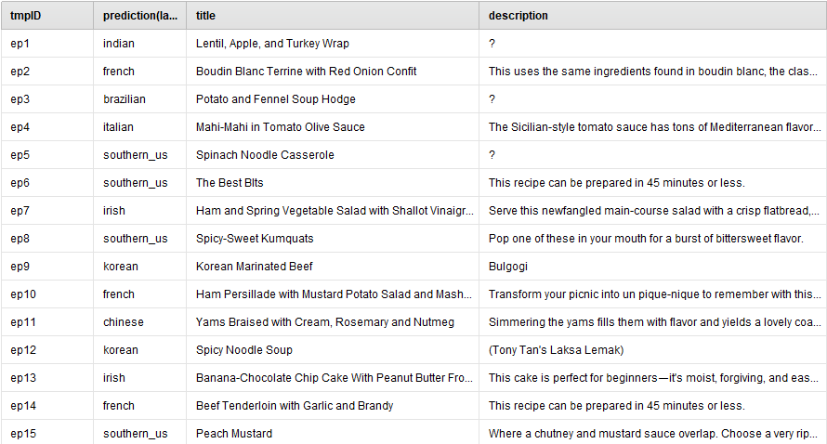
Data Integration - Results

Slide 21
Thanks!

