Slide 1

Developed and Presented by:
Joshua Boudria
Adam Emerson
Ho Anh Tuan Vo
Kevin Flores

Slide 2

Our purpose
Goals:
To create a community
Connect students
Get students involved
Notes:
To create a community: “We want to connect both students and staff by allowing students to easily see details of events created by the staff.”
Connect students: “By allowing students to easily see when events are held that interest them, they will be able meet other like-minded peers.”
Get students involved: “UTA has struggled in the past with getting its student body involved. With this new app we designed we hope to get UTA students into the Maverick spirit!”

Slide 3
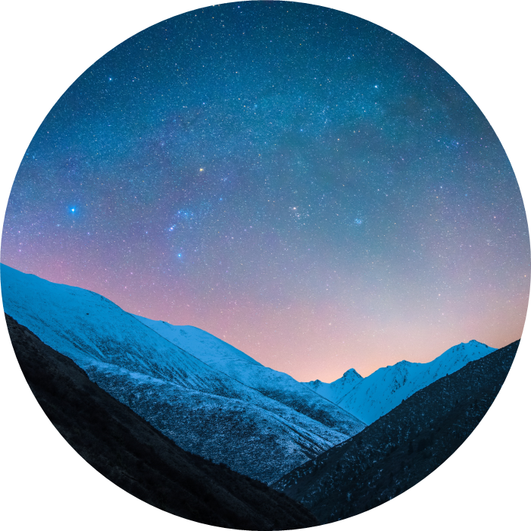
How?
We will present 3 main features such as…
Event cards on a feed, based on interests
Notification system that will update the user over any changes to events or upcoming events on their schedule
Settings tab that will allow users to adjust the app to their preferences including their interests
Notes:
Events will be presented individually on a feed. This is where students will be able to get an overview of the upcoming events at UTA. There is an ‘Info’ button where the user can

Slide 4
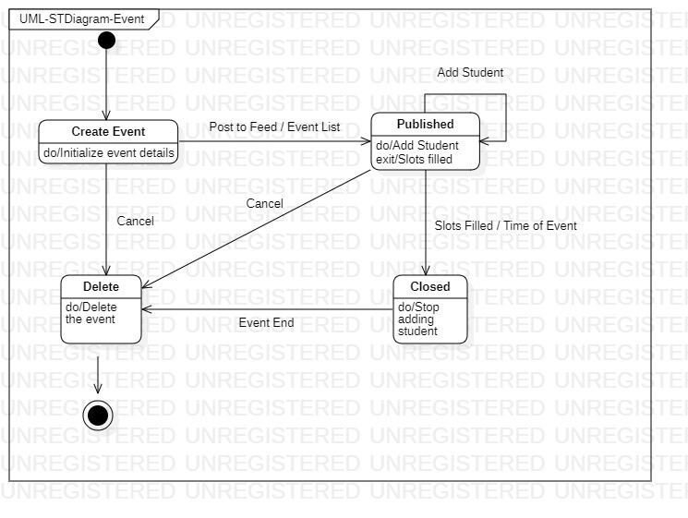
Events
Who? – Anyone
What? – Event titles with their organizer name and description
When? – Dates and times given and placed on Schedule
Where? – Locations and necessary addresses are given
How? – Finished and saved events will be placed on other student's feed
Notes:
This is the bulk of our app. This is the main resource on how students will view and sign up for events.
Who? – “Anyone can access an event at any time as long as the time of the event has not passed the current date.”
What? – “Events will list their description and their purpose in order to draw in interested students.”
When? – “Events will be given a start and end time. These times will be displayed on their schedule which will be covered later.”
Where? – “Locations and addresses will be on the event info”
How? – “When an event is completed in the ‘create event’ process, the event is then published to all students feed. What is the feed you may ask?...” (next slide)

Slide 5
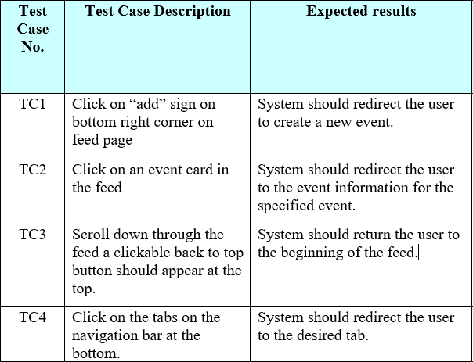
Feed
Accessible through task bar
Feed will show a list of events in their respective priorities
Interests
Date/Time
Info button is presented to learn more about an event
Notes:
At the bottom of the page there will be a task bar that serves as the menu. This menu will allow users to access 4 of our features. Home feed, Notifications, Schedule, and Settings.
The feed will present events based on 2 factors. The priority will be presented based on the interests of the user and then by date and time.
Each card will come with an ‘Info’ button that will allow the user to view the description of the event. This includes the date and time, description, and number of members attending.

Slide 6
Feature two
Schedule and Notifications

Slide 7
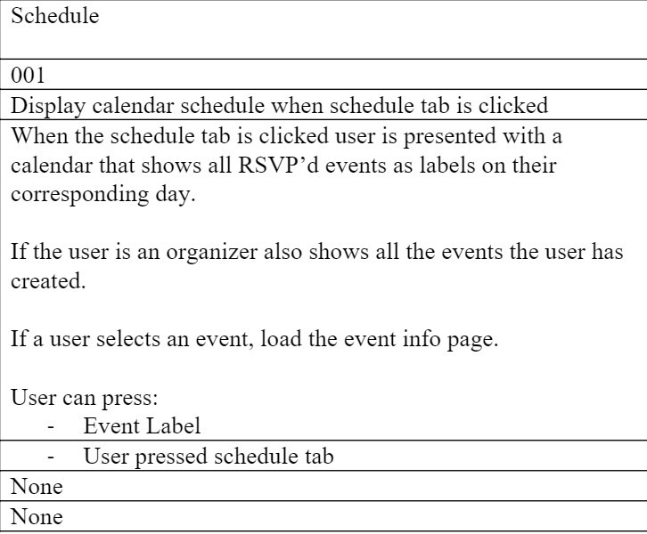
Schedule
Accessible through task bar
Shows upcoming events students has signed up for
Displays by date
Event card will redirect you to event information
Upcoming events will send a notification on day of
Notes:
Schedule is another feature accessed through the task bar. The schedule will begin by starting the current day along with its upcoming events. At the top there will be a scroll option where users are able to view upcoming dates or previous ones.
Users can click on an any event on their schedule and will be redirected to the corresponding event card.
Should there be an event coming up for the current date, their will be a notification sent to the phone to remind the user.

Slide 8
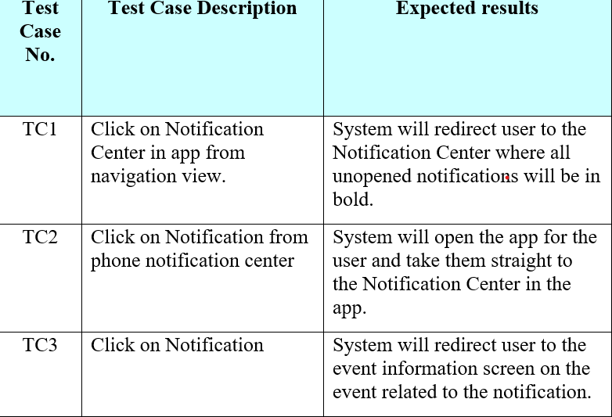
Notifications
Accessible through task bar
Displays all notifications, including previous ones
Unviewed notifications will be in bold
Clicking on the notification will redirect you to event it pertains to
Notes:
Another feature accessible through the task bar.
This is a scrollable list that presents all notifications, including ones that have and have not been viewed. Unviewed notifications will be bolded for users to easily find information they have not seen.
By clicking on a notification, they will be directed to the corresponding event. This is when the notification is clicked on in the menu.
When the notification is clicked on in the locked screen or notifications screen on the phone itself, they will be redirected to the event card.

Slide 9
Feature three
Interests and Settings

Slide 10
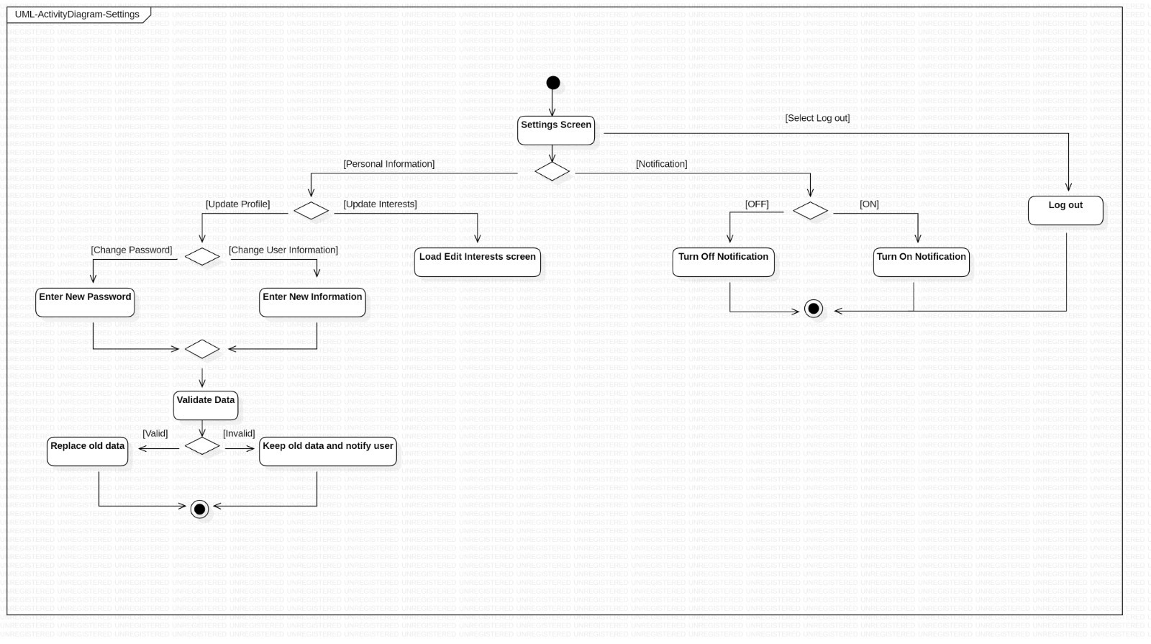
Interests are categories that events fit into
Filter the event feed
Changeable at any time through the settings tab
User can also change personal information in settings
Settings are accessible through task bar
Notes:
Interests are the categories which events are divided into. Each category pertains to either a major such as Engineering, Art, or Business. They also include general school activities such as fraternities/sororities, robotics, or sports.
These interests are what help the user to see events on their feed that interest them the most.
These interests are decided initially when onboarding a new user, but they are not final. They can always be adjusted in the settings menu which is accessed through the task bar.
The settings will allow users to change both their interests and their personal information. Letting them change their name, photo, major, etc.

Slide 11

Now let us show you!
Notes:
Here is what each person will talk about
Josh – Slides, UML/Test Cases/SRA, NOT going to talk about firebase or code specifics
Kevin – Feed and Events,
Adam – Schedule, Interests, Settings
Tuan – Notifications, login
Some options
We can switch up what we talk about
We can trade off a little for each feature

