Slide 1
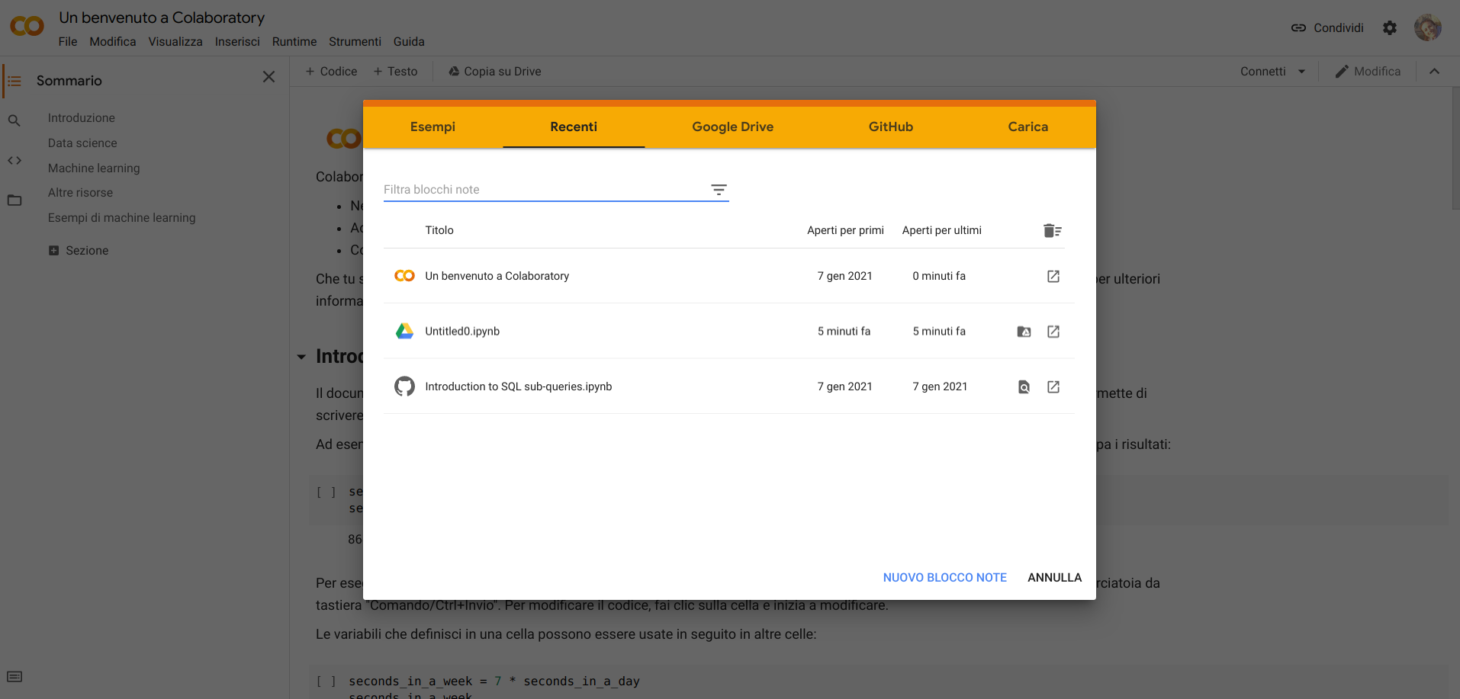
https://colab.research.google.com/
Creare un nuovo script

