Slide 1
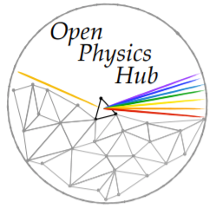
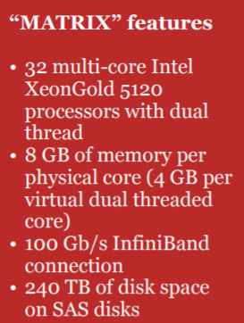
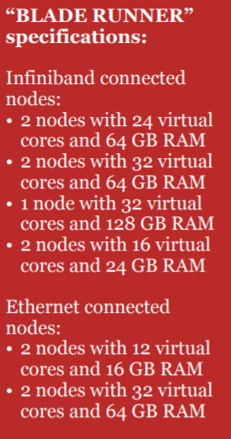
HIGH PERFORMANCE COMPUTING CLUSTER
https://site.unibo.it/openphysicshub/en

