Slide 1
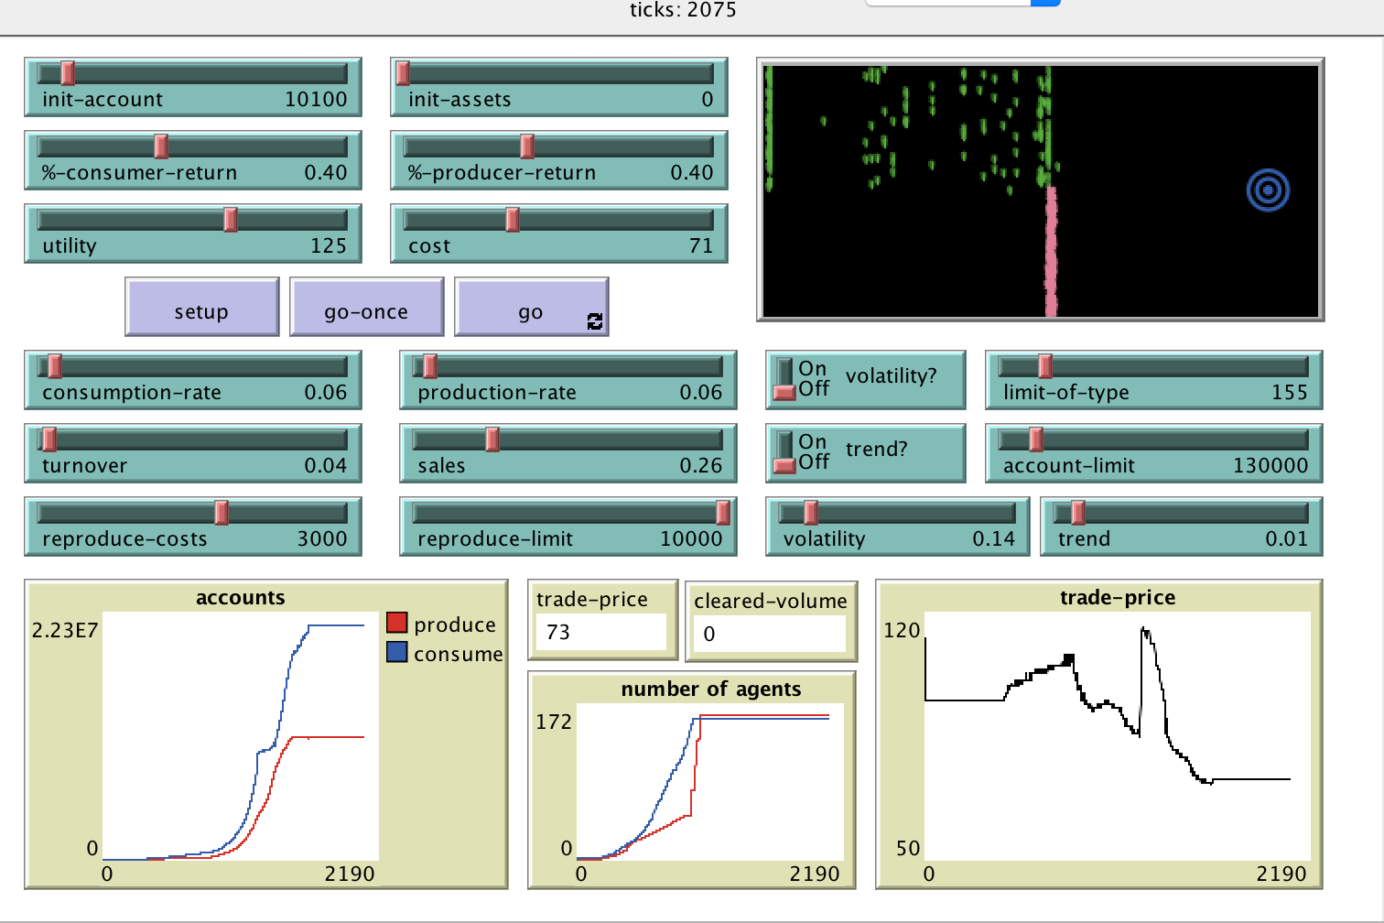
Auction Mechanisms
By: Mike Tamillow
Model:
Agent-Based Modeling of Trading Markets
Zero-Intelligence Traders
Modified from Gode and Sunder, 1993
Demonstrates the behavior of converging to an optimal price given agent price, without knowledge of an equilibrium supply and demand.

Slide 2
Auction Extension written in Scala
ZI Traders - How it works
Traders are grouped into two categories. Producers – build asset (- cost) and sell. Consumers – buy asset and expend it. (+ utility)
During creation, agents are given a price to trade within a range, which remains the same throughout the rest of the simulation.
Agents (each turn):
I will trade a proportional quantity per turn at the price
I will perform economic functions to produce or consume
If I have enough cash, I will hatch 1 with a new trade price
Emergent characteristics:
Describes the growth of a market by accumulating total value in a greater than zero-sum game
Demonstrates convergence to equilibrium prices with unintelligent individual pricing decision
Discrete-time
Double-sided market
Optimize price where supply meets demand.
Manages accounting properties of all trading agents.
Reports last trade price and volume info.

