Slide 1
RAMADDA
Publishing and content management platform for earth science data
Extensible framework
Generality and specialization
Use contexts:
  Case studies, “Youtube for data”, field projects, IDD, LEAD, etc.

Slide 2
RAMADDA
Publishing Services
End user
Web UI
Basic Services
CRUD
Search
Access control
File mgmt
…
Service API
Viewing
External services
(e.g., LDM, IDV)
HTML
RSS
Catalog
OPeNDAP
Products
IDV
Etc.
Harvesters
e.g., File, HTTP,
Catalog
Data Model
RDMS
Collection
Metadata
“Entries”
Notes:
There is a multiplicity of ways of getting information into the repository – an end user uploading data through the web interfaces, external services using the web sevice api (e.g., ldm -> pqact -> repository), a client (like the IDV) that uses the repository api internally, automated file system harvesters, harvesters that can walk other repositories and catalogs.
The core data model consists of groups and entries – groups provide hierarchical organization – entries may represent a file, a URL, or some non-data entity (e.g., a blog post). There is a rich & extensible metadata framework that supports common metadata (e.g., date, geospatial bounds, etc.) as well as descriptive metadata (e.g., tags, thredds metadata, etc.)
The data model is extensible – you can specify new data types (e.g., level 3 radar) and new types of metadata (e.g., fgdc, dif, etc)
The basic services include:
CRUD (Create, read, update, delete)
Search
Event notification – both synchronous (e.g., the IDV posting a event query for real time radar) and asynchronous (e.g., send an email)
Product generation – using the IDV we can generate image and movie products.
Scour and file management
Etc.
A multiplicity of ways of viewing the repository – This is also extensible and it is easy to add in a new way of showing the information. E.g., putting in a Lead-FGDC output handler.

Slide 3
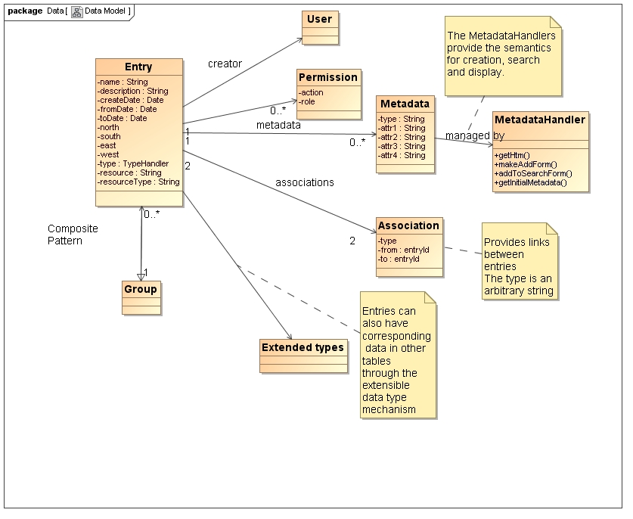
Data Model

Slide 4
Data Model
Defined by a types.xml file
Defines the available entry types
Can specify a handler class
Column definitions result in new DB table
Automatic creation of upload, edit and search forms
<type name="testit" description="Test it">
<column name="fruit" type="enumeration" values="Apple,Banana,Orange" label="Fruit" />
<column name="flag" type="boolean" label="Flag"/>
<column name="number" type="double" suffix="number units"/>
</type>

Slide 5
Data Model
<type name="wikipage" description="Wiki Page“>
<column name="wikitext" type="clob" size="256000" label="Wiki Text"
cansearch="true" showinhtml="false"/>
<column name="category" type="string" label="Wiki Page Category"
cansearch="true" searchtype="select" showinhtml="false"/>
</type>
<type name="level3radar" datatype="radar" description="Level 3 Radar File“>
<column name="station" type="string" cansearch="true"
searchtype="select" label="Station" />
<column name="product" type="string" cansearch="true"
searchtype="select" label="Product" />
</type>

Slide 6
Metadata
<handler category="THREDDS"
class="ucar.unidata.repository.data.ThreddsMetadataHandler" >
<type name="Creator" type="thredds.creator" searchable="true">
<element label="Organization" type="string"/>
<element label="Email" type="email"/>
<element label="URL" type="url"/>
</type>
<type name="Keyword" type="thredds.keyword" searchable="true">
<element label="Value" type="string"/>
<template type="threddscatalog">
<![CDATA[<keyword>${attr1}</keyword>]]></template>
</type>
</handler>

Slide 7
Metadata
<type name="ANZLIC Search Word" type="enum_anzlic_search_words"
searchable="true" browsable="true">
<element
label="Search Word"
type="enumeration"
values="file:/ucar/unidata/repository/resources/metadata/anzlicsearchwords.txt"/>
<template type="threddscatalog">
<![CDATA[<keyword>${attr1}</keyword>]]></template>
</type>

Slide 8
RAMADDA
Tomcat
RepositoryServlet
Jetty
Request
Repository
RepositoryServer
Result
???

Slide 9
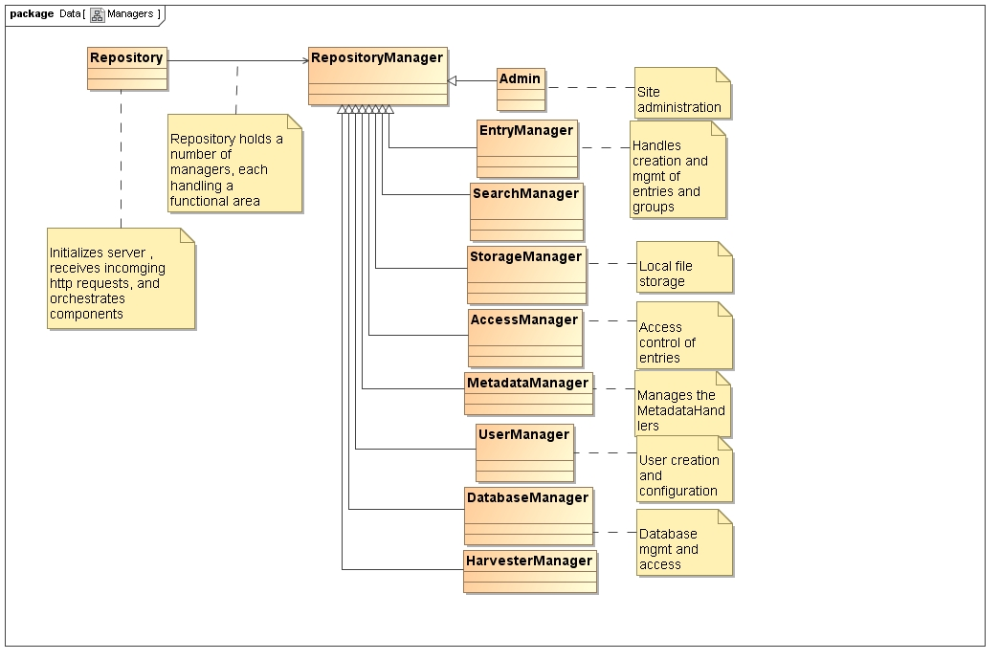
Overview

Slide 10
Configuration and Initialization
State held in local repository home dir (e.g., ~/.unidata/repository )
  repository.properties file, plugins directory, Derby database and local file storage
Initialization:
  Read properties from: system, local storage, plugins and command line
  Define web API
  Create and/or update database
  Create type handlers
  Create metadata handlers
  Create output handlers

Slide 11
Initialization –api.xml
Defines all web-app entry points
Specifies top-level links
Defines admin and data model access control
<api>
<group handler="searchmanager">
<api request="/search/textform"
method="processEntryTextSearchForm"
name="Search" toplevel="true"/>
<api request="/search/browse" method="processEntryBrowseSearchForm" name="Browse"/>
</group>
<group handler="entrymanager">
<api request="/entry/form" method="processEntryForm" actions="edit"/>
</group>
...

Slide 12
Database
Use JDBC and managed by the DatabaseManager
Database to use is defined by the property ramadda.db
  ramadda.db=mysql,postgres,derby
  Default is derby
makedb.sql defines schema
Cross database issues:
  Primitive types – double vs. float8, datetime, etc
  Search limit and offset
All (most) DB access through prepared statements – SQL injection
Utilities:
  Clause.java – Creation of prepared statements
  Tables.java – generated class defines all table and column names

Slide 13
Initialization – metadatahandlers.xml
<metadatahandlers>
<metadatahandler class="ucar.unidata.repository.AdminMetadataHandler" />
<metadatahandler class="ucar.unidata.repository.ContentMetadataHandler" />
<metadatahandler class="ucar.unidata.repository.EnumeratedMetadataHandler"
name="Tag"
type="enum_tag"/>
<metadatahandler class="ucar.unidata.repository.EnumeratedMetadataHandler" file="/ucar/unidata/repository/resources/gcmdkeywords.txt"
name="GCMD Science Keyword"
type="enum_gcmdkeyword"/>
<metadatahandler class="ucar.unidata.repository.ThreddsMetadataHandler"/>
</metadatahandlers>

Slide 14
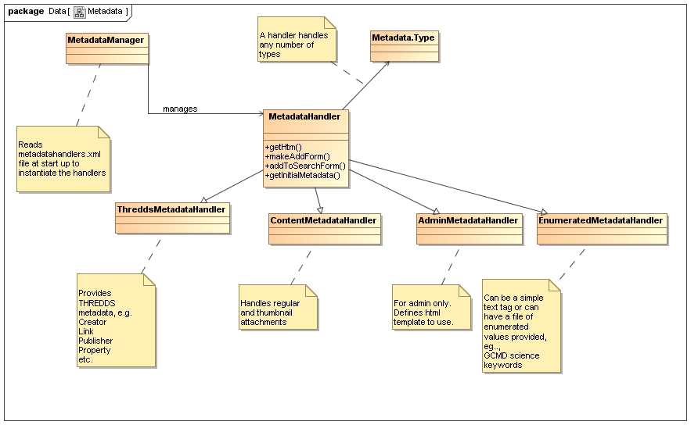
Metadata

Slide 15
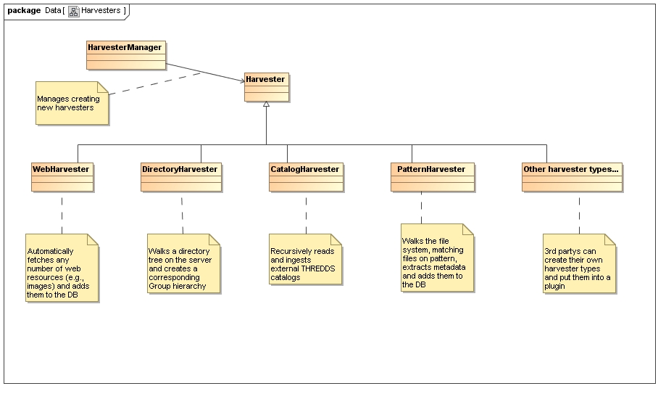
Harvesters

Slide 16
Initialization – outputhandlers.xml
<outputhandlers>
<outputhandler class="ucar.unidata.repository.HtmlOutputHandler" name="Default HTML"/>
<outputhandler class="ucar.unidata.repository.MapOutputHandler" name="Map"/>
<outputhandler class="ucar.unidata.repository.CalendarOutputHandler" name="Calendar"/>
<outputhandler class="ucar.unidata.repository.ImageOutputHandler" name="Image"/>
…

Slide 17
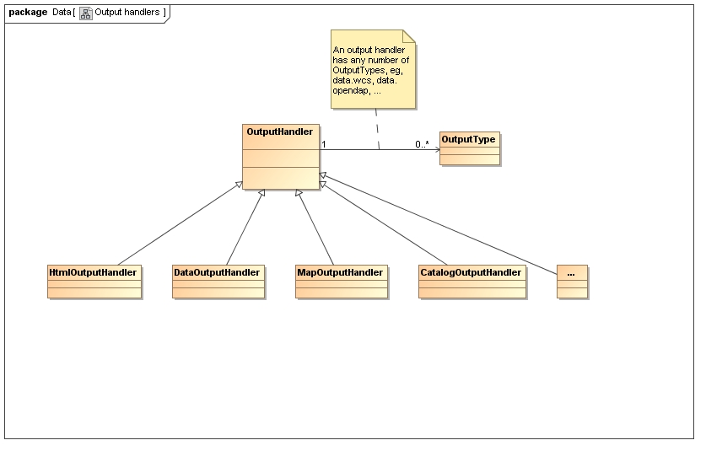
Output Handlers

Slide 18
Example Output Handler - Initialization
public class ExampleOutputHandler extends OutputHandler {
public static final OutputType OUTPUT_EXAMPLE1 =
new OutputType("Example 1","example.example1");
public static final OutputType OUTPUT_EXAMPLE2 =
new OutputType("Example 2","example.example2");
public ExampleOutputHandler(Repository repository, Element element) {
super(repository, element);
addType(OUTPUT_EXAMPLE1);
addType(OUTPUT_EXAMPLE2);
}

Slide 19
Example Output Handler - Registration
/* Add to the types list the OutputTypes that are applicable to the given State.
The State can be viewing a single Entry (state.entry non-null),
viewing a Group (state.group non-null).
These would show up along the top navigation bar. */
protected void addOutputTypes(Request request, State state,
List<OutputType> types)
throws Exception {
//We'll add example1 when we are viewing a group and example2
//when viewing a single entry
if (state.group != null) {
types.add(OUTPUT_EXAMPLE1);
}
if (state.entry != null) {
types.add(OUTPUT_EXAMPLE2);
}
}

Slide 20
Example Output Handler - Output
public Result outputGroup(Request request, Group group,
List<Group> subGroups, List<Entry> entries)
throws Exception {
...}
public Result outputEntry(Request request, Entry entry) throws Exception {
…}

Slide 21
OpenDAP Output Handler
public Result outputOpendap(final Request request, Entry entry) {
//Bridge the ramadda servlet to the opendap servlet
RepositoryDODSServlet servlet = new RepositoryDODSServlet(request, entry) {
public ServletConfig getServletConfig() {
return request.getHttpServlet().getServletConfig();
}
public ServletContext getServletContext() {
return request.getHttpServlet().getServletContext();
}
…};
servlet.init(request.getHttpServlet().getServletConfig());
servlet.doGet(request.getHttpServletRequest(),
request.getHttpServletResponse());
//return a result that says we've already written the result
Result result = new Result("");
result.setNeedToWrite(false);
return result;
}

Slide 22
OpenDAP Output Handler
public class RepositoryDODSServlet extends opendap.servlet.AbstractServlet {
Request repositoryRequest;
Entry entry;
public RepositoryDODSServlet(Request request, Entry entry) {
this.repositoryRequest = request;
this.entry = entry;
}
protected GuardedDataset getDataset(ReqState preq) {
NetcdfFile ncFile = getNetcdfDataset(entry.getResource().getFile());
return new GuardedDatasetImpl(entry.getName(), ncFile, true);
}
}

Slide 23
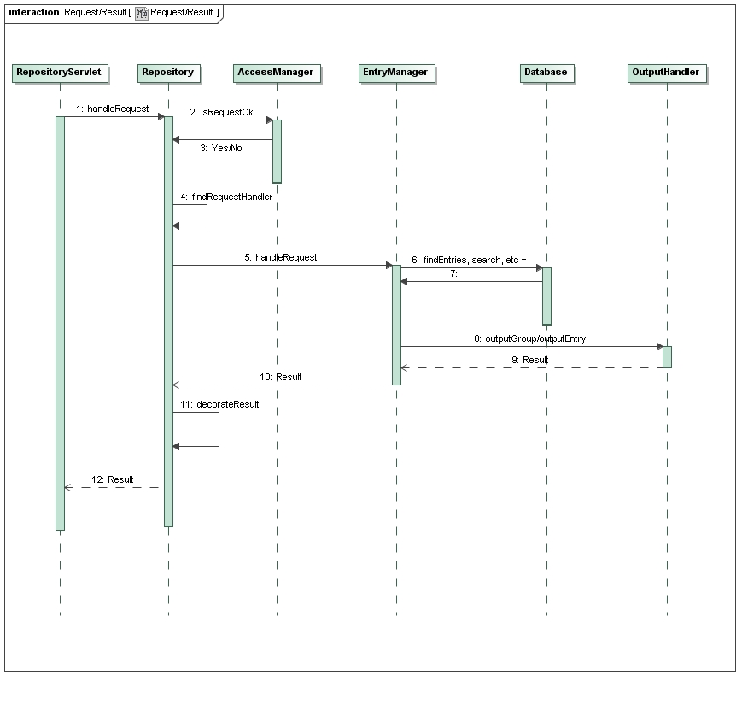
Processing requests

Slide 24
TDS Feature Comparison
RAMADDA supports:
  HTTP service
  Catgen - Generate “catalogs” from local file system using the “Local file view” group type
  Catalog services – generate html view of arbitrary catalogs
  OpenDAP
  Grid subset service
RAMADDA does not yet support:
  Aggregation
  WCS
  Radar collection services

Slide 25
Plans
Solid alpha release by AMS
motherlode:
  Ingest COMET case studies and support full IDD feed
Refine data model
  How to handle hierarchy and collections?
New services:
  Collaboration – chat, wiki, blog, forum
  WCS, aggregation and collection (e.g., radar)
  Image product generation

