Slide 1
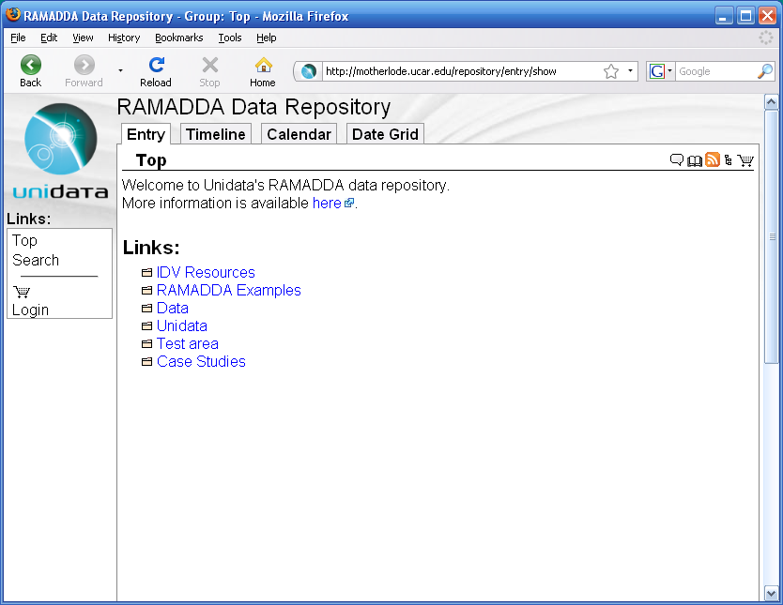
RAMADDA is organized like a file system.
There are groups (directories) and
entries (files)

Slide 2
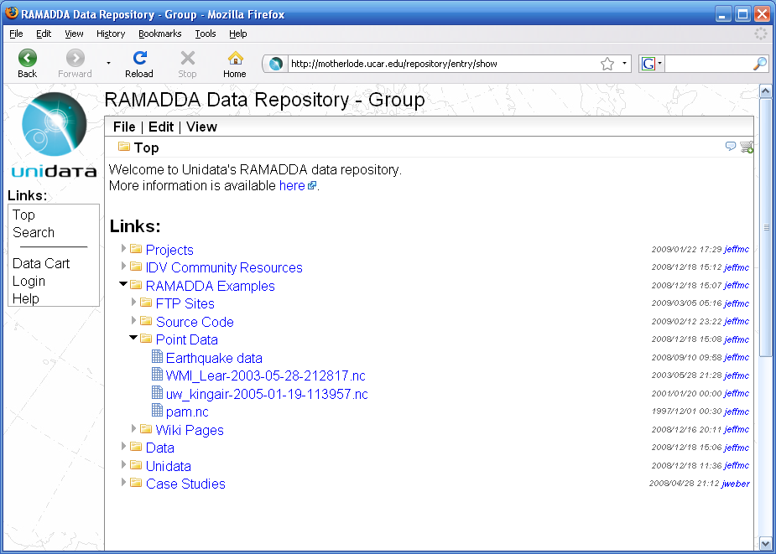
Click on the links to drill
Down to the entry
Click on the arrow icons
to open the group.

Slide 3
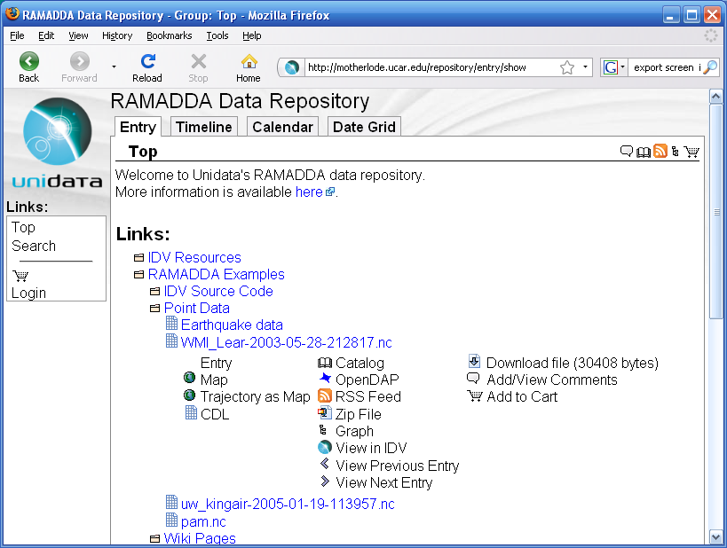
Click on the Entry
icons to see views and
Tasks for Entry.

Slide 4
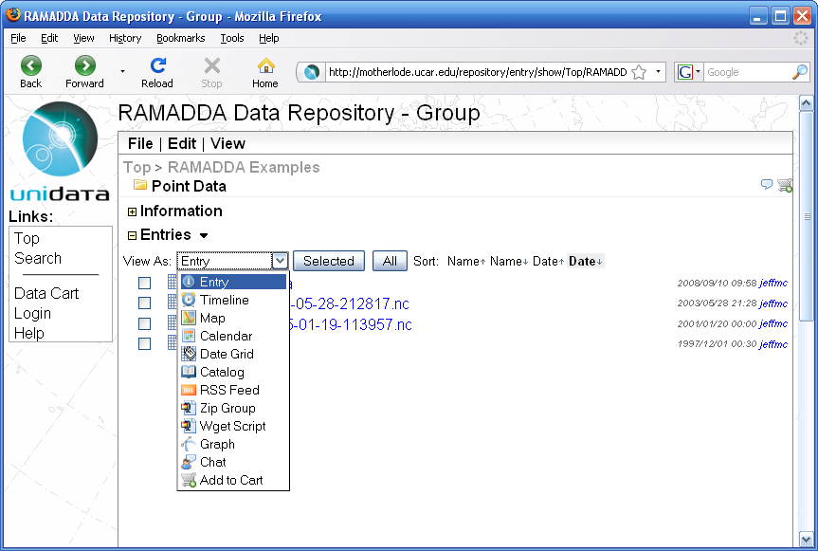
1) Click on the arrow to show the
_{listing form}
_{Apply action to Select}
_{all the entries}
_{2) Select what you want}
_{to do from the list of}
_{Actions views}

Slide 5
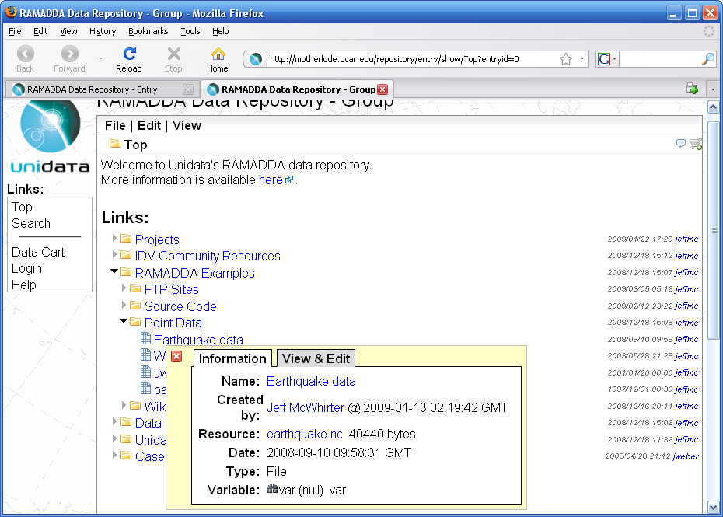
The popup shows the details for the Entry.

Slide 6
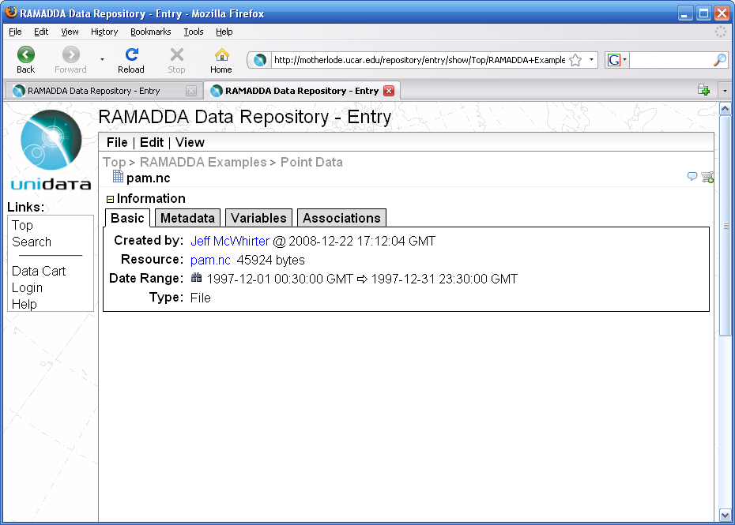
The menus allow you to download, edit and view this entry in a number of ways
The breadcrumbs show where you are
The toolbar shows non-html views, e.g., Catalog, RSS
And other tasks, e.g., download, comments, etc.
The tabs here show Basic information, Metadata, etc.
It this entry is a file you can download it with this link.

Slide 7
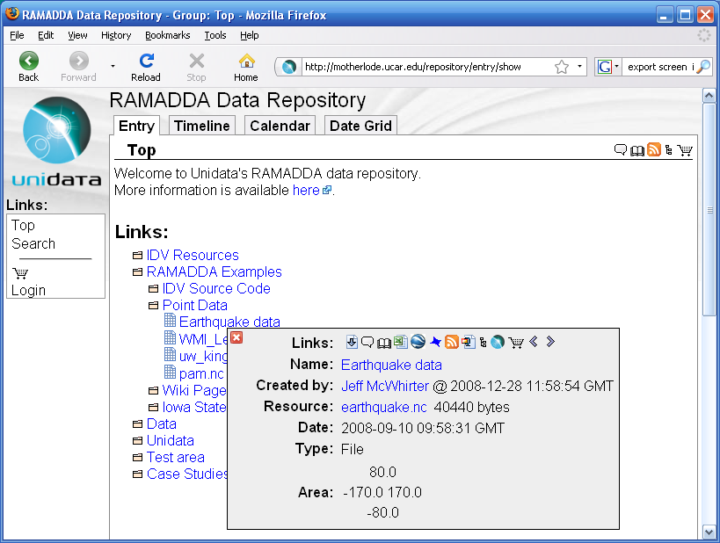
The popup shows the details for the Entry.

Slide 8
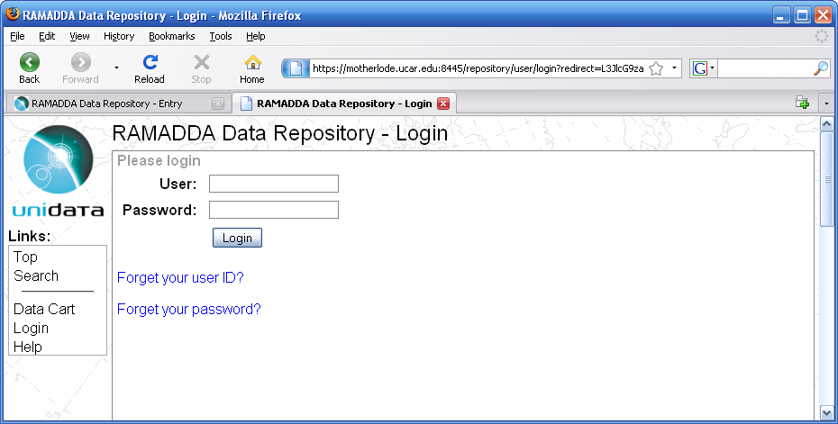
If this server has been configured to send email these links will be shown to enable you to reset your password
_{Login link}

Slide 9
_{New Entry or Group icon}

Slide 10
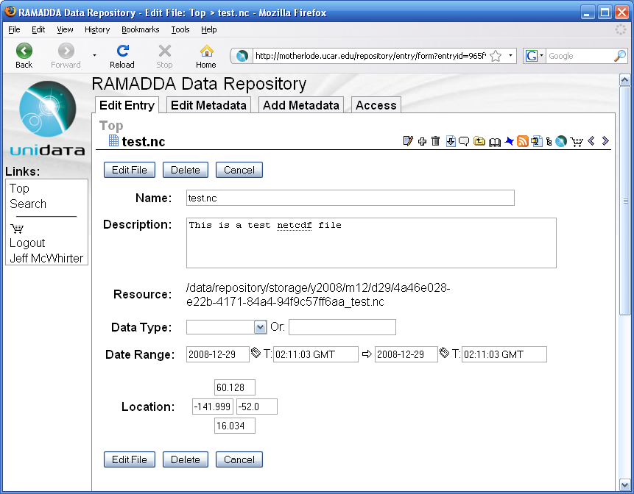
_{Other edit links}

Slide 11
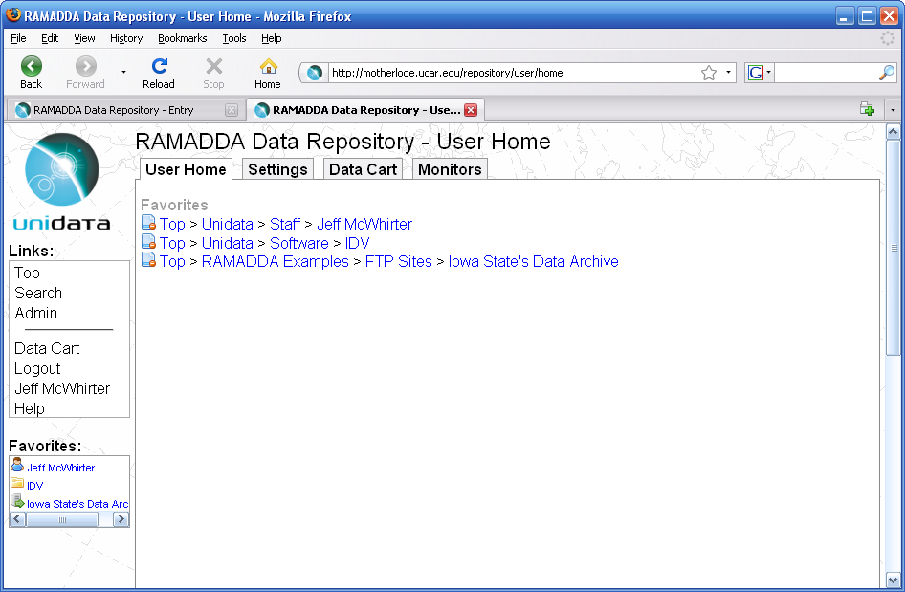
In your user settings page there “User Home” lists your favorites
When you are logged in there are some new links shown to Logout and to go to your user settings page.
You can add entries or groups into a list of Favorites (kind of like bookmarks) that are always shown here.

Slide 12
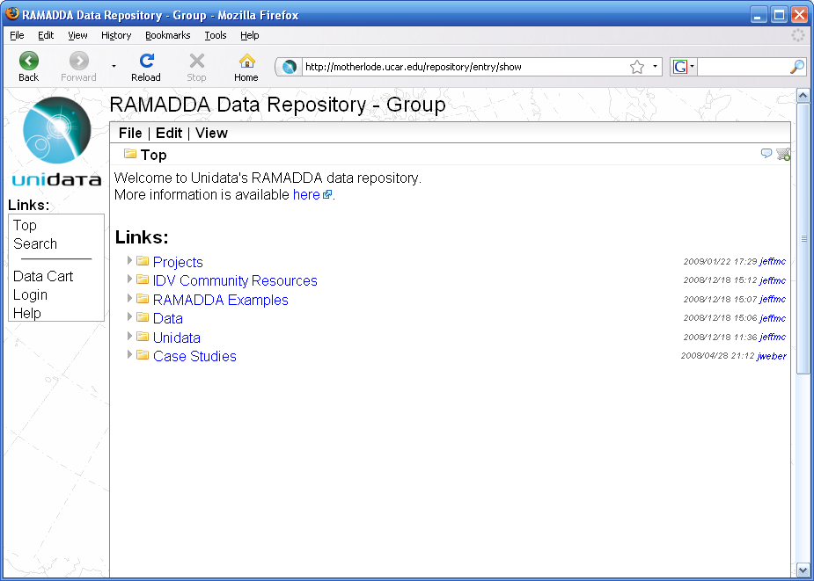
We are looking at the Top group
RAMADDA is organized like a file system.
There are groups (directories) and
entries -files, links, wiki pages and other
things

Slide 13
RAMADDA is organized like a file system.
There are groups (directories) and
entries (files)

Slide 14
Click on the links to drill
Down to the entry
Click on the arrow icons
to open the group.

Slide 15
Click on the Entry
icons to see views and
Tasks for Entry.

Slide 16
The popup shows the details for the Entry.

Slide 17
The menus allow you to download, edit and view this entry in a number of ways
The breadcrumbs show where you are
The toolbar shows non-html views, e.g., Catalog, RSS
And other tasks, e.g., download, comments, etc.
The tabs here show Basic information, Metadata, etc.
It this entry is a file you can download it with this link.

Slide 18
The popup shows the details for the Entry.

Slide 19
If this server has been configured to send email these links will be shown to enable you to reset your password
_{Login link}

Slide 20
_{New Entry or Group icon}

Slide 21
_{Other edit links}

Slide 22
In your user settings page there “User Home” lists your favorites
When you are logged in there are some new links shown to Logout and to go to your user settings page.
You can add entries or groups into a list of Favorites (kind of like bookmarks) that are always shown here.

Slide 23
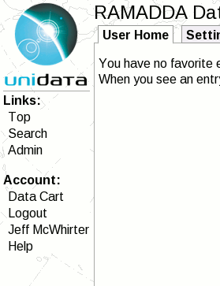
Admin link

Slide 24
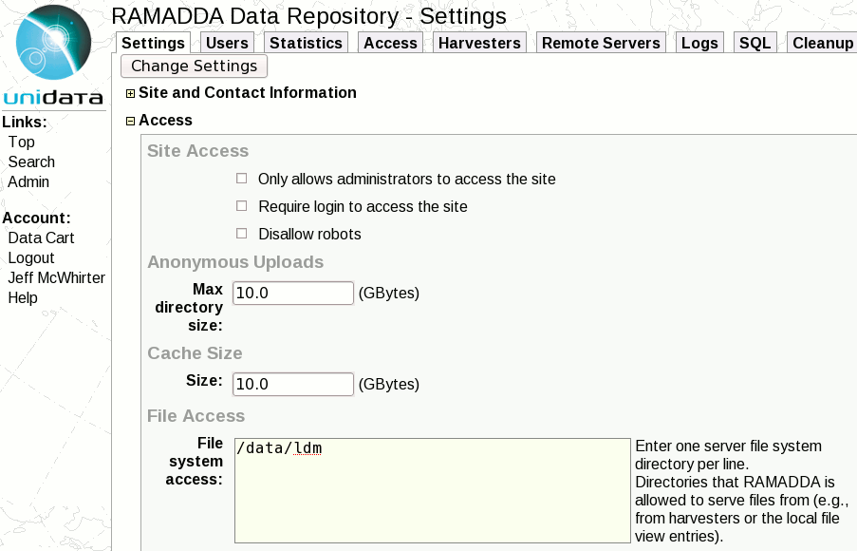
Enter data
Directory here

Slide 25
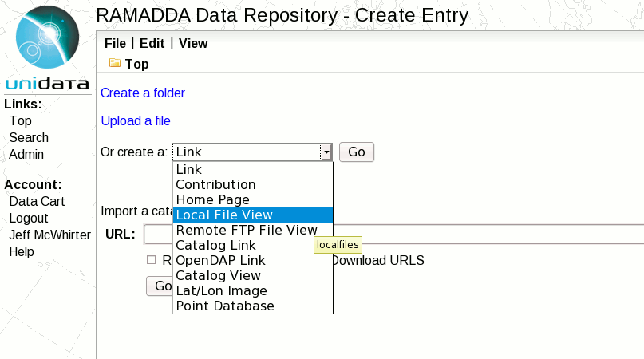
Select Local File View

Slide 26
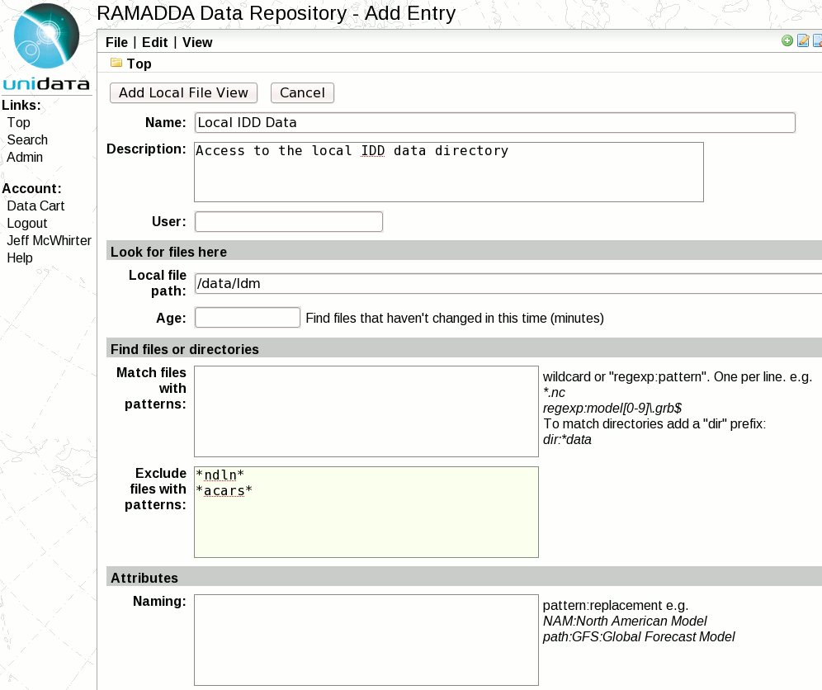
Enter a name and
description
Enter the data
directory
Patterns to exclude

