Slide 1
ML in the Physical Sciences Classroom
Amy McGovern
Professor, School of Computer Science
Adjunct Professor, School of Meteorology
Director, IDEA Lab
University of Oklahoma
amcgovern@ou.edu

Slide 2
Outline
Machine learning
Overview of tree-based methods
Hands-on with jupyter notebooks

Slide 3
What is ML?
Artificial Intelligence
Computers solving difficult tasks through experience and observations
Machine Learning
Adaptive models learn to improve performance on a task given experience
Expert Systems
Operate autonomously with human specified rules. (e.g. fuzzy logic)
Deep Learning
Neural networks with multiple specialized layers for encoding structural information

Slide 4
ML is data hungry!
ML is not magic
Labeled data is a must
Noise can exist but can’t be overwhelming
Data engineering/Feature engineering is time consuming
This is what ML researchers spend most of their time doing!

Slide 5
Decision Trees
Human-readable ML model
Can predict:
Class labels (hail/no hail)
Real-values (hail size, shape parameters)
Probabilities
Demonstrated success in meteorology
Selective model

Slide 6
Growing a Decision Tree
Recursive greedy algorithm
Find the best way to split the data, recursively split each sub-tree until stopping criteria is met
Stop at fully pure tree (overfitting!)
Stop with a specified number of examples
Stop at a maximum depth
https://algobeans.com/2016/07/27/decision-trees-tutorial/

Slide 7
Growing a Tree Example
https://levelup.gitconnected.com/what-are-decision-trees-4bfac0fbb179

Slide 8
Using a Tree
https://levelup.gitconnected.com/what-are-decision-trees-4bfac0fbb179

Slide 9
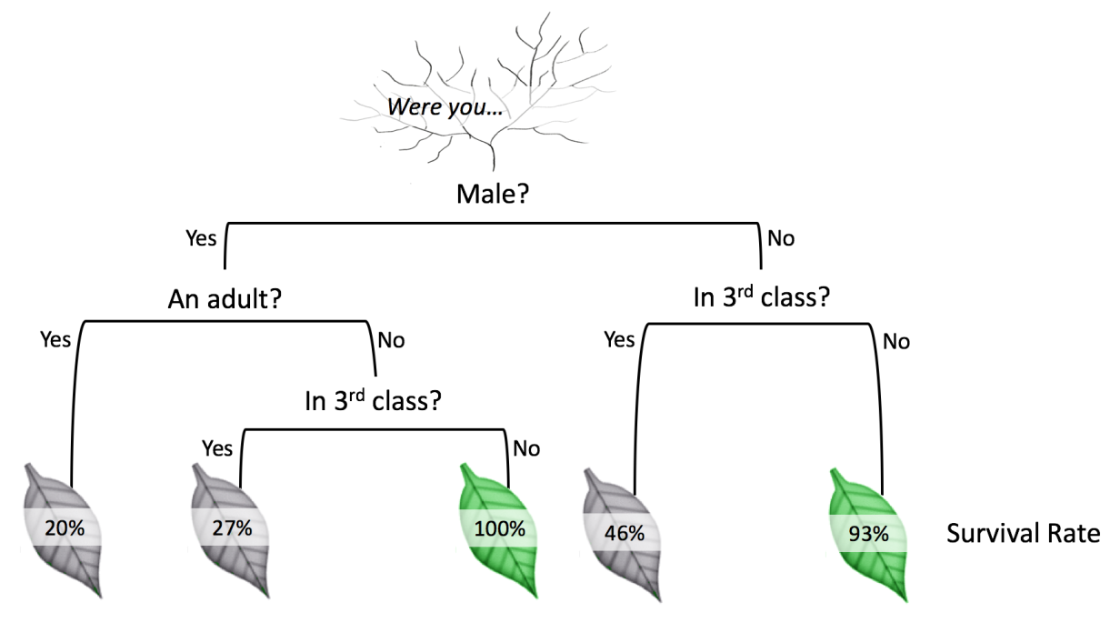
Types of Decision Tree
Classification trees
Predict a label
Predict probability of a label
Regression trees
Predict a real-value
Surviving the Titanic
https://algobeans.com/2016/07/27/decision-trees-tutorial/

Slide 10
Why Decision Trees
Pros
Cons
Easily human readable
Humans have extensive experience with flow charts
Selective
Chooses the most important variables
Brittle
Small changes in the data lead to large changes in the model

Slide 11
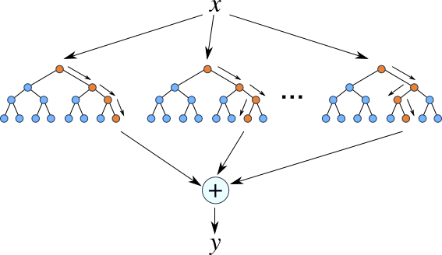
Forests: Ensembles of Trees
Ensembles of (weak) models can be very powerful
Model diversity is critical
Vary initial conditions (bagging)
Vary learning conditions (randomization)
Vary model weights or targets (boosting)
Two most popular methods:
Random Forests
Gradient Boosted Trees
Each tree votes or averages its prediction
http://ncbi-hackathons.github.io/Pharmacogenomics_Prediction_Pipeline_P3/

Slide 12
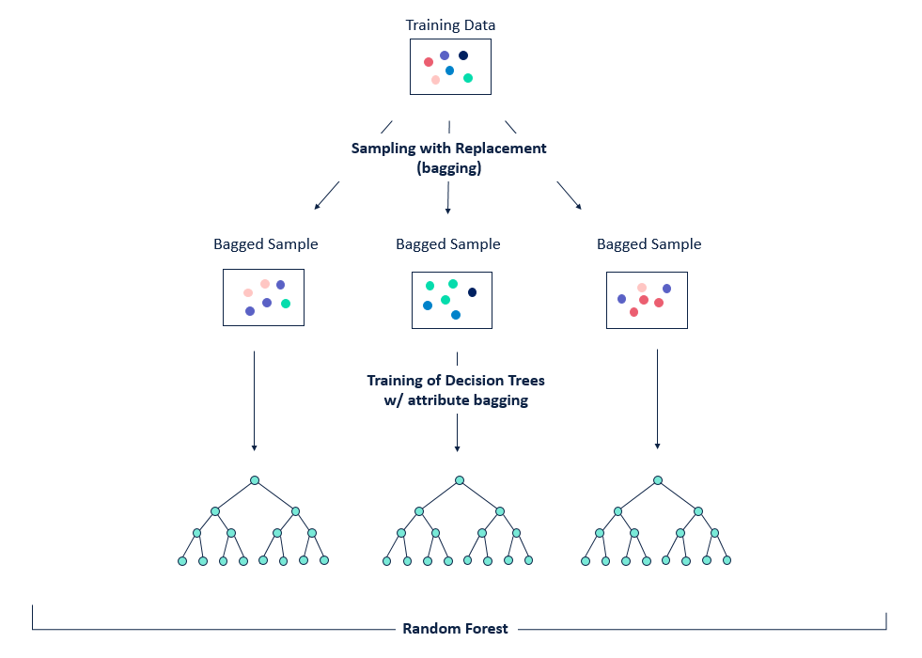
Random Forest: Bagging
Bootstrap resampled data
From n items, sample n with replacement
Approximately 1/3 of data will not be used in each set
Provides critical diversity for tree growth
https://community.alteryx.com/t5/Alteryx-Designer-Knowledge-Base/Seeing-the-Forest-for-the-Trees-An-Introduction-to-Random-Forest/ta-p/158062

Slide 13
Random Forest: Randomization
Each level of each tree can only select from a subset of all possible attributes
Subset should be much smaller than full data set
Ensures individual trees are diverse

Slide 14
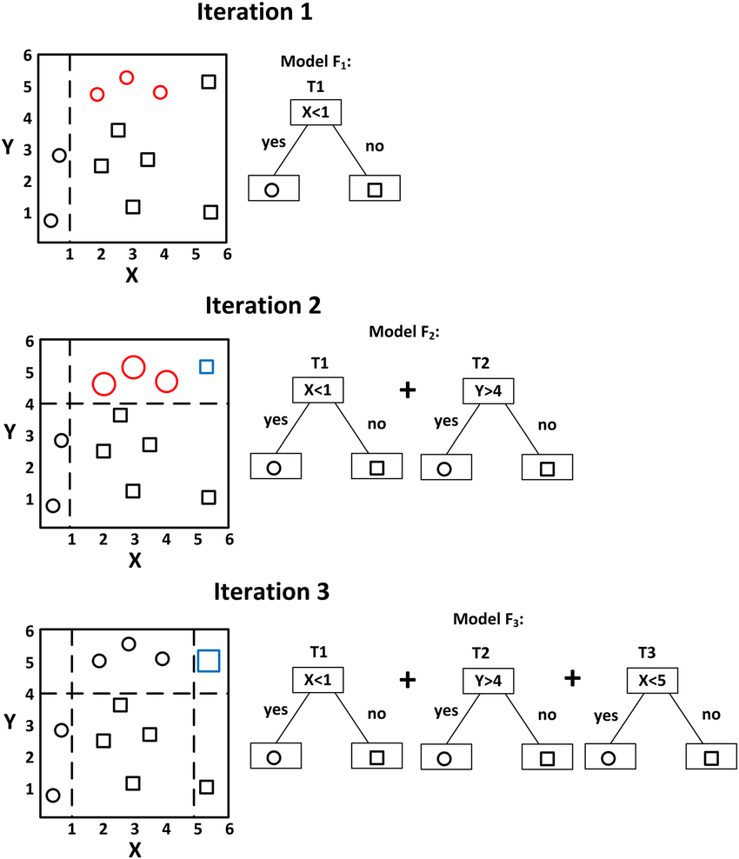
Gradient Boosted Trees
Each tree trained on residual error of previous trees
Examples are weighted by residual error
Trees are weighted by performance
Forest outputs weighted vote
https://www.researchgate.net/figure/A-simple-example-of-visualizing-gradient-boosting_fig5_326379229

Slide 15
Let’s go use the methods!

