Slide 1
Rosetta - Unidata's Web-based Data Translation Tool
2015 Unidata Users Workshop – June 24th
Sean C. Arms ¹
Jennifer Oxelson Ganter ¹
Jeff Weber ¹
Mohan K. Ramamurthy ¹
¹UCAR/Unidata

Slide 2
Rosetta
What is Rosetta?
Vision: General Purpose Data Format Translator
Goal: Get data into standard format
2015 Unidata Users Workshop – June 24th

Slide 3
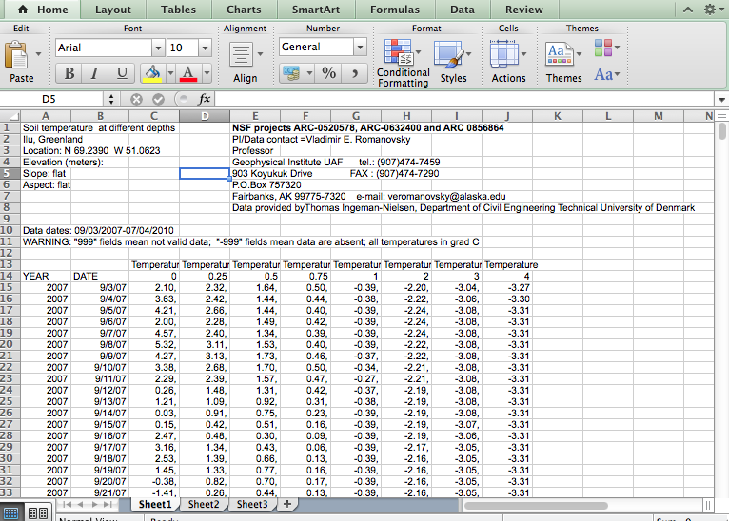
What Many Users Like to Use
2015 Unidata Users Workshop – June 24th

Slide 4
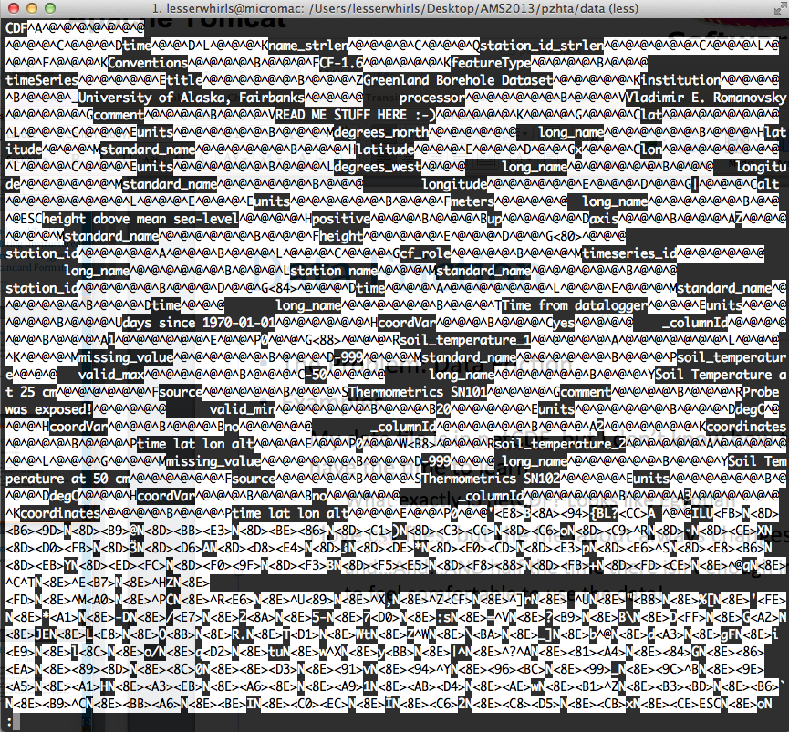
What a Standard Format “Looks” Like
2015 Unidata Users Workshop – June 24th

Slide 5
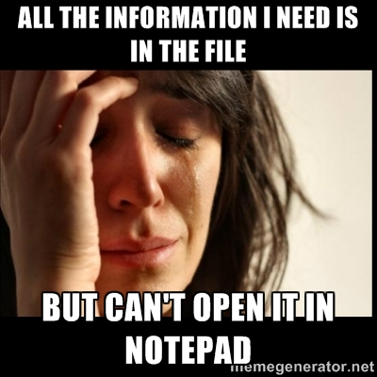
What a Standard Format “Looks” Like
2015 Unidata Users Workshop – June 24th

Slide 6
Rosetta
What is Rosetta?
Vision: General Purpose Data Format converter
Goal: Get data into standard format while still providing users with a format they want to use through the use of standard web services.
2015 Unidata Users Workshop – June 24th

Slide 7
Rosetta
Why bother translating data into a standard format?
What works for the data provider may not work well for the data users scientific workflow.
2015 Unidata Users Workshop – June 24th

Slide 8
Rosetta
What does translating data into a standard format buy us?
Standard format -> a variety of output formats (programmatically!)
Enable subsetting, aggregation, visual data “previews”, enhancing search through automated rich metadata extraction, remote access, etc.
2015 Unidata Users Workshop – June 24th

Slide 9
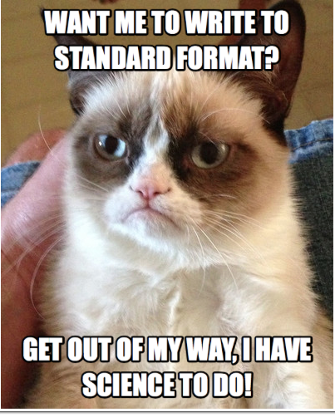
Rosetta
It’s really all about the end users of the data (which could be you!)…but we need to get out of the data providers way as quickly as possible.
2015 Unidata Users Workshop – June 24th

Slide 10
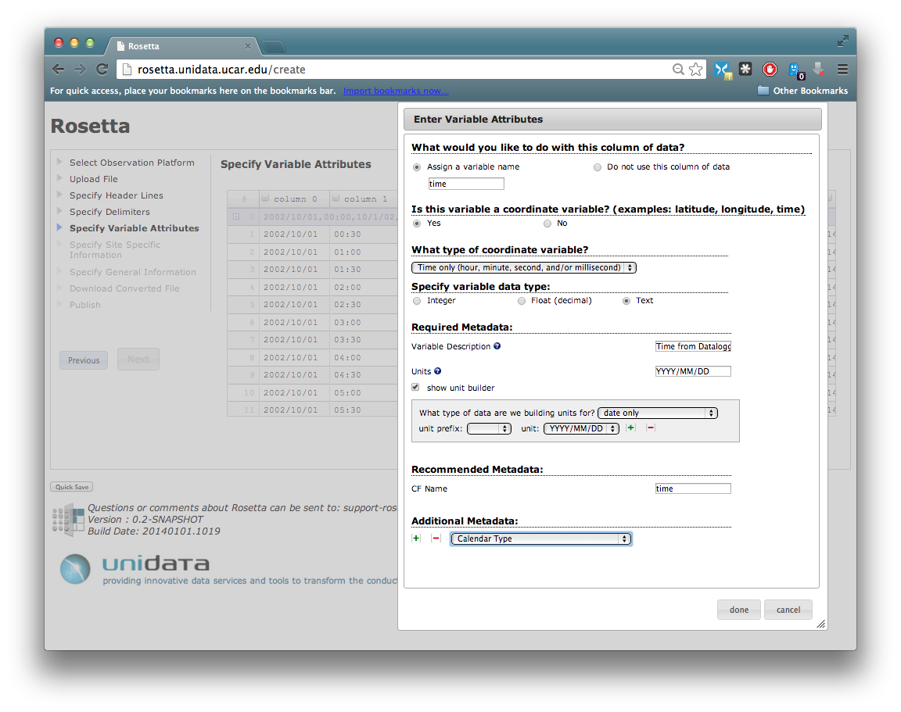
Wizard Based Format Translation
2015 Unidata Users Workshop – June 24th

Slide 11






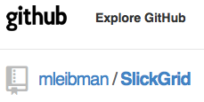
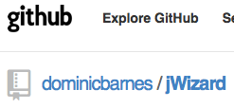
Technology Stack
Java WebApp
Java
Apache Tomcat
Spring MVC
netCDF-Java(CDM)
JavaScript
jQuery, SlickGrid, jWizard
2015 Unidata Users Workshop – June 24th

Slide 12
Rosetta
Server
Client
Browser
Servlet Container
(Apache Tomcat)
javascript front end interface
(Metadata Collection)
rosetta.war
Java
javascript
Session
Storage
2015 Unidata Users Workshop – June 24th
No
netCDF-Java
Publish to Remote Repository?
CFPointWriter
(Transformation)
Yes
Standard File
User File
User File
Standard File
Remote
Repository
Remote Publishing API

Slide 13
Rosetta
Open to collaboration!
Always looking for 'badASCII' example files
Email:
support-rosetta@unidata.ucar.edu
2015 Unidata Users Workshop – June 24th

Slide 14
Rosetta
Home page:
http://www.unidata.ucar.edu/software/rosetta/
Live testing site:
http://rosetta.unidata.ucar.edu
Source code on GitHub:
http://www.github.com/Unidata/rosetta
2015 Unidata Users Workshop – June 24th

Slide 15
Rosetta
Development supported by:
NSF Award 1344155 (GEO): Unidata 2018: Transforming Geoscience through Innovative Data Services
NSF Award 0833450 (AGS): Unidata 2013: A Transformative Community Facility for the Atmospheric and Related Sciences
NSF Award 1016034 (ARC): The Advanced Cooperative Arctic Data and Information Service (ACADIS)
NSF Award 1343785 (ICER): EarthCube Building Blocks: Integrating Discrete and Continuous Data
2015 Unidata Users Workshop – June 24th

