Slide 1
Rosetta - Unidata's Web-based Data Translation Tool Progress and Future Plans
Sean C. Arms ¹
Jennifer Oxelson Ganter ¹
Jeff Weber ¹
Mohan K. Ramamurthy ¹
¹UCAR/Unidata

Slide 2
Rosetta
What is Rosetta?
Vision: General Purpose Data Format Translator
Goal: Get data into standard format

Slide 3
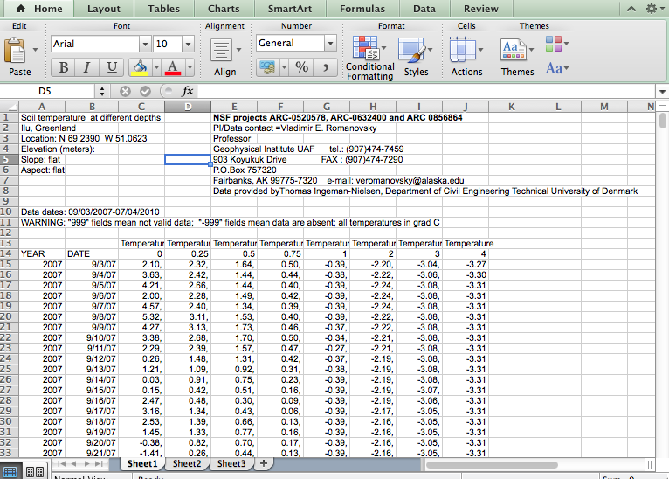
What Many Users Like to Use

Slide 4
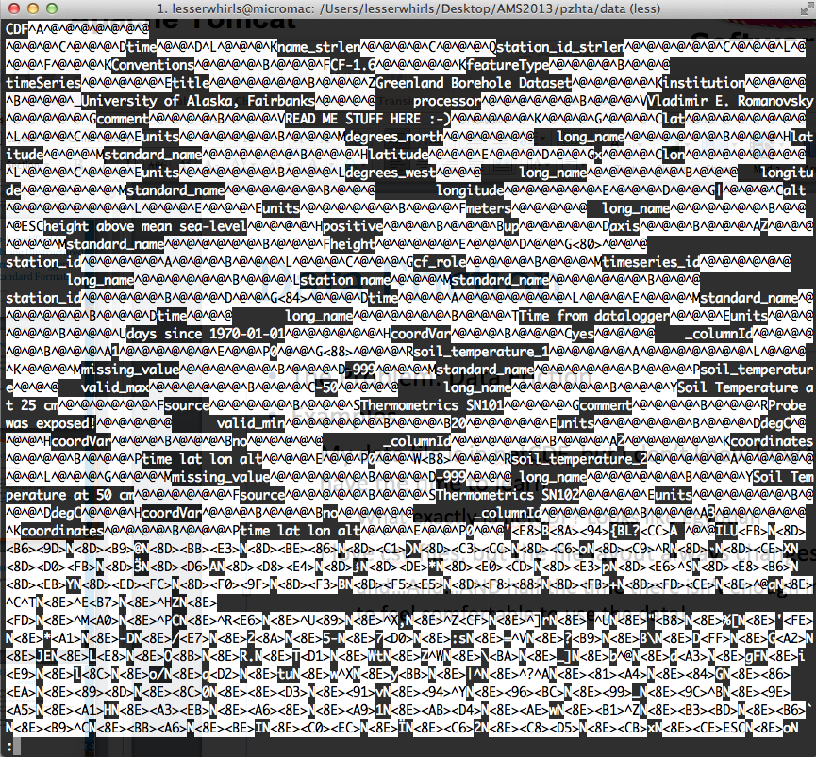
What a Standard Format “Looks” Like

Slide 5
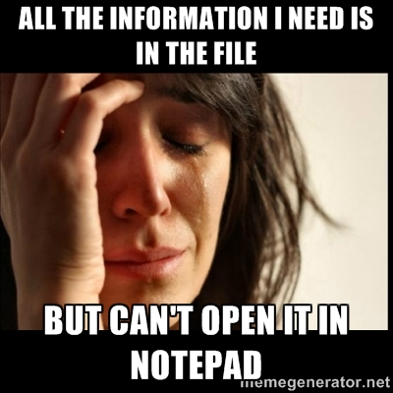
What a Standard Format “Looks” Like

Slide 6
Rosetta
What is Rosetta?
Vision: General Purpose Data Format converter
Goal: Get data into standard format while providing data users with the format they want

Slide 7
Rosetta
Why bother translating data into a standard format?
What works for the data provider may not work well for the data users scientific workflow.

Slide 8
Rosetta
What does translating data into a standard format buy us?
Standard format -> a variety of output formats (programmatically!)
Enable subsetting, aggregation, visual data “previews”, enhancing search through automated rich metadata extraction, etc.

Slide 9
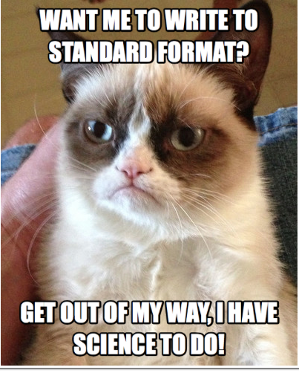
Rosetta
It’s really all about the end users of the data…but we need to get out of the data providers way as quickly as possible.

Slide 10
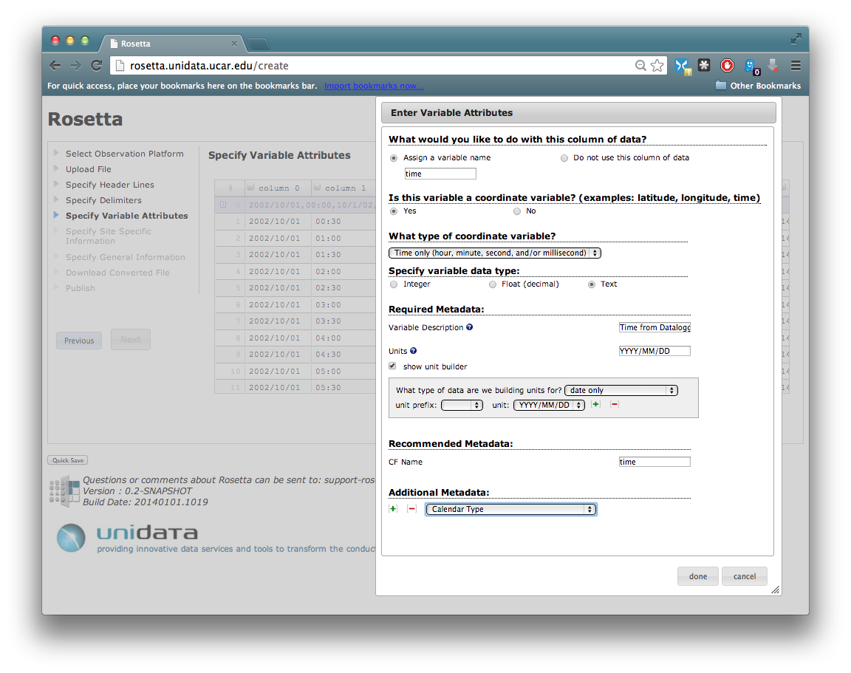
Wizard Based Format Translation

Slide 11






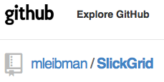
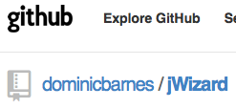
Technology Stack
Java WebApp
Java
Apache Tomcat
Spring MVC
netCDF-Java(CDM)
JavaScript
jQuery, SlickGrid, jWizard

Slide 12


Rosetta – Progress Over Previous Year
Name change:
NcML transaction receipt moved to json
Avoid file rewrites

Slide 13
Rosetta – Progress Over Previous Year
Refactor javascript wizard to ease creation of new wizards flows
Each wizard step is a modular javascript function call (includes validation)
Front end view pieced together by including jspf (jsp fragments)

Slide 14
Rosetta – Progress Over Previous Year
Documentation infrastructure in place
Sphinx, jsDoc3, javadoc
Open to suggestions
Publishing capabilities to remote data portals / archives RAMADDA, ACADIS Gateway

Slide 15
Rosetta
Server
Client
Browser
Servlet Container
(Apache Tomcat)
javascript front end interface
(Metadata Collection)
rosetta.war
Java
javascript
Session
Storage
No
netCDF-Java
Publish to Remote Repository?
IOSP Layer
(Transformation)
Yes
Standard File
User File
User File
Standard File
Remote
Repository
Remote Publishing API

Slide 16
Rosetta – Current Status
Live beta site at Unidata:
http://rosetta.unidata.ucar.edu
Source code on GitHub under Unidata account
http://www.github.com/Unidata/
Time series transforms; trajectories in progress

Slide 17
Rosetta - Future
Add WaterML to translation capabilities
Finalize trajectory interface
Develop profile interface
Preview visualization using d3
Verifying lat/lon entry
Post translation sanity check

Slide 18
Rosetta - Future
Expose TDS-like services on remote data sets
Example: Get point time series data by specifying lat/lon location…
…on a gridded data set hosted on external server exposed solely by OPeNDAP

Slide 19
Rosetta
Open to collaboration!
Always looking for 'badASCII' example files
Email:
support-rosetta@unidata.ucar.edu
Website:
www.unidata.ucar.edu/software/rosetta

Slide 20
Rosetta
Development supported by:
NSF Award 0833450 (AGS): Unidata 2013: A Transformative Community Facility for the Atmospheric and Related Sciences
NSF Award 1016034 (ARC): The Advanced Cooperative Arctic Data and Information Service (ACADIS)
NSF Award 1343785 (ICER): EarthCube Building Blocks: Integrating Discrete and Continuous Data

