Slide 1
TDS Performance
Nov 2008

Slide 2
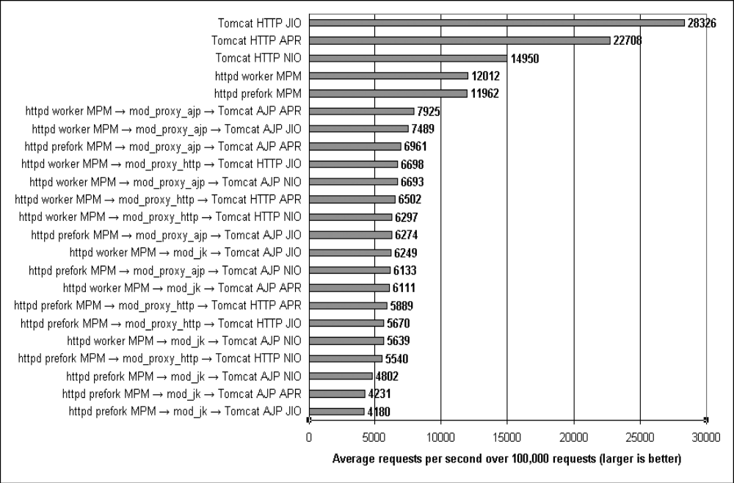
Tomcat: The Definitive Guide, Jason Brittain (O’Reilley 2007)

Slide 3
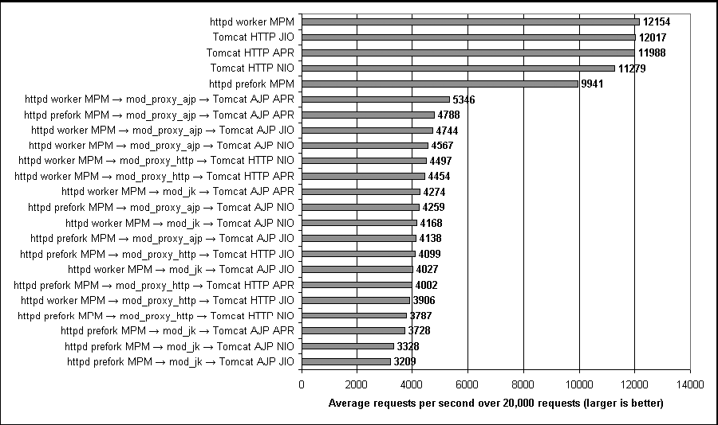
Tomcat: The Definitive Guide, Jason Brittain (O’Reilley 2007)

Slide 4
TDS Stack
THREDDS Data Server
Web Server / Servlet Container
Java Virtual Machine
Operating System

Slide 5
Restricted Access to Datasets
Often need to restrict public access to some/all of your datasets
TDS allows you to restrict at any level of the dataset collection
  Applies to all data services
Role-based authorization
  allows flexibility in defining which users can access which datasets
Pluggable authentication

Slide 6
Pluggable Features
Pluggable = Add your code at runtime
  Authentication
  Viewers
  Dataset Source

Slide 7

?

