Slide 1
Use of TDS to support the LEAD Project
Tom Baltzer
For Unidata Workshop Fall 2006

Slide 2
Linked Environments for Atmospheric Discovery (LEAD)
Produce a web service and portal based, scalable framework for handling meteorological data and model output:
  Identifying, accessing, preparing, assimilating, predicting, managing, analyzing, mining, visualizing
  Independent of data format and physical location
Dynamically adaptive workflows and steering of sensors
Funded by NSF Large Information Technology Research (ITR) award

Slide 3
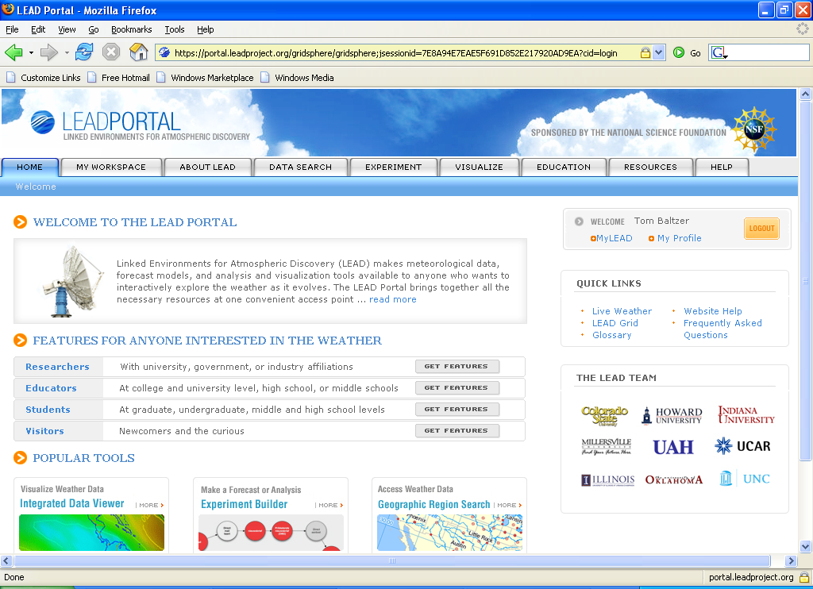
LEAD Portal

Slide 4





The UPC LEAD Test Bed
LEAD
Grid System
Forecast Model Output
Weather station observations
Unidata LEAD
Testbed System
THREDDS
Catalog
OPeNDAP
IDD
Aircraft data
TDS &
TDR
Decoders
Radar data
GridFTP
60-80 TB
= Data in Native Form
= Data in Decoded Form
= CDM Access to Data
= Catalog Access

Slide 5
LEAD Test Bed is supporting LEAD and Unidata Communities
Need to support two different top level catalogs
    - For LEAD project
  http://lead.unidata.ucar.edu:8080/thredds/topcatalog.html
  http://lead.unidata.ucar.edu:8080/thredds/topcatalog.xml
    - For Unidata community
  http://lead.unidata.ucar.edu:8080/thredds/catalog.html
  http://lead.unidata.ucar.edu:8080/thredds/catalog.xml
    Shooting for 6 month archive of IDD data
    Scalability testing for TDS

Slide 6
GridFTP Service
Follow hierarchy from topcatalog
  LEAD Testbed Catalogs ->
  Unidata LEAD Testbed ->
  LEAD IDV Viewable Catalogs ->
  NAM Model Grids ->
  CONUS 40 km (conduit)
And select a given file

Slide 7
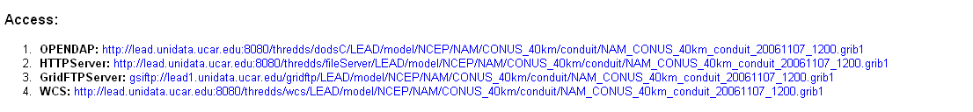
GridFTP Service
GridFTPServer is a special Access provided for LEAD

Slide 8
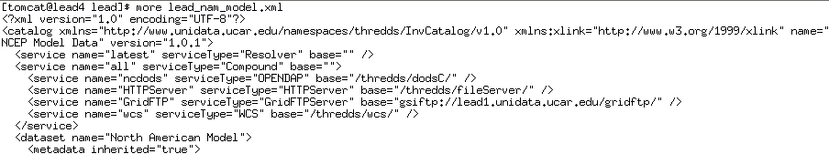
GridFTP Service
Setup new service type and GridFTP server shares disks with TDS server
Key – GridFTP works with URLs
Key - paths need to match!

Slide 9
LEAD Results
LEAD
Grid System
Unidata LEAD
Testbed System
LEAD Systems
(including TeraGrid) will
generate result files that
need to be stored,
cataloged and made
accessible
THREDDS
Catalog
OPeNDAP
TDS
GridFTP
60-80 TB

Slide 10
LEAD Result Files
Workflow system will deposit files on the Unidata LEAD testbed via GridFTP
These files are considered “Private” – that is, they belong to a LEAD user who does not (yet) wish to share them
  myLEAD (private catalog) is only place where URL is to be registered

Slide 11
LEAD Result Files
How do we serve via TDS but keep private?
Security through obscurity
Catalog is put into extraCatalogs.txt file – or in the case of the more recent TDS in the threddsConfig.xml
  <catalogRoot>lead/workshop_wrf_model.xml</catalogRoot>

Slide 12
Demonstration of LEAD Use Case
Snow Storm in CO last week
Steered WRF
NMM 102518

Slide 13
Questions?

