Slide 1
THREDDS Data Server (TDS) Overview
John Caron
Unidata/UCAR
July 2007

Slide 2
THREDDS Data Server (TDS)
100% Java
  Requires JDK 1.5, recommending JDK 1.6
  Open source to our friends
Runs inside of Servlet Container
  Only tested with Tomcat
  Recommend Tomcat 1.6
  Packaged as a single file: thredds.war

Slide 3
THREDDS Data Server
HTTP Tomcat Server
catalog.xml
Application
THREDDS Server
WCS
OPeNDAP
HTTPServer
NetcdfSubset
NetCDF-Java
library
motherlode.ucar.edu
Datasets
IDD Data

Slide 4
Data Services
HTTP Server (file transfer)
OPeNDAP (CDM files)
WCS - Web Coverage Server (gridded)
NetCDF Subset Service (experimental)
NcML virtual datasets

Slide 5
Common Data Model File Formats
General: NetCDF, HDF5, OPeNDAP
Gridded: GRIB-1, GRIB-2
Radar: NEXRAD level II and level III, DORADE, Chinese NEXRAD
Point: BUFR
Satellite: DMSP, GINI
In Progress: NetCDF4, Mcidas AREA, NPOESS, NOAA CLASS legacy files, Barrowdale DataBlade, others

Slide 6
HTTP File Server
Serve any file
Bulk file transfer
Partial file transfer (Accept-Ranges) allows remote netCDF subsetting access
  Efficiency depends on access pattern
  Recommend OPeNDAP for general access

Slide 7
THREDDS OPeNDAP service
Serve any CDM file
  Subsetting by variable, index range
Uses the DODS-Java (DAP 2.0) library
  Non-streaming
OPeNDAP latest server (Hyrax) now has THREDDS catalogs
  Catalogs instead of dods_dir
  Catalogs automatically generated
  Using THREDDS library

Slide 8
THREDDS WCS service
CDM files that have Grid coordinate system
  evenly spaced x,y
Allow to subset the dataset by:
  Lat/lon or projection bounding box
  time and vertical coordinate range
  list of Variables
Return formats
  GeoTIFF floating point, greyscale
  NetCDF/CF-1.0
No reprojections, resamplings
Uses WCS 1.0, work on WCS 1.1 in progress

Slide 9
Standard Processes
ISO Standards
  Driven especially by EU countries
  Abstract models, metadata models
OGC (Open Geospatial Consortium)
  Commercial, government
  Implementation models
Ongoing evolution
  Map CDM data model to Feature Model
  Evolve Coverage to be subtype of Feature
Widespread interest, but adoption is slow
  Complaints about complexity of specification

Slide 10
NetCDF Subset Service
Experiment with REST style web service
Allow to subset the dataset by:
  Lat/lon bounding box
  time and vertical coordinate range
  list of Variables
NetCDF, XML, CSV (spreadsheet)
Gridded Data
  Output is a CF-1.0 netCDF file
  Variation of WCS (simplified request protocol)
Station Data: metars (7 day rolling archive)
Grid as Point Datasets (experimental)
  Extract vertical profile, time series from one point in model data

Slide 11
Other Data Services
Radar Collection Service (prototype)
  Align protocol with NetCDF Subset Service
“Latest Dataset” Service
  finds most recent dataset from a collection
Forecast Model Run Inventory
  Show available inventory from IDD model data

Slide 12
NetCDF Markup Language (NcML)
XML representation of netCDF metadata (like ncdump -h)
Create new netCDF files (like ncgen)
Modify existing datasets
  Add/delete/rename
  Create logical sections of existing variables.
Create unions and aggregations of multiple existing datasets.
Notes:
Another component of the netCDF java library is support for the netCDF Markup Language. NcML is an XML representation of netCDF metadata. It can be used to create new netCDF files as well as modify an existing dataset and even aggregate a set of existing datasets.

Slide 13
TDS and NcML
Embed NcML into the TDS configuration catalog
Server serves a virtual dataset defined by NcML
  NcML hidden from the client
Can “fix” metadata problems
Can augment metadata
NcML aggregation replaces the old “Aggregation Server”
Forecast Model Run Collection Aggregation
Notes:
The TDS can use NcML to wrap datasets that are being served, adding or fixing metadata. The client doesn’t see the NcML, it sees only the dataset the NcML describes. The NcML aggregation capability is what the TDS uses as the replacement to the old OPeNDAP aggregation server.

Slide 14
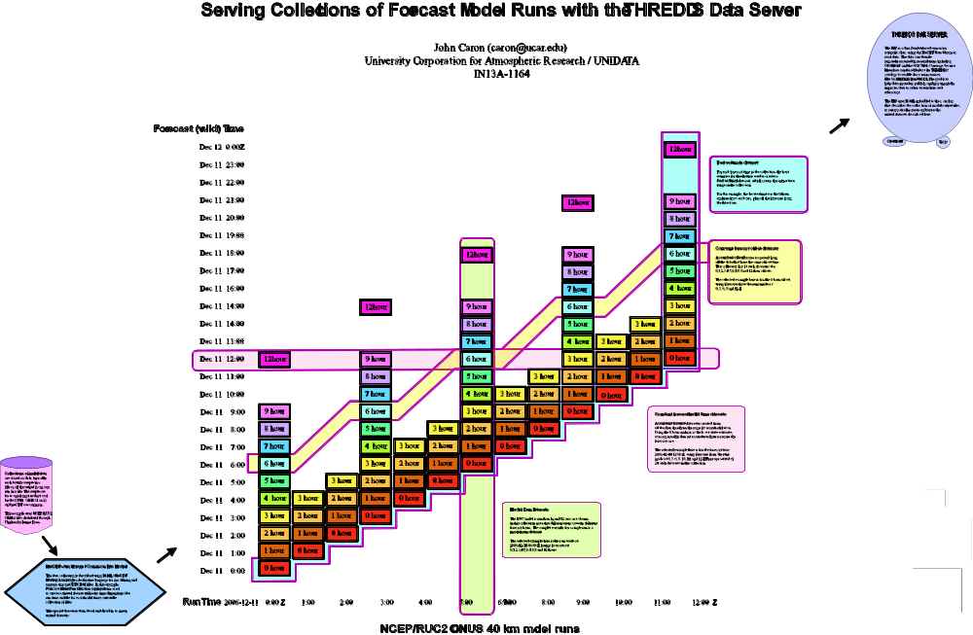
Forecast Model Run Collection
(FMRC)

Slide 15
TDS Catalog Services
THREDDS catalogs
  Client asks server “what have you got?”
Catalog subsetting
Catalog validation
View catalog as HTML

Slide 16
Other Services
“CDM Coordinate System Validator”
Digital Library Record Exporting
  OAI protocol to GCMD

Slide 17
TDS and Digital Libraries
Translate catalog metadata records into Digital Library records
  Collection level records
  Inventory level records
Send records to Digital Libraries
  using OAI (Open Archive Initiative) protocol
Direct harvesting of THREDDS catalogs
No cross-server search service in TDS
Notes:
If a catalog contains the right set of metadata, that metadata can be translated into various Digital Library metadata formats. These records can then be sent to or made available for harvest by various Digital Libraries. (Some search services are crawling THREDDS catalogs and harvesting metadata directly from the catalogs.)

Slide 18
TDS clients
Catalogs
  Browser
  Nj22: ToolsUI, IDV, MyWorld (Northwestern)
OPeNDAP (lots, including IDL, MatLAB)
WCS (still minimal, but expect to grow)
  GDAL, CADCorp, Liping Di (George Mason)
NetCDF Subsetter
  Forms interface
  ESRI ArcGIS (manual download)
  Experimental scripts (CUAHSI)

