Slide 1
THREDDS Data Server Overview
John Caron
Unidata/UCAR
July 2009

Slide 2
THREDDS Data Server
Servlet Container
catalog.xml
Remote Access
Client
THREDDS Server
WCS
OPeNDAP
HTTPServer
WMS
NetCDF-Java
library
configCatalog.xml
Datasets
IDD Data
motherlode.ucar.edu

Slide 3
TDS Stack
THREDDS Data Server
Web Server / Servlet Container
Java Virtual Machine
Operating System

Slide 4
Java Virtual Machine /
Operating Systems
JVM / OS
  Linux, Solaris, Windows (Sun)
  Mac OS X (Apple)
  AIX, Linux, Windows, z/OS (IBM)
  Specialized Java EE Servers (BEA, Oracle, Gemstone)
Java Programmer productivity
  Portability, portability, portability
  Object-Oriented, static type checking for large projects
  Garbage Collected – no memory leaks
  Rich libraries
  Open source
Java is faster than C for some applications
  eg multithreaded server

Slide 5
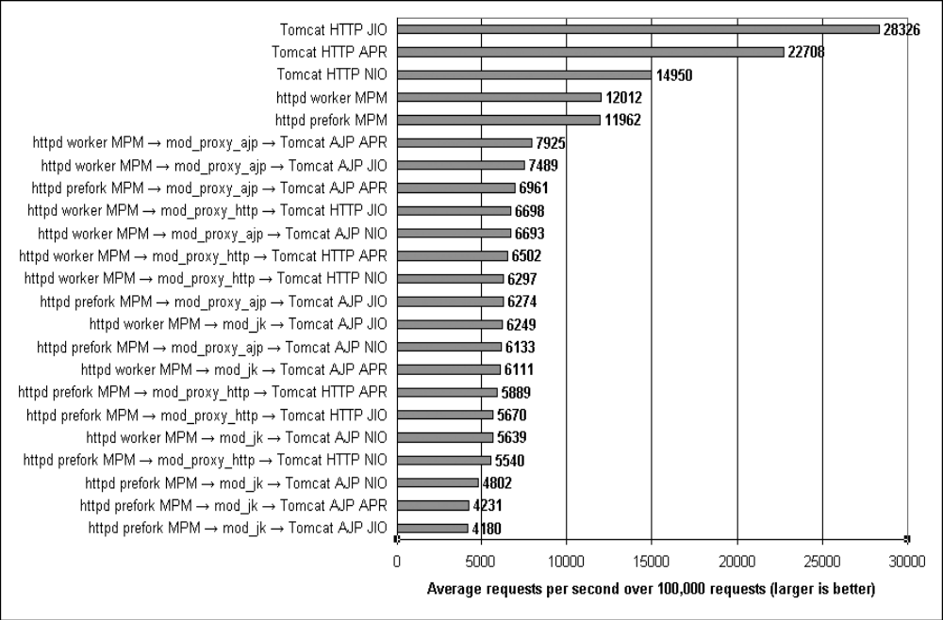
Tomcat: The Definitive Guide, Jason Brittain (O’Reilley 2007)

Slide 6
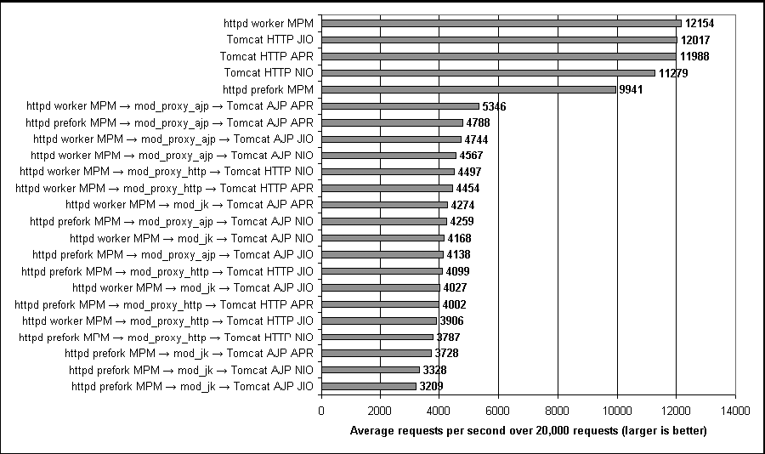
Tomcat: The Definitive Guide, Jason Brittain (O’Reilley 2007)

Slide 7
Web Server / Servlet Container
Web Server - uses HTTP protocol
  Clients make requests
  Server responds, often returning resource, may be HTML or other types
  RESTful style
Servlet
  Standard Java API for creating dynamic web content
  Tomcat (was) the reference implementation
  Other: Jetty, Glassfish, (BEA, Websphere, WebObjects, Oracle, etc)

Slide 8
THREDDS Data Server (4.0+)
100% Java
  Future: may have optional native libraries (netcdf-4)
Java 1.6
  JDK 1.7 is coming “early 2010” : new File API
Tomcat 6.0
  Reports that Jetty works
Spring 2.5
  Internal configuration
  Starting to use Spring MVC
Packaged as a single file: thredds.war
Open-source license (available to our friends)

Slide 9
THREDDS Data Server
Servlet Container
catalog.xml
Remote Access
Client
THREDDS Server
WCS
OPeNDAP
HTTPServer
WMS
NetCDF-Java
library
configCatalog.xml
Datasets
IDD Data
motherlode.ucar.edu

Slide 10
THREDDS Catalogs
Client catalogs
  Client asks server “what have you got?”
  Server returns catalog.xml or catalog.html
Catalogs are hierarchical collections of datasets
Datasets describe online resources
  Typically scientific datasets
  Allow metadata to be added
A Catalog is a virtual directory of online resources

Slide 11
Configuration Catalogs
Admin tells the TDS which / how datasets are to be served
Identify the files on disk
Name, organize, sort, filter into virtual collections
Add discovery metadata
Integrated with NcML
  Create virtual datasets

Slide 12
XML is your friend
<?xml version="1.0" encoding="UTF-8"?>
<catalog name="Unidata THREDDS Data Server" version="1.0.2">
<service name="thisDODS" serviceType="OPENDAP" base="/thredds/dodsC/"/>
<dataset name="Realtime data from IDD">
<catalogRef xlink:href="idd/models.xml" xlink:title="NCEP Model Data" name=""/>
<catalogRef xlink:href="idd/radars.xml" xlink:title="NEXRAD Radar" name=""/>
<catalogRef xlink:href="idd/obsData.xml" xlink:title="Station Data" name=""/>
<catalogRef xlink:href="idd/satellite.xml" xlink:title="Satellite Data" name=""/>
</dataset>
<dataset name="Other Unidata Data">
<catalogRef xlink:href="idd/rtmodel.xml" xlink:title="Unidata Real-time Regional Model" name=""/>
<catalogRef xlink:href="galeon/catalog.xml" xlink:title="Unidata GALEON Experimental Web Coverage Service (WCS) datasets" name=""/>
<dataset name="Test Restricted Dataset" ID="testRestrictedDataset" urlPath="restrict/testData.nc" restrictAccess="tiggeData">
<serviceName>thisDODS</serviceName>
<dataType>Grid</dataType>
</dataset>
</dataset>
</catalog>

Slide 13
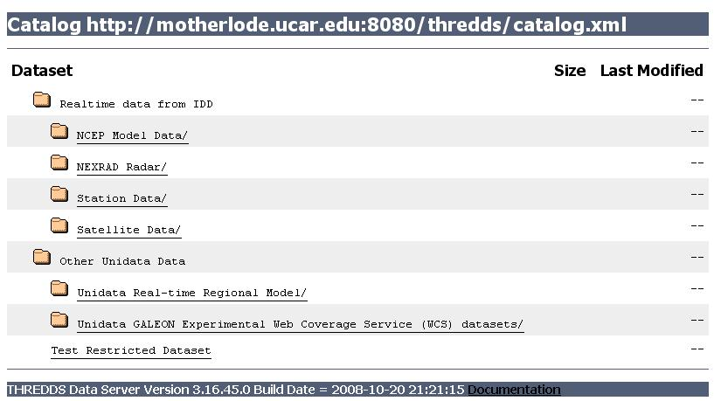

Slide 14
TDS Dataset Scan
<datasetScan name="Ocean Satellite Data" path="/data/ocean/sat/"
location= "/data/tds/netcdf/">
<metadata inherited="true">
<dataType> Grid</dataType>
<dataFormat> NetCDF</dataFormat>
<documentation
xlink:href="http://ncep.noaa.gov/modelinfo/index.html"
xlink:title="NCEP Model documentation" />
<documentation type="processing_level">Transmitted through
Unidata Internet Data Distribution.</documentation>
</metadata>
</datasetScan>

Slide 15
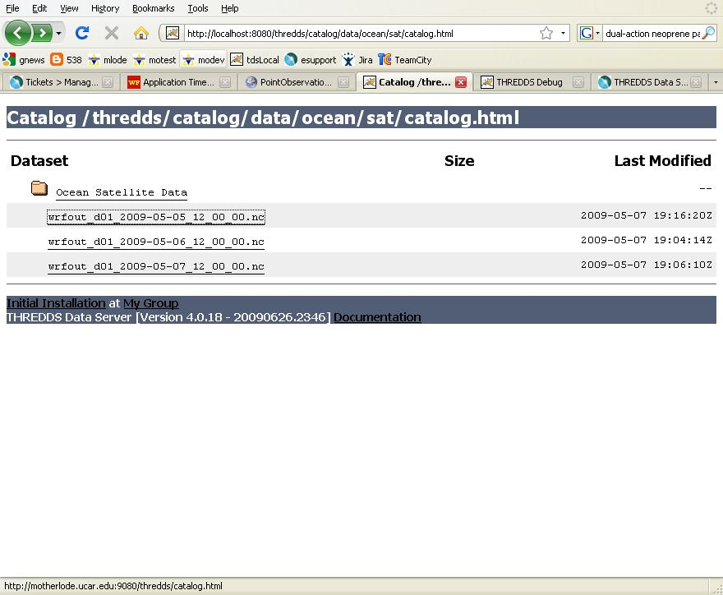

Slide 16
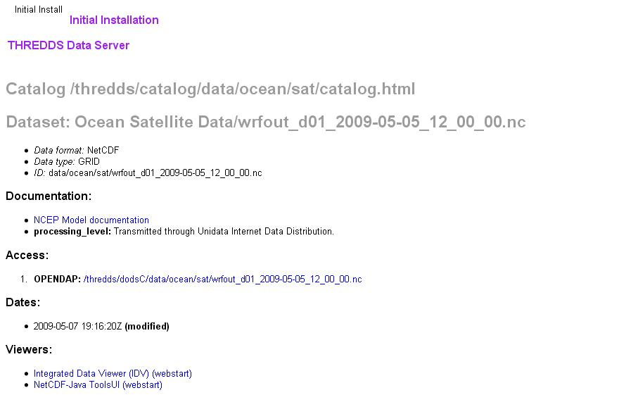

Slide 17
Data Services
Bulk File Transfer
  HTTP Server
Remote access, subsetting CDM files
  OPeNDAP
  Web Coverage Server (WCS)
  Web Map Server (WMS)
  Experimental
    NetCDF Subset Service
    CDM remote service

Slide 18
Common Data Model
HTTP Tomcat Server
catalog.xml
Remote Access
THREDDS Server
WCS
OPeNDAP
HTTPServer
Then a
miracle
happens
NetcdfSubset
NetCDF-Java
library
hostname.edu
Datasets

Slide 19
Netcdf-Java 4.0 File Formats
“CDM files”
General: NetCDF-3, NetCDF-4, HDF5, HDF4, OPeNDAP
Gridded: GRIB-1, GRIB-2, GEMPAK, McIDAS, UAMIV CAMx
Point: BUFR, GEMPAK
Radar: NEXRAD 2&3, DORADE, CINRAD, UF
Satellite: DMSP, GINI, McIDAS, FYSAT
Misc: GTOPO, NLDN, USPLN, etc
Notes:
Diversity of formats:

Slide 20
Application
Scientific Feature Types
Datatype Adapter
NetCDF-Java
CDM architecture
NetcdfDataset
CoordSystem Builder
NetcdfFile
THREDDS
I/O service provider
Catalog.xml
OPeNDAP
NetCDF-3
NIDS
NcML
NetCDF-4
GRIB
HDF5
GINI
Nexrad
DMSP
…

Slide 21
NetCDF Markup Language (NcML)
XML representation of netCDF metadata (like ncdump -h)
Create new netCDF files (like ncgen)
Modify existing datasets
Create unions and aggregations of multiple existing datasets.
Notes:
Another component of the netCDF java library is support for the netCDF Markup Language. NcML is an XML representation of netCDF metadata. It can be used to create new netCDF files as well as modify an existing dataset and even aggregate a set of existing datasets.

Slide 22
NcML example
<?xml version="1.0" encoding="UTF-8"?>
<netcdf xmlns="http://www.unidata.ucar.edu/schemas/netcdf/ncml-2.2"
location=“/data/nids/N0R_20041119_2147">
<attribute name=“cdm_datatype" value=“Radial" />
<remove type=“attribute” name=“password" />
<variable name="Reflectivity" orgName=“R34768”>
<attribute name="units" value=“dBZ" />
</variable>
</netcdf>

Slide 23
TDS and NcML
Embed NcML into the TDS configuration catalog
Server serves a virtual dataset defined by NcML
  NcML hidden from the client
Can “fix” metadata problems
Can augment metadata
General Aggregations
  joinNew, joinExisting, Union
Specialized Aggregations
  Forecast Model Run Collection (FMRC)
  Point Feature Collections (4.1)
Notes:
The TDS can use NcML to wrap datasets that are being served, adding or fixing metadata. The client doesn’t see the NcML, it sees only the dataset the NcML describes. The NcML aggregation capability is what the TDS uses as the replacement to the old OPeNDAP aggregation server.

Slide 24
TDS / NcML Virtual File
<dataset name=“Virtual Dataset Example" urlPath=“data/nexrad/modified” >
<netcdf xmlns="http://www.unidata.ucar.edu/schemas/netcdf/ncml-2.2"
location=“/data/nids/N0R_20041119_2147">
<attribute name=“cdm_datatype" value=“Radial" />
<remove type=“attribute” name=“password" />
<variable name="Reflectivity" orgName=“R34768”>
<attribute name="units" value=“dBZ" />
</variable>
</netcdf>
</datasetScan>

Slide 25
TDS / NcML aggregation
<dataset name="WEST-CONUS_4km Aggregation" urlPath="satellite/3.9/WEST-CONUS_4km">
<netcdf xmlns="http://www.unidata.ucar.edu/schemas/netcdf/ncml-2.2"
<aggregation dimName="time" type="joinNew">
<scan location="/data/satellite/WEST-CONUS_4km/" suffix=".gini" />
</aggregation>
</netcdf>
</dataset>

Slide 26
TDS / NcML
Modify all files in datasetScan
<datasetScan name="Ocean Satellite Data" path="/data/ocean/sat/"
location= "/data/tds/netcdf/">
<netcdf>
<attribute name="Conventions" value="CF-1.0"/>
</netcdf>
</datasetScan>

Slide 27
Security
TDS security depends on Tomcat/Java security
There are no known security holes in current versions
Ongoing security audit of TDS source
  By NOAA
  Applies to latest versions of 3.17+ and 4.0+

Slide 28
Release Status
Current stable version is 4.0.24
  4.0 was released for production June 2009
  Web Map Service
  Uses Netcdf-Java / CDM library 4.0
    Stable release Feb 2009
    Several hundred bug fixes and enhancements
Version 3.17 in maintenance mode
Version 4.1 scheduled for Sept 2009

Slide 29

?

